Slide 1

GROUP 11
Exploratory Data Analysis
IT462
Banking Location
Prof: Dr. Gopinath Panda
Ritwik Agarwal
Sandeep Patro
Gunjan Sethi

Slide 2
Table of Contents
Introduction
Dataset Overview
Problems
Mcar Test
Data Visualization
Feature Engineering
ML Model
Conclusion

Slide 3
INTRODUCTION
In our project, we analyze banking location data to uncover patterns that can guide strategic decisions. By cleaning and exploring the data, we’ll examine factors like proximity to key areas and population density. Our goal is to provide actionable insights that can help banks optimize their locations and improve accessibility for customers

Slide 4
Dataset Overview:
Data source and collection process: data.gov.in
Description of dataset attributes:
SE_ANNO_CAD_DATA :
GLOBALID
CREATOR
CREATED
EDITED
EDITORY-Axis
NAME
ADDRESS
ZIPCODE
WARD
LATITUDE
LONGITUDE
OBJECTID
XCOORD
YCOORD
MAR_ID

Slide 5
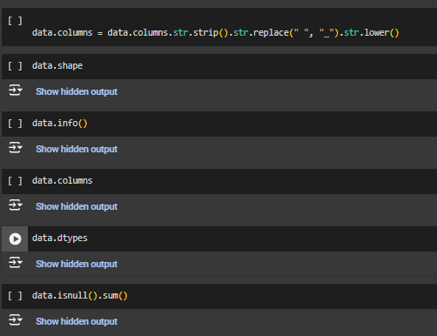
PROBLEMS
1. Missing Data
2. Inconsistent Data Formats
3. Duplication of Records

Slide 6
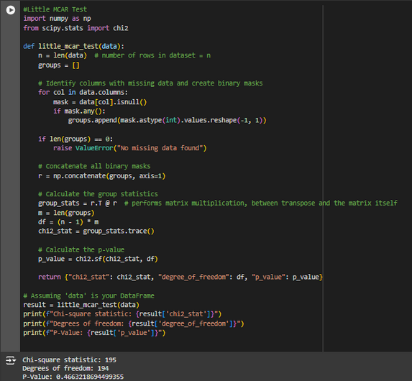
MCAR TEST
Little's MCAR (Missing Completely At Random) test, which checks whether missing data in a dataset is completely random. If the data is missing completely at random (MCAR), the probability of missingness is unrelated to the observed or unobserved data values.
The results of Little’s MCAR test (Chi-square: 195, DF: 194, P-value: 0.4663) suggest the data is Missing Completely At Random (MCAR). With a p-value above 0.05, we fail to reject the null hypothesis, meaning the missingness is unrelated to the data.

Slide 7
DATA VISULAIZATION
Univariate analysis:
Examines the distribution, central tendency, and spread of a single variable to understand its individual characteristics.
Bar charts displays the frequency distribution of a numerical variable.
2. Kernel Density Estimation (kde) A smooth curve overlaid on the histogram to represent the probability density function of the data.

Slide 8
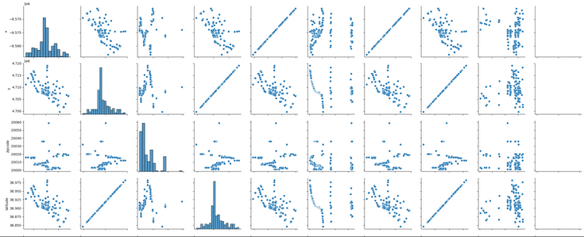
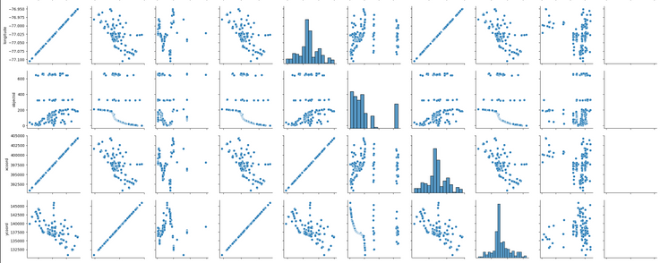
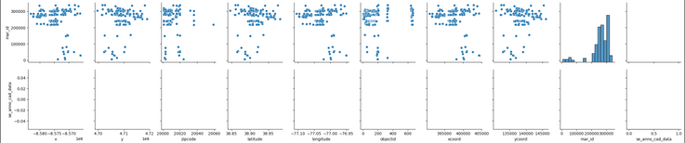
DATA VISULAIZATION
Multivariate analysis:
Explores relationships between pairs of numerical variables.
Scatterplots for variable pairs with diagonal histograms showing individual distributions.
Helped in linear and non-linear relationship, detect correlations and understand over all structure of the data

Slide 9
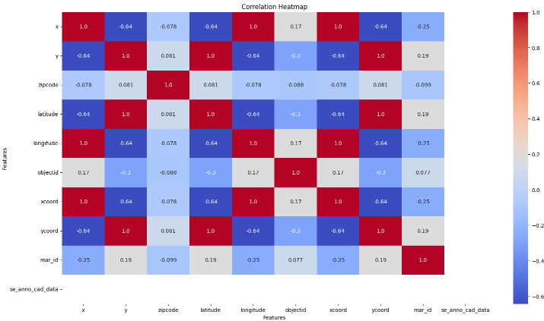
DATA VISULAIZATION
Correlation Heatmap:
A correlation heatmap visualizes the relationships between variables in a dataset.
Most related variables: (xcoord and longitude) or (ycoord and latitude) Both pairs show perfect correlation (1.0), which is expected if they represent the same data in different formats.
Least related variables: mar_id and xcoord/longitude show the lowest correlation (-0.25), zipcode and objectid suggesting little to no relationship with other features

Slide 10
FEATURE ENGINEERING
The code removes the zipcode column and the target column from the dataset. Zipcode is the target variable, and it's being excluded from the features to avoid leak.
Converts categorical variables in features into numeric format using one-hot encoding, can be used in machine learning models, which typically require numeric input.
After feature engineering we need to do model fitting.

Slide 11

ML MODEL
Splits the data into training and testing sets, while ensuring the resulting dataset split is as expected.
we used Random Forest Model for our project which is an ensemble ML model.
Trains the Random Forest Model on the training data (X_train, y_train).
prepares the model to make predictions on unseen data (X_test) and evaluate its performance

Slide 12
CONCLUSION
The Random Forest model’s ensemble of decision trees ensures robustness, balances bias and variance, and delivers reliable predictions. The training-testing split validated its performance on unseen data, proving its real-world potential.

Slide 13
THANK YOU

