Slide 1
Ecommerce Shop
1:I have created a frontend page of web.
2:here I have use react.js library of javascript for creating frontend page.
3:I have use CSS bootstrap for styling the components.
4:I have used bootstrap crousel for sliding the contents.
5:I have not making any image related folder .I have added all the image link in the src element to the internet.
6:I have also used react-router-dom for moving 1 component to another compnenet without changing its pages.
7:I have also be used font like
1:fontawesome
2:googlefont

Slide 2
components:
I have created 4 component given below.
1:Headers
2:HomeCover
3:Slider
4:Footer

Slide 3
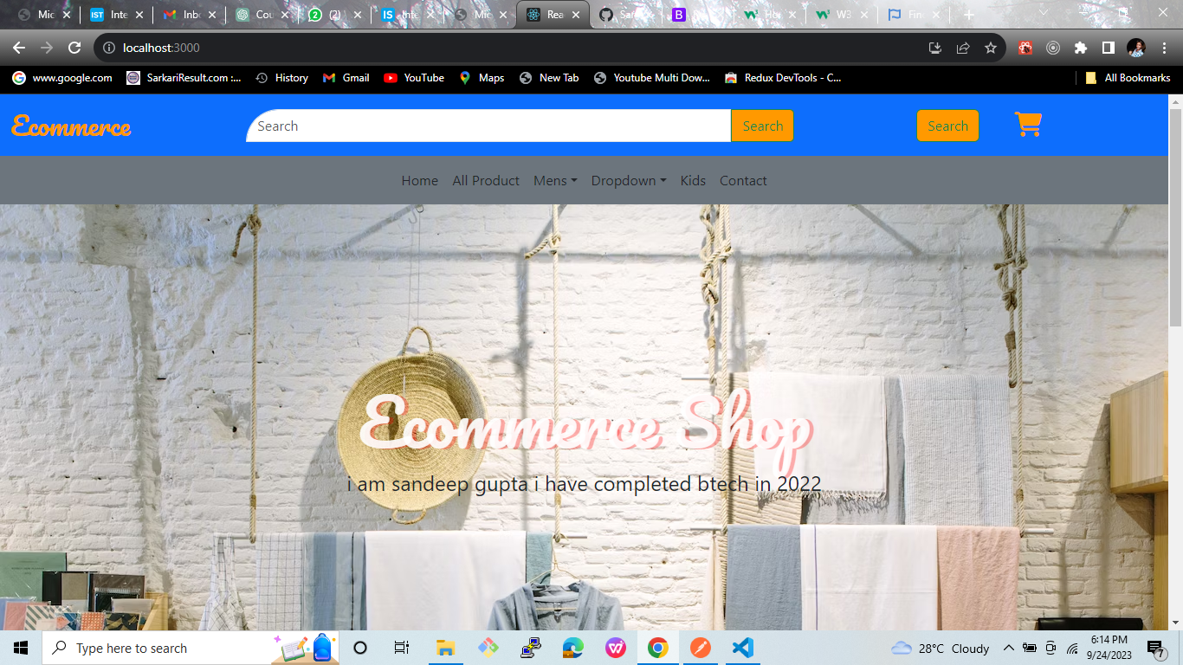
Header:(Desktop)

Slide 4
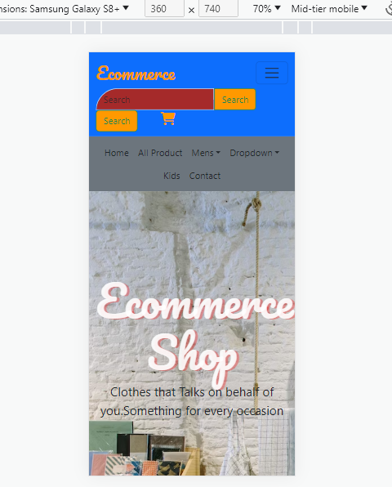
Header:(Mobile)

Slide 5
HomeCover:

Slide 6
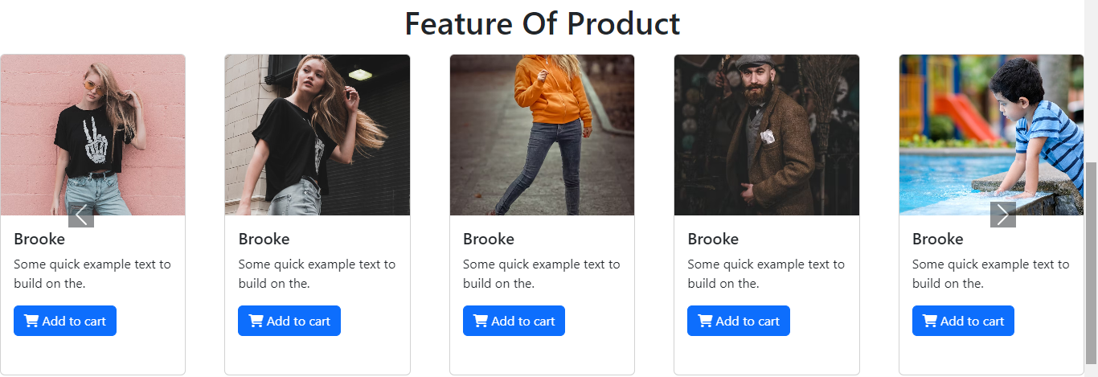
Slider:(Desktop)

Slide 7
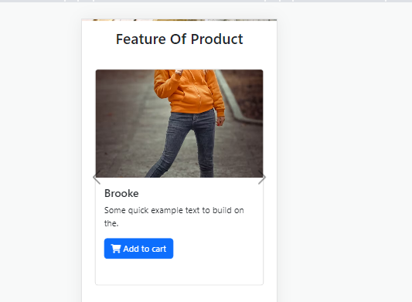
Slider:(Mobile)

Slide 8
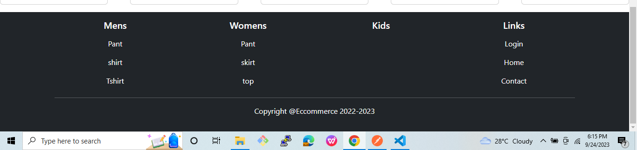
Footer:(Desktop)

Slide 9
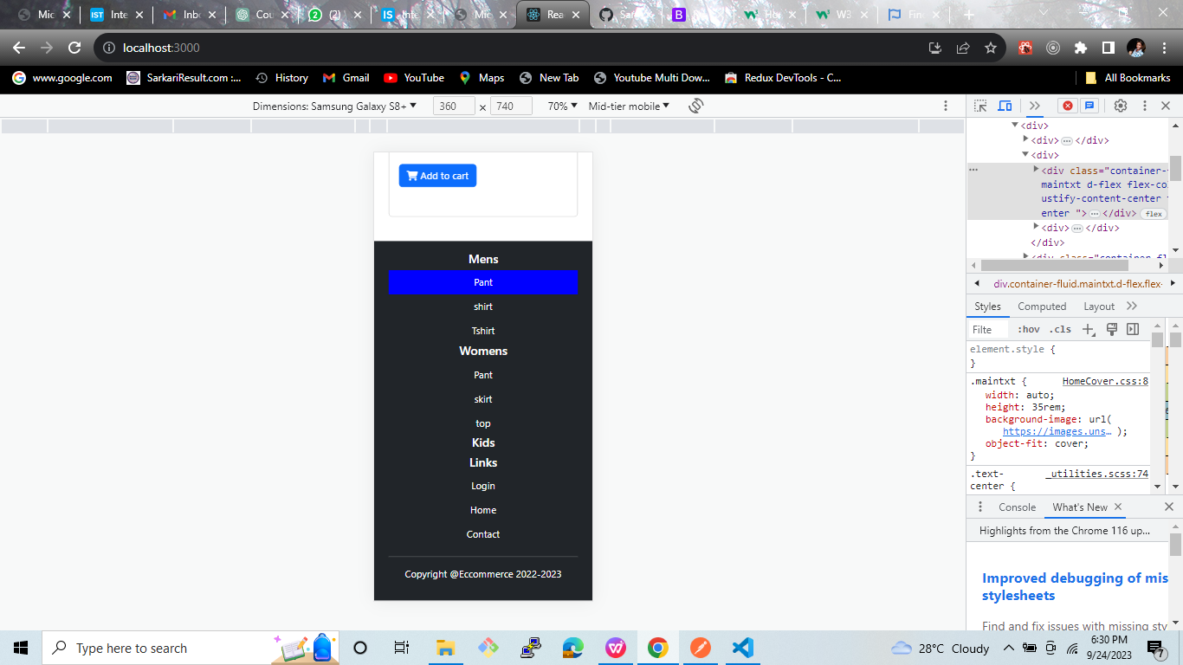
Footer:(Mobile)

Slide 10
Completed Thank You

