Slide 1


    CAMPUS ENERGY CONSUMPTION ANALYSIS USING BIG DATA PROCESSING
Group no - 4
Sandeep P (26)
Merin G S (19)
Devika Rajesh (13)
Sivani Thulaseedharan (28)
Aiswarya A S (4)
Computer Science and Engineering (Data Science), St.Thomas Institute for Science and Technology
Geethu Raj
Vishakh V Nair
Computer Science and Engineering St.Thomas Institute for Science and Technology
7/08/2028
07/8/2026
Department of computer science and engineering(Data Science)
St.Thomas Institute for Science & Technology, Trivandrum
1

Slide 2
    CAMPUS ENERGY CONSUMPTION ANALYSIS USING BIG DATA PROCESSING
Group no - 4
Sandeep P (26)
Merin G S (19)
Devika Rajesh (13)
Sivani Thulaseedharan (28)
Aiswarya A S (4)
Computer Science and Engineering (Data Science), St.Thomas Institute for Science and Technology
Geethu Raj
Vishakh V Nair
Computer Science and Engineering St.Thomas Institute for Science and Technology
7/08/2028
07/8/2026
Department of computer science and engineering(Data Science)
St.Thomas Institute for Science & Technology, Trivandrum
1

Slide 3
INDEX
S.NO. | CONTENT | SLIDE NO.
.6 | ABSTRACT | 9
.7 | INTRODUCTION | 10
.8 | LITERATURE REVIEW | 11
.9 | ARCHITECTURE | 12
.10 | METHODOLOGY | 13
.11 | STATUS & RESULT | 14
07/8/2026
Department of computer science and engineering(Data Science)
St.Thomas Institute for Science & Technology, Trivandrum
2

Slide 4
INDEX
S.NO. | CONTENT | SLIDE NO.
.6 | USE CASE DIAGRAM | 9
.7 | SEQUENCE DIAGRAM | 10
.8 | ROADMAP | 11
.9 | PROBLEM STATEMENT | 12
.10 | CONCLUSION | 13
.11 | REFERENCE | 14
07/8/2026
Department of computer science and engineering(Data Science)
St.Thomas Institute for Science & Technology, Trivandrum
3

Slide 5
ABSTRACT
Educational institutions consume substantial electricity across diverse facilities such as classrooms, laboratories, libraries, and student hostels, making efficient energy monitoring a key operational challenge. Traditional monitoring approaches often lack the capacity to process granular, continuous consumption data across multiple campus sectors. To address this, this project proposes a Campus Energy Consumption Analysis System leveraging Big Data processing technologies to collect, aggregate, and evaluate large-scale electricity usage data across various campus blocks.
The system utilizes the Hadoop Distributed File System (HDFS) for scalable data storage and Apache Spark for high-speed batch processing and aggregation of consumption metrics. By evaluating high-frequency usage logs from smart meters and sub-metering points, the framework pinpoints high-consumption blocks, identifies daily and seasonal peak-usage intervals, and detects localized energy wastage patterns. Rather than focusing on predictive modeling, this project prioritizes comprehensive descriptive and diagnostic analysis. The processed insights are presented through an interactive analytics dashboard, empowering campus administrators and facility managers with clear, actionable visibility to optimize resource allocation, curb unnecessary power consumption, and promote sustainable energy management.
07/8/2026
Department of computer science and engineering(Data Science)
St.Thomas Institute for Science & Technology, Trivandrum
4
Notes:
Educational institutions consume substantial electricity across diverse facilities such as classrooms, laboratories,
libraries, and student hostels, making efficient energy monitoring a key operational challenge. Traditional
monitoring approaches often lack the capacity to process granular, continuous consumption data across multiple
campus sectors. To address this, this project proposes a Campus Energy Consumption Analysis System
leveraging Big Data processing technologies to collect, aggregate, and evaluate large-scale electricity usage data
across various campus blocks.
The system utilizes the Hadoop Distributed File System (HDFS) for scalable data storage and Apache Spark for
high-speed batch processing and aggregation of consumption metrics. By evaluating high-frequency usage logs
from smart meters and sub-metering points, the framework pinpoints high-consumption blocks, identifies daily and
seasonal peak-usage intervals, and detects localized energy wastage patterns. Rather than focusing on predictive
modeling, this project prioritizes comprehensive descriptive and diagnostic analysis. The processed insights are
presented through an interactive analytics dashboard, empowering campus administrators and facility managers
with clear, actionable visibility to optimize resource allocation, curb unnecessary power consumption, and promote
sustainable energy management.

Slide 6
INTRODUCTION
• Educational institutions consume large amounts of electricity daily
• Monitoring energy usage manually is difficult and time consuming.
• Big Data enables efficient collection and analysis of energy consumption data.
• The system identifies high-energy consumption areas and detects energy wastage.
• Interactive dashboards provide clear insights for decision-making.
• The project helps optimize energy usage and promotes sustainable campus management
07/8/2026
Department of computer science and engineering(Data Science)
St.Thomas Institute for Science & Technology, Trivandrum
5

Slide 7
LITERATURE REVIEW
YEAR | PAPER NAME | AUTHOR | OVERVIEW | ADVANTAGES | DISADVANTAGES
2020 | Big Data Analytics for Smart Energy Management: A Review | M. A. Khan | Reviews the application of Big Data technologies such as Hadoop and Spark in energy management systems. Discusses storage, processing, and visualization of large-scale energy consumption data. | Provides scalable storage and distributed processing for large datasets. Supports real-time and batch analytics. | Mainly focuses on general smart grids rather than campus-level electricity consumption.
2021 | Load Shifting and Peak Clipping for Reducing Energy Consumption in an Indian University Campus | A. S. Pillai | Analyzes electricity usage in a university campus and identifies peak demand periods to improve energy efficiency through demand-side management. | Demonstrates campus energy optimization and peak load analysis. Useful for identifying high energy consumption periods. | Does not use Big Data frameworks like Hadoop or Spark and lacks dashboard visualization.
• Educational institutions consume large amounts of electricity daily
• Monitoring energy usage manually is difficult and time consuming.
• Big Data enables efficient collection and analysis of energy consumption data.
• The system identifies high-energy consumption areas and detects energy wastage.
• Interactive dashboards provide clear insights for decision-making.
• The project helps optimize energy usage and promotes sustainable campus management
07/8/2026
Department of computer science and engineering(Data Science)
St.Thomas Institute for Science & Technology, Trivandrum
6

Slide 8
LITERATURE REVIEW
YEAR | PAPER NAME | AUTHOR | OVERVIEW | ADVANTAGE | DISADVANTAGE
2022 | Effect of Physical, Environmental, and Social Factors on Building Energy Consumption Based on Real-World Big Data | Y. Wang | Uses large-scale building energy datasets to analyze factors influencing electricity consumption. Demonstrates the role of Big Data analytics in understanding energy usage patterns. | Utilizes large datasets and advanced analytics for energy consumption studies. | Focuses on prediction models instead of descriptive analysis for campus buildings.
2022 | AI–Big Data Analytics for Building Automation and Management Systems: A Survey | M. H. Rehmani | Surveys Big Data technologies used in building automation, energy monitoring, and intelligent energy management systems. Discusses Hadoop, Spark, IoT, and visualization techniques. | Comprehensive overview of Big Data technologies for smart buildings. Highlights modern analytics techniques. | Survey paper only; does not provide a complete implementation for campus energy analytics.
• Educational institutions consume large amounts of electricity daily
• Monitoring energy usage manually is difficult and time consuming.
• Big Data enables efficient collection and analysis of energy consumption data.
• The system identifies high-energy consumption areas and detects energy wastage.
• Interactive dashboards provide clear insights for decision-making.
• The project helps optimize energy usage and promotes sustainable campus management
07/8/2026
Department of computer science and engineering(Data Science)
St.Thomas Institute for Science & Technology, Trivandrum
7

Slide 9
LITERATURE REVIEW
YEAR | PAPER NAME | AUTHOR | OVERVIEW | ADVANTAGE | DISADVANTAGE
2023 | Big Data Analytics Framework for Smart Building Energy Management | H. Zhang | Proposes a Big Data framework integrating Hadoop and Spark to analyze building electricity consumption and improve energy efficiency. | Efficient distributed processing, scalable architecture, and interactive visualization support. | Primarily designed for commercial smart buildings rather than educational campuses.
• Educational institutions consume large amounts of electricity daily
• Monitoring energy usage manually is difficult and time consuming.
• Big Data enables efficient collection and analysis of energy consumption data.
• The system identifies high-energy consumption areas and detects energy wastage.
• Interactive dashboards provide clear insights for decision-making.
• The project helps optimize energy usage and promotes sustainable campus management
07/8/2026
Department of computer science and engineering(Data Science)
St.Thomas Institute for Science & Technology, Trivandrum
8

Slide 10
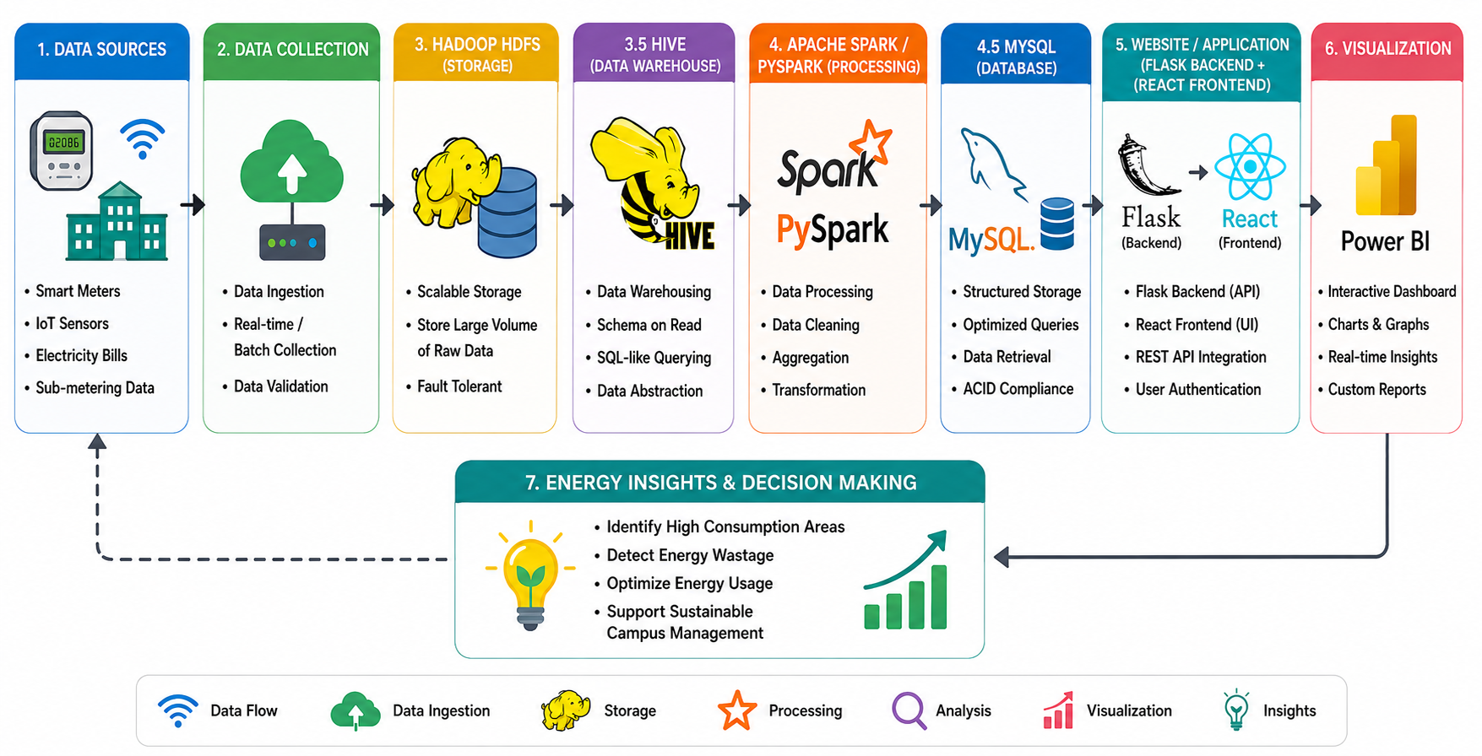
ARCHITECTURE
07/8/2026
Department of computer science and engineering(Data Science)
St.Thomas Institute for Science & Technology, Trivandrum
9

Slide 11
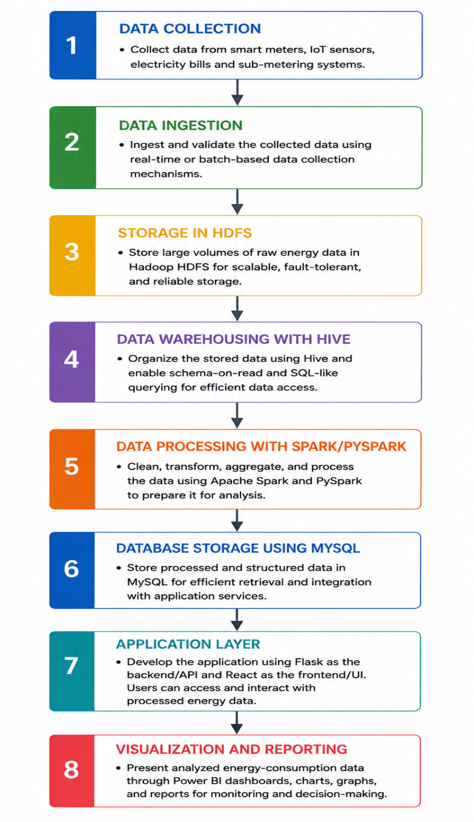
METHODOLOGY
07/8/2026
Department of computer science and engineering(Data Science)
St.Thomas Institute for Science & Technology, Trivandrum
10

Slide 12
STATUS & RESULT
• Raw electricity consumption data has been collected and stored in HDFS.
• The system successfully analyzes campus electricity consumption using Big Data technologies.
• The data has been organized using Hive for efficient SQL-based querying.
• It identifies peak usage hours, block-wise energy consumption, and areas of possible energy wastage.
•Apache Spark has been used to analyze electricity usage, identify peak hours, block-wise consumption, and detect energy wastage.
• The interactive web application and Power BI dashboard provide clear visual reports for easy monitoring.
• The processed results have been stored in MySQL.
• The project enables campus administrators to make informed decisions for better energy management, optimize electricity usage, and reduce unnecessary power consumption.
• A Flask/React web application and Power BI dashboard have been developed to display the analysis in a user-friendly manner.
• The system has been tested successfully using sample campus electricity data.
07/8/2026
Department of computer science and engineering(Data Science)
St.Thomas Institute for Science & Technology, Trivandrum
11

Slide 13
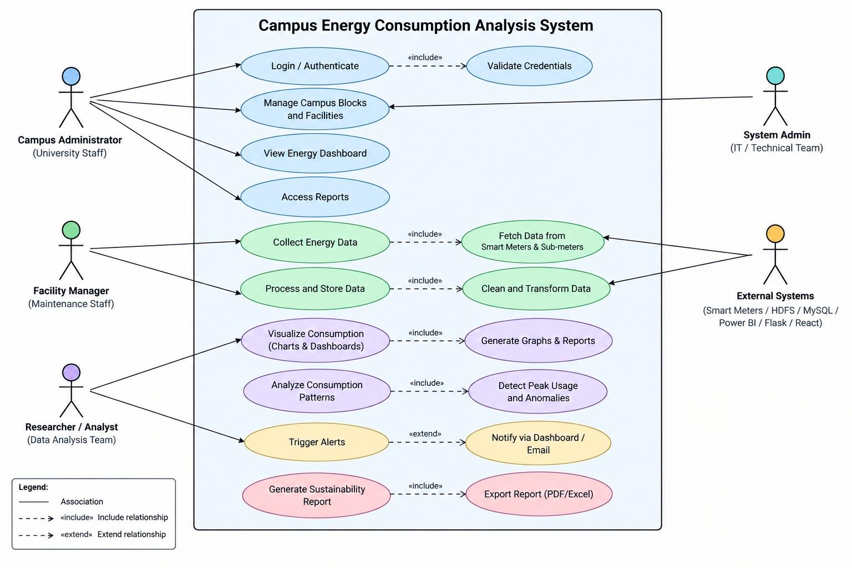
Use case diagram
07/8/2026
Department of computer science and engineering(Data Science)
St.Thomas Institute for Science & Technology, Trivandrum
12

Slide 14
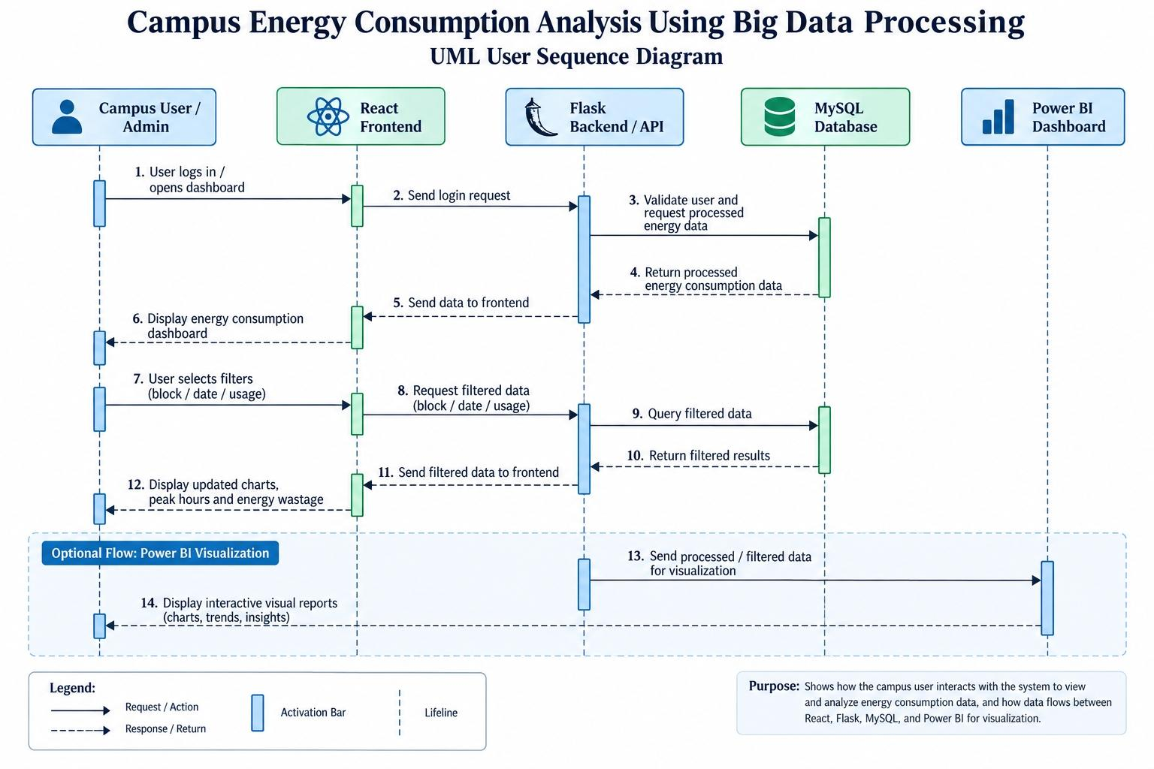
Sequence diagram
07/8/2026
Department of computer science and engineering(Data Science)
St.Thomas Institute for Science & Technology, Trivandrum
13

Slide 15
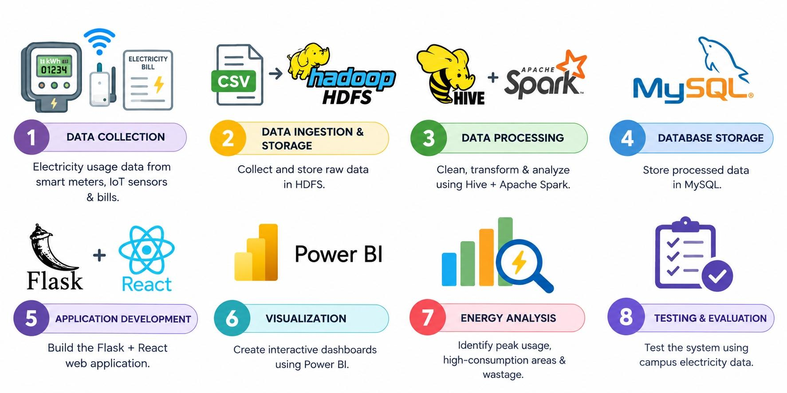
ROADMAP
07/8/2026
Department of computer science and engineering(Data Science)
St.Thomas Institute for Science & Technology, Trivandrum
14

Slide 16
PROBLEM STATEMENT
•Educational institutions consume large amounts of electricity across classrooms, laboratories, libraries, hostels, and other facilities.
•Existing methods of monitoring electricity consumption are often manual, time-consuming, and difficult to manage for large amounts of data.
•It is difficult to identify high-consumption areas, peak usage periods, and energy wastage from raw electricity data.
• There is a need for a scalable system that can collect, store, process, and analyze large-scale campus energy data efficiently.
•Therefore, a Big Data-based system is required to provide clear insights for monitoring and optimizing campus energy consumption.
07/8/2026
Department of computer science and engineering(Data Science)
St.Thomas Institute for Science & Technology, Trivandrum
15

Slide 17
CONCLUSION
This project successfully demonstrates how Big Data technologies can be used to monitor and analyze electricity consumption across a campus. By using HDFS for storage, Hive for data organization, Apache Spark for analytics, MySQL for processed data storage, and Flask/React with Power BI for visualization, the system provides meaningful insights into energy usage. It helps identify peak consumption hours, block-wise electricity usage, and energy wastage, enabling campus administrators to make informed decisions, reduce unnecessary power consumption, and improve overall energy efficiency.
07/8/2026
Department of computer science and engineering(Data Science)
St.Thomas Institute for Science & Technology, Trivandrum
16

Slide 18
REFERENCE
07/8/2026
Department of computer science and engineering(Data Science)
St.Thomas Institute for Science & Technology, Trivandrum
17

Slide 19
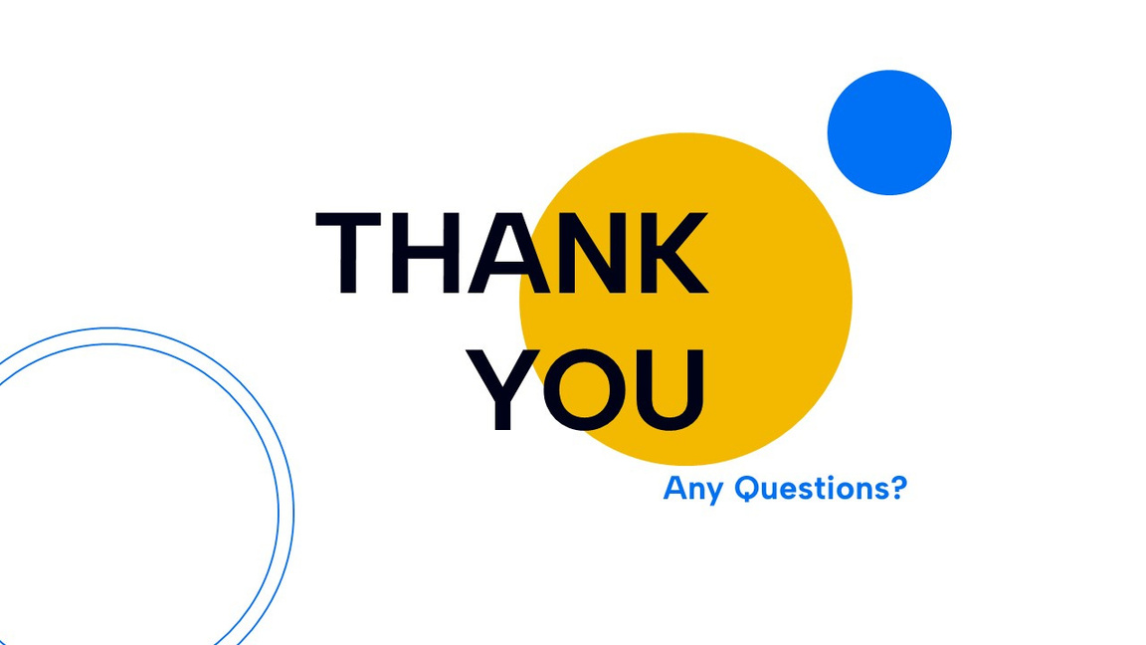
07/8/2026
Department of computer science and engineering(Data Science)
St.Thomas Institute for Science & Technology, Trivandrum
18

