Slide 1
Welcome to powerpoint presentation
About Trees

Slide 2
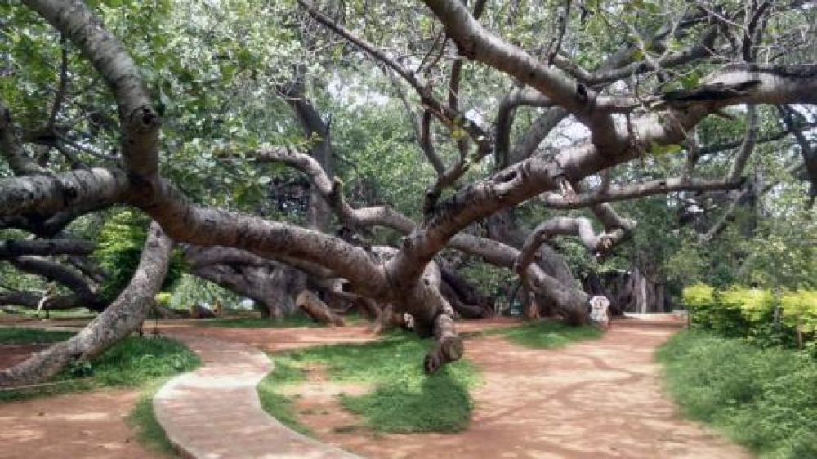
Pillalamarri(Banyan Tree)
Pillalamarri^{[1]} (Children's Banyan) or Peerlamarri (Saints Banyan)^{[citation needed]} is an 800-year-old banyan tree located in Mahabubnagar, Telangana, India.^{[2]} The tree is spread over 4 acres. It is a major tourist attraction located 4 kilometers from Mahbubnagar city.^{[3]}

Slide 3
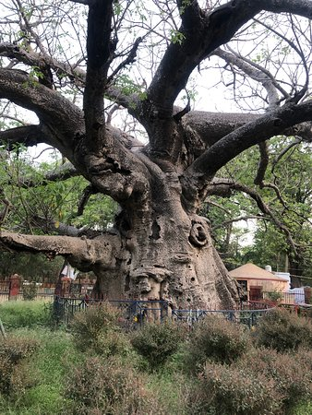
Parijaat Tree
The Parijaat tree is a sacred baobab tree in the village of Kintoor, near Barabanki, Uttar Pradesh, India, about which there are several legends.

Slide 4
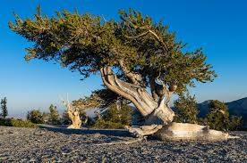
The term bristlecone pine covers three species of pine tree (family Pinaceae, genus Pinus, subsection Balfourianae). All three species are long-lived and highly resilient to harsh weather and bad soils. One of the three species, Pinus longaeva, is among the longest-lived life forms on Earth. The oldest of this species is more than 4,800 years old,^{[1]} making it the oldest known individual of any species.

