Slide 1
DESIGN AND IMPLEMENTATION OF A DATABASE MANAGEMENT SYSTEM FOR
Library Circulation &
Digital Resource Management
REVIEW 1 | Project Based Learning
Database Management Systems
September 2026

Slide 2
AGENDA
01
Problem Identification
02
Scope & Objectives
03
Users & User Roles
04
Functional Requirements
05
Non-Functional Requirements & Business Rules
06
ER Diagram
07
Relational Schema

Slide 3
1
Problem Identification
Key challenges with manual and legacy library management systems
Unreliable Tracking
No Digital Resource Mgmt
Manual Fine Calculation
Manual ledgers lead to discrepancies in book locations, availability, and member histories.
Older systems lack infrastructure to track e-books, journals, audiobooks, and digital access.
Prone to human error, inconsistencies, and disputes; creates unnecessary admin overhead.
Inefficient Reservations
Data Redundancy
No automated queue system leads to chaotic, unfair distribution of popular titles.
Duplicated information across registers causes anomalies and unreliable reporting.

Slide 4
2
Project Scope
IN SCOPE
OUT OF SCOPE
Physical Asset Management — books, journals, media
Digital Resource Management — e-books, audiobooks
Member Management — registration, profiling, tracking
Circulation — issue, return, renewal workflows
Reservation System — automated FIFO queuing
Fine Management — auto-calculate & track fines
Digital Access Logging — usage analytics
Inter-library loan systems
E-commerce / payment gateway integration
AI-driven recommendation engines

Slide 5
2
Objectives
1
Comprehensive Catalogue
2
Accurate Circulation
3
Automated Fines
4
Efficient Reservations
5
Digital Access Logging
Centralize all physical & digital assets
Real-time issue/return/inventory tracking
Rule-based overdue fine calculation
Fair, automated FIFO reservation queue
Track e-book/journal usage & engagement
6
Insightful Reports
7
Data Integrity
8
Role-Based Access
9
Fast Search
10
Streamlined Admin
Overdue, popular books, fine collection reports
PK, FK, CHECK constraints throughout
Admin, Librarian, Member permissions
Indexed multi-parameter catalogue search
Reduce manual workload for staff

Slide 6
3
Users & User Roles
Admin / Chief Librarian
Assistant Librarian
Member
System / Automated
Full CRUD access to entire database
Manage catalogue & member accounts
Process issues/returns, adjust fines
Override defaults, generate all reports
Process day-to-day issues & returns
Search catalogue, manage queries
Administer reservation queues
Cannot modify system config
Search catalogue, view availability
Place/cancel reservations
View borrowing history & fines
Access digital resources
Daily fine calculation triggers
Auto-expire unfulfilled reservations
FIFO queue state management
Overdue status updates

Slide 7
4
Functional Requirements
FR-001 through FR-012
Catalogue Management
Member Management
FR-001: Add/edit/remove books, authors, publishers, categories
FR-002: Manage multiple editions and copies per title
FR-003: Enforce unique ISBN and Accession Numbers
FR-004: Register new members, update profiles
FR-005: Categorize by type (Student/Faculty/External)
FR-006: Track membership validity periods
Circulation (Issue/Return)
Reservation Management
FR-007: Issue physical copies to valid members
FR-008: One active issue per copy at a time
FR-009: Record returns, calculate overdue days
FR-010: Place reservations on unavailable titles
FR-011: Maintain FIFO reservation queue
FR-012: Auto-expire unclaimed reservations

Slide 8
4
Functional Requirements (cont.)
FR-013 through FR-019
Fine Management
Digital Resource Management
Search & Reports
FR-013: Auto-calculate fines based on overdue days
FR-014: Track partial and full fine payments
FR-015: Fine amounts must never be negative
FR-016: Maintain records for e-books, journals, audiobooks
FR-017: Log every member download/view access securely
FR-018: Search by title, author, ISBN, category
FR-019: Reports: available titles, overdue copies,
member history, popular books, fine collection

Slide 9
5
Non-Functional Requirements
1
2
3
4
5
Data Integrity
Performance
Security
Scalability
Backup & Recovery
Normalization up to 3NF,
constraints to prevent
orphaned records
Efficient queries with
proper indexing on
ISBN, Title, Author
Role-Based Access Control
(RBAC) for all user
types
Handle thousands of
members and millions
of catalogue items
Scheduled automated
backups with swift
recovery mechanisms

Slide 10
5
Business Rules
Core constraints governing the database design
BR-01
ISBN must be unique across all books
BR-02
Accession number unique across all copies
BR-03
Only one active issue per copy at a time
BR-04
Issue_Date <= Due_Date always
BR-05
Return_Date >= Issue_Date when returned
BR-06
Reservations follow FIFO queue order
BR-07
Fine amounts must be non-negative (>= 0)
BR-08
Max N active issues per member (by type)
BR-09
Digital logs: Member + Resource + Timestamp
BR-10
Every copy linked to a valid edition

Slide 11
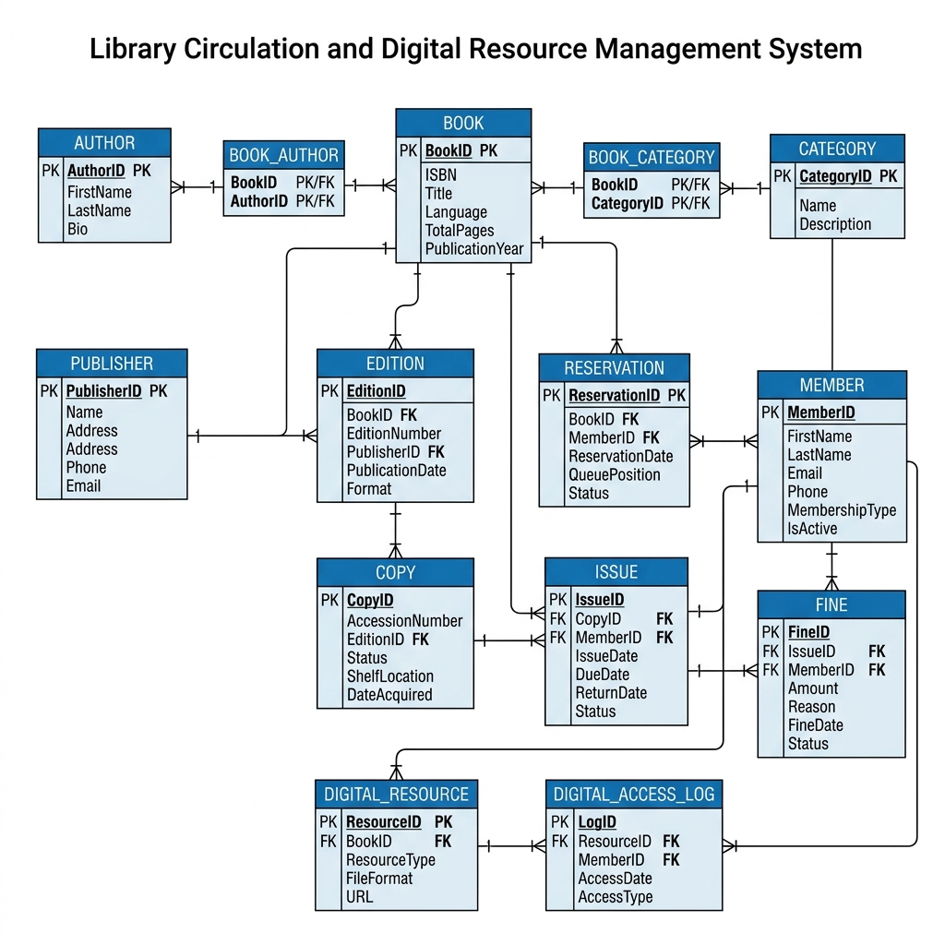
6
Entity-Relationship Diagram
Conceptual design covering 14 entities with cardinality notation

Slide 12
6
Entities Overview
14 tables covering all principal domains
Book
Author
Publisher
Category
Edition
Copy
Member
ISBN, Title, Language
Name, Bio
Name, Address, Contact
Name, Description
EditionNo, Date, Format
AccessionNo, Status, Shelf
Name, Email, Type, Active
Issue
Reservation
Fine
DigitalResource
DigitalAccessLog
BookAuthor
BookCategory
IssueDate, DueDate, Return
Date, Queue, Status
Amount, Reason, PaidDate
Type, Format, URL
AccessDate, Type, IP
BookID, AuthorID (M:N)
BookID, CategoryID (M:N)

Slide 13
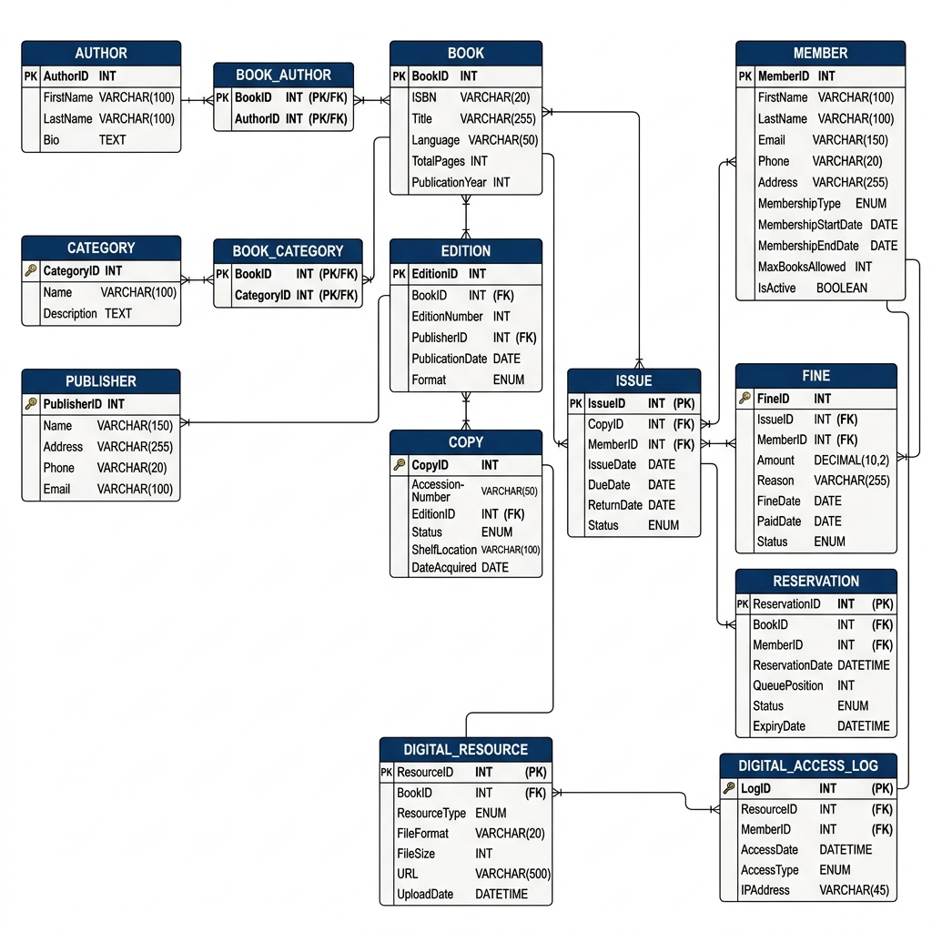
7
Relational Schema Diagram
Tables with data types, primary keys, and foreign key relationships

Slide 14
7
Integrity Constraints Summary
UNIQUE Constraints
CHECK Constraints
DEFAULT Values
Book.ISBN
Copy.AccessionNumber
Member.Email
Publisher.Name
Category.Name
Fine.Amount >= 0
Book.TotalPages > 0
Edition.EditionNumber > 0
MaxBooksAllowed > 0
QueuePosition >= 1
DueDate >= IssueDate
ReturnDate >= IssueDate
Copy.Status = 'Available'
Issue.Status = 'Active'
Reservation.Status = 'Pending'
Fine.Status = 'Pending'
Member.IsActive = TRUE

Slide 15
Thank You
Library Circulation & Digital Resource Management System
Review 1 Presentation | DBMS Project Based Learning
Questions & Discussion

