Slide 1
Pipeline Builder
Self-Service Pipeline Platform — Product Walkthrough
PRODAPT
Prepared for Director review

Slide 2
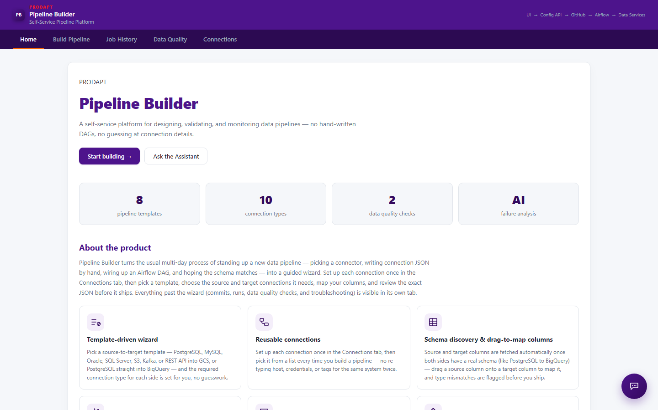
What is Pipeline Builder?
A guided, self-service platform for designing, validating and monitoring data pipelines
• Replaces hand-written Airflow DAGs and manual connection JSON with a guided wizard
• Template-driven: 8 pipeline templates across PostgreSQL, MySQL, Oracle, SQL Server, S3, Kafka, REST API, BigQuery
• Reusable connections: configure a source/target once, reuse across pipelines
• Schema discovery & drag-to-map column mapping
• Built-in Data Quality monitoring with AI-assisted failure analysis

Slide 3
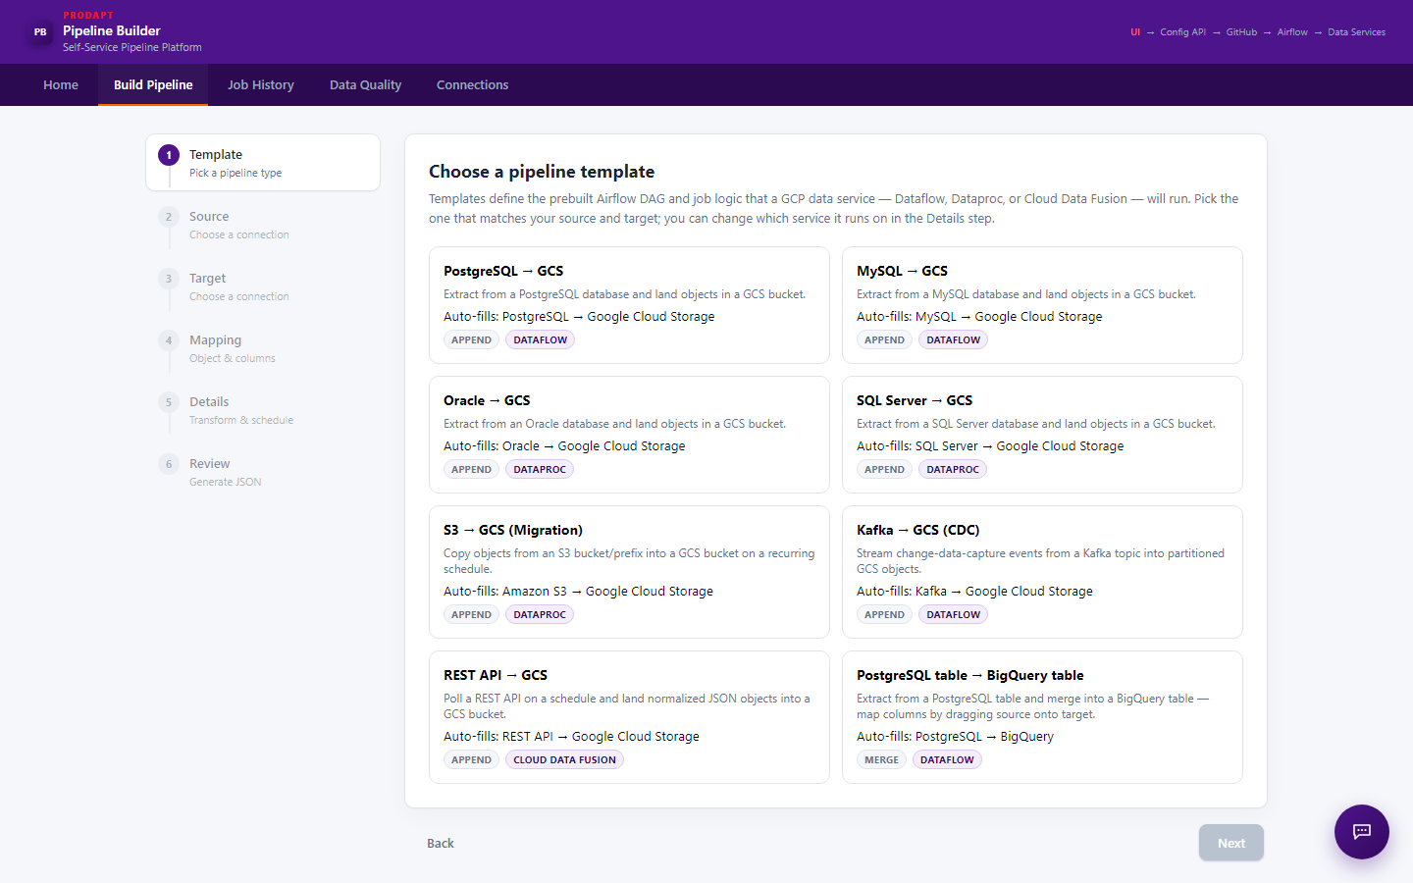
Build Pipeline
A 6-step guided wizard: Template → Source → Target → Mapping → Details → Review

Slide 4
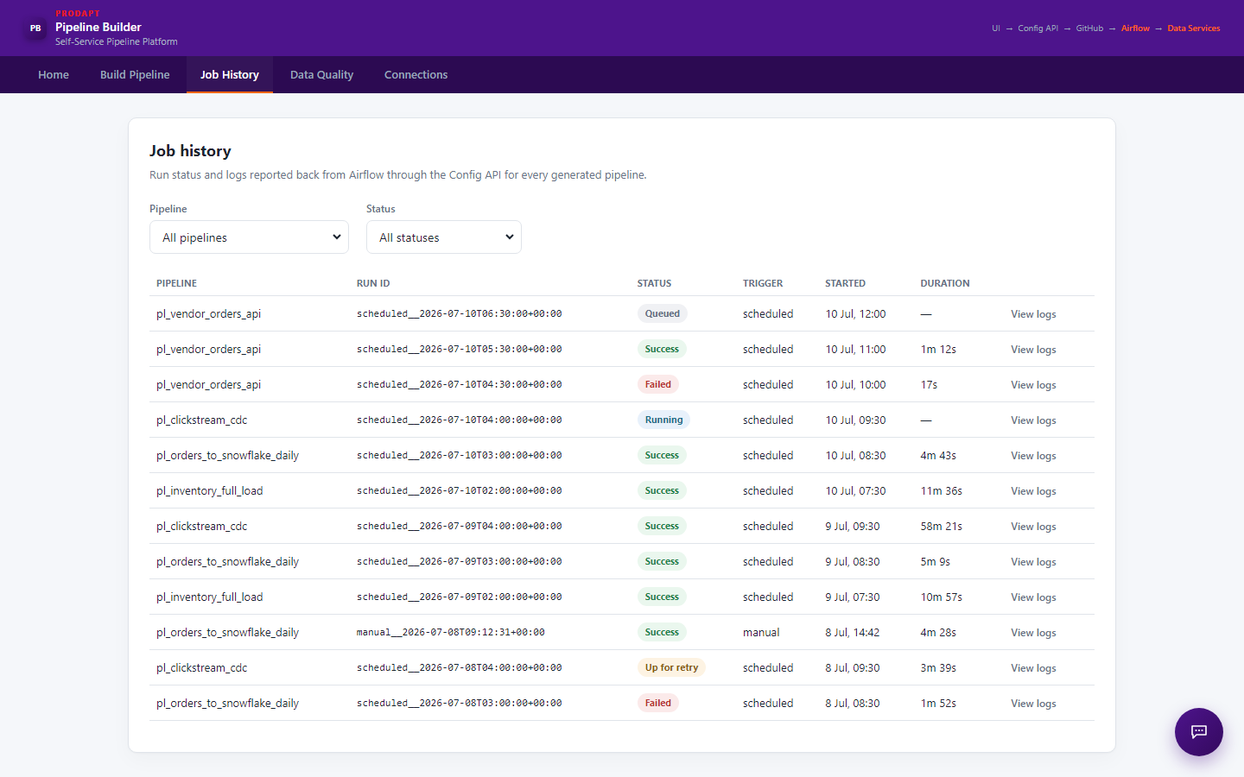
Job History
Run status and logs reported back from Airflow through the Config API for every generated pipeline

Slide 5
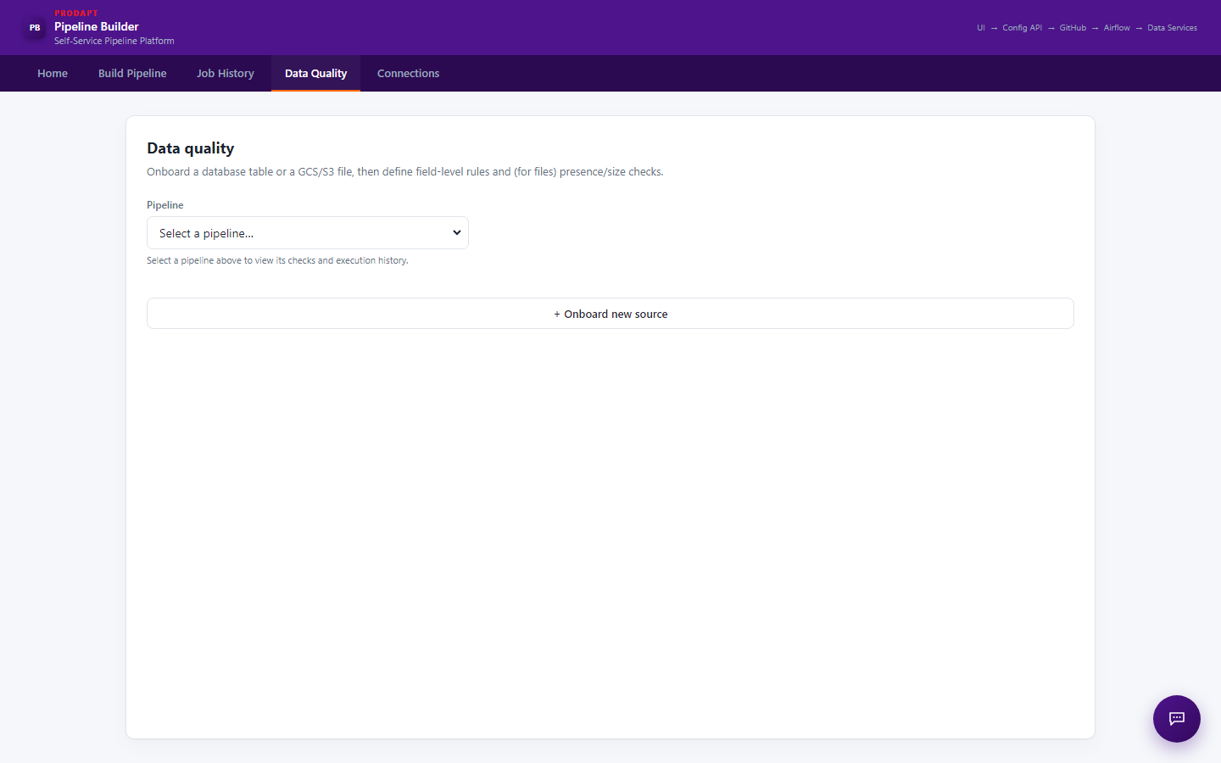
Data Quality — Improved Initial State
Fix: the pipeline dropdown no longer auto-selects a pipeline on load, so no check results are shown until the user chooses one

Slide 6
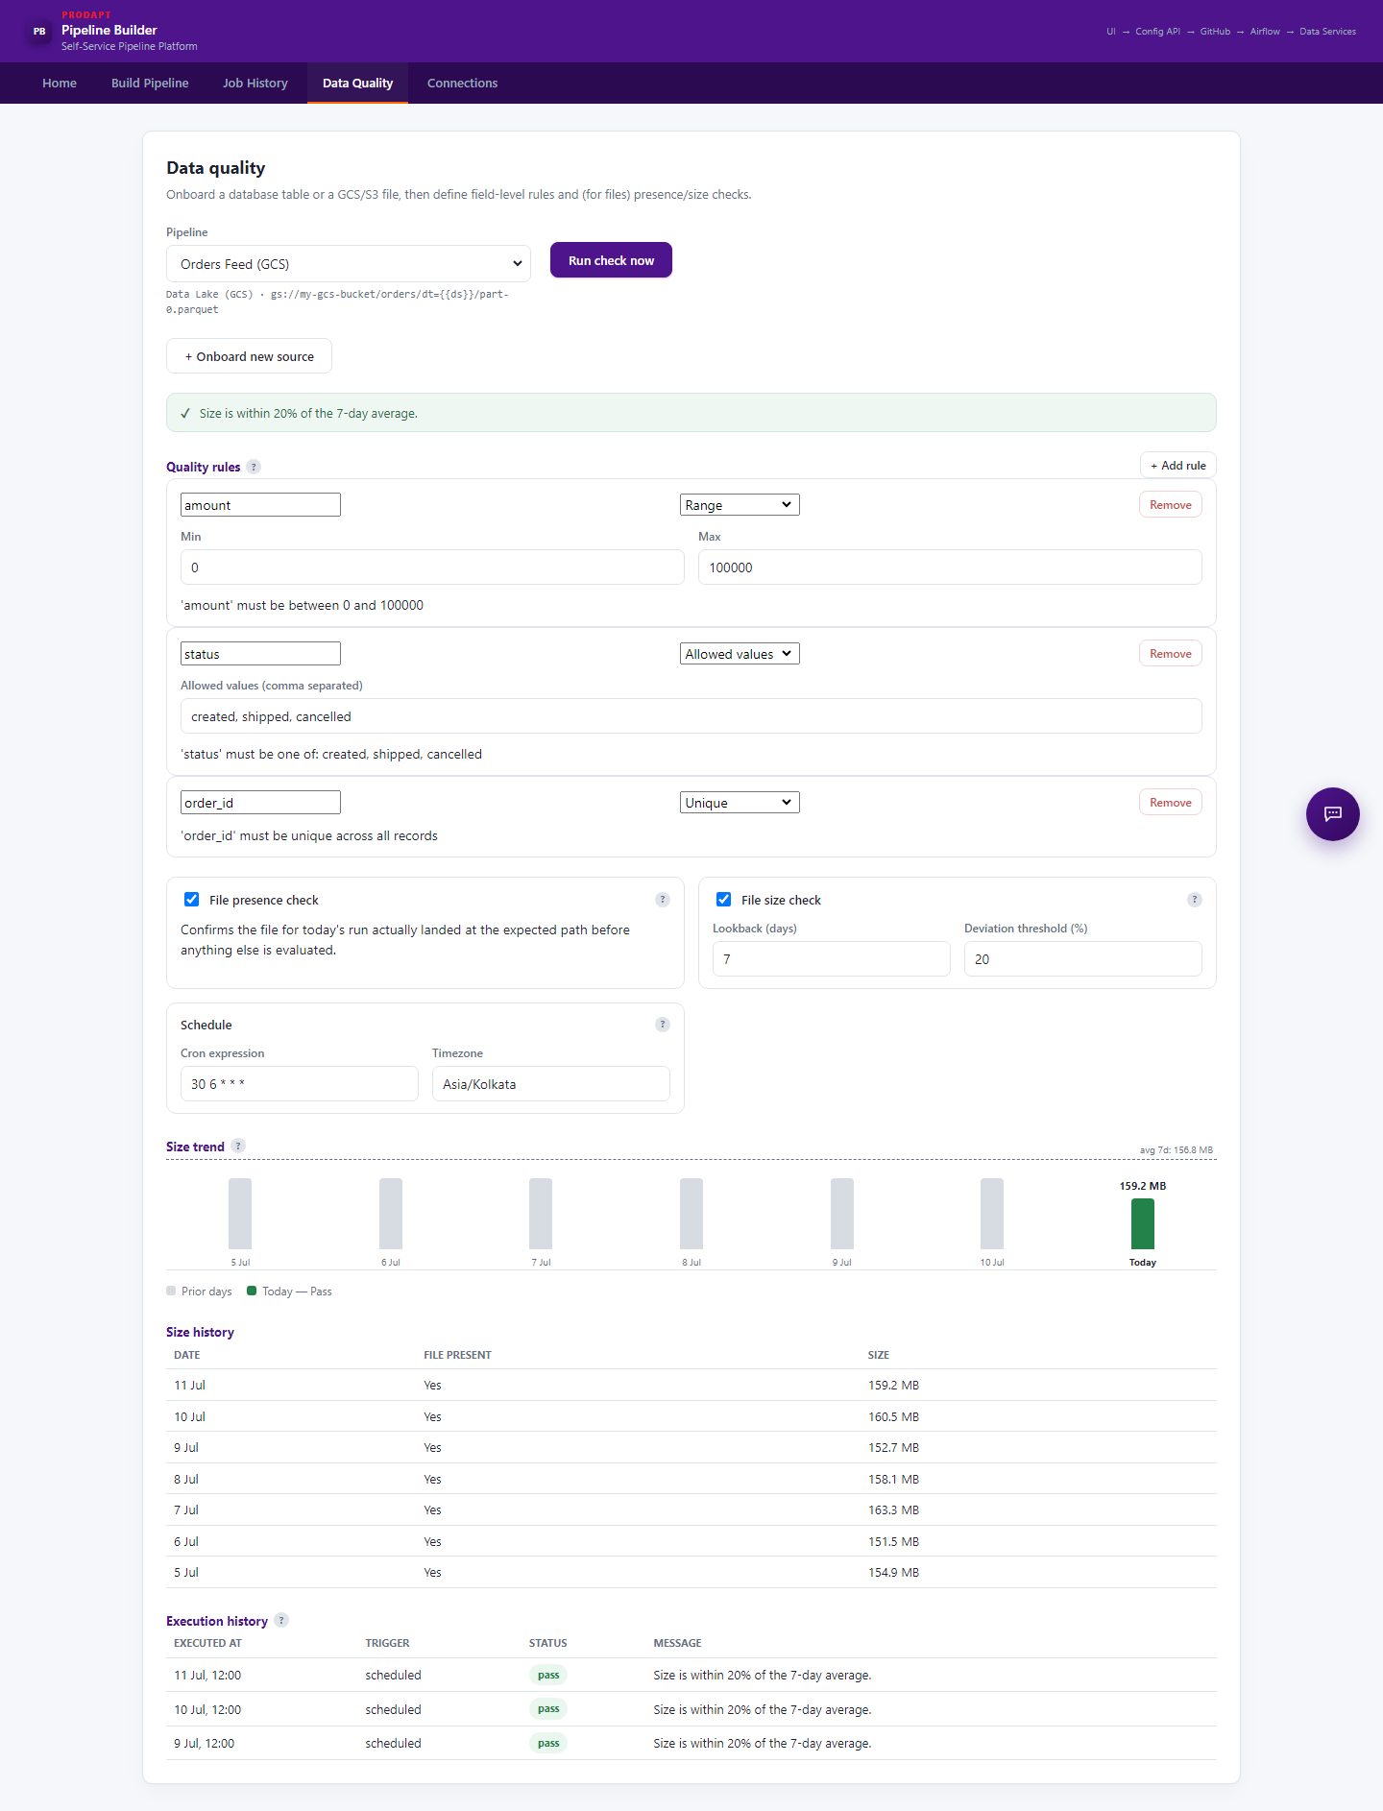
Data Quality — After Selecting a Pipeline
Once a pipeline is chosen from the dropdown, its checks, generated SQL, size trend and execution history appear

Slide 7
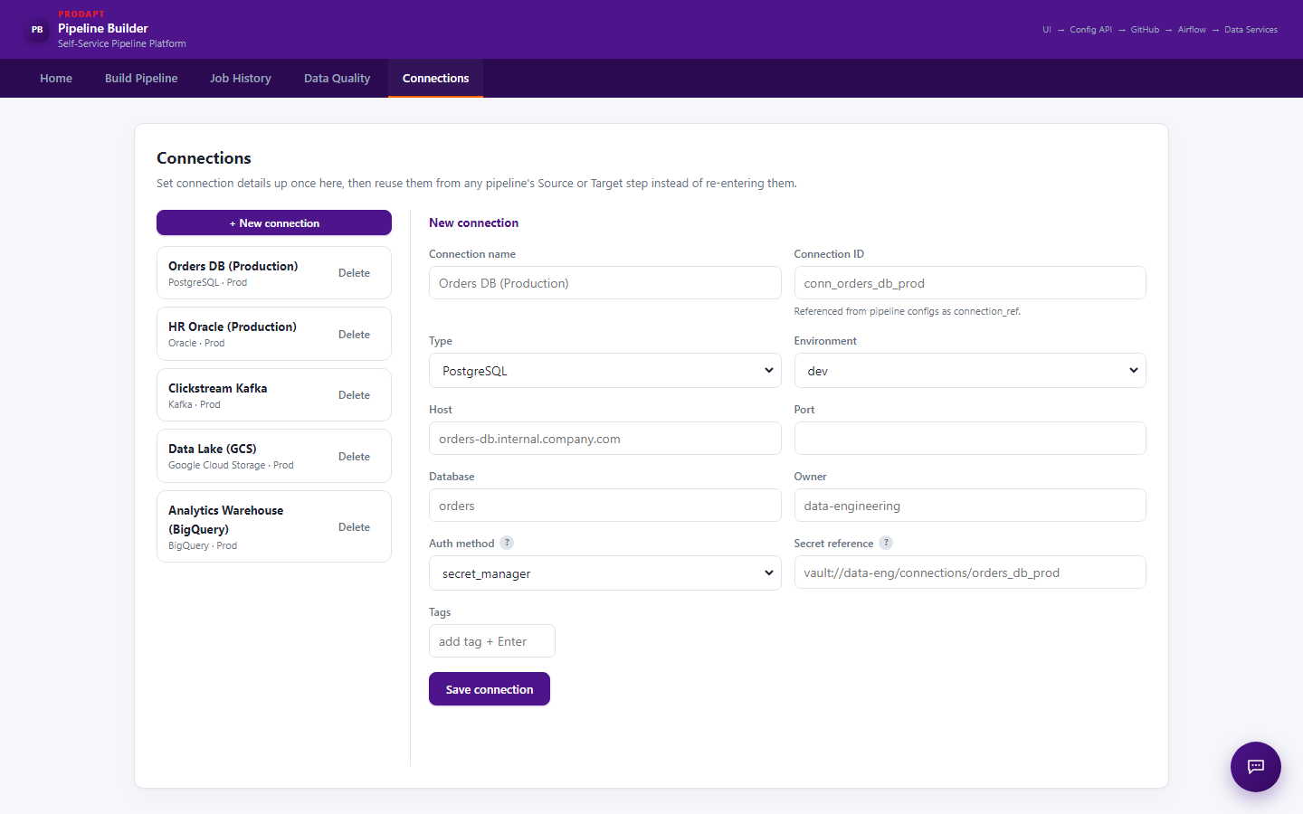
Connections
Set connection details up once, then reuse them from any pipeline's Source or Target step

Slide 8
Summary
• Home, Build Pipeline, Job History, Data Quality and Connections cover the full pipeline lifecycle in one UI
• Recent improvement: Data Quality tab no longer pre-selects a pipeline on load — users now explicitly choose a pipeline before seeing its checks, avoiding confusion with stale/default results
• Next: continue hardening Data Quality onboarding flow and expand AI-assisted failure analysis coverage

