Slide 1
Capstone Project-1
Global Terrorism Analysis
Presented By:
Sandeep R

Slide 2
Analysing Dataset
Exploring Dataset
Remove Unwanted Columns[Features]
Analyse Dataset
To Find Reasonable Findings That might alleviate the Issue.
Provide a Reasonable Conclusion

Slide 3
Description of Dataset
The Global Terrorism Database (GTD) is an open-source database including information on terrorist attacks around the world from 1970 through 2017. The GTD includes systematic data on domestic as well as international terrorist incidents that have occurred during this time period and now includes more than 180,000 attacks. The database is maintained by researchers at the National Consortium for the Study of Terrorism and Responses to Terrorism (START), headquartered at the University of Maryland.

Slide 4
Exploring Dataset
The Data is from year 1970 to 2017
Dataset contains 181691 Examples and 135 Features
Dataset contains 106 Columns with more than one NaN values
Select only the columns which has Null values less than the 10% of the total Examples of the Dataset.

Slide 5
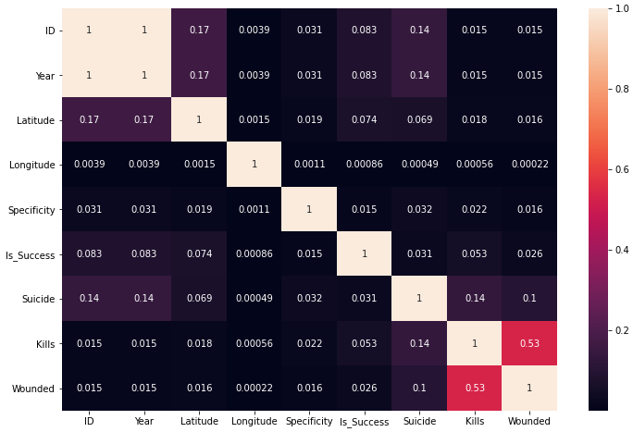
Correlation of Numerical columns:
Wounded and Kills are closely
Related Features it might be
Because, During the terrorist
Attack Some people gets Killed
While few of them gets wounded.

Slide 6
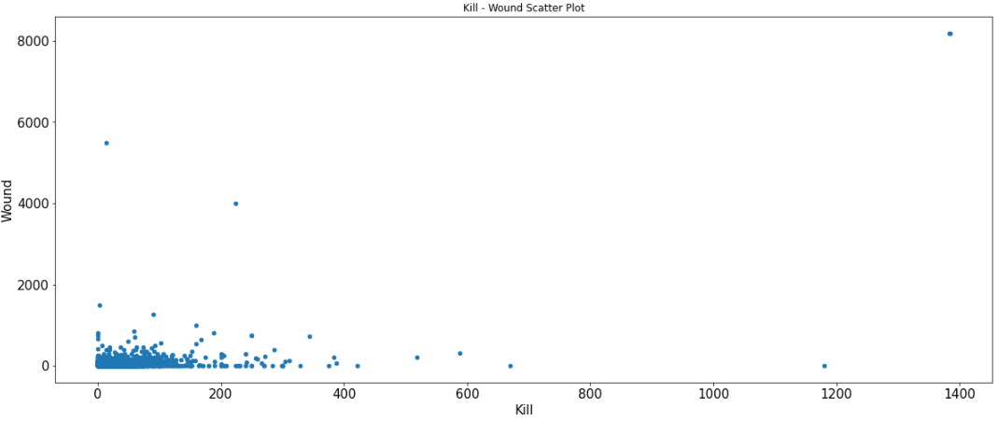
Death and Injury
Notes:
In the majority of acts of terrorism, the mortality rate and injuries were low, but a small number of actions led to too many deaths and injuries.

Slide 7
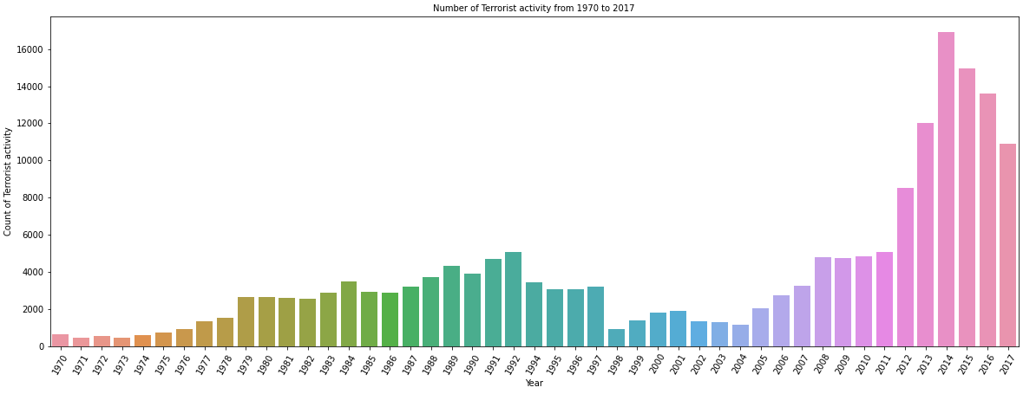
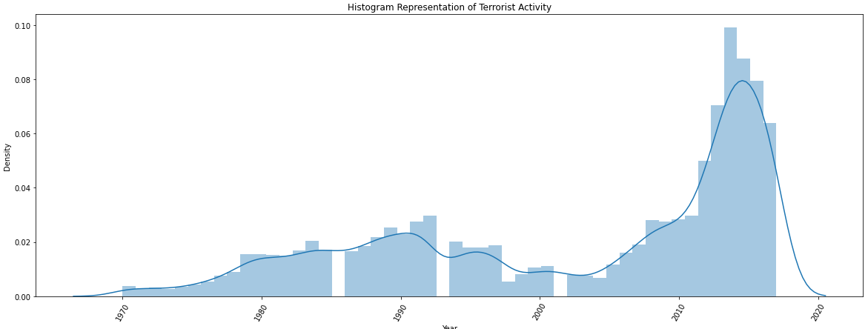
Terrorist Activity From 1970 to 2017

Slide 8
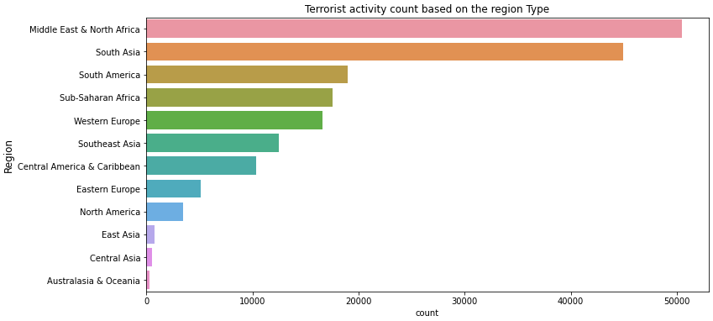
Terrorist activity count based on Region Type

Slide 9
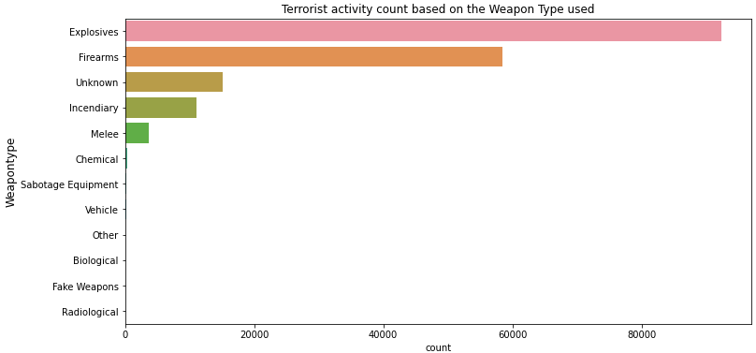
Type of Weapons

Slide 10
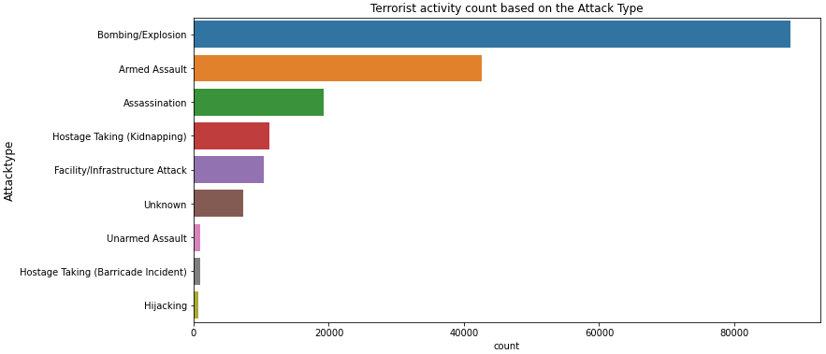
Type of Terrorist Attack

Slide 11
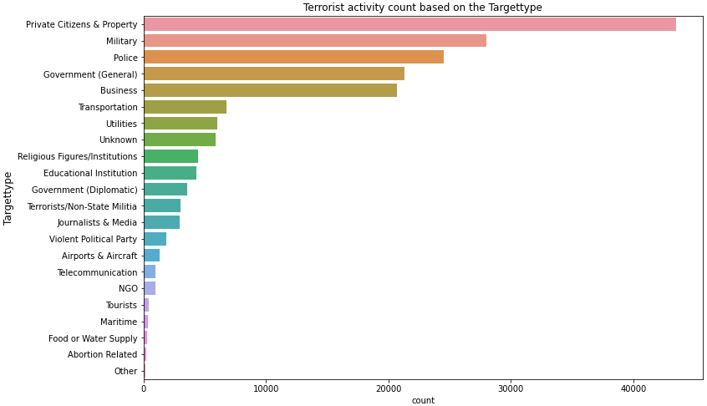
Different target type of Terrorist attack

Slide 12
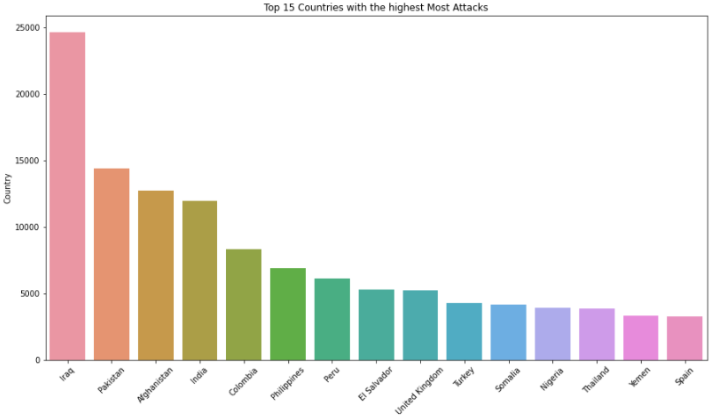
Top 15 Countries with Highest terror attack

Slide 13
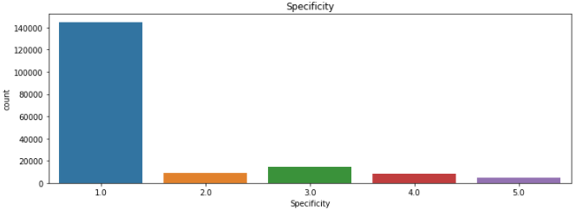
Specificity

Slide 14
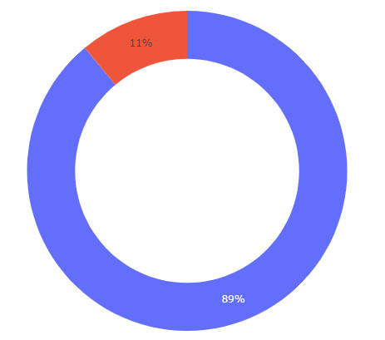
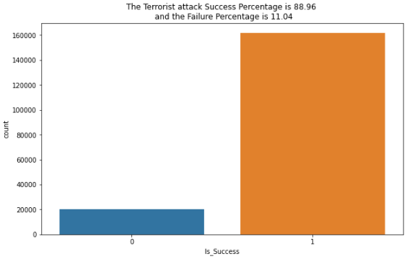
Failure and Success Ratio

Slide 15
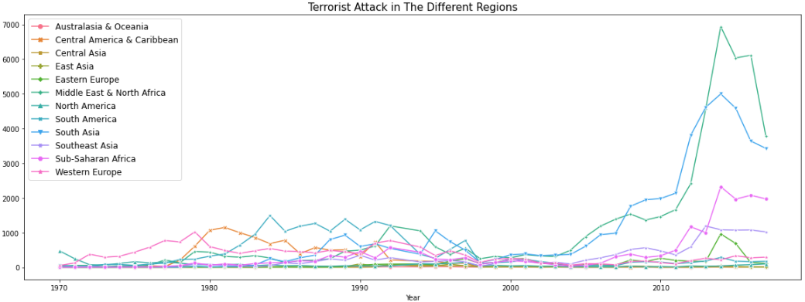
Terrorist Attack on Different Regions

Slide 16
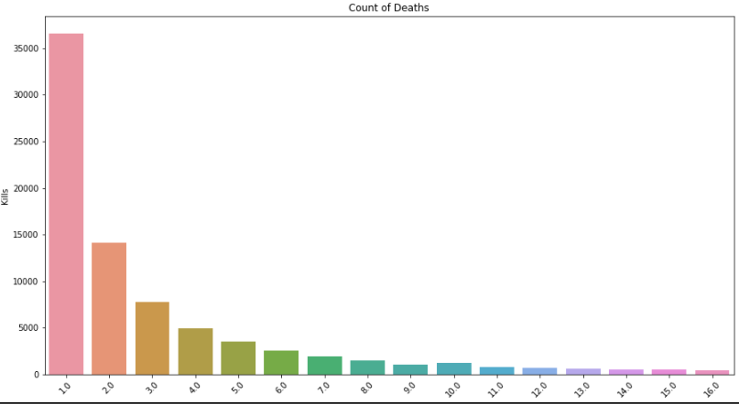
Death Counts

Slide 17
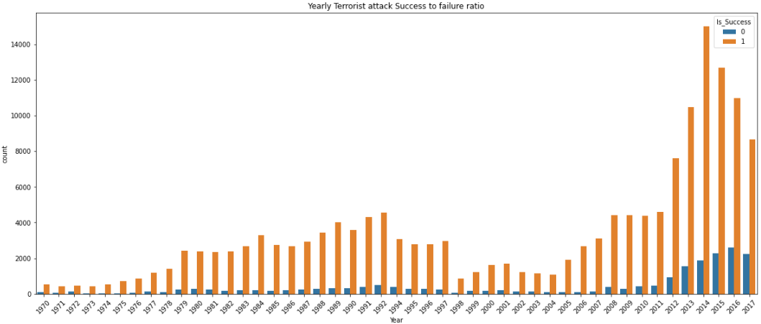
Yearly Terrorist attack Success to Failure Ratio

Slide 18
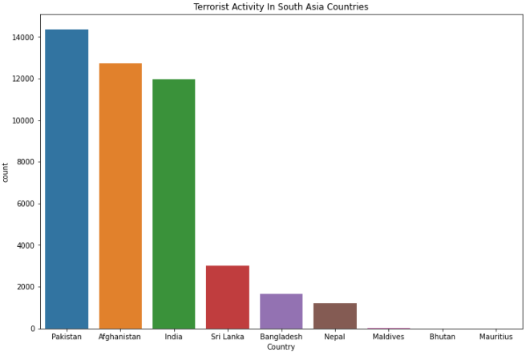
Terrorist Activity in South Asia Countries

Slide 19
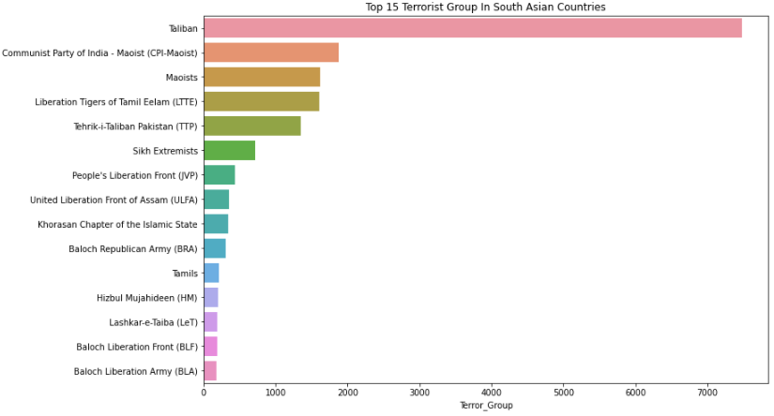
Top 15 Terrorist Group in South Asia Countries

Slide 20
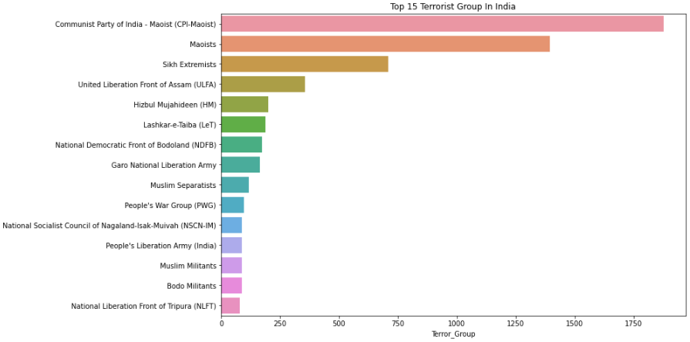
Top 15 Terrorist Group in India

Slide 21
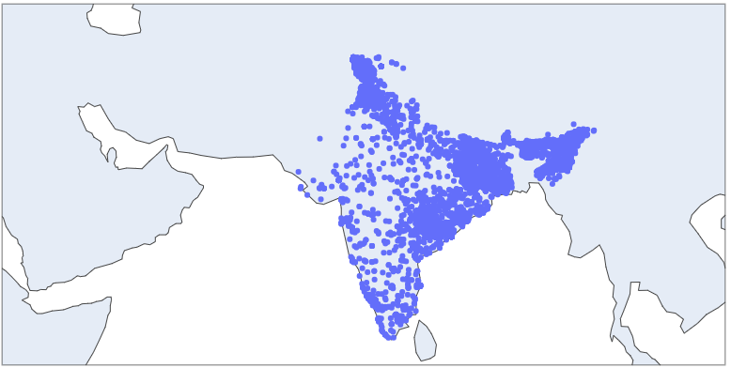
Terrorist Attacks in India

Slide 22
Conclusion
Terrorist Activity is observed to decrease From 2015, As there is decrease in terrorist activity from 2015 to 2017 if there was data available after 2017 the same can be confirmed.
Most of the Terrorist activity in India is In Northern and North Eastern part of India where the Border of India Lies with neighboring countries.

Slide 23
Thank You

