Slide 1
Capstone Project-3
Product Recommendation Engine

Slide 2
Building Product Recommendation Model
Exploring Dataset
Exploratory Data Analysis and Handling Null values
Feature Engineering
Model Building and Finding The Best Model
Recommend Products based on the Best Model.

Slide 3
Brief Description of Dataset
Dataset related to over 2 Million customer reviews and ratings of Beauty related products sold on amazon website.
Dataset Contains:
unique UserId (Customer Identification),
The product ASIN (Amazon's unique product identification code for each product),
Ratings (ranging from 1-5 based on customer satisfaction) and
Timestamp of the rating (in UNIX time)

Slide 4
Exploratory Data Analysis
Dataset contains 2023070 Records and 4 Variables
Dataset doesn’t contain any null values
Minimum rating is 1 while the Maximum rating is 5.
Only 25% of the dataset falls between 1 to 4 rating
75% of the dataset is in the Range 4 to 5 rating
Total number of Unique Users are 1210271
Number of Unique Products are 249274

Slide 5
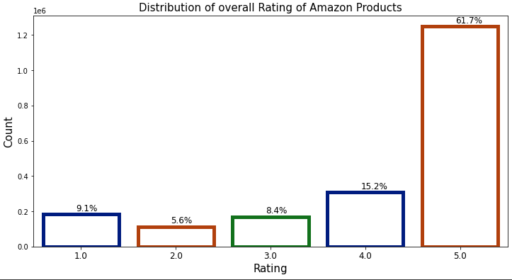
Rating of Products

Slide 6
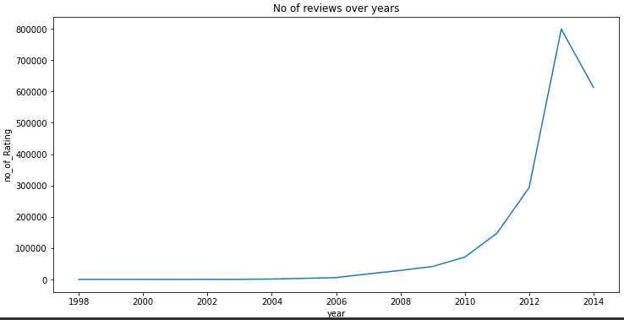
Review Over Year

Slide 7
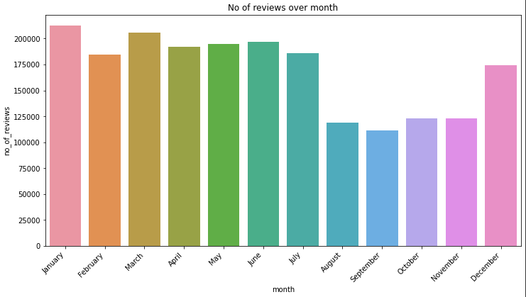
Review over Month

Slide 8
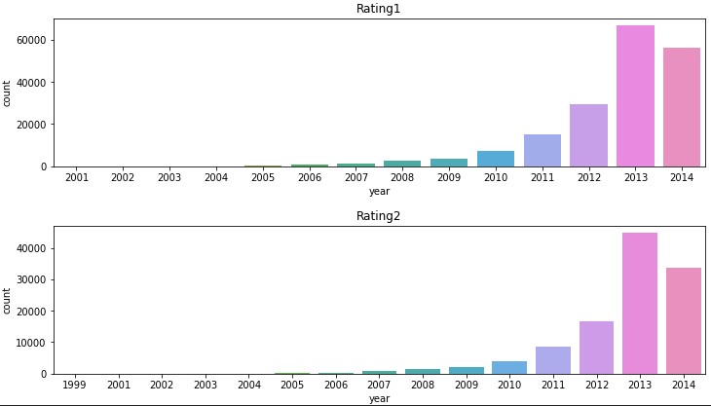
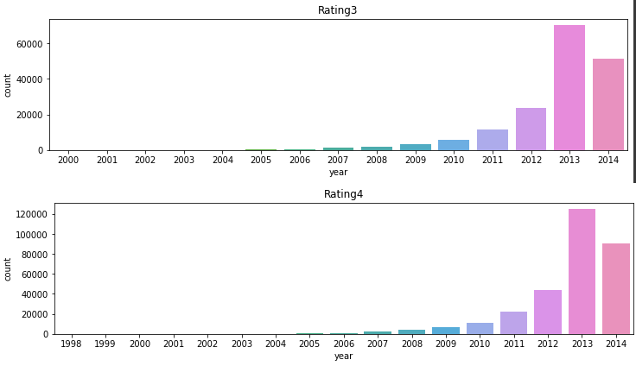
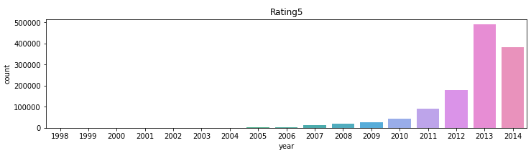
Ratings over Years

Slide 9
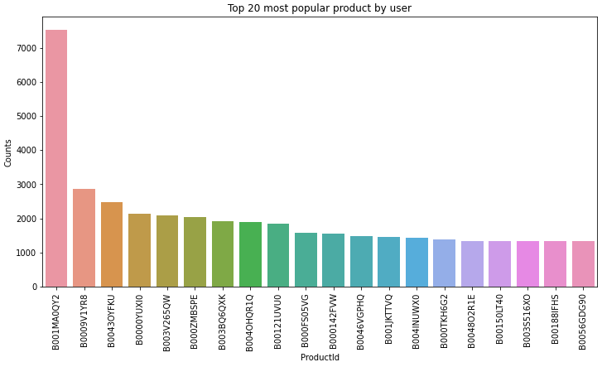
Popular Product By User

Slide 10
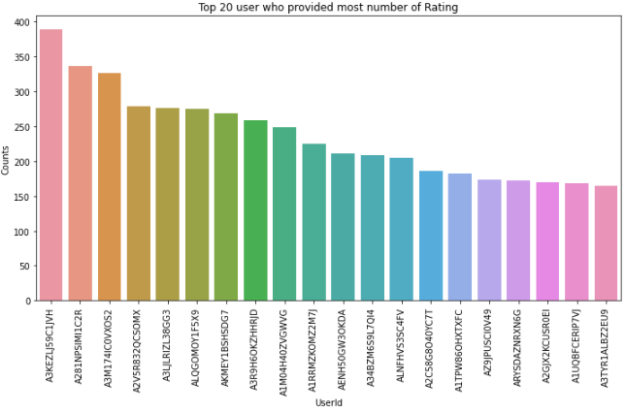
Top Customers With Most Number of Rating

Slide 11
Popularity Recommended Model
 | UserId | ProductId | true_ratings | predicted_ratings
0 | AXRMB1697C1MY | B0078DXKLI | 5.0 | 3.562500
1 | A43SU2MFB7LX8 | B0078DXKLI | 4.0 | 3.562500
2 | ABFUIZW6PAJNK | B002K8W1UC | 5.0 | 4.113636
3 | A357E2DE2FBLS9 | B002K8W1UC | 5.0 | 4.113636
4 | A3MQEP2Z1VVQB9 | B002K8W1UC | 3.0 | 4.113636
RMSE score for popularity Recommended Model is 1.2521

Slide 12
Collaborative Filtering Model
Trained Two Models KnnwithMeans and SVD

Slide 13
Collaborative Filtering Model
KnnwithMeans
RMSE score for KnnwithMeans is 1.1466
SVD
RMSE Score for SVD is 1.1032
Find the best parameters through GridsearchCV
After Hyperparameter tuning RMSE score is 0.9615
Choosen this model as the Best model, Using this model Products are Recommended to the users.

Slide 14
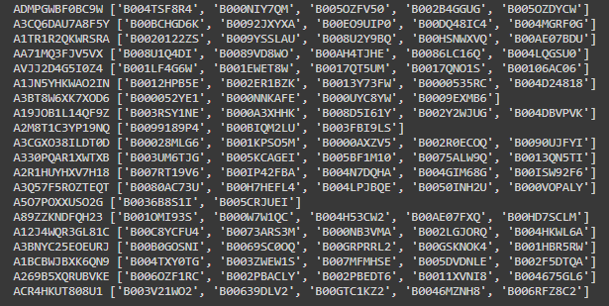
Recommendation using Collaborative Filtering Model

Slide 15


Slide 16


