Slide 1
Capstone Project
Coronavirus Tweet Sentiment Analysis
Presented By:
Sandeep R

Slide 2
Introduction
The given challenge is to build a classification model to predict the sentiment of Covid-19 tweets. The tweets have been pulled from Twitter and manual tagging has been done. We are given information like Location, Tweet At, Original Tweet, and Sentiment.
One should know what is mean by Sentiment Analysis. Sentiment Analysis is the process of computationally identifying and categorizing opinions expressed in a piece of text, especially in order to determine whether the writer’s attitude towards a particular topic is Positive, Negative, or Neutral.

Slide 3
Standard Operating Procedure
Following is the Standard Operating Procedure to tackle the Sentiment Analysis kind of project. We will be going through this procedure to predict what we supposed to predict!
Exploratory Data Analysis.
Data Preprocessing.
Vectorization.
Classification Models.
Evaluation.
Conclusion.

Slide 4
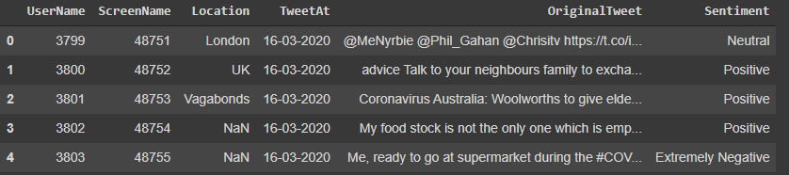
Data Summary
The original dataset has 6 columns and 41157 rows. In order to analyze various sentiments, We require just two columns named Original Tweet and Sentiment. There are five types of sentiments- Extremely Negative, Negative, Neutral, Positive, and Extremely Positive as you can see in the following picture.

Slide 5
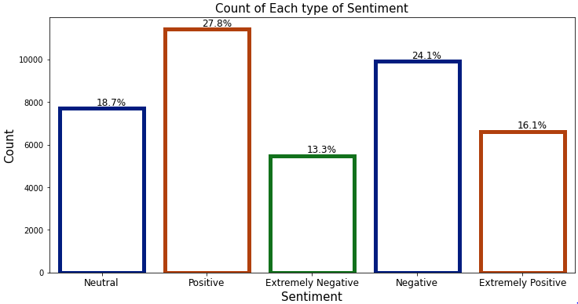
Basic Exploratory Data Analysis
When we try to explore the ‘Sentiment’ column, we came to know that most of the peoples are having positive sentiments about various issues shows us their optimism during pandemic times. Very few people are having extremely negatives thoughts about Covid-19.

Slide 6
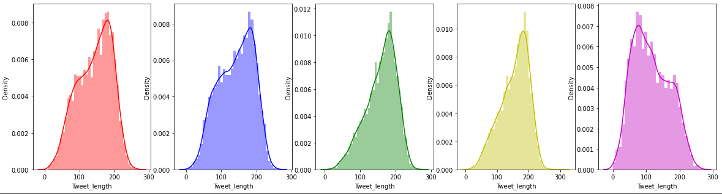
Distribution of message Length for each type of Sentiment
From the below Distribution plot it can be seen that all the distributions are equally Distributed. Length of the Message doesn't depend on the sentiment of the tweet.

Slide 7
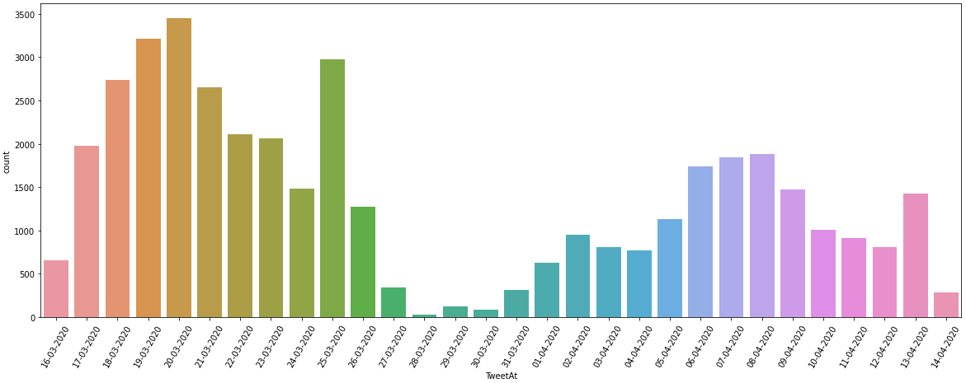
Count of Tweets For Each Day
Initially the Count of tweets were quite high but gradually the count of tweets related to corona started to decrease.

Slide 8
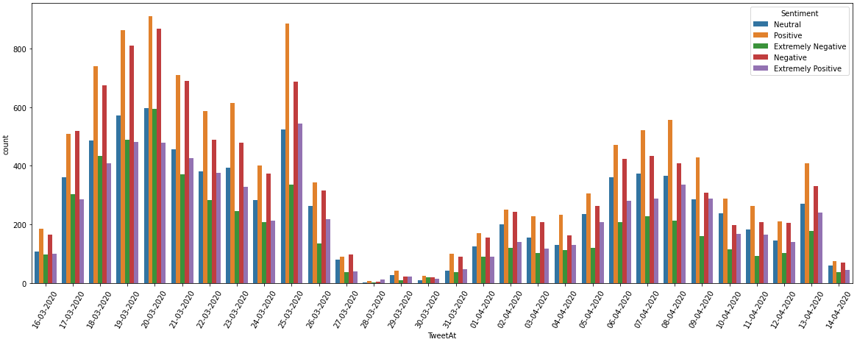
Count of Types Tweets For Each Day
Almost all the days we can see that the Count of Positive tweet was high as compared with other kind of tweets.

Slide 9
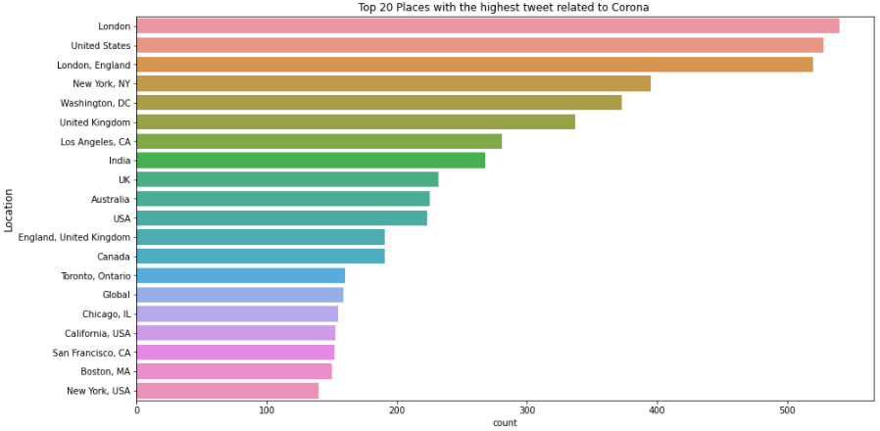
Geographical Location with Highest Tweets

Slide 10
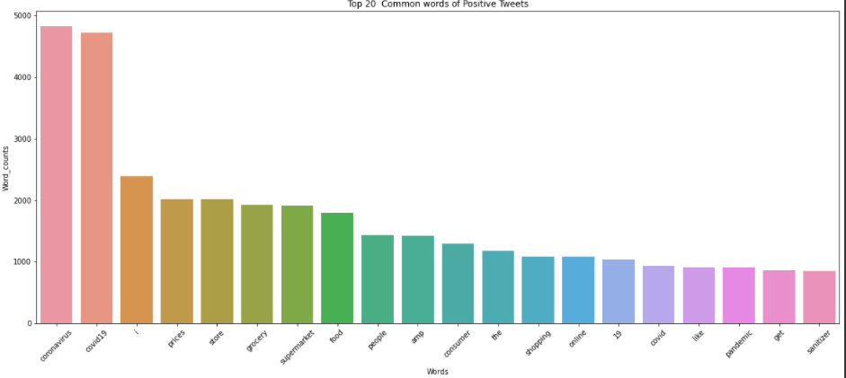
Common Words in Positive Tweets

Slide 11
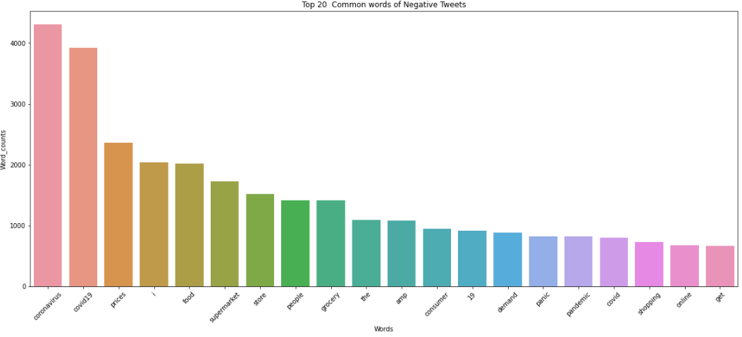
Common Words in NegativeTweets

Slide 12
Result of Training Different Models
Models | Test_score
SVC | 0.603984
LogisticRegression | 0.582483
RandomForestClassifier | 0.528912
GradientBoostingClassifier | 0.464893
DecisionTree | 0.442906
XGboost | 0.440233
KNN | 0.214893

Slide 13
Conclusion
In this way, we can explore more from various textual data and tweets. Our models will try to predict the various sentiments correctly. I have used various models for training our dataset but some models show greater accuracy while some do not. For multiclass classification, the best model for this dataset would be SVC.

Slide 14
Thank You

