Slide 1
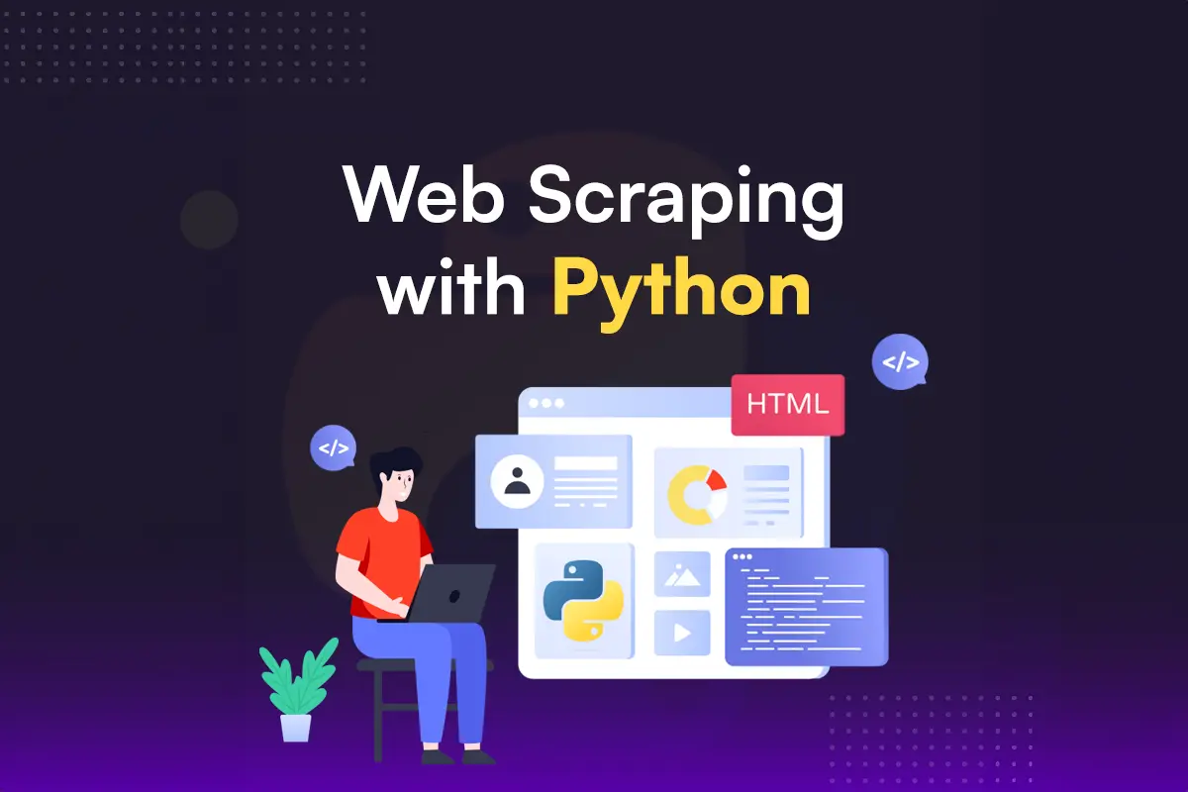
Web Scraping using Python
Project Overview - Books to Scrape
BY- SANDEEP MOHINTA
COURSE: BBA DA&AI
SEM: IV
YEAR: II

Slide 2
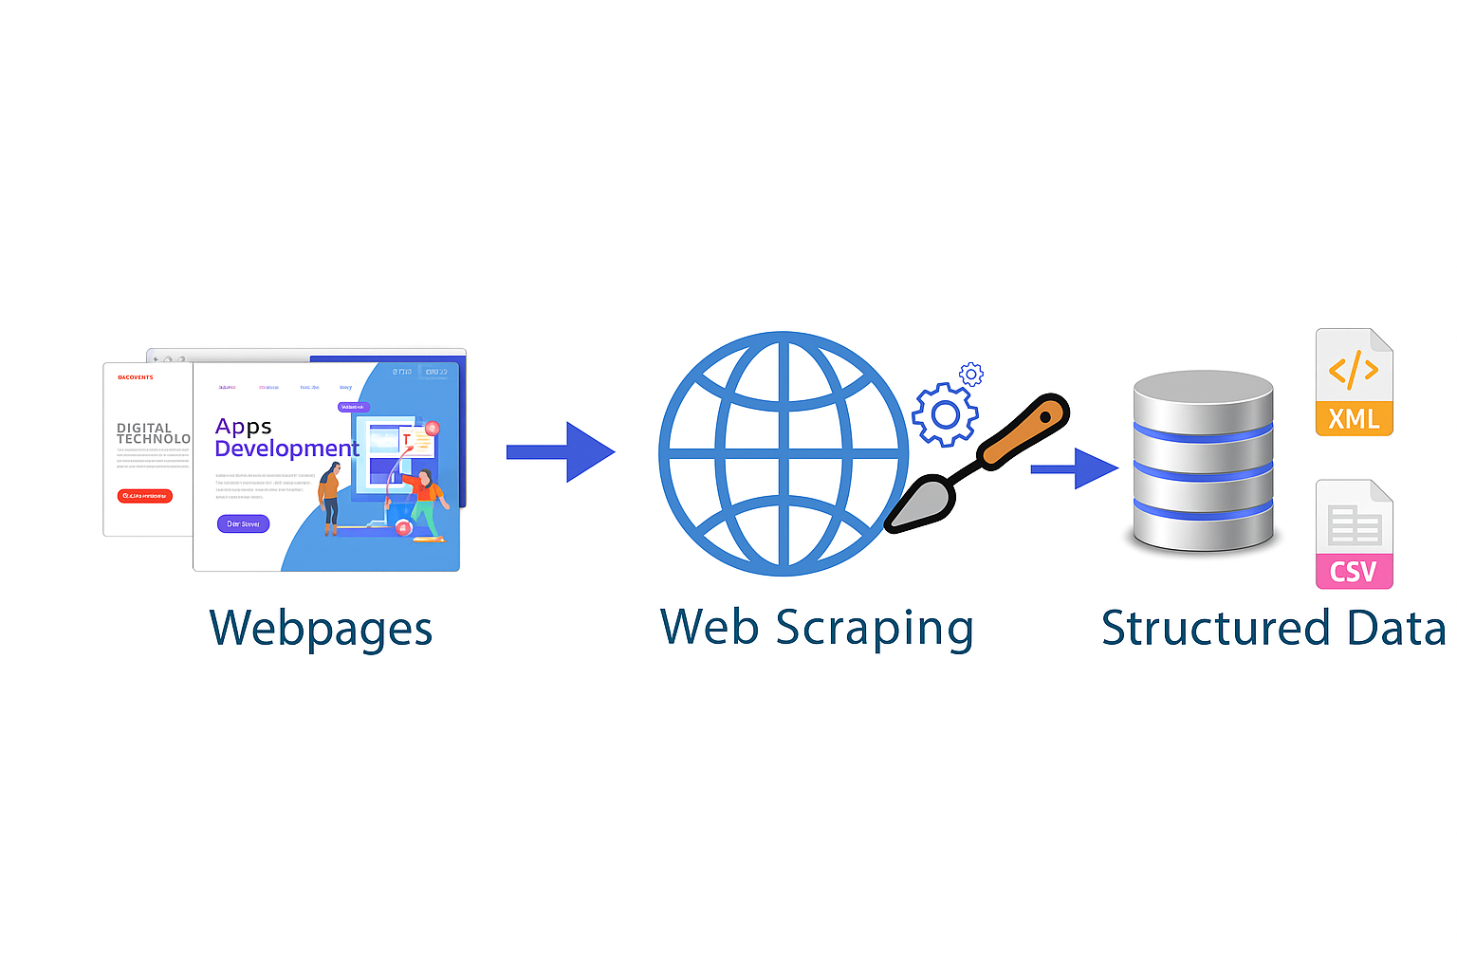
Introduction
Web scraping is the process of extracting data from websites.
This project extracts book data (title, price, availability) from 'Books to Scrape' using Python.

Slide 3
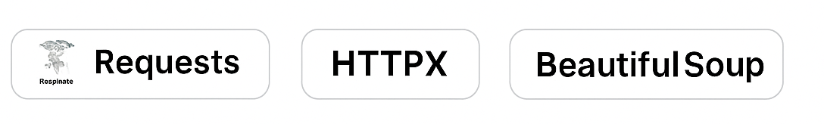
Tools and Libraries Used
- Python
- Requests (HTTP requests)
- BeautifulSoup (HTML parsing)
- Pandas (Data handling and saving to CSV)

Slide 4
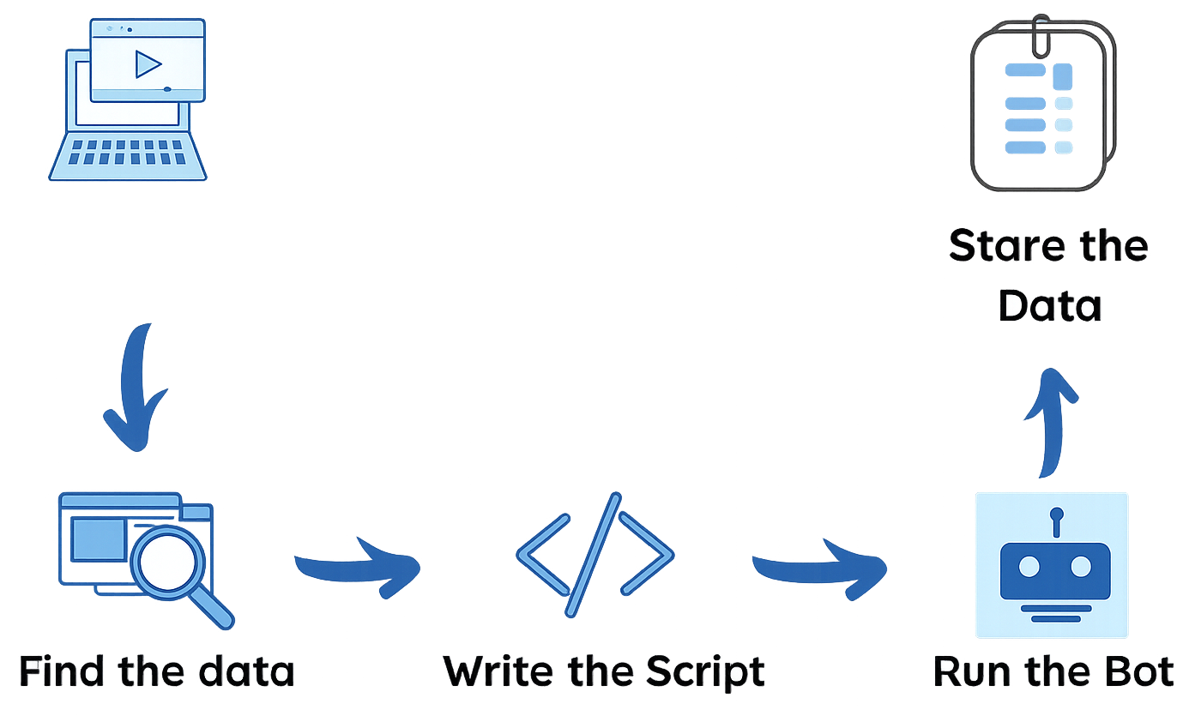
Workflow
1. Send HTTP request to the website
2. Parse HTML using BeautifulSoup
3. Extract required data (title, price, availability)
4. Store the data in a CSV file
Select The Website

Slide 5
Python Code Overview
- Send request: requests.get(url)
- Parse with BeautifulSoup
- Loop through book entries
- Extract text and save with pandas
- Save to books.csv

Slide 6
Sample Output
Title | Price | Availability
------|-------|--------------
A Light in the Attic | £51.77 | In stock
Tipping the Velvet | £53.74 | In stock
Soumission | £50.10 | In stock

Slide 7
Challenges
- Website structure may change
- Pages using JavaScript are harder to scrape
- Handle connection errors and timeouts

Slide 8
Conclusion
This project demonstrates how to extract structured data from a website.
It can be expanded to include more pages or used with other websites.
Future improvements could include using Selenium for dynamic content.

