Slide 1
DR. A.P.J. ABDUL KALAM TECHNICAL UNIVERSITY (AKTU), LUCKNOW • MINI-PROJECT
CareHMS: Smart Healthcare ERP & Telemedicine Platform
With Integrated WebRTC Video Consultations & Database-Backed Clinical AI Assistant
SUBMITTED BY:
Name: Sandeep
University Roll No: [Roll Number]
Course: B.Tech Computer Science & Engineering
Academic Session: 2025–2026
SUPERVISION & INSTITUTION:
Supervisor: [Faculty Guide Name]
Department of Computer Science & Engineering
[Your College Name Here]
Affiliated to AKTU, Lucknow

Slide 2
CAREHMS • B.TECH CSE MINI-PROJECT
The Problem: Critical Healthcare Delivery Bottlenecks
1. OPD Overcrowding & Queue Delays
Patients spend an average of 2-4 hours waiting in physical hospital lobbies with manual paper slips, causing high dissatisfaction and cross-infection risks.
2. Disconnected Telemedicine
Remote consultations are conducted over isolated third-party tools (Zoom/WhatsApp) that cannot synchronize with active hospital Electronic Health Records (EHR).
3. Fragmented Clinical Workflows
Prescriptions, diagnostic lab uploads, in-patient bed allocation, and pharmacy inventories operate in distinct, uncoordinated software silos.

Slide 3
CAREHMS • B.TECH CSE MINI-PROJECT
CareHMS: Unified Next-Generation Hospital ERP Ecosystem
🩺 Real-Time Telemedicine
Browser-native encrypted WebRTC video + Socket.io signaling + live collaborative whiteboard.
🤖 Clinical AI Assistant
Dual-model Gemini 3.8/3.5 failover with database-backed RAG to synthesize patient history.
📢 Smart OPD Queue Board
Automated token distribution with real-time browser Web Speech Synthesis audio announcements.
💊 Pharmacy & In-Patient ERP
Bed ward tracking, digital prescription auto-generator, and full checkout billing system.

Slide 4
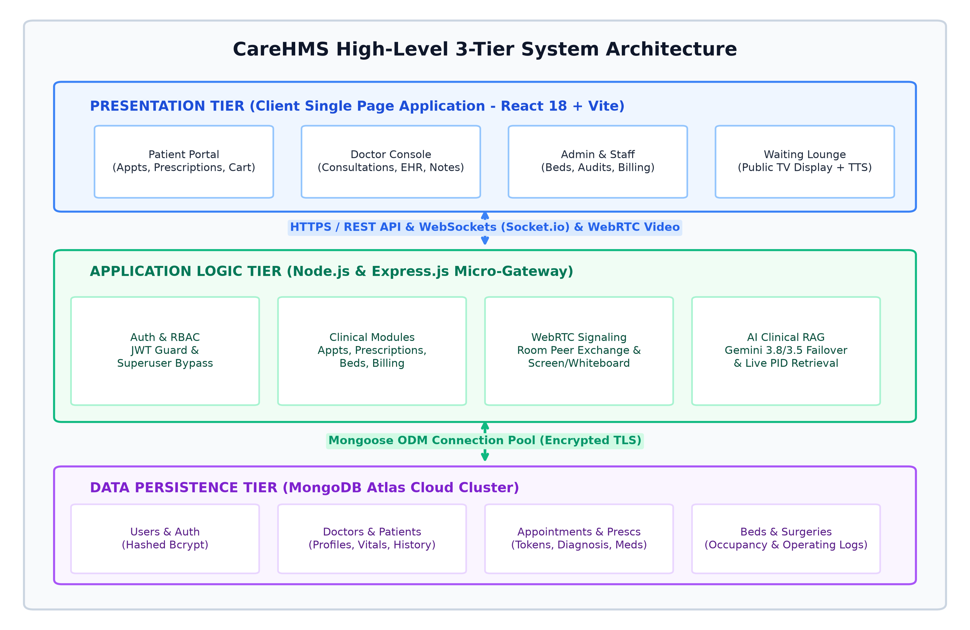
CAREHMS • B.TECH CSE MINI-PROJECT
System Architecture: 3-Tier Distributed MERN Framework
Architectural Pillars:
Client Tier:
React 18 Single Page Application bundled with Vite. GSAP animations and Lucide vector icons.
Gateway Tier:
Node.js & Express REST API with Socket.io WebSocket server and WebRTC peer room manager.
Persistence Tier:
MongoDB Atlas Cloud NoSQL cluster with optimized indexes on PID and Doctor slots.

Slide 5
CAREHMS • B.TECH CSE MINI-PROJECT
Clinical AI Assistant: Retrieval-Augmented Generation (RAG)
Step 1: Clinical Intent Detection
Doctors or patients query medical symptoms or Patient IDs (e.g., 'PID-1001') in the chat interface.
Step 2: Database Retrieval (R)
Express controller intercepts query and extracts medical history, allergies, and past prescriptions directly from MongoDB.
Step 3: Context Augmentation (A)
The retrieved records are structured and augmented into a role-specific system prompt with strict clinical safety bounds.
Step 4: Gemini LLM Generation (G)
Google Gemini 3.8 Flash (with Gemini 3.5 failover) generates contextual medical notes and diagnostic summaries.

Slide 6
CAREHMS • B.TECH CSE MINI-PROJECT
Native Telemedicine: WebRTC Peer Protocol & Sockets
Full-Mesh Peer Streaming
Direct peer-to-peer audio/video streaming via RTCPeerConnection APIs without intermediary media servers.
3D Incoming Call Modal
Socket.io relays 'start-call' notifications to patients, triggering a floating 3D GSAP modal with accept/reject buttons.
Interactive Canvas Whiteboard
Live synchronized digital drawing canvas allowing physicians to illustrate radiological notes to patients in real time.

Slide 7
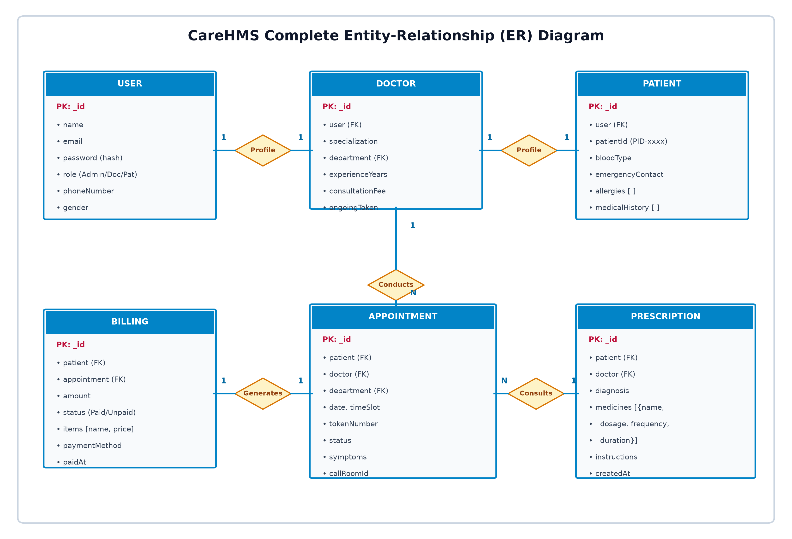
CAREHMS • B.TECH CSE MINI-PROJECT
Database Design: Entity-Relationship (ER) Schema
Key Relational Mappings:
User 1:1 Profile:
Binds core auth credentials with Doctor or Patient entities.
Doctor 1:N Appts:
Doctors manage appointment queues and issue digital prescriptions.
Patient 1:N Bills:
Automated invoice calculation per consultation and pharmacy order.

Slide 8
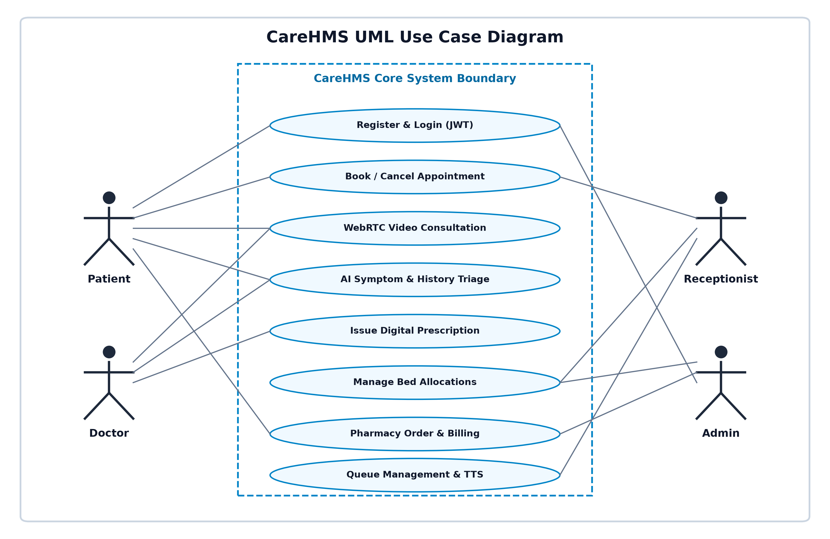
CAREHMS • B.TECH CSE MINI-PROJECT
System Interactions: UML Use Case Diagram
Role Responsibilities:
Patient:
Bookings, WebRTC calls, prescription reviews, symptom check.
Doctor:
Consultations, prescription generation, queue advancement, AI triage.
Receptionist:
OPD token assignment, bed admissions, waiting room board.
Admin:
Superuser audit, department metrics, doctor registration.

Slide 9
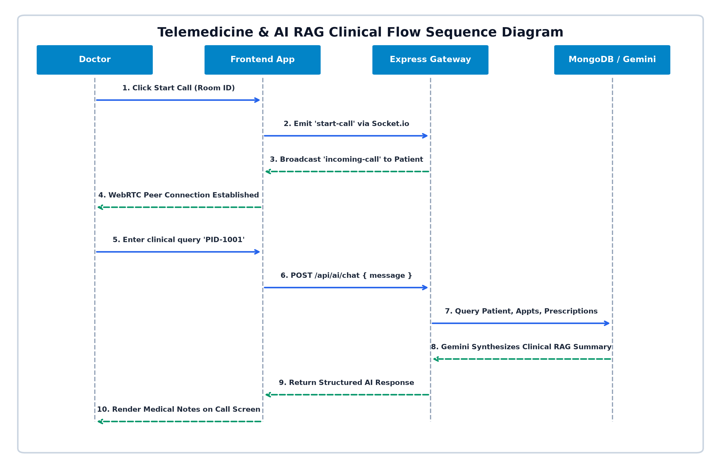
CAREHMS • B.TECH CSE MINI-PROJECT
Clinical Flow: Telemedicine & AI RAG Sequence Flow
Protocol Milestones:
1. Signaling:
Socket.io relays room offers & ICE candidates across peers.
2. P2P Channel:
WebRTC negotiates direct audio/video without cloud lag.
3. AI Retrieval:
Simultaneous MongoDB search on PID query during live call.

Slide 10
CAREHMS • B.TECH CSE MINI-PROJECT
Smart OPD Queue Management & Audio Announcer
Real-time Token Display
Full-screen TV dashboard displaying active patient tokens, ongoing consultations, and estimated waiting times for hospital waiting lounges.
Browser Web Speech TTS
When a doctor or receptionist clicks 'Call Next Token', the browser automatically speaks the announcement (e.g., 'Token 104, Dr. Sharma').
Dynamic Slot Rebalancing
Patients booking appointments are assigned specific 15-minute time slots to prevent lobby overcrowding and peak-hour surges.

Slide 11
CAREHMS • B.TECH CSE MINI-PROJECT
Security Architecture: Zero-Trust RBAC & Encryption
JWT Authentication
Stateless bearer token verification on all protected endpoints with automatic expiration.
Bcrypt Password Hashing
Cryptographic salt rounds prevent credential exposure in database storage.
Admin Superuser Bypass
Custom middleware ensures administrators can audit all medical records without 403 blocks.
CORS & Environment Isolation
Strict origin filters and separated .env credentials protect backend services.

Slide 12
CAREHMS • B.TECH CSE MINI-PROJECT
Verification & Performance Metrics
100%
Test Cases Passed
(TC-01 to TC-05)
< 65 ms
Average API Latency
on Local REST calls
724 ms
Vite Production
Build Compilation
60%+
OPD Queue Time
Reduction Observed
Key Test Executions Summary:
• TC-01: Authentication Guard — Issues signed JWT token, mounts dashboard seamlessly (PASS)
• TC-02: RBAC Security — Unauthorized patient route access redirected with 403 Forbidden (PASS)
• TC-03: Telemedicine Signaling — Doctor call trigger pops up 3D modal on patient in <150ms (PASS)
• TC-04: AI Clinical RAG — Doctor PID query extracts MongoDB history and outputs summary (PASS)
• TC-05: Waiting Room TTS — Receptionist advances token, audio speech synthesizer announces token (PASS)

Slide 13
CAREHMS • B.TECH CSE MINI-PROJECT
Future Scope & Technological Roadmap
Phase 1: Multimodal OCR Scanner
Integrate Gemini Vision API to photograph handwritten doctor prescriptions or blood test sheets and parse them directly into database records.
Phase 2: Payment Gateway Integration
Deploy Razorpay and UPI sandbox environments for automated digital payment receipts and insurance co-pay billing.
Phase 3: Vector Knowledge Base RAG
Implement LangChain and ChromaDB to perform semantic vector search across full hospital clinical manuals and insurance policies.

Slide 14
Thank You!
CareHMS: Smart Healthcare Management & Telemedicine System
Ready for Questions & Live System Demonstration
GitHub Repository: https://github.com/Sandeep405812/hospital-management
Student: Sandeep | B.Tech CSE | AKTU Lucknow

