Slide 1

Coursera Capstone Project: Clustering of Rome Subway stations

Slide 2
Introduction
The Rome Metro (Metropolitana di Roma) started operation in 1955. It has three lines: A (orange), B (blue) and C (green). It has 73 stations, the length of it is about 60 km. The lines A and B intersect at Termini Station, which is also the main train station in Rome. Annually it serves for 279 million of people (2012).
We want to look at the areas surrounding metro stations and cluster them. The areas in the historical center of Rome have a lot of touristic attractions (Vatican, Colosseum, Trevi Fountain, Spanish Steps) and hotels. Some neighborhoods are in residential areas, other in commercial. The venues near to the station determine how people use it.
Analysis of data can show the primary purpose of the station. This data is useful for commercial business (location to open a new business), for local government (can help them in city planning), and for subway development in the future (where open new stations).

Slide 3
Data
List of all subway stations and their geo data (latitude, longitude). The list of station is easy to get from [Wikipedia](https://it.wikipedia.org/wiki/Stazioni_della_metropolitana_di_Roma). However, this table does not contain geo data.
To get geo data we can use prepared csv file [github](https://github.com/Sandeep810/Coursera_Capstone/blob/master/Stations_Rome.csv), which contains list of the stations and geo data. By merging two sources of data we can get this dataframe. Also we need to do some data preparation: clean it, remove duplicates and sort it by name of the Station in lexicographical order.

Slide 4
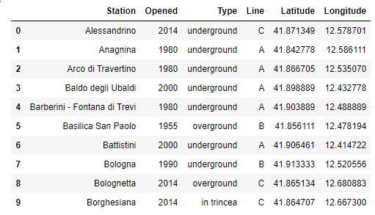

Slide 5
Foursquare API to explore venue types surrounding each station. Foursquare outlines these high-level venue categories with more sub-categories:
Arts & Entertainment (4d4b7104d754a06370d81259)
College & University (4d4b7105d754a06372d81259)
Event (4d4b7105d754a06373d81259)
Food (4d4b7105d754a06374d81259)
Nightlife Spot (4d4b7105d754a06376d81259)
Outdoors & Recreation (4d4b7105d754a06377d81259)
Professional & Other Places (4d4b7105d754a06375d81259)
Residence (4e67e38e036454776db1fb3a)
Shop & Service (4d4b7105d754a06378d81259)
Travel & Transport (4d4b7105d754a06379d81259)

Slide 6

Methodology
Before we start to a specific analysis, lets visualize our data and get some basic knowledge about it. Using Folium we build the map of Rome with metro stations on it, the center of the map we choose the location of Barberini - Fontana di Trevi. This is very nice picture of it, because usually it is crowded with tourists.

Slide 7
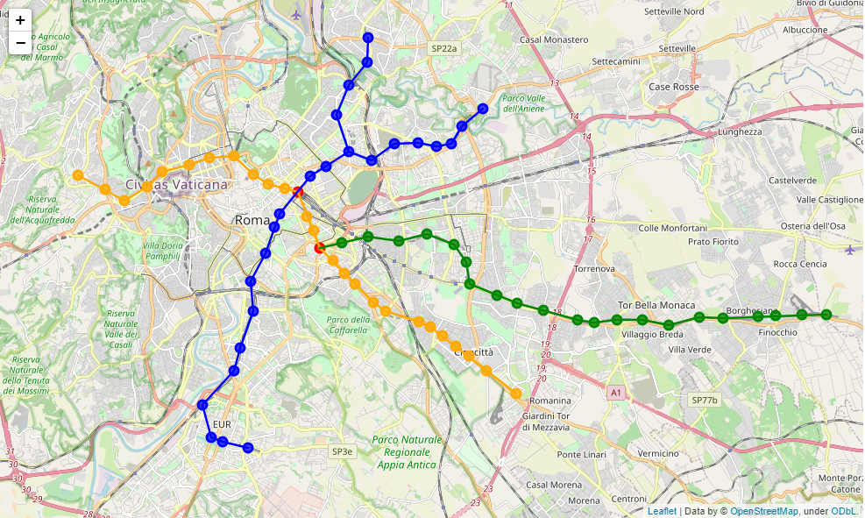
Rome metro map

Slide 8
First, we use Foursquare API to get venues by categories for each station. The list of categories we can get using API call or hard coded them. As discussed above we select radius equal to 1000 meters. The API call straight forward and well documented on the official website. It returns the necessary data for us, which is total number of venues by a specific category. We need to parse JSON and extract this value and update our dataframe.

Slide 9
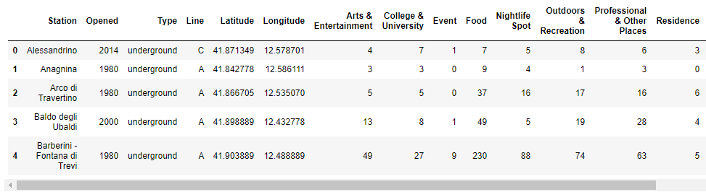

Slide 10
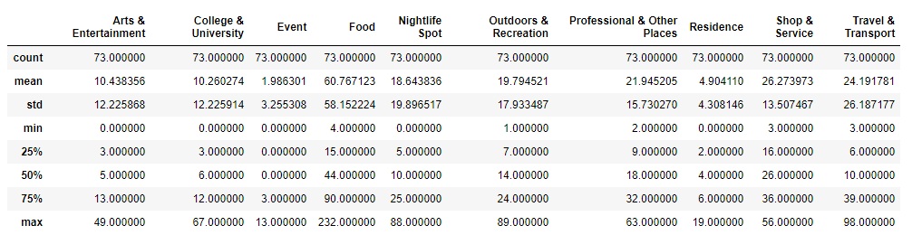
Let’s analyze data with describe method

Slide 11
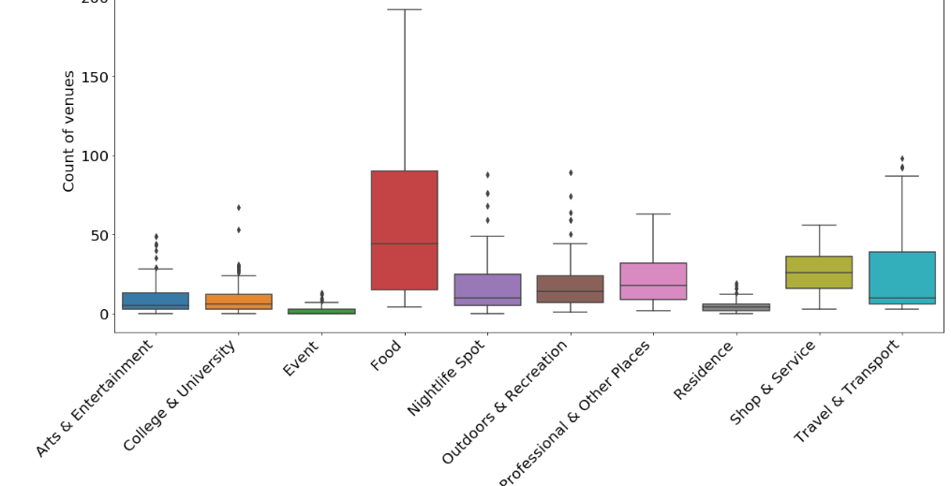

Slide 12
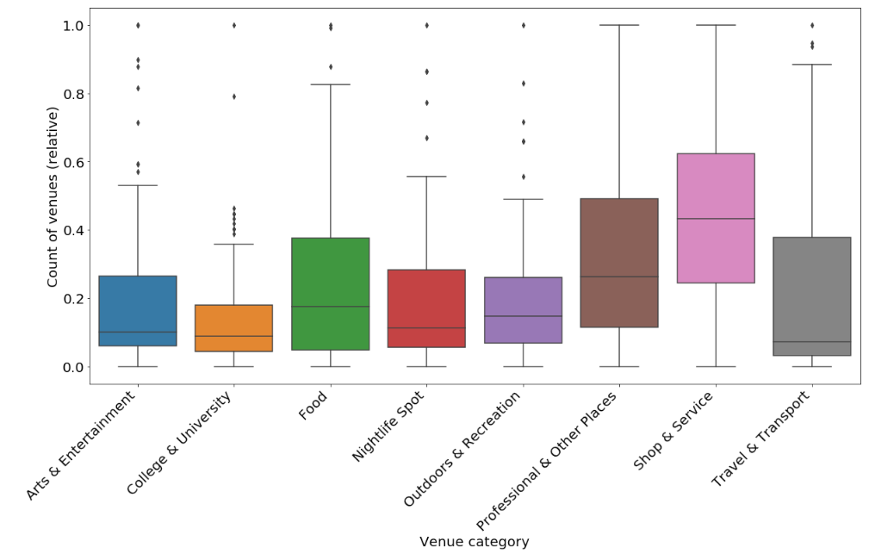
Normalize data

Slide 13
Clustering
How many clusters to select?

Slide 14
The Elbow method. The method consists of plotting the explained variation as a function of the number of clusters, and picking the elbow of the curve as the number of clusters to use. The same method can be used to choose the number of parameters in other data-driven models, such as the number of principal components to describe a data set.

Slide 15
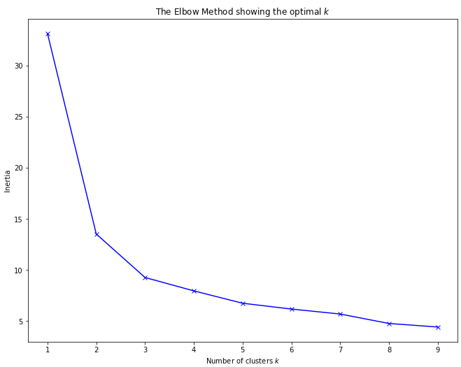
So, optimal number of clusters based on 'Elbow method' is 3 for our dataframe. Note that, the elbow method is sometimes ambiguous.

Slide 16
The Silhouette method. An alternative is the average silhouette method (Kaufman and Rousseeuw, 1990) which can be also used with any clustering approach. Let's try to use different approach to find optimal number of clusters – Silhouette method. The Silhouette Score reaches its global maximum at the optimal k.

Slide 17
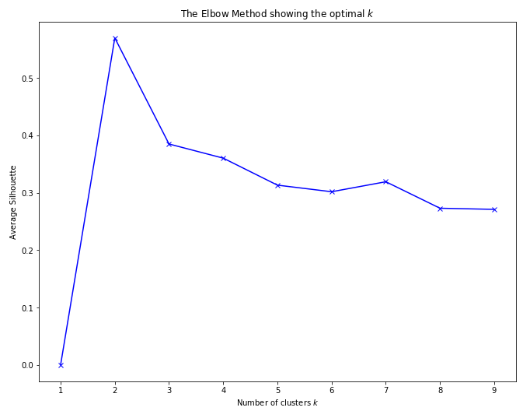
The Silhouette method shows, that 2 is optimal choice for number of clusters. However observation and analysis showed that 2 is not enough, so we are going to use value – 3.

Slide 18
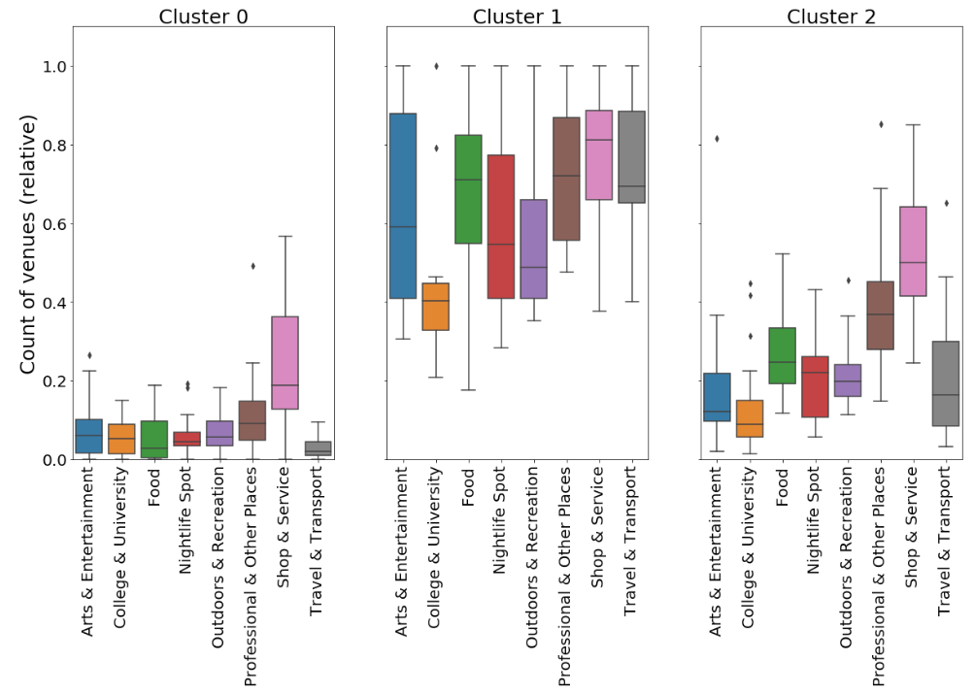

Slide 19
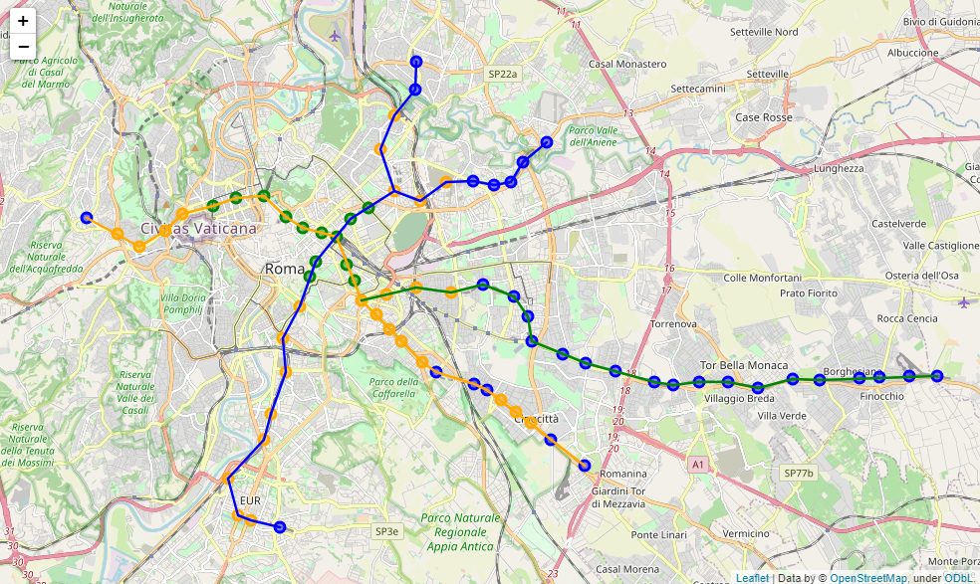

Slide 20
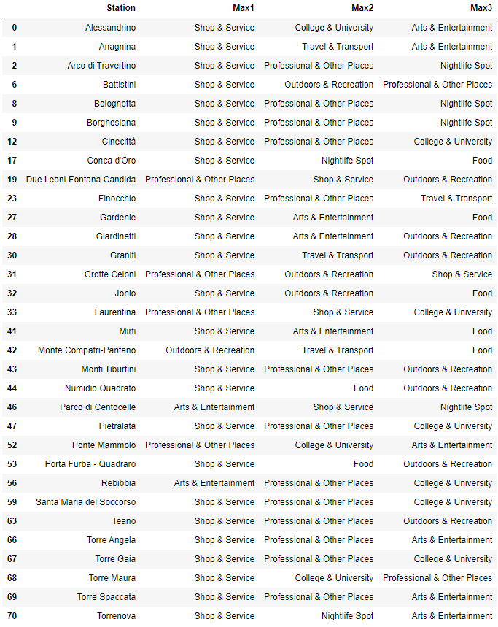
Cluster 0

Slide 21
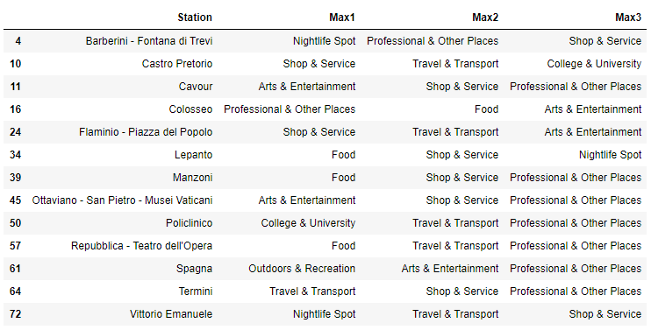
Cluster 1

Slide 22
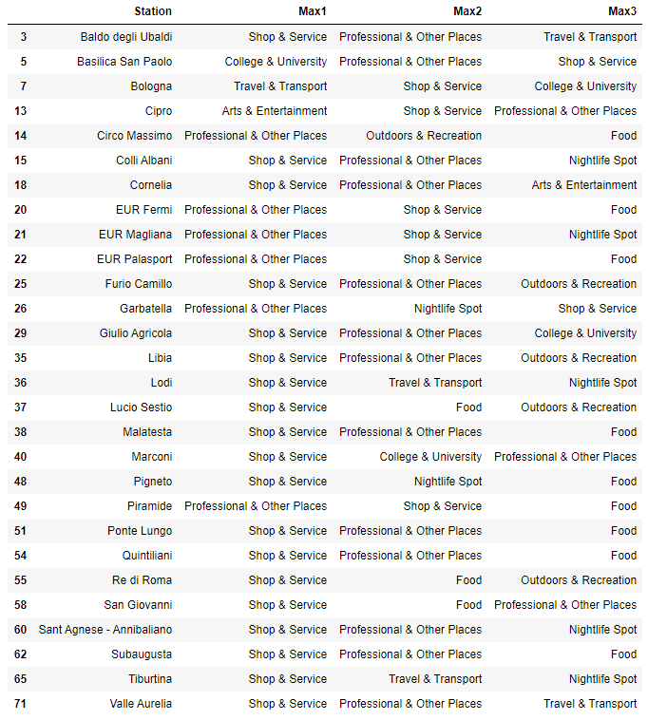
Cluster 2

Slide 23
Results
Cluster 1 is a historical and touristic part of the city. Cluster 0 is mainly residential area, and cluster 2 is borderline between cluster 0 and cluster 1.
Cluster 0 has many venues in category Shop & Service.
Cluster 1 has a mix of venues in different categories.
Cluster 2 is very similar to cluster 0, it has many venues in category Shop & Service.
Let’s create data sets for each cluster and show the top 3 categories for each station.
So, basically, we can have just two clusters, as silhouette method showed us. However I used 3 clusters, because with 2 clusters stations close to Vatican clustered incorrectly (they should be clustered as a historical part of the city).
Everything important for foreigner/tourist is located in the cluster 1.

Slide 24
Conclusion
Due to limitations of free data of Foursquare API we can study only basic information about the city. It can be interesting to study city based on attendance of public places and their price range. In this case we can find expensive and cheap places, compare price and attendance relationship. Also it could be interesting to have monthly statistical data of using each metro station. This information would help in the future development of the metro system in Rome.

Slide 25
Reference
Glickman, Mark, and Pavlos Protopapas. “CS109B Data Science 2: Advanced Topics in Data Science.” CS109B - Lab 7: Clustering, 2019, harvard-iacs.github.io/2019-CS109B/labs/lab7/solutions/.
Godfrey, Kate, et al. “Determining The Optimal Number Of Clusters: 3 Must Know Methods.” Datanovia, 21 Oct. 2018, www.datanovia.com/en/lessons/determining-the-optimal-number-of-clusters-3-must-know-methods/.
“Stazioni Della Metropolitana Di Roma.” Wikipedia, Wikimedia Foundation, 6 Jan. 2020, it.wikipedia.org/wiki/Stazioni_della_metropolitana_di_Roma.
Rogozhin, Stanislav. “Classification of Moscow Metro Stations Using Foursquare Data.” Medium, Towards Data Science, 24 June 2019, towardsdatascience.com/classification-of-moscow-metro-stations-using-foursquare-data-fb8aad3e0e4.

