Slide 1


STATE URBAN DEVELOPMENT AUTHORITY
Proudly Announces
THE LAUNCH OF ONLINE
WATER CONNECTION MANAGEMENT SYSTEM

Slide 2


Presentation Overview
Corporate profile
Solution architecture and presentation

Slide 3
Sparrow Softech Pvt. Ltd.
Survey, Assessment, collection and recovery of major
sources of revenue for Urban Local Bodies of Jharkhand

Slide 4
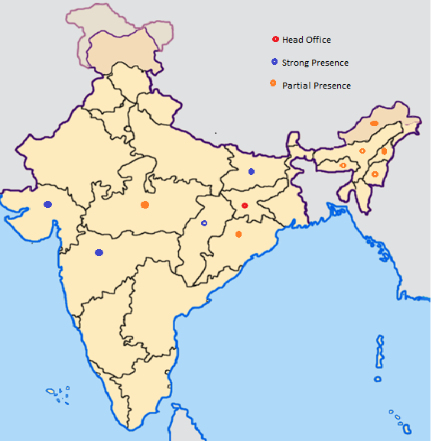
Our Presence
Company Profile
Founded in 2005 Head Quartered in Ranchi (India)
Operations in whole of North, East, West and Central India
3200 + Employees Strength
FY 15-16 Revenue Guidance: INR 20 Crore, AGR- 240%
Preferred partner of several Government and Public organizations

Slide 5

SUDA,S Water Board is now Online!
Apply for new Connection/Regularization through online/Jan Suvidha
Kendra/Pragya Kendra/Tab carried by Meter Reader cum Collection Agent
Check & Pay your water user charges online/Payment of dues through online/Jan
Suvidha Kendra/Pragya Kendra/Tab carried by Meter Reader cum Collection
Agent
Pay your water user charges bill at your doorstep through Meter Reader cum
Collection Agent
Get your Payment/Dues alert on your mobile phone

Slide 6
GENERAL INSTRUCTION
Bring holding tax receipt/Id proof & address proof for new connection .
Pay advance “Water Connection Fee”.
Bills will be raised on fixed rate(if connection is non - metered)/unit charges(if connection is metered).
Arrears can be paid in installment .
Pay within 15 days of billing else 2% interest will be charged

Slide 7
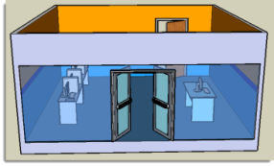

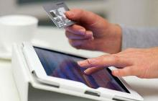
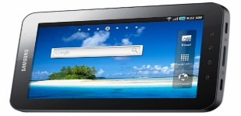


Work-flow of the system
At Jan Suvidha Kendra
Online Payment
Hand Held devices through our collectors
Server
Internet Service Provider

Slide 8
ADVANTAGES
No more ambiguity in the details of holdings information, water user charges or its
payments
No more waiting or standing in queue to get information of water user charges
information and its payment.
Better redressal of grievances related to new water connection/ regularization, water
user charges and others.

Slide 9
SOFTWARE AT A GLANCE

