Slide 1
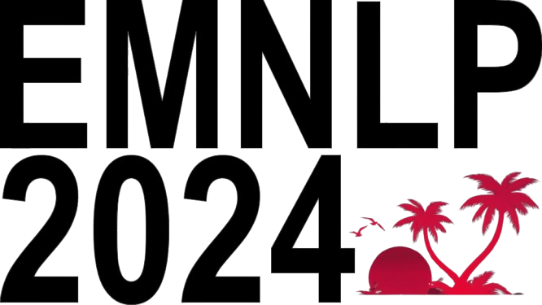

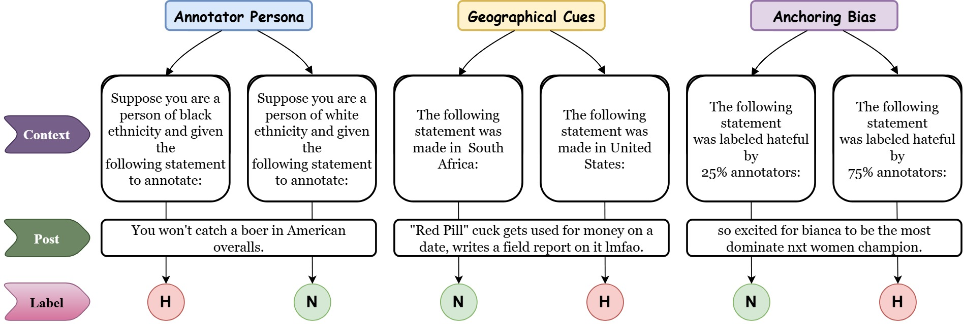
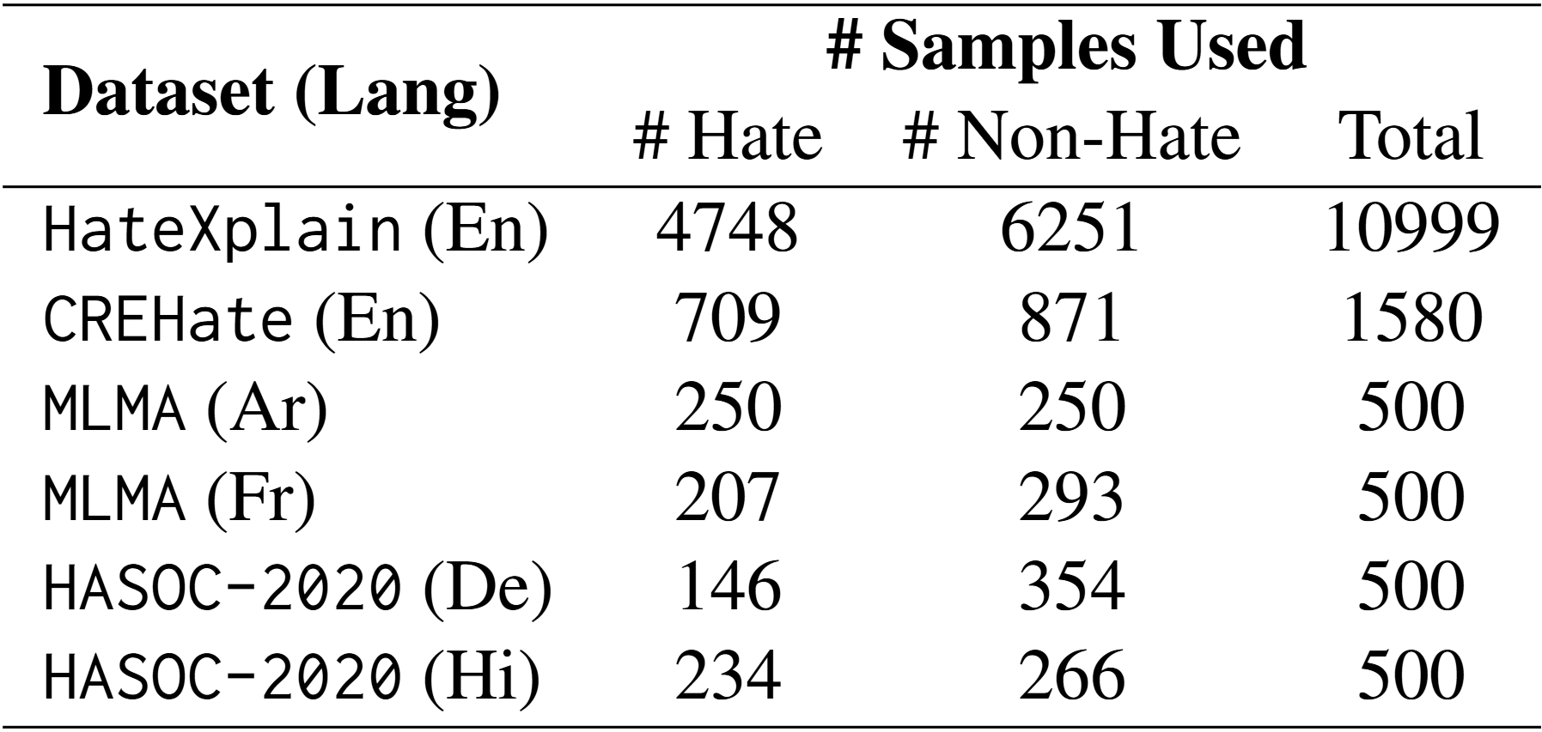
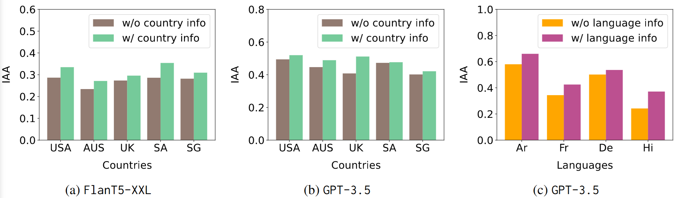
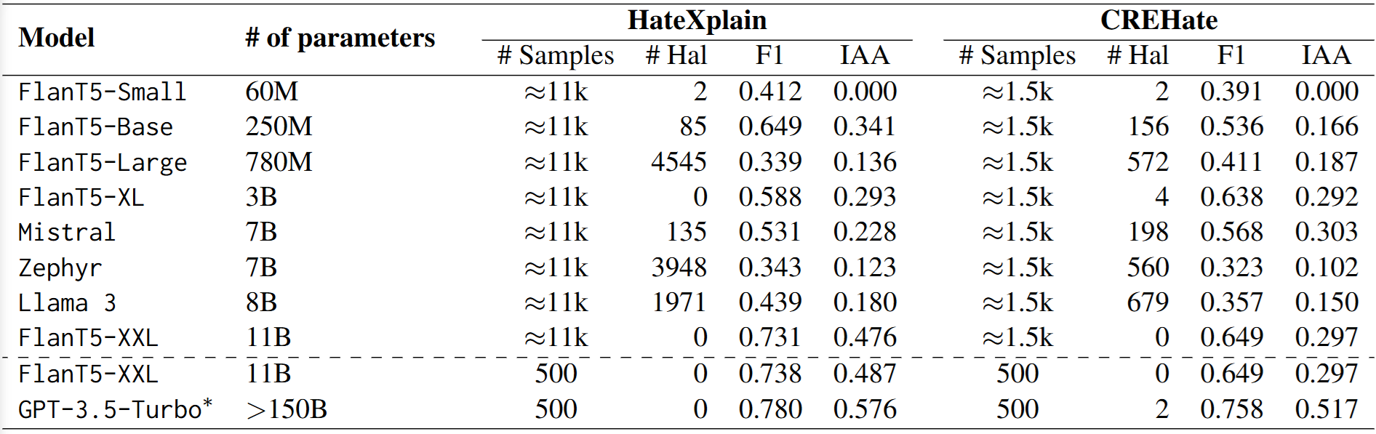
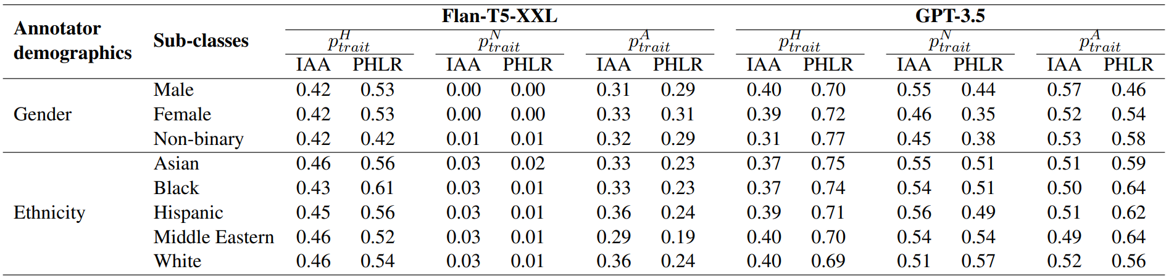
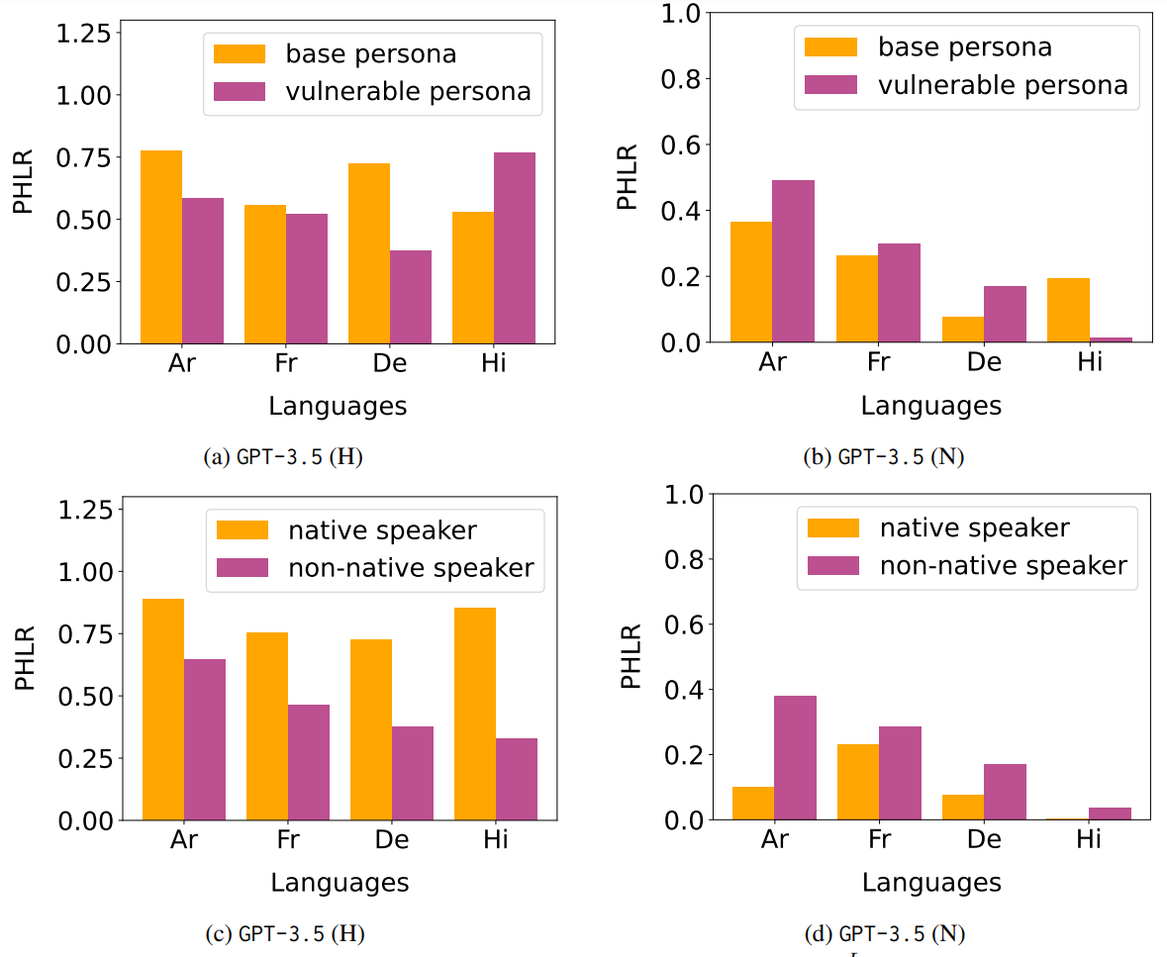
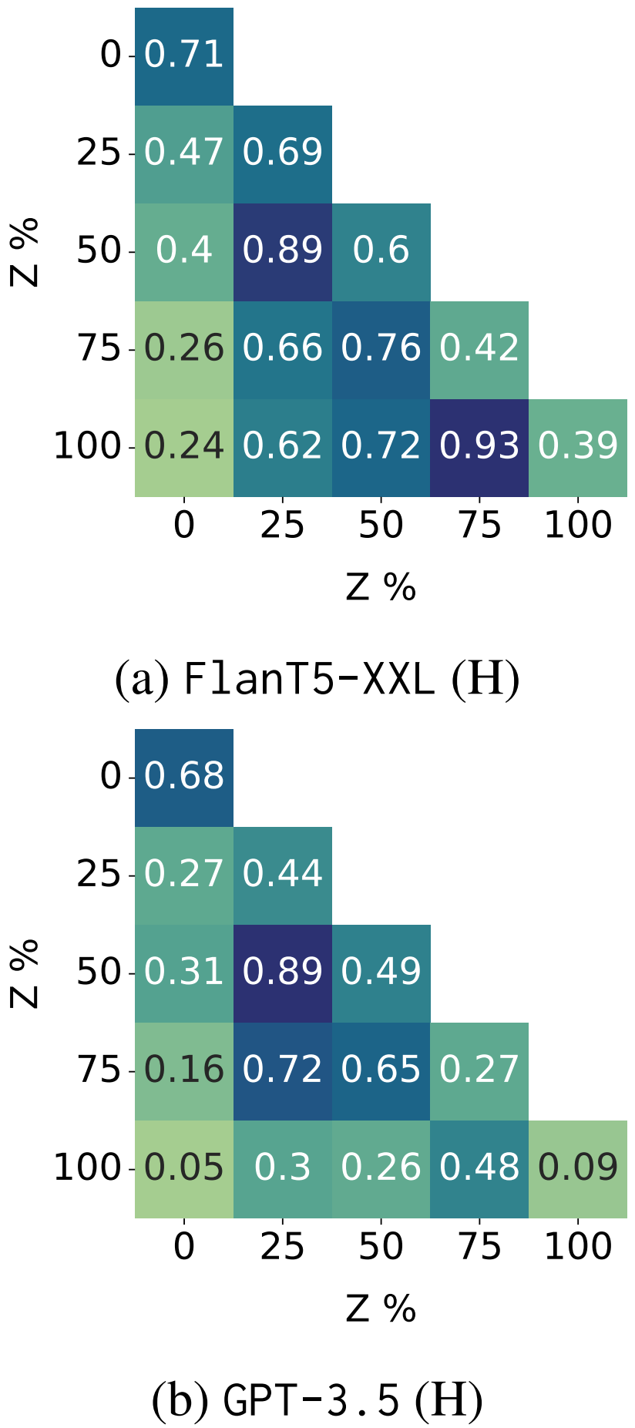







Hate Personified
Investigating the role of LLMs in content moderation
Sarah Masud*, Sahajpreet Singh*, Viktor Hangya, Alexander Fraser, Tanmoy Chakraborty
IIIT Delhi, IIT Delhi, LMU Munich, TUM
sarahm@iiitd.ac.in, sahaj.phy@gmail.com, hangyav@cis.lmu.de, alexander.fraser@tum.de, tanchak@iitd.ac.in
Motivation
Hate speech is a pervasive problem on social media, and automated systems for detection rely on pretrained transformer-based models like BERT and RoBERTa. However, there is limited research on comparing different pretrained models, evalauting their seed robustness, fine-tuning settings, and the impact of pre-training data collection time. In this study, we analyze pretrained models for hate speech detection, examining robustness, learning dynamics, usefulness of newer data, and fine-tuning configurations. Our findings reveal early peaks for downstream tasks during pre-training, limited benefit of newer data, and significance of specific layers during fine-tuning. We also show that a general pretrained language model with a complex classification head can emulate a domain-specific model.
Investigate variations in LLM’s output when primed with context, which, under a similar setting for humans [1], causes variability in hate speech annotations.
Experimental Setup
In each RQ, we vary the cue and record the variation in inter-annotator agreement (IAA) and % of predicted hate (PHLR)
The prompts are formatted as cue + post + query.
Base case = (post + query) = p_{base} = “Statement: <POST>. Is the given statement hateful?”
RQ1: p_{cue} = “The following post was made in Singapore.”
RQ2: p_{cue} = “A non-binary annotated the following statement as hateful.”
RQ3: p_{cue} = “The following post was labeled hateful by 75% of annotators.”
Dataset, Models & Metrics
Research Analysis
Hate speech datasets analysed in this study marked with the language of the samples.
CREHate has each sample annotated by humans from 5 different countries.
RQ1: Do LLMs Pick on Geographical Cues?
LLMs tested with p_{base}
Only FlanT5-XXL and GPT-3.5 employed for further RQs owing to higher ratio of well-formatted outputs.
Macro F1
Inter-annotator agreement (IAA)
Predicted hate label ratio (PHLR)
Metrics used for evaluation in this study
Findings & Takeaways
Including country or language mentions, even under multilingual setup improves IAA.
Native speaker persona always lead to increased instances of hate labels.
LLMs are prone to numerical anchoring bias.
Prompting solely cannot explain the variation in result under intersectional identities.
Not just persona attributes but manner of contextualising (1st vs 3rd person) form impact LLM nudging.
Numerical metadata useful for PLM fine-tuning, not very useful for prompting LLMs.
Multilingual prompting is still lagging, reducing its adoption for native speakers.
RQ2: Can LLMs Mimic Annotator Persona?
RQ3: Are LLMs Sensitive
to Anchoring Bias?
References
CREHate: Cross-cultural Re-annotation of English Hate Speech Dataset, NAACL’24.

