Slide 1
PROJECT PHASE 1 / AI&DS
LuNaVision AI
An Intelligent Multi-Agent Pipeline for Automated Exoplanet Discovery from TESS Observations
PROJECT GUIDE
• Dr. S. Sasikala • Mrs. M. Bhavadharini
TEAM MEMBERS
• B R Prasanna • M Sandeep • S Gokul
LUNAVISION AI | PROJECT PHASE 1 / AI&DS
01

Slide 2
PRESENTATION OUTLINE
Agenda
01
Abstract
08
Architecture Diagram
02
Objectives
09
Module 1 — Orchestrator Agent
03
Scope of the Project
10
Module 2 — Data Acquisition Agent
04
Existing System
11
Modules 3 & 4 — Preprocessing & Transit Detection Agents
05
Proposed System
12
Module 5 — Feature Engineering Agent (GPU)
06
Literature Survey
13
Module 6 — Classification Agent
07
Modules and Methodologies
LUNAVISION AI | PROJECT PHASE 1 / AI&DS
02

Slide 3
LUNAVISION AI
Abstract
The discovery of exoplanets has become a rapidly growing field in modern astronomy, providing valuable insights into planetary systems beyond our solar system. Space missions such as NASA's Transiting Exoplanet Survey Satellite (TESS) generate vast amounts of stellar light curve data, making manual analysis increasingly difficult. To address this challenge, researchers have applied various Machine Learning (ML) and Deep Learning (DL) techniques, including Random Forest, Support Vector Machine (SVM), Convolutional Neural Networks (CNN), Long Short-Term Memory (LSTM), and Transformer-based models, to identify planetary transit signals and distinguish them from noise and false positives. While these approaches have achieved promising results, they are typically designed for individual stages of the detection process and often require manual intervention for preprocessing, validation, and interpretation. This project proposes LuNaVision AI: An Intelligent Multi-Agent Pipeline for Automated Exoplanet Discovery from TESS Observations, a collaborative AI framework that automates the complete exoplanet detection workflow. The proposed system employs specialized AI agents for astronomical data acquisition, light curve preprocessing, noise reduction, transit detection, exoplanet classification, orbital parameter estimation, explainable decision-making, and automated scientific report generation. By integrating Multi-Agent Systems, Large Language Models (LLMs), Explainable Artificial Intelligence (XAI), Machine Learning, Deep Learning, and time-series analysis, LuNaVision AI provides a scalable, interpretable, and intelligent solution for processing noisy astronomical datasets. The framework aims to improve detection accuracy, reduce false positives, minimize manual effort, and accelerate exoplanet discovery through an autonomous and efficient scientific analysis pipeline.
Multi-Agent Systems
Large Language Models (LLMs)
Explainable Artificial Intelligence (XAI)
Machine Learning
Deep Learning
Time-series analysis
LUNAVISION AI | PROJECT PHASE 1 / AI&DS
03

Slide 4
LUNAVISION AI
Objectives
To develop an AI-based multi-agent framework for automated exoplanet discovery.
To automate TESS data acquisition and preprocessing.
To reduce noise in stellar light curves.
01
02
03
To detect potential planetary transit signals.
To classify exoplanet candidates and false positives.
To estimate orbital parameters.
04
05
06
To provide Explainable AI (XAI) for decisions.
To generate automated scientific reports.
To reduce manual effort and improve scalability.
07
08
09
LUNAVISION AI | PROJECT PHASE 1 / AI&DS
04

Slide 5
SCOPE OF THE PROJECT
Where It Is Used
Astronomical Research – Assist astronomers in analysing TESS observations.
01
Exoplanet Discovery – Identify potential planets from stellar light curves.
02
Space Missions – Support analysis of large-scale TESS datasets.
03
Planetary System Studies – Assist in studying planets beyond our Solar System.
04
Scientific Data Analysis – Automate processing of large and noisy astronomical datasets.
05
LUNAVISION AI | PROJECT PHASE 1 / AI&DS
05

Slide 6
SCOPE OF THE PROJECT
Benefits
01
Automates the exoplanet detection workflow.
One-line Scope
1
02
Reduces manual effort in data analysis.
LuNaVision AI can be used as an intelligent assistance system for astronomers and space-research applications to automatically analyse TESS observations and identify potential exoplanet candidates.
03
Reduces false positives during candidate identification.
04
Handles large datasets efficiently.
05
Improves interpretability using XAI.
06
Generates automated scientific reports.
07
Accelerates exoplanet discovery.
LUNAVISION AI | PROJECT PHASE 1 / AI&DS
06

Slide 7
EXISTING SYSTEM
A CNN-Based Ensemble Model for Exoplanet Detection
EXISTING APPROACH
LIMITATIONS
Uses stellar flux (light intensity) for exoplanet detection.
Applies multiple Machine Learning and Deep Learning models.
Uses CNN-based ensemble learning for classification.
Evaluates models using Accuracy, Precision, Sensitivity and Specificity.
The proposed Ensemble-CNN achieved 99.62% accuracy in the study.
Mainly focuses on exoplanet classification.
Does not provide a complete automated end-to-end discovery pipeline.
Does not cover all stages such as data acquisition, orbital parameter estimation, XAI and automated scientific reporting.
EXISTING SYSTEM WORKFLOW
Stellar Light Intensity
Data Processing
ML/DL Models
Ensemble-CNN
Exoplanet Classification
Need for an automated, scalable, and interpretable end-to-end exoplanet discovery pipeline.
PROBLEM
LUNAVISION AI | PROJECT PHASE 1 / AI&DS
07

Slide 8
PROPOSED SYSTEM
LuNaVision AI
An intelligent multi-agent pipeline that automates the complete exoplanet discovery workflow.
WORKFLOW
01
02
03
04
05
06
07
TESS Data
Preprocessing & Noise Reduction
Transit Detection
Exoplanet Classification
Orbital Parameter Estimation
XAI Interpretation
Scientific Report
LUNAVISION AI | PROJECT PHASE 1 / AI&DS
08

Slide 9
PROPOSED SYSTEM
Key Technologies & Advantages
KEY TECHNOLOGIES
ADVANTAGES
Multi-Agent Systems
End-to-end automation
01
01
ML & Deep Learning
Reduced manual effort
02
02
LLMs
Fewer false positives
03
03
XAI
Scalable & interpretable
04
04
Time-Series Analysis
05
LUNAVISION AI | PROJECT PHASE 1 / AI&DS
09

Slide 10
LITERATURE SURVEY — PART 1 OF 2
Review of Prior Work
S.No | Title | Authors | Journal Name | Year | Methodology Used | Pros and Cons
1 | Exoplanet Imaging via Differentiable Rendering | Brandon Y. Feng, Rodrigo Ferrer-Chávez, Aviad Levis, William T. Freeman, Jason J. Wang | International Journal of Data Science and Analytics (Springer) | 2025 | Differentiable Rendering | Pros: Better contrast; improves faint-planet detection; uses wavefront data. Cons: High complexity; simulation-based; depends on wavefront data.
2 | Feature extraction for exoplanet detection | Pimentel J, Amorim J, Rudzicz | International Journal of Data Science and Analytics (Springer) | 2024 | Feature Extraction | Pros: Uses multiple feature domains; strong classification performance; reduces dataset bias through cross-validation. Cons: Depends on preprocessing; requires feature engineering; feature importance needs further analysis.
3 | Light intensity of stars for exoplanet detection | Jara-Maldonado, M. et al | IEEE Region 10 Symposium (TENSYMP) | 2022 | KNN + SMOTE | Pros: High accuracy; handles class imbalance; works with limited observations. Cons: Limited dataset; performance decreases with less data; mainly classification-focused.
4 | Identifying Exoplanets with Deep Learning IV: Removing stellar activity signals from RV data using neural networks | de Beurs Z.L. et al | The Astronomical Journal (IOP / AAS) | 2022 | Neural Networks + Linear Regression | Pros: Removes stellar activity signals; improves RV quality; validated with real observations. Cons: Requires spectral information; generalization needs further testing; RV-focused.
LUNAVISION AI | PROJECT PHASE 1 / AI&DS
10

Slide 11
LITERATURE SURVEY — PART 2 OF 2
Review of Prior Work
S.No | Title | Authors | Journal Name | Year | Methodology Used | Pros and Cons
5 | A CNN-based ensemble model for exoplanet detection. | Priyadarshini I, Puri V | Earth Science Informatics (Springer) | 2021 | Ensemble-CNN | Pros: High detection accuracy; improves model performance; combines multiple models. Cons: Higher complexity; increased computational cost; mainly classification-focused.
6 | Scientific domain knowledge & deep learning | Ansdell, M. et al | The Astrophysical Journal Letters (IOP / AAS) | 2018 | Domain-Informed DL | Pros: Improves accuracy and recall; better detection of low-SNR transits; supports smaller models. Cons: Needs additional input data; requires centroid information; risk of overfitting.
7 | Discovering new worlds: signal processing methods for RV exoplanet detection. IEEE Signal Process | Khan, M.S., Jenkins, J., Yoma, N.B | IEEE Signal Processing Magazine (Vol. 34, pp.104–115) | 2017 | Signal Processing | Pros: Improves signal-to-noise ratio; provides statistical methods; useful for weak signals. Cons: Mainly RV-focused; relies on signal-processing techniques; not an automated AI pipeline.
8 | Exoplanet detection methods | Wright, J.T., Gaudi, B.S | Book chapter — Planets, Stars and Stellar Systems, Vol. 3 (Springer Netherlands); also on arXiv (2012) | 2012 | Detection Methods Review | Pros: Covers major detection methods; explains detection requirements; compares method sensitivity. Cons: Broad review; less focus on AI/ML; does not provide a new detection model.
LUNAVISION AI | PROJECT PHASE 1 / AI&DS
11

Slide 12
MODULES AND METHODOLOGIES
Modules
9 AGENTS
01
Orchestrator Agent
02
Data Acquisition Agent
03
Preprocessing Agent
Coordinates every stage and logs the full pipeline run.
Downloads TESS FITS light curves and reference catalogs.
Cleans, normalizes and detrends every light curve.
04
Transit Detection Agent
05
Feature Engineering Agent (GPU)
06
Classification Agent
Runs a BLS / TLS search to find repeating dip signals.
Extracts 35+ features using CuPy / PyTorch acceleration.
Ensemble ML model assigns a calibrated planet probability.
07
Parameter Fitting Agent
08
Active Learning Agent
09
Reporting Agent
Estimates orbital parameters via batman + emcee MCMC.
Sends unsure candidates to a human and retrains on new labels.
Generates plots, the candidate catalog and the final report.
LUNAVISION AI | PROJECT PHASE 1 / AI&DS
12

Slide 13
MODULES AND METHODOLOGIES
Methodology
TESS Data
Acquire
Preprocess & Detrend
BLS/TLS Detect
01
02
03
04
Visualize & Report
MCMC Parameter Fit
Ensemble Classify
GPU Feature Extraction
08
07
06
05
Active Learning feeds unsure cases back into training
FEEDBACK LOOP
LUNAVISION AI | PROJECT PHASE 1 / AI&DS
13

Slide 14
ARCHITECTURE DIAGRAM
LuNaVision AI — Multi-Agent Architecture
ORCHESTRATOR AGENT — dispatches work, retries failures, enforces sequencing, logs every stage of the run
DATA SOURCES
0
Setup & Data Ingestion
1
Preprocessing & Detection
2
Feature Engineering
NASA MAST / TESS Archive
ExoFOP-TESS TOI Catalog
NASA Exoplanet Archive
TESS SPOC TCE + TIC Catalog
MAST + Catalogs: astroquery pulls FITS, TOI, TCE & TIC data
FITS Parsing: astropy extracts time, flux, quality flags
Synthetic Injection: batman injects transits to boost rare class
Clean & Detrend: 3σ sigma-clip → wotan biweight (0.75d)
Quality Gate: drop <13.5 days or noisy (>5σ) targets
Period Search: BLS/TLS scan finds repeating dips
35+ Features: geometry, shape, odd/even, stellar, stats
GPU Kernels: CuPy + PyTorch, auto CPU fallback
Anti-Hang Guard: timeouts, RAM checks, checkpointing
OUTPUT: Raw Light Curves + Manifest
OUTPUT: Candidate List (period, depth, SDE)
OUTPUT: Feature Matrix (X) + Labels (y)
3
Ensemble ML Classifier
4
Orbital Parameter Fitting
5
Visualization & Report
6
Enhanced Analysis (Bonus)
Balance Classes: SMOTE fixes rare-planet imbalance
Stacked Ensemble: Random Forest + XGBoost + Extra Trees
Calibrate + Explain: Platt scaling; SHAP confirms real signal
Transit Model: batman builds the physics-based light curve
MCMC Sampling: emcee: 32 walkers × 1000 steps
Credible Intervals: 16/50/84th percentiles; least-sq. fallback
7 Diagnostic Plots: raw/detrended LC, periodogram, phase-fold…
Model Diagnostics: confusion matrix, PR curves, calibration
Auto PDF Report: Jinja2 fills a 3-page per-candidate report
Centroid Analysis: confirms dip is on-target, not a blend
Injection–Recovery: measures true detection sensitivity
Active Learning: routes <65% confidence cases to a human
OUTPUT: Planet Probability + Class (target F1 ≥ 90%)
OUTPUT: Physical Parameters + 95% Credible Intervals
OUTPUT: Plots + Ranked Catalog + PDF Report
OUTPUT: Robustness Metrics + Retraining Feedback
Active Learning feedback retrains Stage 3
LUNAVISION AI | PROJECT PHASE 1 / AI&DS
14

Slide 15
EXOPLANET DETECTION PIPELINE — PIPELINE COORDINATION
Module 1 — Orchestrator Agent
Objective: Coordinates every stage and logs the full pipeline run.
Work Dispatch Dispatches work to the agent responsible for each stage of the pipeline.
STAGE FLOW
01
01
Pipeline Run Request
02
Stage Sequencing Enforces sequencing: acquire, preprocess, features, train, fit and report always run in pipeline order.
02
Dispatch Stage to Its Agent
03
Failure Handling Retries failures; a stage that still cannot complete stops the run and is named in the log.
Resume from Disk Each stage resumes from what is already saved, so an interrupted run continues instead of restarting.
03
Retry or Stop on Failure
04
05
Run Logging Logs every stage of the run with its duration and a one-line summary of what it produced.
04
Log Stage & Move On
06
Two Run Modes Batch mode chains the stages over many targets; single-target mode takes one star end to end.
05
Completed Run + Run Log
LUNAVISION AI | PROJECT PHASE 1 / AI&DS
15

Slide 16
EXOPLANET DETECTION PIPELINE — PIPELINE COORDINATION
Module 1 — Visual Explanation & Output
One orchestrator, eight worker agents
OUTPUT
Stages completed in the correct order
Data Acquisition
Preprocessing
Transit Detection
Feature Engineering (GPU)
01
02
03
04
05
Full pipeline run log (stage, time, summary)
02
ORCHESTRATOR AGENT
dispatches work · enforces sequencing · retries failures · logs every stage
Progress updates for each stage
03
Classification
Parameter Fitting
Active Learning
Reporting
06
07
08
09
STAGE FLOW
Pipeline Run Request → Dispatch Stage to Its Agent → Retry or Stop on Failure → Log Stage & Move On → Completed Run + Run Log
Illustration of: Work Dispatch, Stage Sequencing, Failure Handling, Resume from Disk, Run Logging, Two Run Modes.
Schematic drawn for explanation only; it is not measured pipeline output.
LUNAVISION AI | PROJECT PHASE 1 / AI&DS
16

Slide 17
EXOPLANET DETECTION PIPELINE — DATA ACQUISITION & SETUP
Module 2 — Data Acquisition Agent
Objective: Automatically fetch raw star-brightness data from NASA's TESS satellite and get it ready for analysis.
MAST Archive Queries astroquery searches NASA's MAST archive for TESS light curves by sector, camera and CCD.
STAGE FLOW
01
MAST Archive & Reference Catalogs
01
02
Reference Catalog Downloads Auto-downloads and parses the ExoFOP TOI list, NASA Confirmed Planets table and the SPOC TCE catalog.
FITS Parsing astropy reads each FITS file to pull out time, PDCSAP flux and data-quality flags.
Download FITS Files (.fits)
03
02
04
Label Unification Messy disposition codes (PC, KP, CP, EB, BEB, FP, V) are mapped into 4 clean classes.
Parse Time · Flux · Quality Flags
03
05
Synthetic Transit Injection batman injects artificial planet dips into quiet light curves to boost the rare Transit class.
Parallel, Resumable Downloads A thread pool downloads many files at once and skips files already saved if a run is interrupted.
Light Curves + Manifest / EDA
06
04
LUNAVISION AI | PROJECT PHASE 1 / AI&DS
17

Slide 18
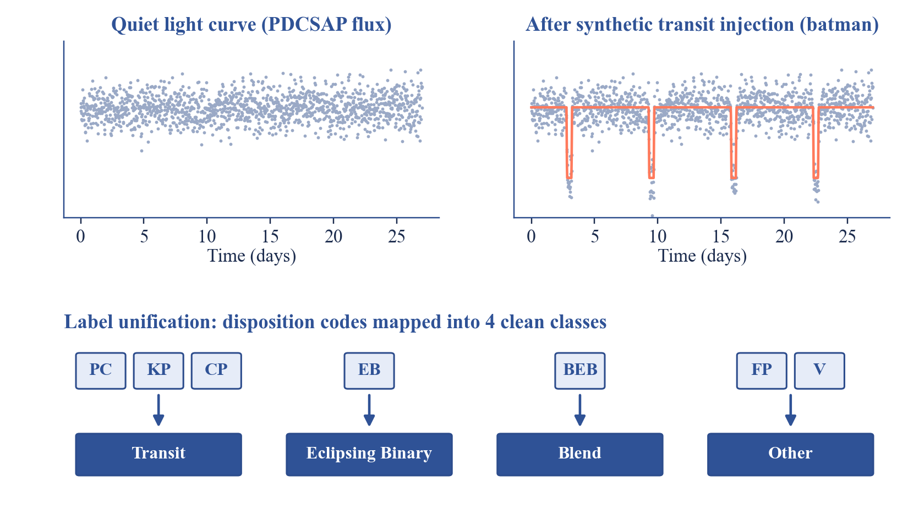
EXOPLANET DETECTION PIPELINE — DATA ACQUISITION & SETUP
Module 2 — Visual Explanation & Output
OUTPUT
Raw TESS light-curve .npz files
01
Unified label catalog & TIC stellar parameters
02
Download manifest + initial EDA results
03
STAGE FLOW
MAST Archive & Reference Catalogs → Download FITS Files (.fits) → Parse Time · Flux · Quality Flags → Light Curves + Manifest / EDA
Illustration of: MAST Archive Queries, Reference Catalog Downloads, FITS Parsing, Label Unification, Synthetic Transit Injection, Parallel, Resumable Downloads.
Schematic drawn for explanation only; it is not measured pipeline output.
LUNAVISION AI | PROJECT PHASE 1 / AI&DS
18

Slide 19
EXOPLANET DETECTION PIPELINE — PREPROCESSING & TRANSIT SEARCH
Modules 3 & 4 — Preprocessing & Transit Detection Agents
Objective: Clean up the noisy raw brightness readings and search for repeating dips that could be planets.
Normalization Every light curve is divided by its median flux so all stars sit on the same brightness scale.
STAGE FLOW
01
01
Raw PDCSAP Flux
02
Outlier Removal Iterative 3σ sigma-clipping, up to 5 passes, strips cosmic-ray hits and bad cadences.
02
Sigma-Clip 3σ × 5 passes
03
Gap Handling Small gaps (≤3 cadences) are filled by interpolation; longer gaps are flagged, not guessed.
Detrending A wotan bi-weight filter (0.75-day window) removes slow drift while keeping the transit dip intact.
03
Wotan Detrend (biweight, 0.75 d)
04
05
Quality Gating Targets with <13.5 days of data, or noise >5× the expected photon noise, are dropped automatically.
04
BLS / TLS Period Search
06
BLS / TLS Search A Box/Transit Least Squares scan tests thousands of trial periods to find the strongest repeating dip.
05
Candidate List (period, depth, SDE)
LUNAVISION AI | PROJECT PHASE 1 / AI&DS
19

Slide 20
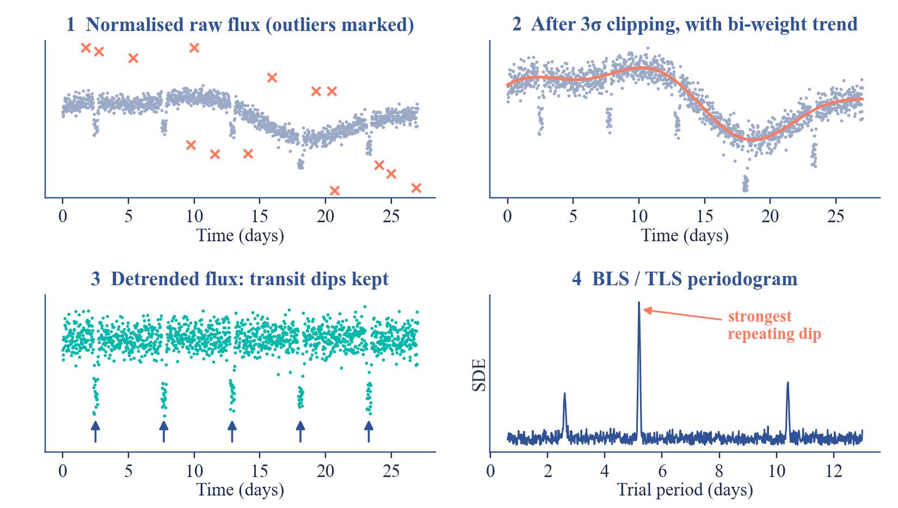
EXOPLANET DETECTION PIPELINE — PREPROCESSING & TRANSIT SEARCH
Modules 3 & 4 — Visual Explanation & Output
OUTPUT
Cleaned & detrended light curves
01
Candidate list (period, depth, duration)
02
BLS / TLS parameters (SDE, FAP)
03
STAGE FLOW
Raw PDCSAP Flux → Sigma-Clip 3σ × 5 passes → Wotan Detrend (biweight, 0.75 d) → BLS / TLS Period Search → Candidate List (period, depth, SDE)
Illustration of: Normalization, Outlier Removal, Gap Handling, Detrending, Quality Gating, BLS / TLS Search.
Schematic drawn for explanation only; it is not measured pipeline output.
LUNAVISION AI | PROJECT PHASE 1 / AI&DS
20

Slide 21
EXOPLANET DETECTION PIPELINE — FEATURE ENGINEERING (GPU-ACCELERATED)
Module 5 — Feature Engineering Agent (GPU)
Objective: Turn each candidate signal into a set of numbers a machine-learning model can actually learn from.
35+ Engineered Features Transit geometry, signal quality, shape, odd/even depth, secondary eclipse, centroid and stellar stats.
STAGE FLOW
01
Detrended Light Curve
01
GPU Acceleration Phase-folding, FFTs and statistics run on an NVIDIA GPU via CuPy and PyTorch, with automatic CPU fallback.
02
Phase-Fold Signal
02
Anti-Hang Safeguards Capped worker count, per-task timeouts and RAM monitoring stop one stuck light curve from freezing the run.
03
Batch Checkpointing Progress saves every batch, so a long feature-extraction job can resume instead of restarting.
GPU Kernels (CuPy + PyTorch)
04
03
Stellar Cross-Match Pulls Teff, log g, radius, mass and distance from the TIC catalog for astrophysical context.
35+ Feature Vector
05
04
LUNAVISION AI | PROJECT PHASE 1 / AI&DS
21

Slide 22
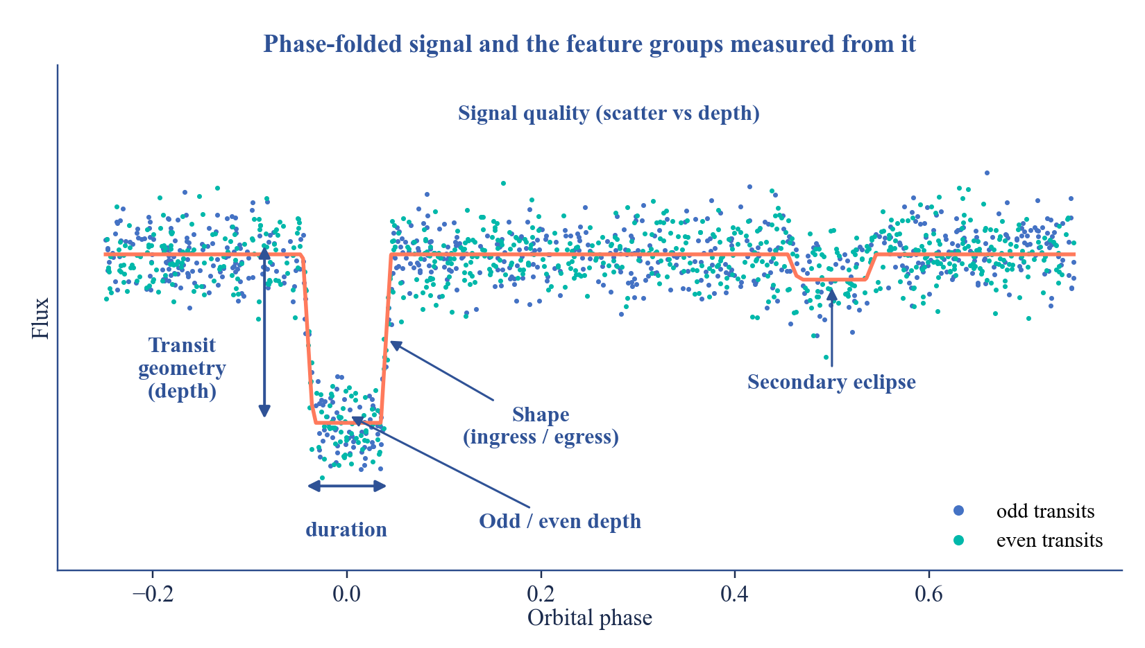
EXOPLANET DETECTION PIPELINE — FEATURE ENGINEERING (GPU-ACCELERATED)
Module 5 — Visual Explanation & Output
OUTPUT
feature_matrix.csv — one row per candidate
01
35+ columns, ready for machine learning
02
STAGE FLOW
Detrended Light Curve → Phase-Fold Signal → GPU Kernels (CuPy + PyTorch) → 35+ Feature Vector
Illustration of: 35+ Engineered Features, GPU Acceleration, Anti-Hang Safeguards, Batch Checkpointing, Stellar Cross-Match.
Schematic drawn for explanation only; it is not measured pipeline output.
LUNAVISION AI | PROJECT PHASE 1 / AI&DS
22

Slide 23
EXOPLANET DETECTION PIPELINE — ENSEMBLE MACHINE-LEARNING CLASSIFIER
Module 6 — Classification Agent
Objective: Let the model decide, on its own, whether a candidate signal is really a planet or something else.
Class Balancing SMOTE oversampling fixes the natural imbalance — real planets are rare next to false positives.
STAGE FLOW
01
Feature Matrix + SMOTE Balancing
01
02
Ensemble Models Random Forest, XGBoost and Extra Trees are trained together and combined via a stacked meta-learner.
Probability Calibration Platt scaling makes predicted probabilities trustworthy — a "0.9" really means ~90% confident.
Random Forest
XGBoost
Extra Trees
03
04
Explainability (SHAP) SHAP values confirm the model relies on physically meaningful features like depth and SDE, not noise.
Meta-Learner + Platt Calibration
05
05
Confidence Routing Predictions below 65% confidence are flagged for human review instead of being trusted blindly.
Planet Probability
06
Target: macro F1-score ≥ 90% on held-out test data
LUNAVISION AI | PROJECT PHASE 1 / AI&DS
23

Slide 24
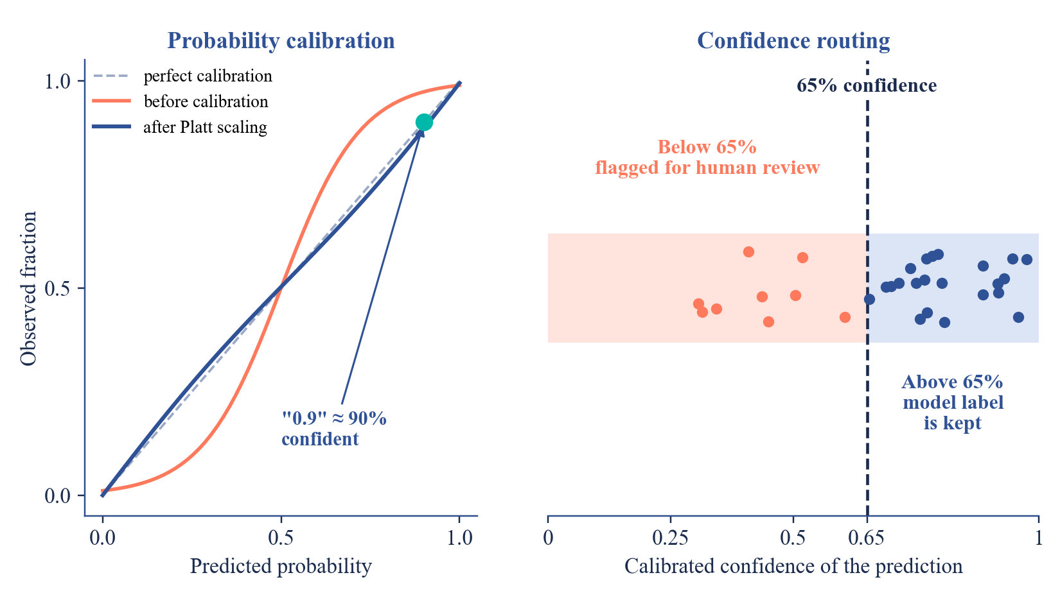
EXOPLANET DETECTION PIPELINE — ENSEMBLE MACHINE-LEARNING CLASSIFIER
Module 6 — Visual Explanation & Output
OUTPUT
Trained ML ensemble model
01
Calibrated planet probability per candidate
02
Planet / EB / Blend / Other class label
03
STAGE FLOW
Feature Matrix + SMOTE Balancing → Random Forest + XGBoost + Extra Trees → Meta-Learner + Platt Calibration → Planet Probability
Illustration of: Class Balancing, Ensemble Models, Probability Calibration, Explainability (SHAP), Confidence Routing.
Schematic drawn for explanation only; it is not measured pipeline output.
LUNAVISION AI | PROJECT PHASE 1 / AI&DS
24

Slide 25
LUNAVISION AI
Conclusion
End-to-End Automation LuNaVision AI automates exoplanet discovery from TESS data acquisition through to the scientific report.
NEXT PHASE
01
Parameter Fitting Agent
Orbital parameters via batman + emcee MCMC.
07
Multi-Agent Architecture Nine specialised agents, coordinated by an Orchestrator, keep the pipeline modular, resumable and scalable.
02
Active Learning Agent
Unsure candidates go to a human; the model retrains.
Robust Signal Detection Detrending, BLS / TLS search and 35+ GPU-accelerated features separate real transits from noise.
08
03
Reporting Agent
Plots, candidate catalog and the final report.
Reliable Classification A calibrated stacked ensemble of Random Forest, XGBoost and Extra Trees reduces false positives.
09
04
Explainable and Human-Guided SHAP explanations and confidence routing keep every decision interpretable and open to expert review.
KEY TAKEAWAY
05
An automated, scalable and interpretable path from raw TESS light curves to ranked planet candidates.
Phase 1 delivers Modules 1–6 — from orchestration to classification
LUNAVISION AI | PROJECT PHASE 1 / AI&DS
25

Slide 26
LUNAVISION AI
References
01
B. Y. Feng, R. Ferrer-Chávez, A. Levis, W. T. Freeman and J. J. Wang, “Exoplanet Imaging via Differentiable Rendering,” International Journal of Data Science and Analytics (Springer), 2025.
02
J. Pimentel, J. Amorim and F. Rudzicz, “Feature Extraction for Exoplanet Detection,” International Journal of Data Science and Analytics (Springer), 2024.
03
M. Jara-Maldonado et al., “Light Intensity of Stars for Exoplanet Detection,” IEEE Region 10 Symposium (TENSYMP), 2022.
04
Z. L. de Beurs et al., “Identifying Exoplanets with Deep Learning IV: Removing Stellar Activity Signals from RV Data Using Neural Networks,” The Astronomical Journal (IOP / AAS), 2022.
05
I. Priyadarshini and V. Puri, “A CNN-Based Ensemble Model for Exoplanet Detection,” Earth Science Informatics (Springer), 2021.
06
M. Ansdell et al., “Scientific Domain Knowledge Improves Exoplanet Transit Classification with Deep Learning,” The Astrophysical Journal Letters (IOP / AAS), 2018.
07
M. S. Khan, J. Jenkins and N. B. Yoma, “Discovering New Worlds: Signal Processing Methods for RV Exoplanet Detection,” IEEE Signal Processing Magazine, vol. 34, pp. 104–115, 2017.
08
J. T. Wright and B. S. Gaudi, “Exoplanet Detection Methods,” in Planets, Stars and Stellar Systems, vol. 3, Springer Netherlands, 2012.
LUNAVISION AI | PROJECT PHASE 1 / AI&DS
26

Slide 27
PROJECT PHASE 1 / AI&DS
Thank You
Questions and suggestions are welcome
PROJECT GUIDE
• Dr. S. Sasikala • Mrs. M. Bhavadharini
TEAM MEMBERS
• B R Prasanna • M Sandeep • S Gokul
LUNAVISION AI | PROJECT PHASE 1 / AI&DS
27

