Slide 1

PROJECT PHASE 1 / AI & DS
Sentinel AI
An Explainable AI Framework for Intelligent Phishing Detection and Cyber Risk Assessment
PROJECT GUIDE
Dr. M. Raghini
TEAM MEMBERS
Giritharan K • Krishna Kumar B • Santhosh Kumar TR
SENTINELAI | PROJECT PHASE 1 / AI&DS
01

Slide 2













INTERACTIVE NAVIGATION
Agenda
Abstract & Objectives
Problem statement and project goals
Scope of the Project
Who benefits from SentinelAI
Existing vs Proposed System
Gaps today and our solution
Literature Survey
9 reviewed research works
Modules & Methodology
8 core system modules
Proposed Results
What the system delivers
Architecture Diagram
End-to-end system design
Module 1 – Input & Feature Analysis
URL, QR, Email & SMS pipeline
Module 2 – ML Classifier
XGBoost vs Random Forest results
Module 3 – Cyber Intelligence
Real-time risk assessment
Module 4 – Explainability & AI Guidance
SHAP + LLM in action
Module 5 – Risk Report & Dashboard
Unified security dashboard
SENTINELAI | PROJECT PHASE 1 / AI&DS
02

Slide 3



ABSTRACT
One Framework. Every Threat Vector.
Phishing attacks are getting smarter — and most detectors are black boxes that block first and explain nothing. SentinelAI is a lightweight, Explainable-AI (XAI) framework that classifies URLs & QR codes, scores real-world cyber risk, and tells users exactly why — in plain language.
Hybrid Feature Engineering
Explainable by Design
Dynamic Risk Score
Lexical URL, domain, SSL/TLS, DNS, structural & JS-behavior signals fused together.
SHAP gives feature-level reasoning behind every single prediction — no black box.
Not just Yes/No — a nuanced, quantified trust score for every website.
LLM-Powered Guidance
URL + QR Code Coverage
Interactive Dashboard
Converts technical output into human-readable explanations & next steps.
Decodes QR payloads and analyzes embedded links for hidden threats.
One unified view for predictions, risk, SHAP charts & mitigation actions.
SENTINELAI | PROJECT PHASE 1 / AI&DS
03

Slide 4

OBJECTIVES
What SentinelAI Sets Out To Do
Detect Intelligently
Explain Every Decision
Score, Don't Just Flag
Identify phishing URLs & QR codes with a lightweight detection framework.
Achieve high interpretability with SHAP (SHapley Additive Explanations).
Replace binary Yes/No with a dynamic, quantified cyber risk score.
Guide the User
Visualize the Threat
Recover What's Legitimate
Deliver personalized, human-readable security advice via an LLM.
Build an interactive dashboard for threat analysis & mitigation actions.
Refilter legitimate mail from spam and recover it safely.
SENTINELAI | PROJECT PHASE 1 / AI&DS
04

Slide 5


SCOPE OF THE PROJECT
Who SentinelAI Protects
Individual Users
Educational Institutions
Small & Medium Businesses
Personal protection against phishing, scams, malicious URLs & QR codes.
Protect students & staff while improving campus-wide cyber awareness.
Help employees spot suspicious emails, links & messages.
Organizations & Enterprises
Financial & E-Commerce
Future SaaS Product
Centralized cyber-risk monitoring and threat assessment.
Detect phishing & fraudulent links targeting customers.
SentinelAI as a web platform, browser extension, or API service.
SENTINELAI | PROJECT PHASE 1 / AI&DS
05

Slide 6
LITERATURE SURVEY — PART 1 OF 2
Grounding SentinelAI in Prior Work
S.No. | Title | Authors | Journal / Year | Methodology | Pros & Cons
1 | Phishing URL Detection and Interpretability with ML: A Cross-Dataset Approach (Base) | Liyan Yi, Adebayo Omotosho, Hamed Balogun | Wiley • 2026 | RF, XGBoost, LightGBM + SHAP | Pros: Strong generalization across datasets. Cons: Only focuses on URL text.
2 | APOLLO: A GPT-based tool to detect phishing emails (Research) | Giuseppe Desolda, Francesco Greco, Luca Vigano | ACM HCI • 2025 | GPT-4o with VirusTotal API | Pros: 99% accuracy; high-quality user warnings. Cons: High API costs.
3 | Explainable machine learning for phishing feature detection (Research) | Maria Carla Calzarossa, Paolo Giudici, Rasha Zieni | Wiley • 2024 | Random Forest with Lorenz Zonoids | Pros: Identifies key features effectively. Cons: Limited to 74 URL features.
4 | Evaluating the Efficiency of AI/ML Techniques on Cyber Security Solutions (Survey) | Ozkan-Okay, Akin, Aslan, Kosunalp, Iliev, Stoyanov | IEEE Access • 2024 | Comprehensive survey of ML, DL, RL | Pros: Broad overview of cyber threats. Cons: General review, no new tool.
SENTINELAI | PROJECT PHASE 1 / AI&DS
08

Slide 7
LITERATURE SURVEY — PART 2 OF 2
Grounding SentinelAI in Prior Work
S. No. | Title | Authors | Journal / Year | Methodology | Pros & Cons
5 | A comprehensive survey of AI-enabled phishing attack detection (Survey) | Basit, Zafar, Liu, Javed, Jalil, Kifayat | Telecom. Systems (Springer) • 2021 | Categorized into 4 AI-based groups | Pros: Clear map of detection landscape. Cons: Surveys existing work only.
6 | A Perspective on Explainable AI Methods: SHAP and LIME (Lit) | Salih, Raisi-Estabragh, Boscolo Galazzo, et al. | Adv. Intelligent Systems (Wiley) • 2024 | Tested SHAP & LIME on medical data | Pros: Shows XAI tools can be unreliable. Cons: Hard to map to cybersecurity.
7 | Systematic Review on Phishing Email Detection Using NLP (Survey) | Salloum, Gaber, Vadera, Shaalan | IEEE Access • 2022 | Analyzed 100 papers on NLP for phishing | Pros: Pinpoints top NLP techniques. Cons: English-language papers only.
8 | Artificial Intelligence for Cybersecurity: A State of the Art (Lit) | Al Siam, Hassan, Bhuiyan | IEEE ICAIC • 2024 | Mapped AI types to defense roles | Pros: Clear multi-AI strategy. Cons: Theoretical, no code testing.
9 | Synergistic Phishing Intrusion Detection: Hybrid Ensembles + XAI (Research) | Isaac Kofi Nti, Murat Ozer, Chengcheng Li | Electronics (MDPI) • 2026 | Behavioral + structural hybrid ensembles | Pros: 97% accuracy via multi-signal fusion. Cons: Behavior tracking raises privacy concerns.
SENTINELAI | PROJECT PHASE 1 / AI&DS
09

Slide 8





EXISTING SYSTEM
Today's Tools Fall Short
Black Box Models Many current systems use complex Deep Learning (like CNNs or RNNs) that are highly accurate but impossible for humans to understand.
Currently Used Tools
VirusTotal & Google Safe Browsing
Computational Intensity Existing frameworks often require significant hardware, making them slow for real-time mobile or browser use.
Widely used reputation-lookup services — but they only tell you if a site is blocklisted, not why it's risky.
Static Signatures Traditional antivirus software often fails against “zero-hour” (brand new) phishing attacks that don’t match known signatures.
Lack of Guidance Most tools simply block a site without telling the user how to protect themselves next time.
SENTINELAI | PROJECT PHASE 1 / AI&DS
10

Slide 9
PROPOSED SYSTEM
The SentinelAI Answer
Tiered SentinelAI Framework
Hybrid Feature Engineering
Explainable AI (XAI)
A tiered approach combining feature extraction, lightweight ML classification, and an interpretability layer.
Analyzes lexical URL data, domain age, SSL status, and webpage JavaScript behavior.
Uses the SHAP framework to show exactly which features (e.g., a suspicious URL length or missing SSL) led to the classification — or Feature Importance techniques in the RF model.
LLM Integration
Dynamic Risk Score
Smart Spam Recovery
Automatically generates easy-to-understand explanations and security “next steps” for the user.
Provides a nuanced trustworthiness rating rather than a binary result.
Detects the legitimate emails in the spam and then helps to recover them safely.
SENTINELAI | PROJECT PHASE 1 / AI&DS
11

Slide 10
MODULES & METHODOLOGIES
How SentinelAI Is Built
MODULE 1
MODULE 2
Hybrid Feature Engineering
Real-Time Cyber Intelligence
Extract lexical URL, domain, SSL, DNS, HTTP & webpage structural features.
Enrich features using live DNS, RDAP/WHOIS, SSL, reputation & threat-intel data.
MODULE 3
MODULE 4
Lightweight ML Classifier
Explainability Layer (SHAP)
Random Forest/XGBoost classify inputs as legitimate, suspicious, or malicious + risk score.
SHAP identifies the features driving each prediction and provides transparent reasoning.
SENTINELAI | PROJECT PHASE 1 / AI&DS
12

Slide 11

MODULES & METHODOLOGIES
How SentinelAI Is Built
MODULE 5
MODULE 6
Multimodal Threat Analyzer
LLM Guidance Engine
Extends analysis to QR codes, emails & scam/spam messages via decoding & extraction.
Converts technical ML/XAI outputs into human-readable explanations & prevention tips.
MODULE 7
MODULE 8
Cyber Risk & Report Generation
Interactive Security Dashboard
Combines prediction, live intel & explanations into a risk score and downloadable report.
Flask/Django web interface visualizing risk scores, SHAP explanations & recommendations.
SENTINELAI | PROJECT PHASE 1 / AI&DS
13

Slide 12
MODULES & METHODOLOGIES — PART 3 OF 3
5 PROPOSED MODULES
Research Extension Layer
Threat Evidence Fusion Combines ML output with DNS, SSL, RDAP & reputation evidence into one unified signal.
Agentic Tool-Calling An investigation agent dynamically selects which security tools to run per case.
Adversarial Robustness Tests detection against typosquatting, obfuscation and other evasive URL variants.
Uncertainty & Calibration Checks whether ML confidence scores are statistically reliable, not just accurate.
Concept Drift & Continual Learning Detects evolving phishing patterns and evaluates controlled model retraining.
SENTINELAI | PROJECT PHASE 1 / AI&DS
14

Slide 13

PROPOSED RESULT
What SentinelAI Delivers
Phishing Classification
Cyber Risk Assessment
Explainable Predictions
Identify URLs and QR-code-based links as Legitimate, Suspicious, or Malicious.
Generate a dynamic risk score and threat level based on multiple security indicators.
Use SHAP to identify and visualize the key features influencing each prediction.
Real Time Threat Analysis
Intelligent Security Guidance
Unified Security Dashboard
Incorporate domain, SSL, DNS, reputation, and other security intelligence to improve threat assessment.
Provide human readable explanations, prevention tips, and recommended actions using an LLM.
Display the prediction, risk score, feature importance, threat intelligence, and security recommendations in an interactive interface.
SENTINELAI | PROJECT PHASE 1 / AI&DS
15

Slide 14
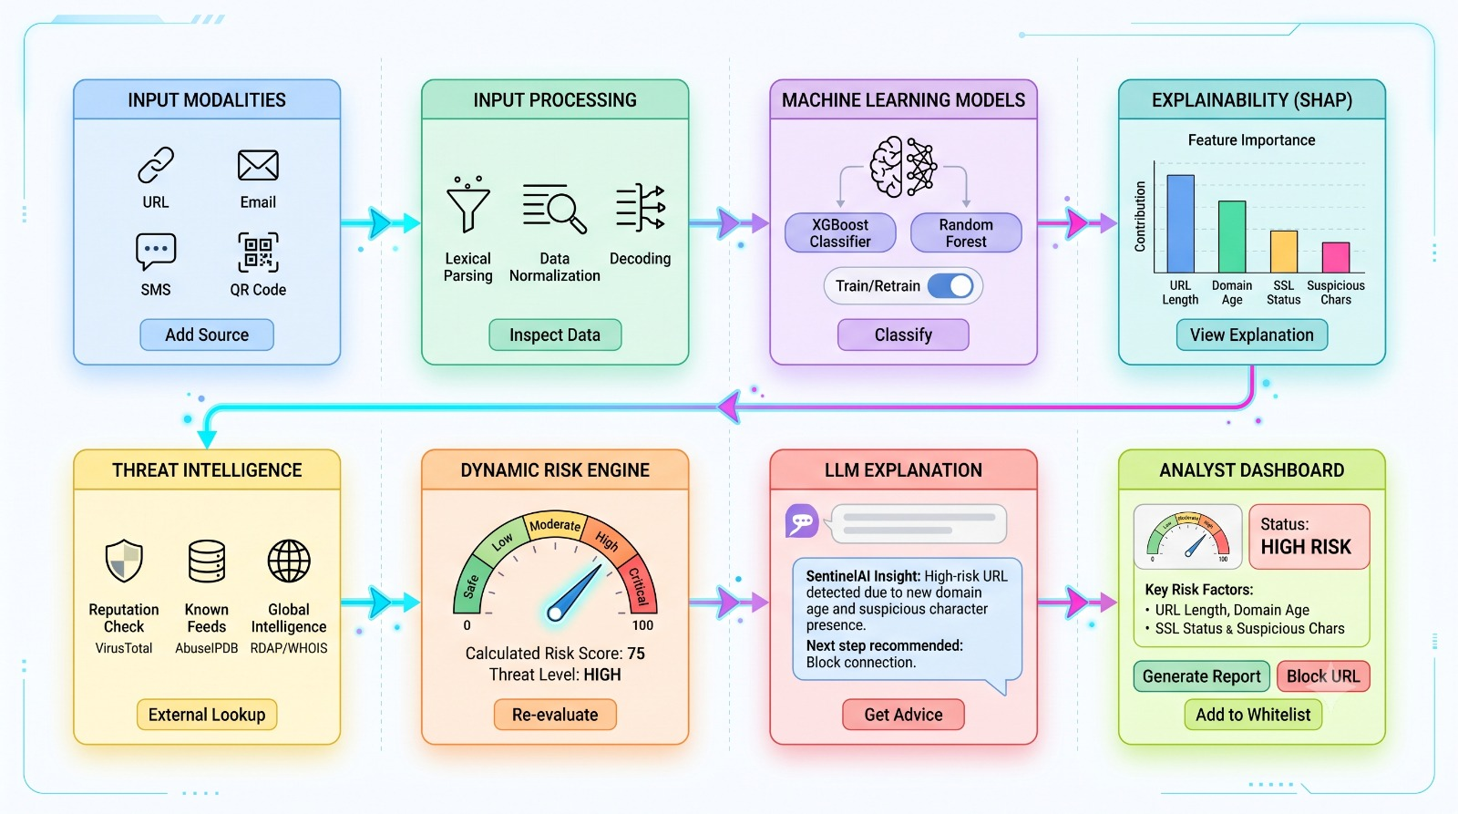
SYSTEM DESIGN
Architecture Diagram
SENTINELAI | PROJECT PHASE 1 / AI&DS
16

Slide 15




MODULE 1
Lightweight ML Classifier
Primary Classifier
Comparison Model
Primary Dataset
Employs XGBoost as the main high-performance classification engine.
Integrates Random Forest as a benchmark to evaluate and compare performance.
Utilizes the PhiUSIIL dataset as the foundation for URL training & classification.
Validation Dataset
Feature Compatibility
Lightweight Architecture
Uses the UCI Phishing Websites dataset for independent validation.
Handles feature matching across datasets where structural compatibility permits.
Structures the classifiers for fast, efficient real-time execution.
SENTINELAI | PROJECT PHASE 1 / AI&DS
17

Slide 16
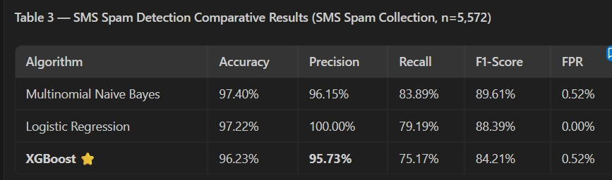
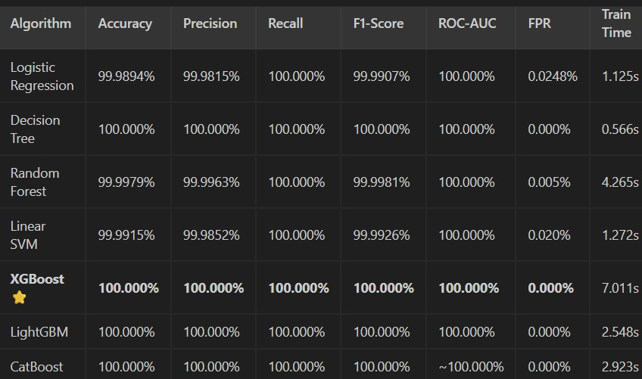
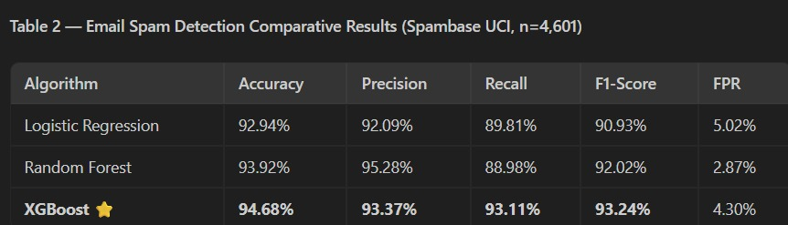
MODULE 1 — RESULTS
Model Performance Results
SENTINELAI | PROJECT PHASE 1 / AI&DS
18

Slide 17
MODULE 2
Cyber Intelligence & Risk Assessment
Cyber Intelligence Collects DNS, domain registration, SSL/TLS, HTTP, and redirect information.
Threat Intelligence Uses reputation sources such as VirusTotal, PhishTank, OpenPhish, and AbuseIPDB.
Probability Fusion Combines ML prediction probabilities with real-time security evidence.
Risk Scoring Generates a unified 0–100 risk score with five levels: Safe, Low, Moderate, High, Critical.
Evidence Integration Uses threat indicators and security findings to support the final risk score.
Dashboard Integration Sends risk ratings and intelligence results to the centralized dashboard.
SENTINELAI | PROJECT PHASE 1 / AI&DS
19

Slide 18


MODULE 3
Explainability Layer & AI Guidance
SHAP Explanation Identifies the key features influencing each ML prediction.
Feature Contribution Highlights risk-increasing and safety-ensuring indicators for every scan.
Transparent Insights Explains the mathematical factors behind threat classification.
LLM Guidance Converts ML, SHAP, and cyber-intelligence results into plain-language explanations.
Actionable Recommendations Provides security actions, prevention tips, and threat summaries.
Dashboard Integration Displays feature-contribution charts and human-readable insights.
Secure & Reliable Uses Groq only as a guidance layer, with fallback mechanisms and privacy controls.
SENTINELAI | PROJECT PHASE 1 / AI&DS
20

Slide 19
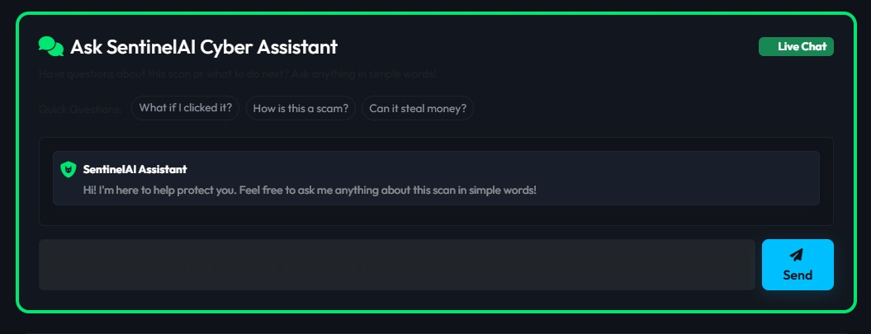
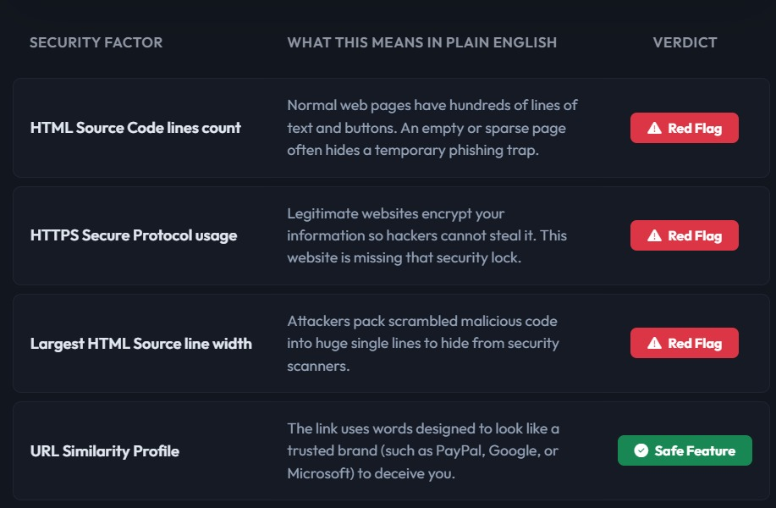
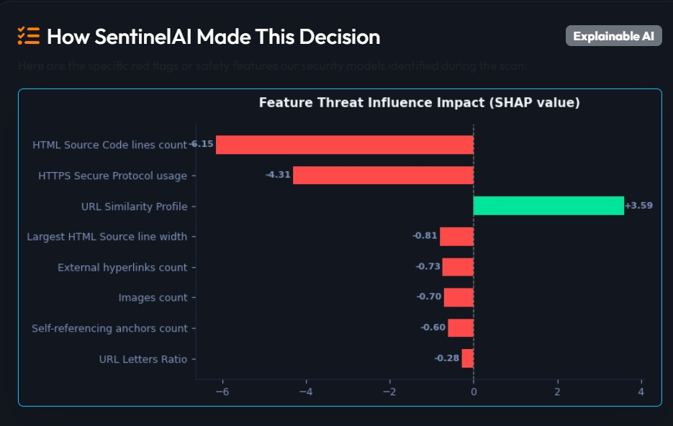
MODULE 3 — IN ACTION
Explainability & Guidance in the Dashboard
SENTINELAI | PROJECT PHASE 1 / AI&DS
21

Slide 20
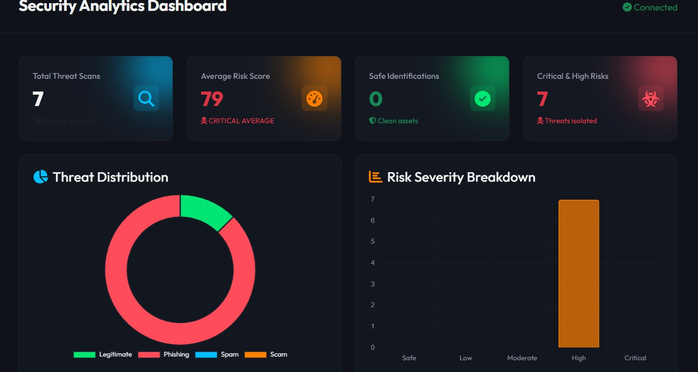
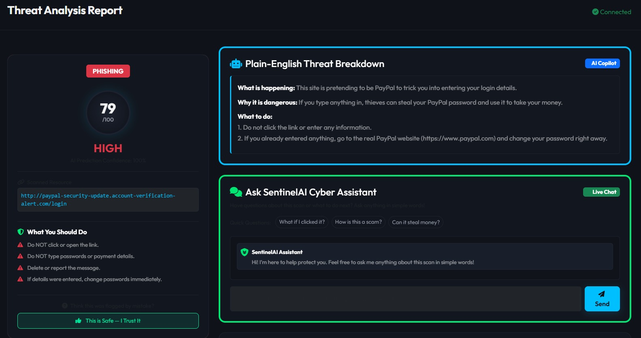
MODULE 3 — IN ACTION
The Unified Security Dashboard
SENTINELAI | PROJECT PHASE 1 / AI&DS
22

Slide 21
MODULE 4
PROPOSED RESEARCH MODULE
Threat Evidence Fusion Engine
Multi-Source Evidence Combines ML classification/confidence with URL, DNS, SSL/TLS, RDAP, reputation & redirect signals.
Evidence Normalization Converts heterogeneous security signals into a common, comparable scale.
Evidence Weighting & Fusion Merges the ML prediction with independent threat-intelligence evidence into one profile.
Unified Threat Evidence Produces a single combined evidence output that feeds directly into Cyber Risk Assessment.
Research Evaluation Compares ML-only vs ML+DNS/SSL/RDAP vs ML+Threat-Intel vs ML+All-Evidence on Accuracy, Precision, Recall, F1, ROC-AUC, FPR, FNR.
Research Question Does combining ML predictions with real-time cyber intelligence improve threat assessment over ML-only detection?
SENTINELAI | PROJECT PHASE 1 / AI&DS
23

Slide 22
MODULE 5
PROPOSED RESEARCH MODULE
Agentic Tool-Calling Engine
Investigation Orchestration An agent layer decides which security tools to invoke — it does not replace the ML classifier.
Dynamic Tool Selection Chooses from DNS, SSL, RDAP, Reputation, ML and SHAP tools based on the investigation so far.
Example Reasoning Flow Classify → if suspicious, check domain age → DNS → SSL → reputation → SHAP → structured evidence to AI Guide.
Evidence Handoff Collected tool outputs pass to Evidence Fusion, then Risk Assessment and the AI Guide.
Observable Actions Only Shows tool-selection decisions and outputs only — no hidden chain-of-thought is exposed.
Research Question Can dynamic tool selection give effective investigation while reducing unnecessary security-tool calls?
SENTINELAI | PROJECT PHASE 1 / AI&DS
24

Slide 23
MODULE 6
PROPOSED RESEARCH MODULE
Adversarial URL Robustness Engine
Purpose Evaluates how robust SentinelAI is against deliberately modified or obfuscated phishing URLs.
Adversarial Categories Character substitution, typosquatting, homoglyphs, URL encoding/obfuscation, subdomain & redirect manipulation, brand impersonation.
Evaluation Pipeline Original URL → Adversarial Transformation → Modified URL → SentinelAI Classifier → Compare Predictions → Robustness Evaluation.
Evaluation Metrics Robust Accuracy, Attack Success Rate, Detection Rate, False Negative Rate, Prediction Stability.
Research Question How resilient is SentinelAI when phishing URLs are deliberately modified to evade detection?
Status Proposed research module — no robustness percentages are reported until adversarial experiments are run.
SENTINELAI | PROJECT PHASE 1 / AI&DS
25

Slide 24
MODULE 7
PROPOSED RESEARCH MODULE
Model Uncertainty & Calibration Engine
Purpose Checks whether ML confidence scores are actually reliable, not just whether accuracy is high.
Calibration Pipeline ML Prediction → Prediction Probability → Calibration Analysis → Confidence Reliability → Risk Assessment.
Components Confidence bins, calibration curve, reliability diagram, Expected Calibration Error (ECE), Brier Score.
High-Confidence Error Analysis Examines whether predictions at ~95% confidence are correct approximately 95% of the time.
Research Question Are SentinelAI's confidence scores reliable enough to support cyber-risk decisions?
Status Proposed research module — evaluation metrics only; no calibration results are reported yet.
SENTINELAI | PROJECT PHASE 1 / AI&DS
26

Slide 25
MODULE 8
PROPOSED RESEARCH MODULE
Concept Drift & Continual Learning Engine
Purpose Detects when evolving phishing patterns make the current model less effective, flagging a need to retrain.
Drift Detection Techniques Population Stability Index (PSI), Kolmogorov–Smirnov test, feature-distribution & performance monitoring.
Drift Architecture Historical vs Current Data → Distribution Monitoring → Drift Detection → Retraining or Continued Monitoring.
Continual Learning Workflow New verified samples → Validation → Drift check → Retraining → Model evaluation → Deployment.
Research Question Can SentinelAI detect phishing-pattern drift and maintain performance through controlled model updates?
Status Proposed research module — continual learning is not implemented in the current system.
SENTINELAI | PROJECT PHASE 1 / AI&DS
27

Slide 26
RESEARCH ARCHITECTURE
Proposed System vs Research Extensions
Proposed Intelligence Layer
IMPLEMENTED
Research Extension Layer
PROPOSED
Lightweight ML Classifier URL feature engineering + Random Forest/XGBoost classification.
Threat Evidence Fusion Fuses ML output with DNS/SSL/RDAP/reputation evidence.
Agentic Tool-Calling Agent dynamically selects which security tools to run.
Cyber Risk Assessment Combines threat evidence into a risk score and severity category.
Adversarial Robustness Tests detection against obfuscated, evasive URL variants.
Explainable AI SHAP identifies the features driving each prediction.
Uncertainty & Calibration Checks whether confidence scores are statistically reliable.
AI Guide LLM turns results into plain-language guidance and recommendations.
Concept Drift & Continual Learning Detects pattern drift and evaluates controlled retraining.
SENTINELAI | PROJECT PHASE 1 / AI&DS
28

Slide 27
Thank You
SentinelAI — Explainable, Real-Time, User-Centric Cyber Defense
Questions & Discussion
← Back to Agenda
SENTINELAI | PROJECT PHASE 1 / AI&DS
30

