Slide 1
UPI Compiler Tool Chain:
Conditional Operators
Unified Programming Interface
PASS Science Works, India

Slide 2
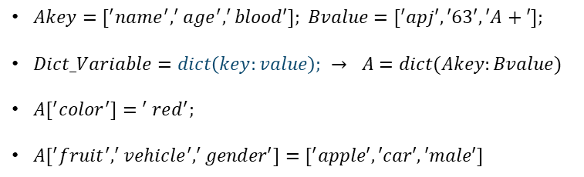
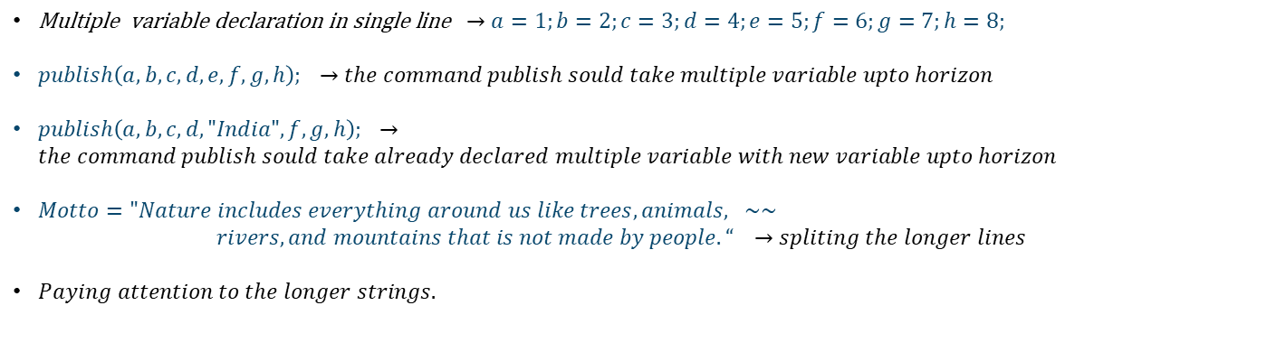
Line Alignment & extended command:
$\text{Multiple }\text{variable }\text{declaration in single line} →a=1;b=2;c=3;d=4;e=5;f=6;g=7;h=8;$
$publish\left(a,b,c,d,e,f,g,h\right); →the command publish sould take multiple variable upto horizon$
$publish\left(a,b,c,d,"India",f,g,h\right); →the command publish sould take already declared multiple variable with new variable upto horizon$
$Motto="Nature includes everything around us like trees, animals, \sim \sim$
      $rivers, and mountains that is not made by people. “$ $→spliting the longer lines$
$Paying attention to the longer strings.$
Dictionary:
Keys = Dict_variable.keys();
Values = Dict_variable.values();
Value_1 = Dict_variable[‘key1’];
Key_1 = Dict_variable.match_key[‘value_1’]
L = Dict_Variable.size();
Special_Functions
$Akey=[^{′}name^{′},^{′}age^{′},^{′}blood′]; Bvalue=[^{′}apj′,′63′,′A+′];$
$Dict_Variable=dict\left(key:value\right);$ $→ A=dict(Akey:Bvalue)$
$A[^{′}color^{′}]{= }^{′}red^{′};$
$A[^{′}fruit^{′},^{′}vehicle^{′},^{′}gender′]=[^{′}apple′,′car′,′male′]$
Unified Programming Interface
PASS Science Works, India

Slide 3
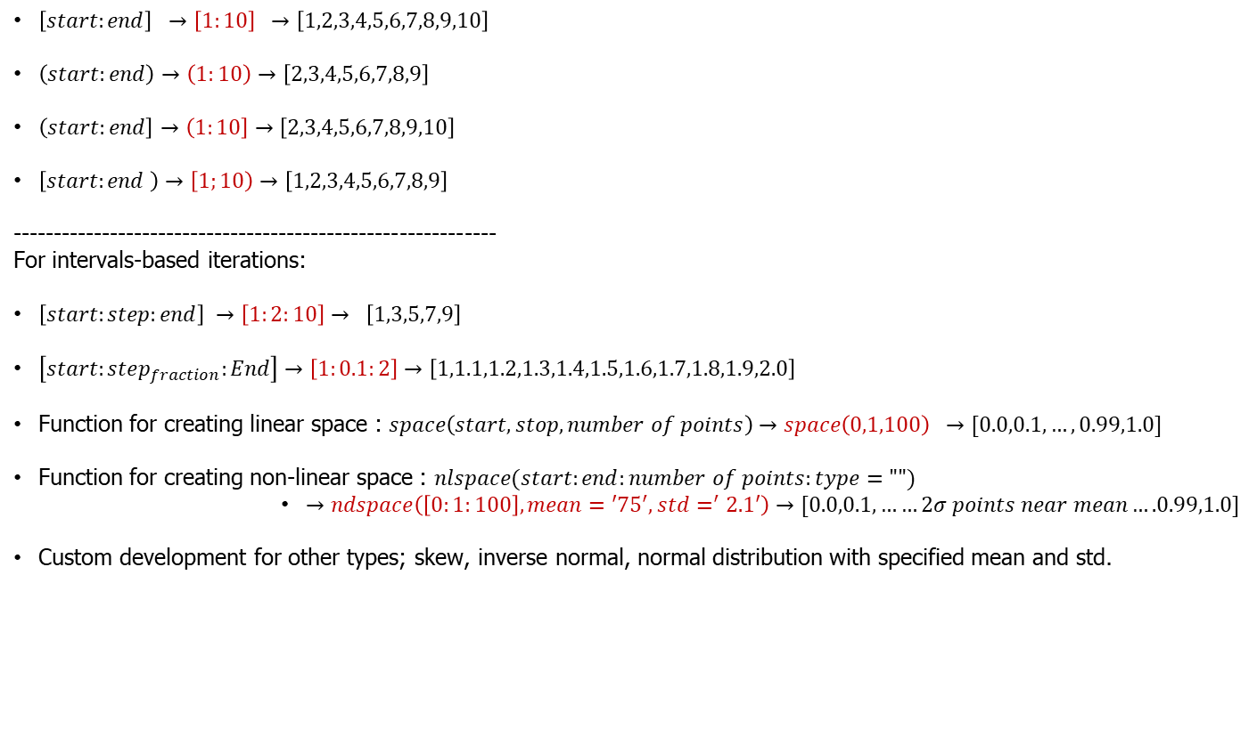
List Creation:
$\left[start:end\right] →\left[1:10\right] →\left[1,2,3,4,5,6,7,8,9,10\right]$
$\left(start:end\right)→\left(1:10\right)→\left[2,3,4,5,6,7,8,9\right]$
$\left(start:end\right]→\left(1:10\right]→\left[2,3,4,5,6,7,8,9,10\right]$
$\left[start:end \right)→\left[1;10\right)→\left[1,2,3,4,5,6,7,8,9\right]$
------------------------------------------------------------
For intervals-based iterations:
$\left[start:step:end\right] →\left[1:2:10\right]→ \left[1,3,5,7,9\right]$
$\left[start:step_{fraction}:End\right]→\left[1:0.1:2\right]→\left[1,1.1,1.2,1.3,1.4,1.5,1.6,1.7,1.8,1.9,2.0\right]$
Function for creating linear space : $space\left(start,stop,number of points\right)→space\left(0,1,100\right) →[0.0,0.1,…,0.99,1.0]$
Function for creating non-linear space : $nlspace(start:end:number of points:type="")$
        $→ndspace\left(\left[0:1:100\right],mean=\text{′}{75}^{′},std=^{′}2.1′\right)→[0.0,0.1,……2σ points near mean….0.99,1.0]$
Custom development for other types; skew, inverse normal, normal distribution with specified mean and std.
Consider [] as ideal bracket for UPI
Unified Programming Interface
PASS Science Works, India

Slide 4
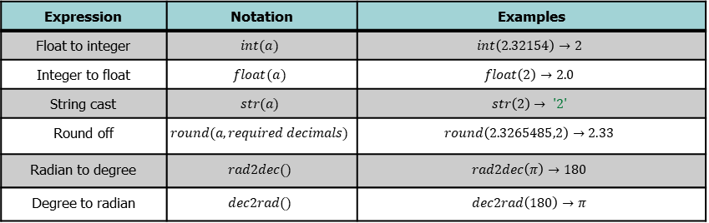
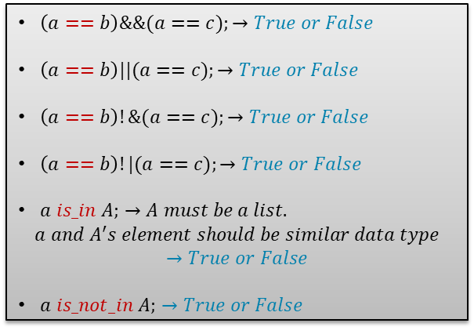
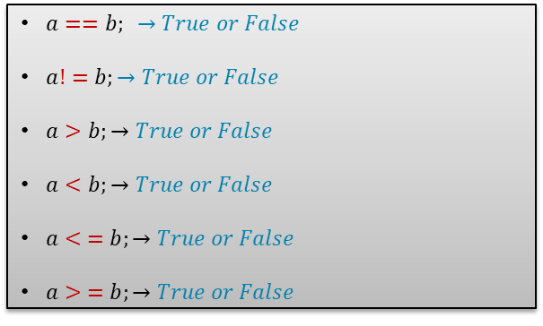
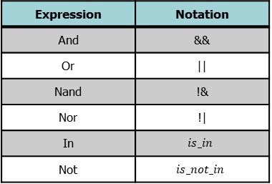
Available Conditional Operators:
$a==b; →True or False$
$a!=b;→True or False$
$a>b;→True or False$
$a<b;→True or False$
$a< =b;→True or False$
$a> =b;→True or False$
Examples
Binary Operators:
Logical Operators:
Expression | Notation
Is equal to | ==
Is not equal to | !=
Is greater than | >
Is lesser than | <
Is greater than or equal | >=
Is lesser than or equal | <=
Expression | Notation
And | &&
Or | ||
Nand | !&
Nor | !|
In | $$is_in$$
Not | $$is_not_in$$
Examples
$\left(a==b\right)\&\&(a==c);→True or False$
$\left(a==b\right)||(a==c);→True or False$
$\left(a==b\right)!\&(a==c);→True or False$
$\left(a==b\right)!|(a==c);→True or False$
$a is_in A;$ $→A must be a list.$
$$a and A^{′}s element should be similar data type$$
$$→True or False$$
$a is_not_in A;$ $→True or False$
*Twin character symbols should be written without space. Otherwise, it is syntax error.
Data Conversion Operators:
Expression | Notation | Examples
Float to integer | $$int(a)$$ | $$int\left(2.32154\right)→2$$
Integer to float | $$float(a)$$ | $$float\left(2\right)→2.0$$
String cast | $$str(a)$$ | $$str\left(2\right)→ \text{′2′}$$
Round off | $$round(a,required decimals)$$ | $$round\left(2.3265485,2\right)→2.33$$
Radian to degree | $$rad2dec()$$ | $$rad2dec\left(π\right)→180$$
Degree to radian | $$dec2rad()$$ | $$dec2rad\left(180\right)→π$$
Unified Programming Interface
PASS Science Works, India

Slide 5

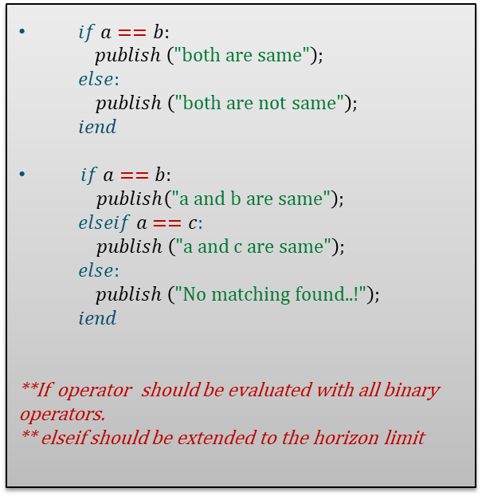
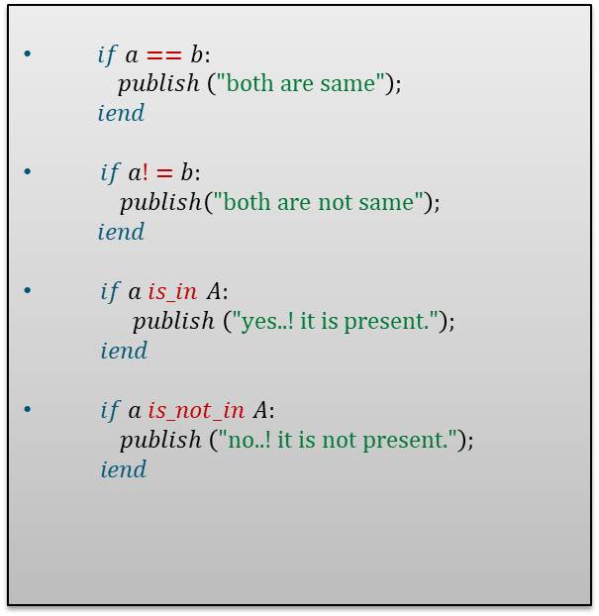
“if” Operator(with branch operators):
“if” Operator (with branch operators):
$if a==b:$
  $$publish \left(\text{"both are same"}\right);$$
  $$iend$$
$if a!=b:$
  $publish\left(\text{"both are not same}"\right);$
  $$iend$$
$if a is_in$ $A:$
$$publish \left(\text{"}\text{yes..! it is present."}\right);$$
$iend$
$if a is_not_in$ $A:$
$$publish \left(\text{"}\text{no}\text{..! it is}\text{ not}\text{ present."}\right);$$
$$iend$$
$if a==b:$
  $$publish \left(\text{"both are same"}\right);$$
  $$else:$$
  $publish \left(\text{"both are}\text{ not}\text{ same"}\right);$
  $$iend$$
$if a==b:$
  $publish\left(\text{"a and b are same}"\right);$
  $$elseif a==c:$$
  $$publish \left(\text{"a and }\text{c }\text{are same"}\right);$$
  $$else:$$
  $publish \left(\text{"}\text{No matching found..!"}\right);$
  $$iend$$
**If operator should be evaluated with all binary operators.
** elseif should be extended to the horizon limit
Similarly, “$if not$” also be developed..!
Unified Programming Interface
PASS Science Works, India

Slide 6
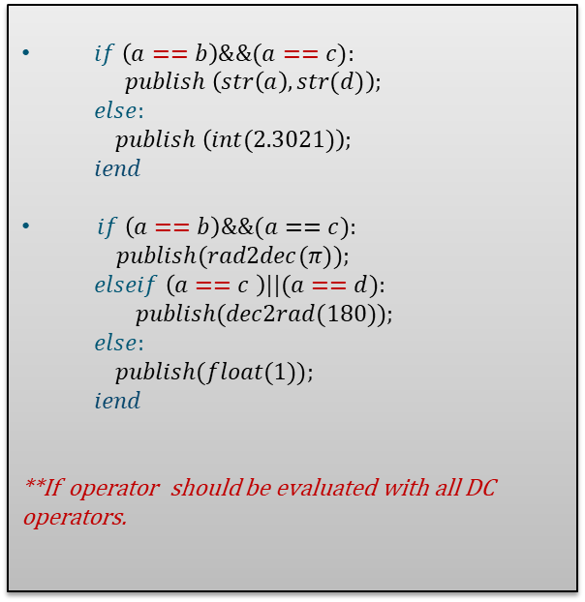
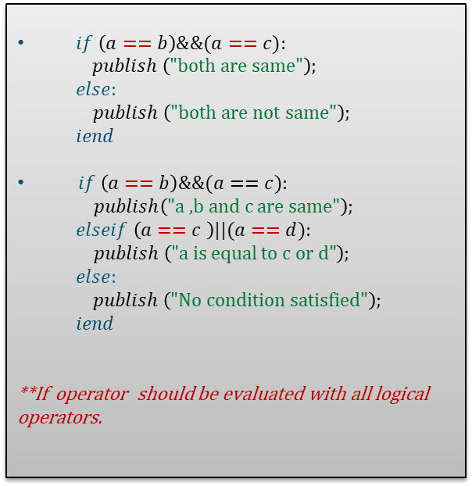
“if” Operator (with logical operators):
“if” Operator (with DC operators):
$if \left(a==b\right)\&\&(a==c):$
  $$publish \left(\text{"both are same"}\right);$$
  $$else:$$
  $publish \left(\text{"both are}\text{ not}\text{ same"}\right);$
  $$iend$$
$if \left(a==b\right)\&\&(a==c):$
  $publish\left(\text{"a ,b and c are same}"\right);$
  $$elseif \left(a==c \right)||(a==d):$$
  $$publish \left(\text{"a }\text{is equal to c or d}\text{"}\right);$$
  $$else:$$
  $publish \left(\text{"}\text{No condition satisfied"}\right);$
  $$iend$$
**If operator should be evaluated with all logical operators.
$if \left(a==b\right)\&\&(a==c):$
  $$publish \left(str\left(a\right),str(d)\right);$$
  $$else:$$
  $publish \left(int(2.3021)\right);$
  $$iend$$
$if \left(a==b\right)\&\&(a==c):$
  $publish(rad2dec(π));$
  $$elseif \left(a==c \right)||(a==d):$$
  $$publish(dec2rad(180));$$
  $$else:$$
  $publish(float(1));$
  $$iend$$
**If operator should be evaluated with all DC operators.
Unified Programming Interface
PASS Science Works, India

Slide 7
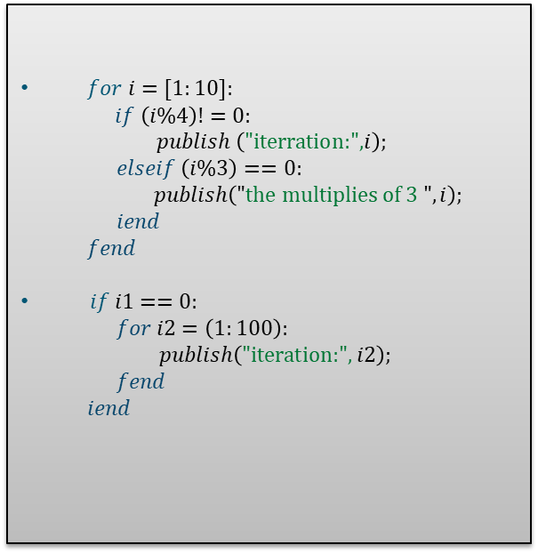
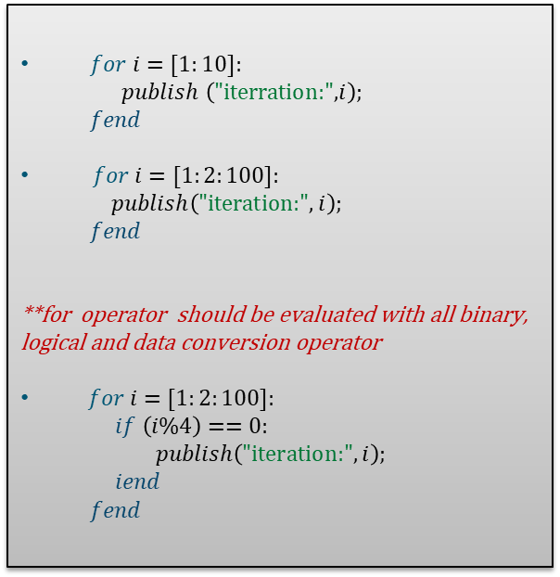
“for” Operator:
“for” Operator (with branches+):
$for i=[1:10]:$
  $$publish \left(\text{"iterration:",}i\right);$$
  $$fend$$
$for i=[1:2:100]:$
  $publish\left(\text{"iteration:}", i\right);$
  $$fend$$
**for operator should be evaluated with all binary, logical and data conversion operator
$for i=[1:2:100]:$
  $if \left(i\%4\right)==0:$
  $publish\left(\text{"iteration:}", i\right);$
  $iend$
  $$fend$$
$for i=[1:10]:$
  $if \left(i\%4\right)!=0:$
  $publish \left(\text{"iterration:",}i\right);$
  $elseif \left(i\%3\right)==0:$
  $publish\left("\text{the multiplies of 3 }",i\right);$
  $iend$
  $$fend$$
$if i1==0:$
  $for i2=\left(1:100\right):$
  $publish\left(\text{"iteration:}", i2\right);$
  $fend$
  $$iend$$
Unified Programming Interface
PASS Science Works, India

Slide 8

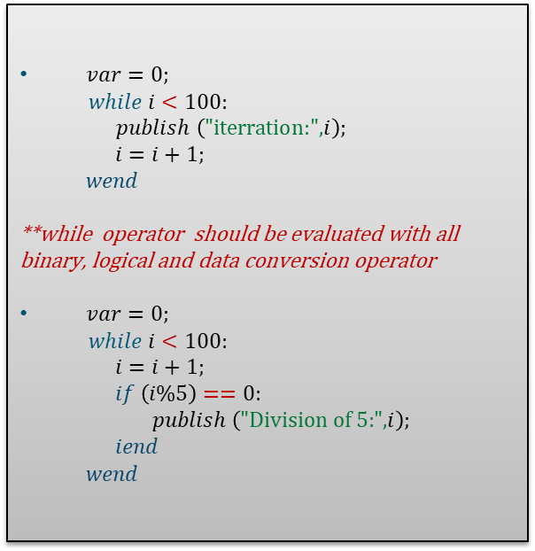
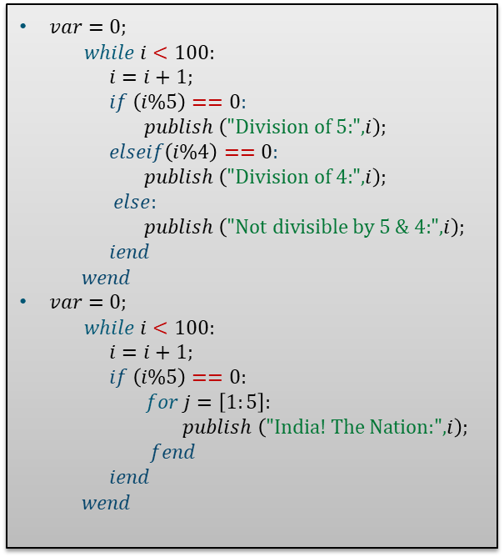
“while” Operator:
“while” Operator (with branch):
$var=0;$
$while i<100:$
  $$publish \left(\text{"iterration:",}i\right);$$
  $i=i+1;$
  $$wend$$
**while operator should be evaluated with all binary, logical and data conversion operator
$var=0;$
$while i<100:$
  $i=i+1;$
  $if \left(i\%5\right)==0:$
  $publish \left(\text{"}\text{Division of 5:",}i\right);$
  $iend$
  $$wend$$
$var=0;$
$while i<100:$
  $i=i+1;$
  $if \left(i\%5\right)==0:$
  $publish \left(\text{"Division of 5:",}i\right);$
  $elseif\left(i\%4\right)==0:$
  $publish \left(\text{"Division of 4:",}i\right);$
  $else:$
  $publish \left(\text{"}\text{Not divisible by 5 \& 4:",}i\right);$
  $iend$
  $$wend$$
$var=0;$
$while i<100:$
  $i=i+1;$
  $if \left(i\%5\right)==0:$
  $for j=\left[1:5\right]:$
  $publish \left(\text{"}\text{India! The Nation}\text{:",}i\right);$
  $fend$
  $iend$
  $$wend$$
Similarly, “$while not$” also be deveoped
Unified Programming Interface
PASS Science Works, India

Slide 9
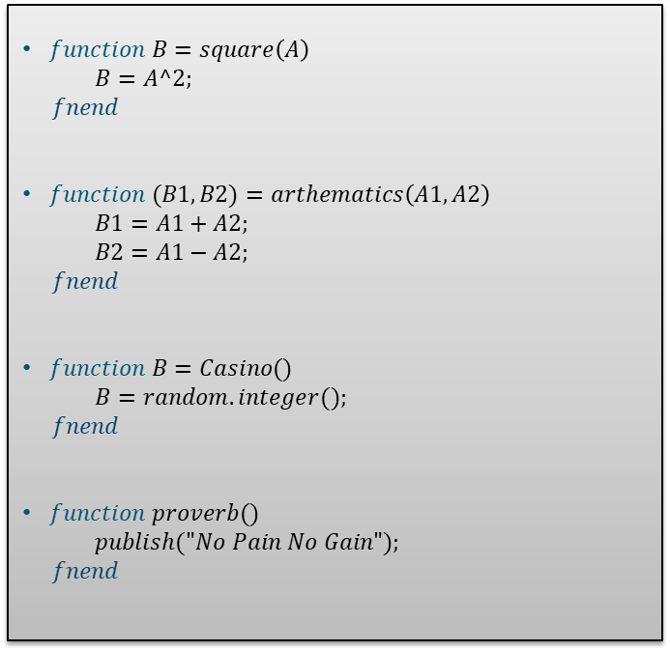
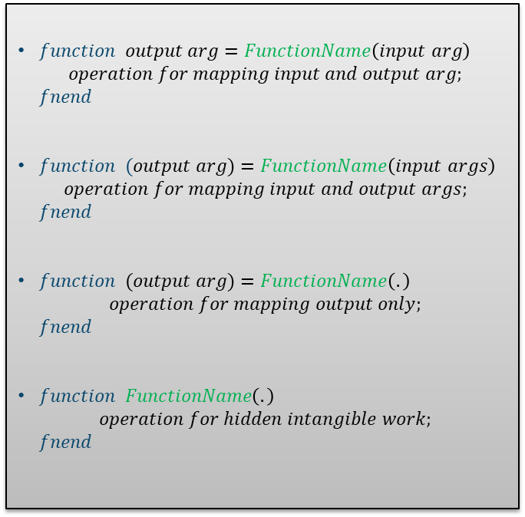
Functions (Syntax):
Functions (Examples):
Single variable function
$function output arg=FunctionName\left(input arg\right)$
$$operation for mapping input and output arg;$$
$fnend$
$function (output arg)=FunctionName\left(input args\right)$
$$operation for mapping input and output args;$$
$fnend$
$function (output arg)=FunctionName\left(.\right)$
$$operation for mapping output only;$$
$fnend$
$function FunctionName\left(.\right)$
$$operation for hidden intangible work;$$
$fnend$
$function B=square\left(A\right)$
  $B=A^2;$
$fnend$
$function (B1,B2)=arthematics\left(A1,A2\right)$
  $B1=A1+A2;$
  $B2=A1−A2;$
$fnend$
$function B=Casino()$
  $B=random.integer();$
$fnend$
$function proverb()$
  $publish("No Pain No Gain");$
$fnend$
Multi variable function
Function with no input
Function with no input & output
Unified Programming Interface
PASS Science Works, India

Slide 10
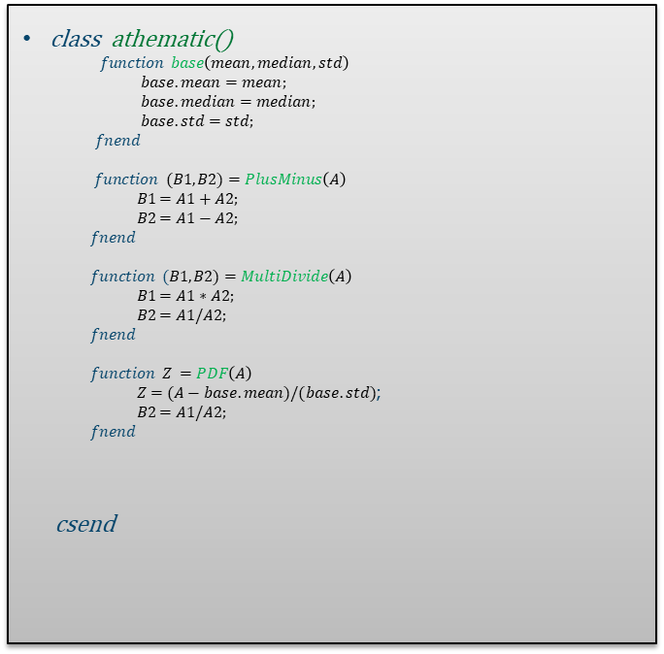
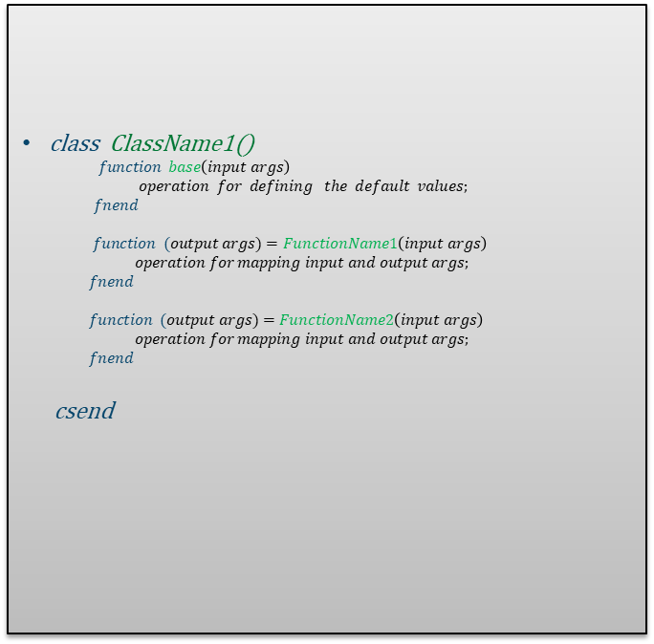
Class (Syntax):
Class (Example):
class ClassName1()
$function base\left(input args\right)$
  $operation for defining the default values;$
  $fnend$
$function (output args)=FunctionName1\left(input args\right)$
$operation for mapping input and output args;$
$fnend$
$function (output args)=FunctionName2\left(input args\right)$
$operation for mapping input and output args;$
$fnend$
csend
class athematic()
$function base\left(mean,median,std\right)$
  $base.mean=mean;$
  $base.median=median;$
  $base.std=std;$
  $fnend$
$function (B1,B2)=PlusMinus\left(A\right)$
$B1=A1+A2;$
$B2=A1−A2;$
$fnend$
$function (B1,B2)=MultiDivide\left(A\right)$
$B1=A1∗A2;$
$B2=A1/A2;$
$fnend$
$function Z =PDF\left(A\right)$
$Z=(A−base.mean)/(base.std)$;
$B2=A1/A2;$
$fnend$
csend
Unified Programming Interface
PASS Science Works, India

Slide 11
Sanity Test
(Primitives - Operators – Loop)
Unified Programming Interface
PASS Science Works, India

Slide 12
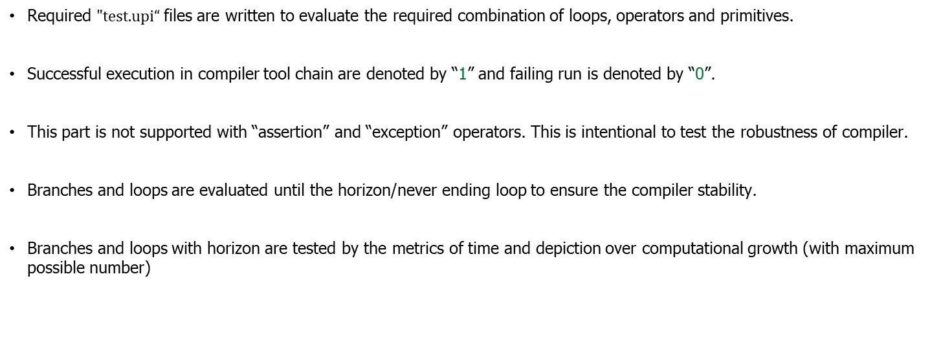
Evaluation Method:
Required $\text{"test.upi}“$files are written to evaluate the required combination of loops, operators and primitives.
Successful execution in compiler tool chain are denoted by “1” and failing run is denoted by “0”.
This part is not supported with “assertion” and “exception” operators. This is intentional to test the robustness of compiler.
Branches and loops are evaluated until the horizon/never ending loop to ensure the compiler stability.
Branches and loops with horizon are tested by the metrics of time and depiction over computational growth (with maximum possible number)
Unified Programming Interface
PASS Science Works, India

Slide 13
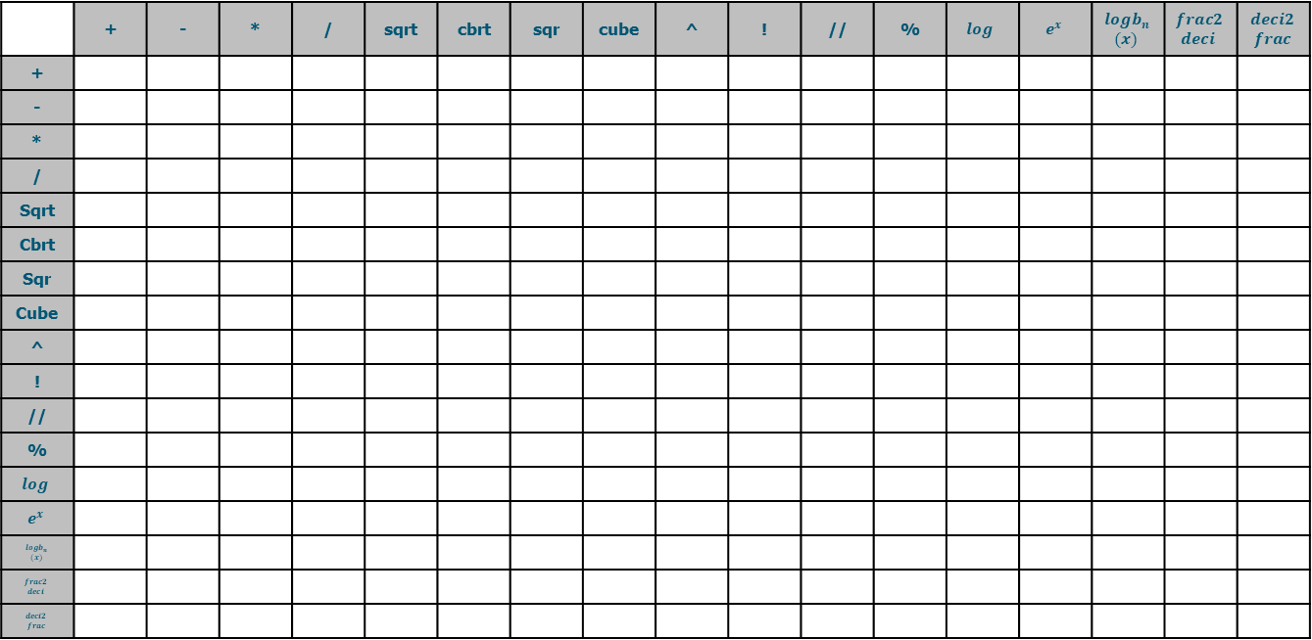
Sanity Test (Primitives over primitives):
 | + | - | * | / | sqrt | cbrt | sqr | cube | ^ | ! | // | % | $$log$$ | $$e^{x}$$ | $$logb_{n}$$ $$(x)$$ | $$frac2$$ $$deci$$ | $$deci2$$ $$frac$$
+
-
*
/
Sqrt
Cbrt
Sqr
Cube
^
!
//
%
$$log$$
$$e^{x}$$
$$logb_{n}$$ $$(x)$$
$$frac2$$ $$deci$$
$$deci2$$ $$frac$$
Total number of checkpoint Evaluations = 17*17 = 289
Unified Programming Interface
PASS Science Works, India

Slide 14
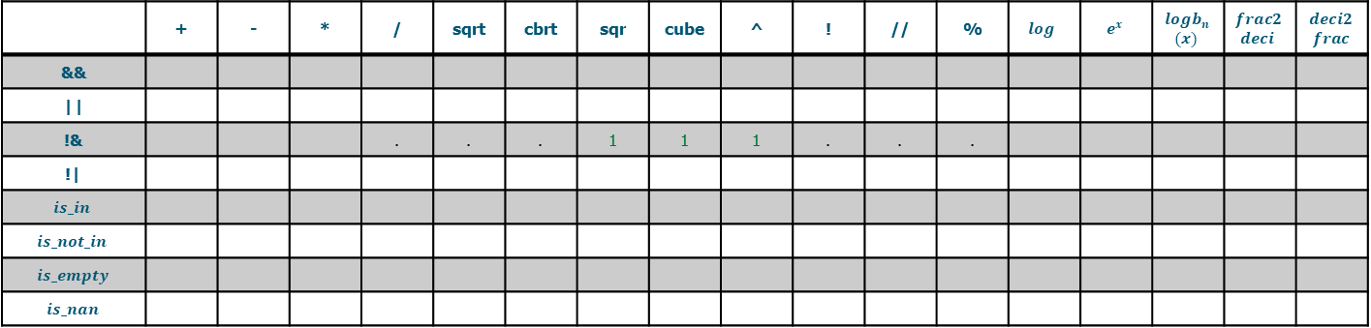
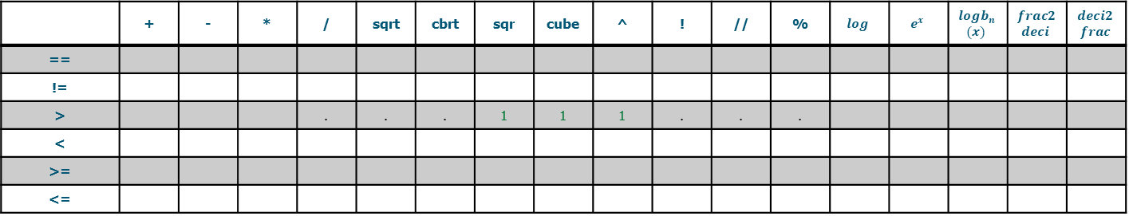
Sanity Test (Binary Operator):
 | + | - | * | / | sqrt | cbrt | sqr | cube | ^ | ! | // | % | $$log$$ | $$e^{x}$$ | $$logb_{n}$$ $$(x)$$ | $$frac2$$ $$deci$$ | $$deci2$$ $$frac$$
==
!=
> |  |  |  | . | . | . | 1 | 1 | 1 | . | . | .
<
>=
<=
Total number of checkpoint Evaluations = 17*6 = 102
Sanity Test (Logical Operator):
 | + | - | * | / | sqrt | cbrt | sqr | cube | ^ | ! | // | % | $$log$$ | $$e^{x}$$ | $$logb_{n}$$ $$(x)$$ | $$frac2$$ $$deci$$ | $$deci2$$ $$frac$$
&&
||
!& |  |  |  | . | . | . | 1 | 1 | 1 | . | . | .
!|
$$is_in$$
$$is_not_in$$
$$is_empty$$
$$is_nan$$
Total number of checkpoint Evaluations = 17*8 = 136
Unified Programming Interface
PASS Science Works, India

Slide 15
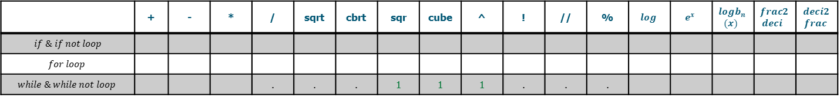
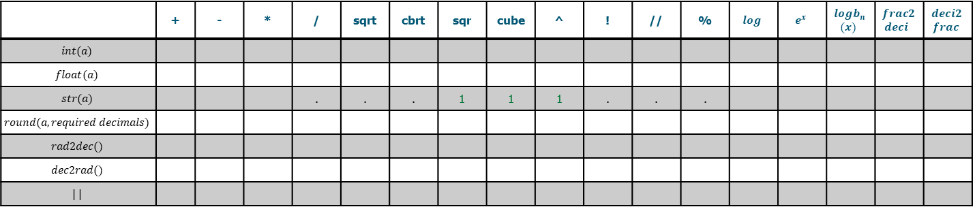
Sanity Test (Data Conversion Operator):
 | + | - | * | / | sqrt | cbrt | sqr | cube | ^ | ! | // | % | $$log$$ | $$e^{x}$$ | $$logb_{n}$$ $$(x)$$ | $$frac2$$ $$deci$$ | $$deci2$$ $$frac$$
$$int(a)$$
$$float(a)$$
$$str(a)$$ |  |  |  | . | . | . | 1 | 1 | 1 | . | . | .
$$round(a,required decimals)$$
$$rad2dec()$$
$$dec2rad()$$
$$| |$$
Total number of checkpoint Evaluations = 18*6 = 108
Sanity Test (Loop Operator):
 | + | - | * | / | sqrt | cbrt | sqr | cube | ^ | ! | // | % | $$log$$ | $$e^{x}$$ | $$logb_{n}$$ $$(x)$$ | $$frac2$$ $$deci$$ | $$deci2$$ $$frac$$
$if \& if not loop$
$$for loop$$
$$while \& while not loop$$ |  |  |  | . | . | . | 1 | 1 | 1 | . | . | .
Total number of checkpoint Evaluations = 17*5 = 85
Unified Programming Interface
PASS Science Works, India

Slide 16
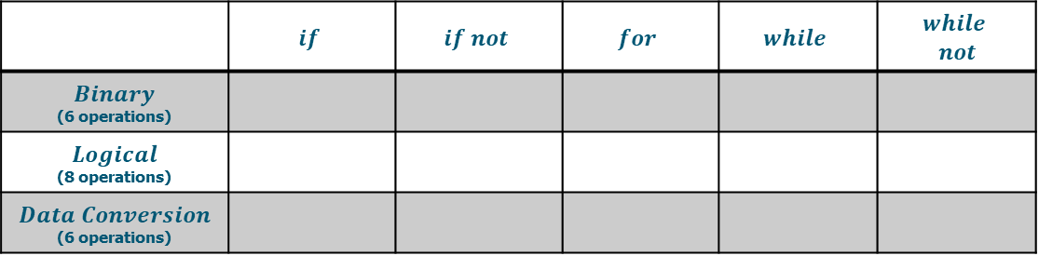
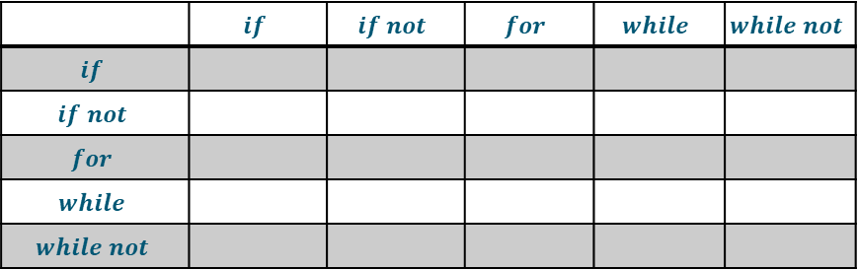
Sanity Test (Loop – Binary-Logical-Data Conversion):
 | $$if$$ | $$if not$$ | $$for$$ | $$while$$ | $$while$$ $$not$$
$$Binary$$ (6 operations)
$$Logical$$ (8 operations)
$$Data Conversion$$ (6 operations)
Sanity Test (Loop-to-loop):
 | $$if$$ | $$if not$$ | $$for$$ | $$while$$ | $$while not$$
$$if$$
$$if not$$
$$for$$
$$while$$
$$while not$$
Unified Programming Interface
PASS Science Works, India

Slide 17
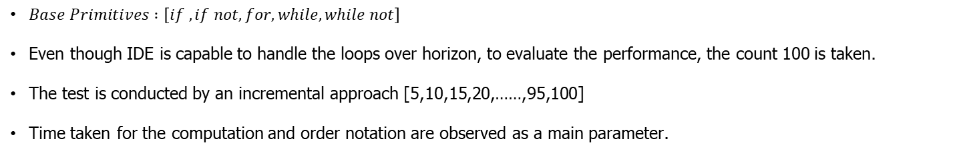
Horizon Test:
$Base Primitives :$ $\left[if , if not, for, while, while not\right]$
Even though IDE is capable to handle the loops over horizon, to evaluate the performance, the count 100 is taken.
The test is conducted by an incremental approach [5,10,15,20,……,95,100]
Time taken for the computation and order notation are observed as a main parameter.
Continuing to ace it!
Unified Programming Interface
PASS Science Works, India

