Slide 1
Progress of the new Run Registry
History is now available in datasets, runs and configuration in a consistent manner( event sourcing architecture). Consistency and accountability are guaranteed. Every change in the data is tracked and never deleted (immutable).
Run registry now uses its own link with SSO and it is accessible to the internet as well: https://cmsrunregistry.web.cern.ch. E-groups are used for authentication.
The way certification works in the new RR leverages history and removes “syncing”, no longer a weekly sync is needed between workspaces. History is then useful to track conflicts.

Slide 2
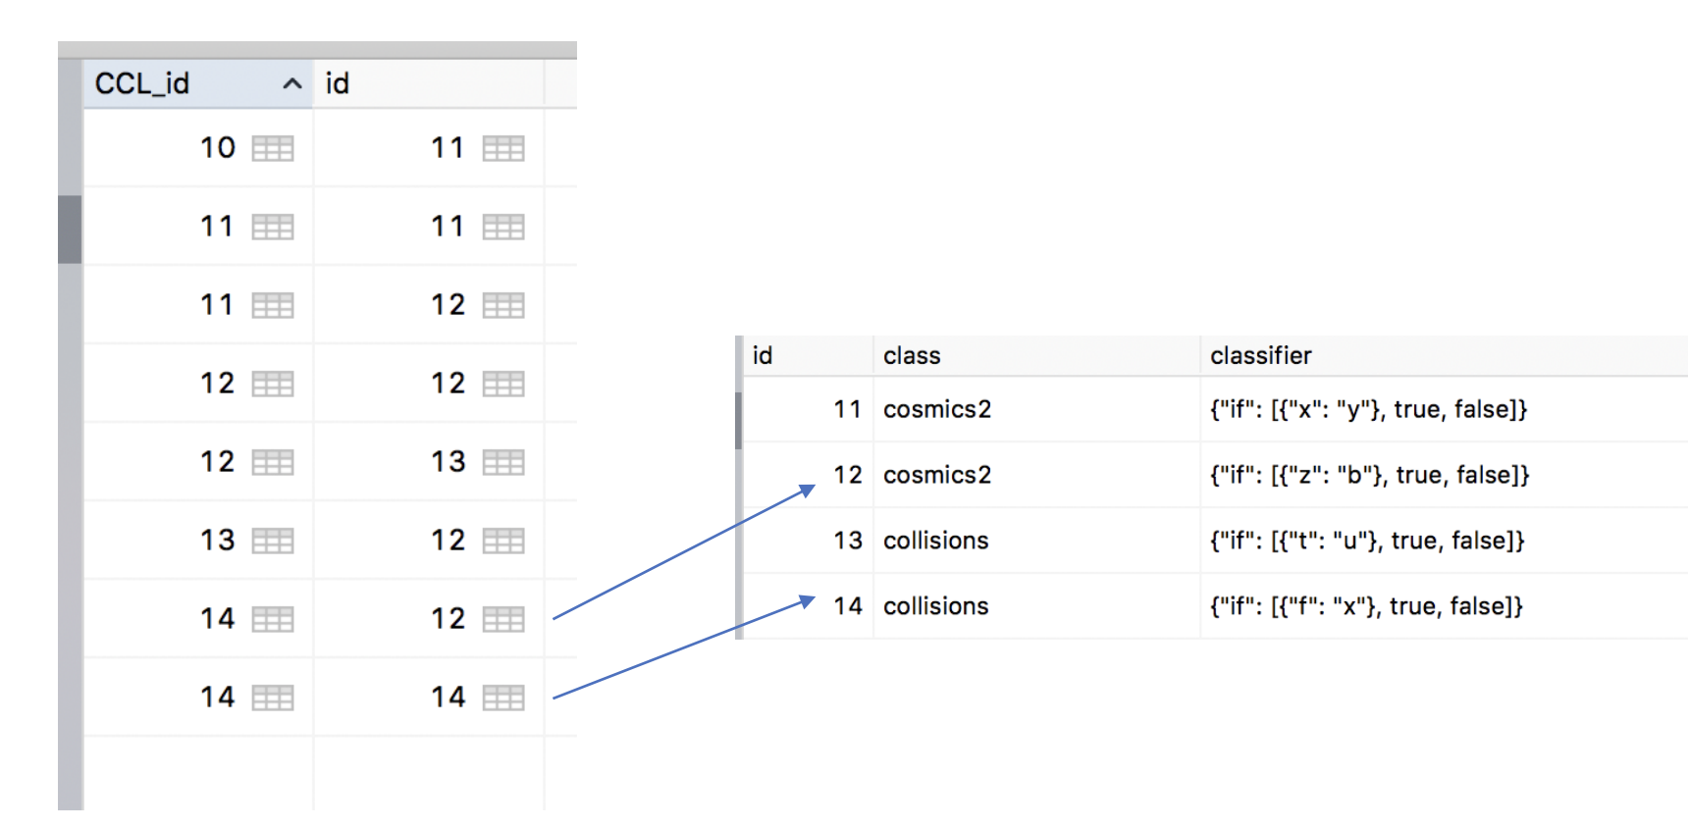
Run Registry works under the hood like GIT
There is a current version (14) that points to the data. Whenever data changes, the current version is increased by one (next one would be 15) and points to the new data.

Slide 3
Storage and Performance
After testing with 1 million run events (sample data) storage-wise and performance-wise the application responded reasonably well. (storage of 3 GB, response time of 3.6 seconds).

