Slide 1
FUTURE RUN REGISTRY
Fabio Espinosa

Slide 2
Contents
Context
Users
Problems
Proposal
Challenges
Architecture
Database/DB-Schema
Back end
Front end
Data input
Conclusions

Slide 3
Users of Run Registry
Online Shifters
Offline Shifters
DC Expert
API users

Slide 4
Problems reported by users
Delays of runs appearing in the system (sometimes in the size of hours). Cause: Synchronization is needed between two databases (online-offline).
Complicated GUI. Too much unused functionality.
Era is needed to be set manually. There can be more automation.
RR is slow and users sometimes don’t know if it is loading or stuck.
Slow fixes by maintainers.
Certificate issues and logins (authentication).

Slide 5
Other Problems
Difficult maintainability. The db schema design is extremely complicated. There are over 260 tables between the two dbs. This makes a new developer to take ages to make any change in the current system.
Outdated technology. RR was built using the best web frameworks of 2012.
Three web apps that can fit into one. One that apparently nobody uses (User).

Slide 6
Actual Db Schema for Online RR

Slide 7
Actual Db Schema for Offline RR

Slide 8
PROPOSAL

Slide 9
RR Weekly Workflow
Runs
Golden JSON
Legend:
RUN REGISTRY
Data input
Human input
Operation input
Data output
Lumisections
DC Expert
DQM GUI / DBS
Shifters

Slide 10
Overview for Future RR
Must be developed with state of the art technologies.
Must be maintainable, well documented and design must be as simple as possible.
Must allow lots of automation via API (API completely separated from front end).
Must have great performance and be user-friendly.
Possible human errors must be prevented by design.
Information should be allowed for everyone to see, but only for authorized users to edit/delete.
Must not be a copy of current RR, but a complete new solution.

Slide 11
New Design Major Challenges
Handling triggers, make them work as soon as they should, store them and make them user-friendly to write.
User authentication working with e-groups.
Make existing data in current RR fit new RR. This includes 69 tables for Online db and 191 tables for Offline db. Have to go through each table importing data and exporting to new schema. (Do we actually need old data).
Handling possible immutable database schema design.

Slide 12
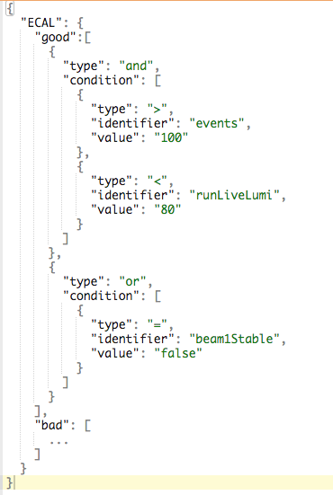
Handling Triggers viable solution
Can be easily stored
Are not hard to understand
Can be easily validated
Requires a learning curve
Are easily evaluated at runtime
Must have consistency
A JSON editor is not the friendliest thing, but is not changed frequently.

Slide 13
Database PostgreSQL vs Oracle
PostgreSQL
Pros:
Open source
Vastly more used in real world
Has support in managed DBS at CERN
Very popular in developer community
Notify() function built in
Built in support for JSON storage
Cons:
Will not be able to query WBM/OMS data source directly.
Oracle
Pros:
Has support as managed DBS at CERN
Current WBM uses Oracle
More developers in CERN
Cons:
Closed source
Fewer developers worldwide know it.

Slide 14
DB Schema
Event sourcing schema
Pros:
It will have a built in log “for free”
Database can be viewed at any point in time
Cons:
It will be my first time using such schema.
Unknown time horizon for learning curve.
Normal “relational” schema
Pros:
It is the most common way to use a relational db.
Cons:
It is problematic for creating snapshots, or restoring to any point in time
Creating a log, and user actions is not trivial.

Slide 15
Back End (REST API)
Python: current language and probably the chosen language (with Flask framework):
Pros:
Is used throughout CERN.
Acquiring talent of Python developers is easy.
Cons:
The new maintainers will also need to know JavaScript to modify front end.
JavaScript (Node.js)
Pros:
Has the advantage that the whole stack of Run Registry will be in only one prog. language.
Cons:
It is not as maintainable as Python

Slide 16
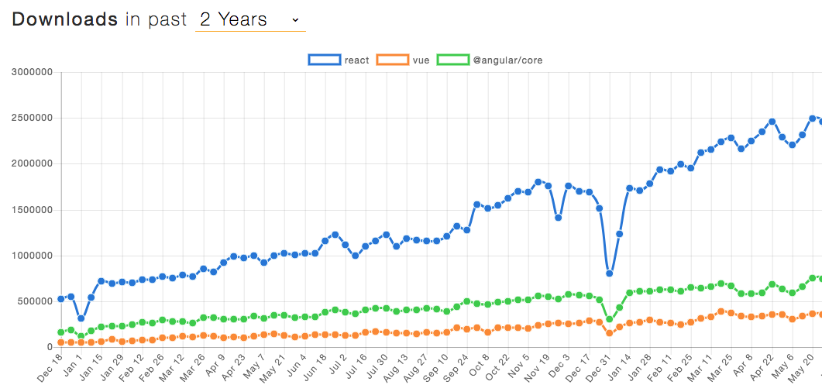
Front End
React.js for interactivity. Hands down the most popular js library/framework for front-end in the world right now. (Already used in other CMS projects like OMS
Easy integration of real-time architecture.
Other options: Vue.js, Angular or Backbone.

Slide 17
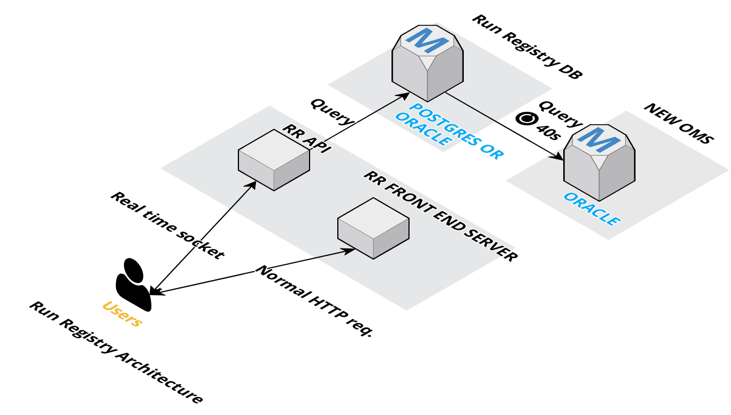
PROPOSED ARCHITECTURE

Slide 18
Additional Users requests
Link to elogs for every run, the elogs must be filtered by run and by timestamp.
Link to DQM GUI for every run.
Option to upload text file that contemplates changes between component status (Change in batch) or WYSIWYG editor.
Bookmarkability. Make URL contain filtered data table.
Preserve functionality of data filtering in current tables. Mostly ”like” functionality.

Slide 19
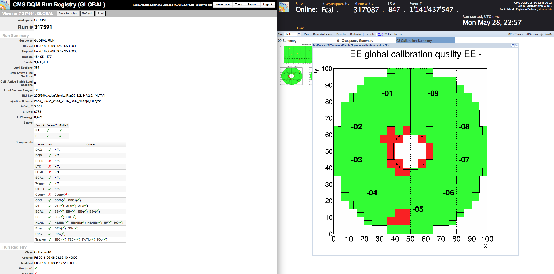
What a current shifter screen looks like
Two tabs that can be integrated into one -> Make DQM GUI available in RR. There will be no way that “human mistake” occurs in selecting same run in both applications.

Slide 20
Other ideas
Implement a real time chat inside RR to facilitate collaboration between offline physics teams.
Enforce deadline of physics groups to set components good/bad Monday midnight for weekly runs. Controversial.
Integrate DQM GUI into RR. Make it easy so that in the future, machine learning can fit in RR.

