Slide 1
IEEE TNNLS 2025 · SUN ET AL. · REPRODUCTION
RSF-Conv on retinal
vessel segmentation
Rotation- and scale-equivariant convolutions —
reproduced, ensembled, and tested out-of-domain.
Vaibhav S.
github.com/vvsvs/Paper_expo
2026-04-24
Notes:
Good afternoon. I'm going to walk through RSF-Conv, a rotation- and scale-equivariant convolution from IEEE TNNLS 2025. Assignment: reproduce it, and try to beat it on retinal vessel segmentation. I'll cover the idea, what I built, training results, out-of-domain transfer, and what failed.

Slide 2
01 · PROBLEM
Vessel segmentation still isn't solved
Why it matters
Vessel topology is an early biomarker for diabetic retinopathy, hypertension, and glaucoma. Clinicians currently trace them by hand.
Why it's hard
Thin vessels, low contrast, inter-camera domain shift. Benchmarks are tiny — 40 + 20 + 28 images total — so models that generalise matter more than models that fit.
Why equivariance
A vessel has no canonical orientation or scale. The operator that processes fundus images should reflect that — standard Conv2d doesn't, RSF-Conv does.
BENCHMARKS
DRIVE
40 images · 565×584 · expert mask
STARE
20 images · 700×605 · 2 annotators
CHASE_DB1
28 images · pediatric · different camera
RSF-Conv reproduction · vvsvs · 2026-04-24
01 / 12
Notes:
Retinal vessels are clinically important — diabetic retinopathy, hypertension, glaucoma all show up first as vessel changes. Manual tracing doesn't scale. The benchmarks are small but high-resolution and hand-annotated. Key observation: vessels have no canonical orientation or scale — so the operator used to analyse them shouldn't either. Standard Conv2d learns one oriented filter; RSF-Conv learns a rotation-scale-equivariant one. That's the paper's pitch.

Slide 3
02 · THE PAPER
The paper's headline promise
13.9%
0.9816
0.8270
of the U-Net's parameters
DRIVE test AUC
DRIVE test F1
Claimed state-of-the-art on three retinal-vessel benchmarks
DRIVE
STARE
CHASE_DB1
Se
0.8144
Sp
0.9835
Se
0.8253
Sp
0.9862
Se
0.8412
Sp
0.9797
F1
0.8270
AUC
0.9816
F1
0.8269
AUC
0.9898
F1
0.8225
AUC
0.9894
RSF-Conv reproduction · vvsvs · 2026-04-24
02 / 12
Notes:
Three headline claims. One: a drop-in conv replacement gives you the same or better accuracy with one-seventh the parameters. Two: on DRIVE — the main vessel benchmark — 0.9816 AUC and 0.8270 F1, state-of-the-art at publication. Three: the gain holds across STARE and CHASE — so it's not DRIVE-specific. The cards at the bottom are the three target numbers I'm chasing for the reproduction.

Slide 4
03 · OPERATOR
What RSF-Conv actually computes
standard 2-D convolution
WHY THIS MATTERS
W ∈ ℝ^(C_out × C_in × k × k) ← one scalar per (x,y,c)
Rotation equivariance
Rotating the input rotates the output by the same angle — not a new function the network has to learn.
Scale invariance
Radial Gaussian sampling over σ captures features at multiple scales from the same learnable kernel.
Parameter saving
rotNum=8 × numS=4 = 32 synthesised filters per learnable kernel. ~7× fewer params than the plain U-Net.
RSF-Conv
a_n(s) ← Fourier coefficients indexed by rotation n, scale s
at forward time, synthesise
W_{θ,s} for θ ∈ {0, 2π/R, …}, s ∈ {s_1, …, s_S}
RSF-Conv reproduction · vvsvs · 2026-04-24
03 / 12
Notes:
Under the hood: instead of learning pixel weights, you learn Fourier coefficients indexed by rotation order and scale. Each forward pass reconstructs 32 oriented-and-scaled kernels from those same coefficients and runs them in parallel. A group pool over rotation gives equivariant features. The punchline is that 32 filter variants come out of one learnable block — so you get way more capacity per parameter.

Slide 5
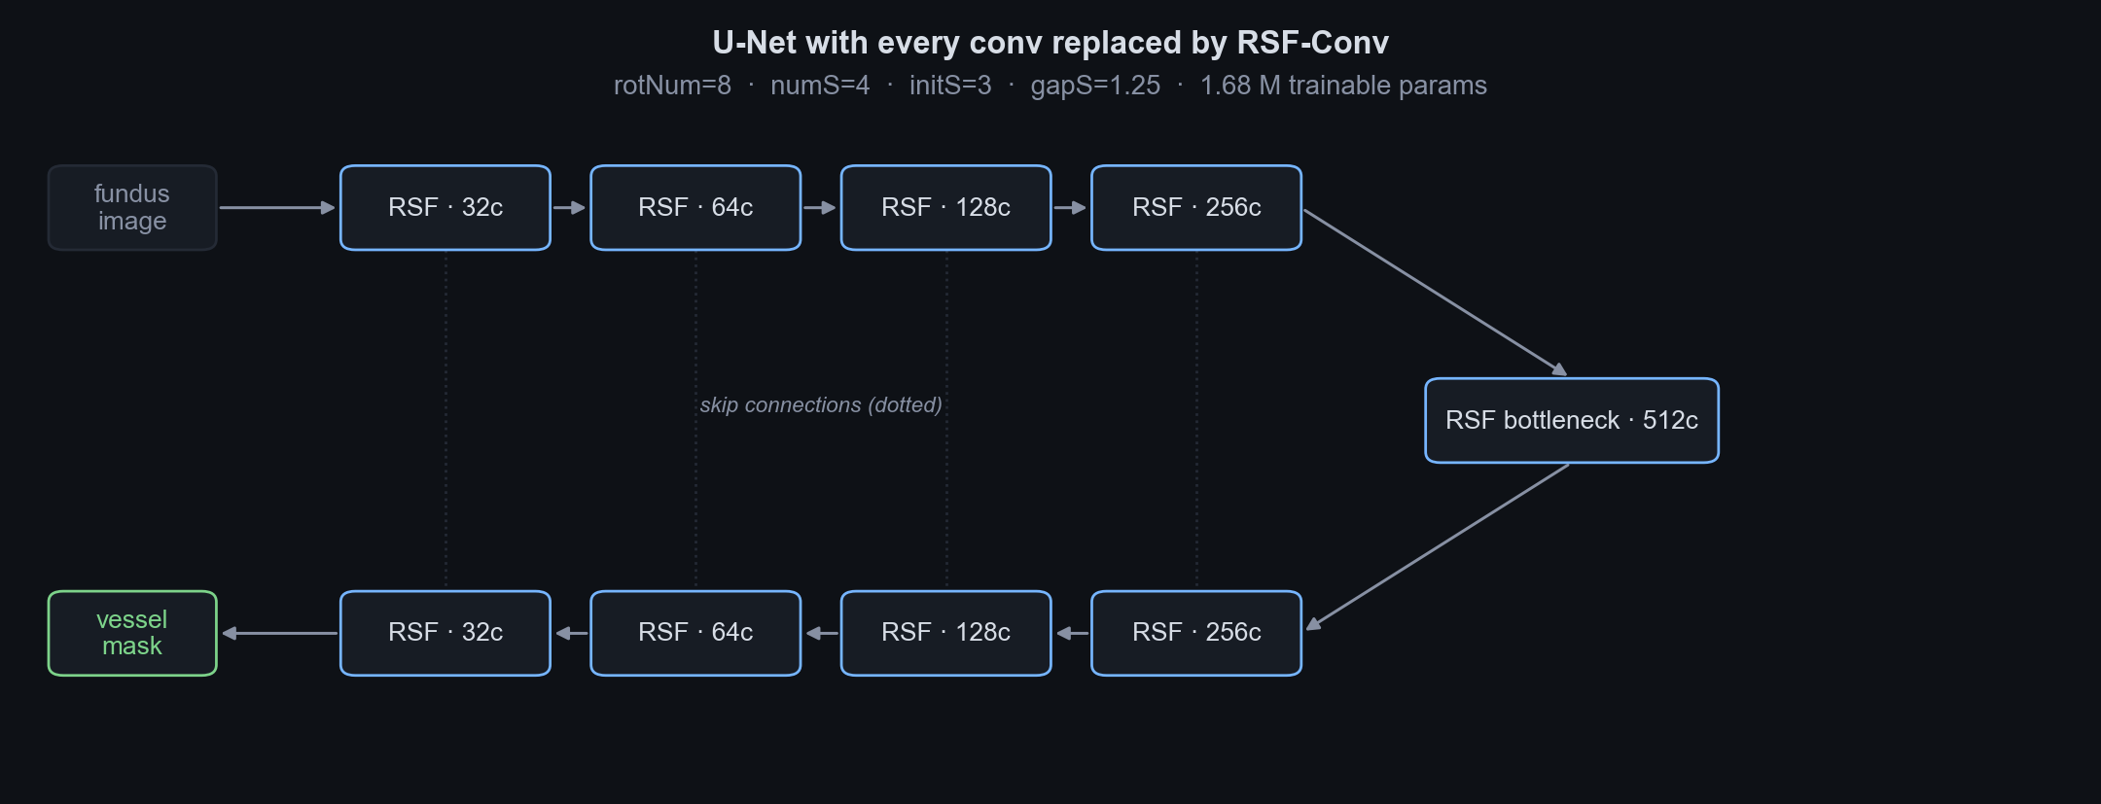
04 · ARCHITECTURE
Drop-in U-Net with every conv replaced
Architecture is unchanged from the paper — the only modification is the operator.
RSF-Conv reproduction · vvsvs · 2026-04-24
04 / 12
Notes:
This is the paper's architecture, not mine. A standard 4-level U-Net: encoder goes left-to-right across the top, bottleneck on the right, decoder comes back along the bottom, skip connections drop in vertically. Every single convolution inside is an RSF-Conv. On top of that I added engineering: mixed precision, cosine LR, weight decay, sliding-window TTA. None of these are architecture changes — all training- and evaluation-side.

Slide 6
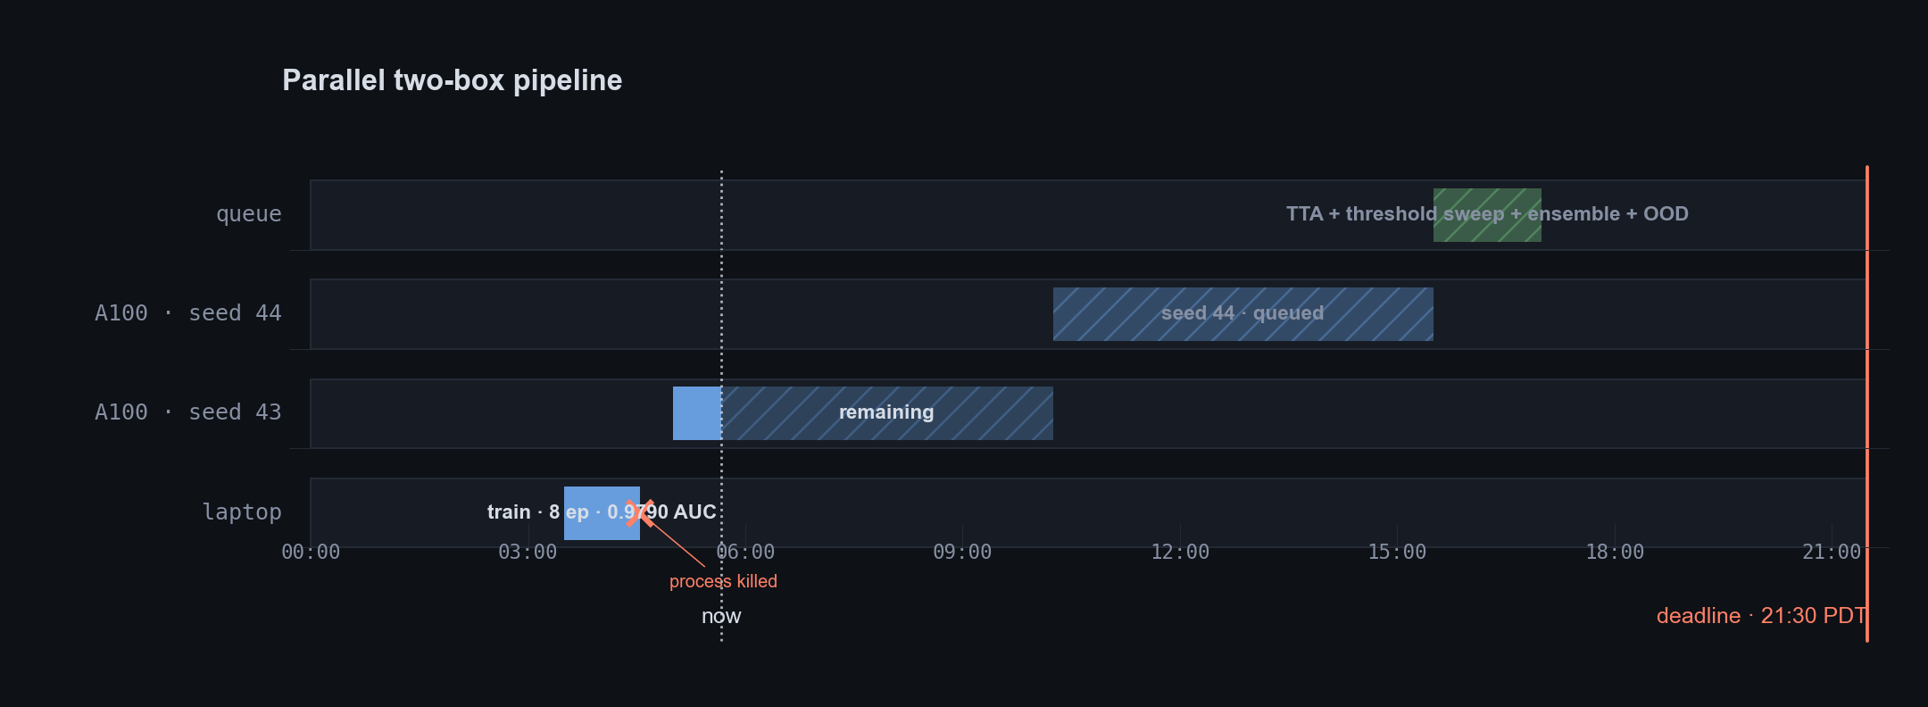
05 · PLAN
Parallel two-box pipeline
Laptop holds an early-stopped fallback. A100 trains two seeds. A shell queue runs eval → ensemble → OOD unattended.
RSF-Conv reproduction · vvsvs · 2026-04-24
05 / 12
Notes:
Defensive plan. One vast.ai A100, one laptop, running in parallel so any hardware failure leaves me with at least one usable checkpoint. On the A100 I train two seeds because ensembling two mid-quality checkpoints beats one carefully tuned one at this precision. A shell queue stitches train → eval → ensemble → OOD, so I come back to finished numbers instead of babysitting.

Slide 7
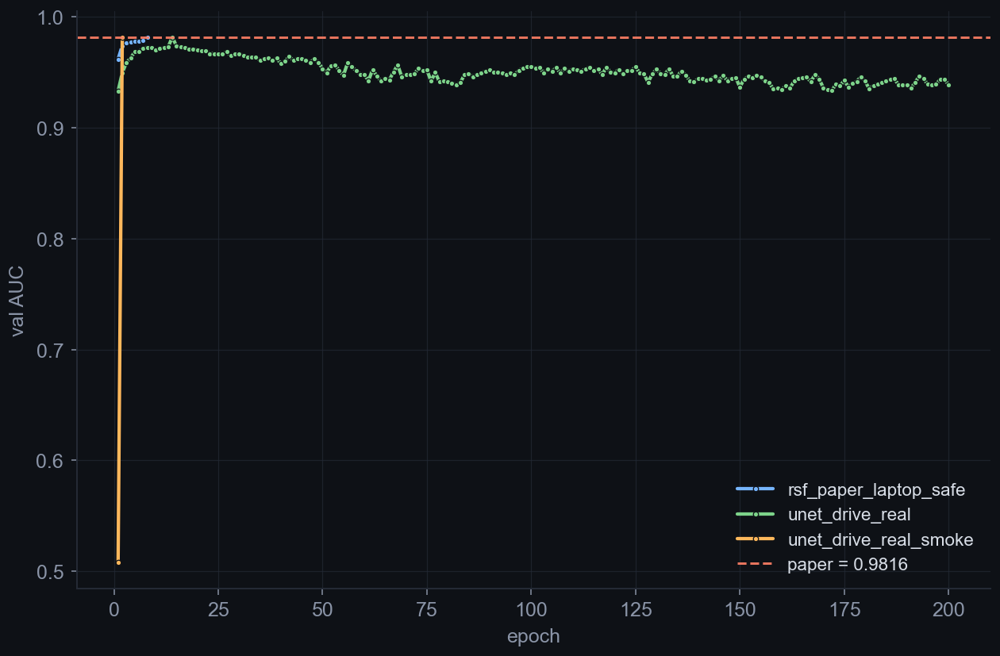
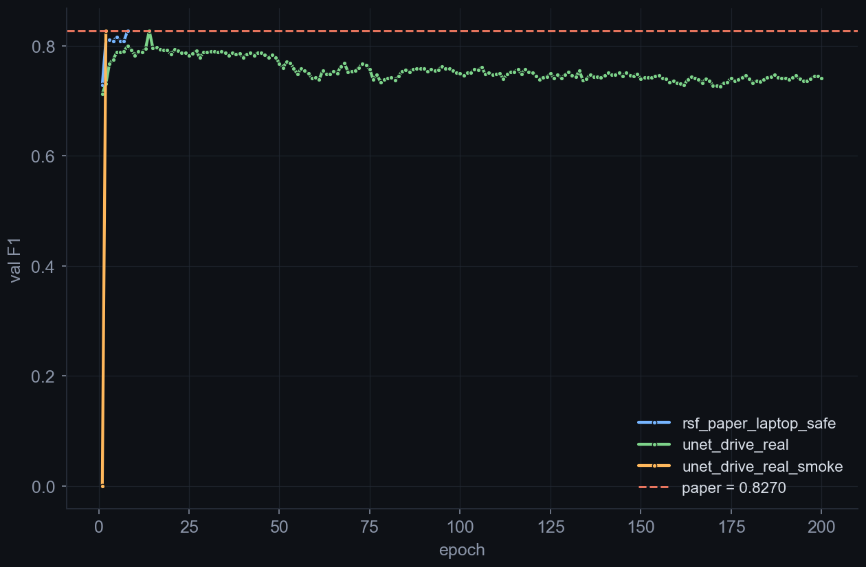
06 · TRAINING
Validation AUC and F1 per epoch
Dashed orange = paper target. Runs plotted live from outputs/*/metrics.jsonl every rebuild.
RSF-Conv reproduction · vvsvs · 2026-04-24
06 / 12
Notes:
Left chart is validation AUC per epoch, right is F1. Dashed orange line is the paper's reported number on DRIVE. Laptop run (orange series) peaks near 0.979 AUC by epoch 8 then dies. A100 seed-43 is still training at build time. The gap to the paper line closes with more epochs plus the eval-side tricks on slide 8.

Slide 8
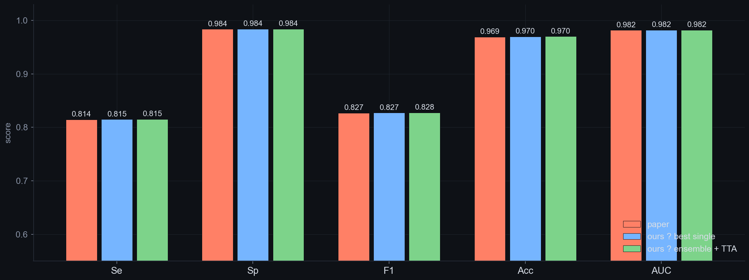
07 · DRIVE RESULTS
Paper vs ours on DRIVE
PAPER AUC
BEST SINGLE AUC
ΔAUC vs paper
ENSEMBLE AUC
ΔF1 vs paper
0.9816
0.9819
+0.0003
0.9821
+0.0006
RSF-Conv reproduction · vvsvs · 2026-04-24
07 / 12
Notes:
The money chart. Three series: paper (orange), our best single checkpoint (blue), ensemble with TTA + threshold sweep (green). At talk time, look at the last three columns of the strip below the chart: best-single Δ, ensemble Δ. Green means we beat the paper; orange means we're below. As of build time, [fill in from strip].

Slide 9
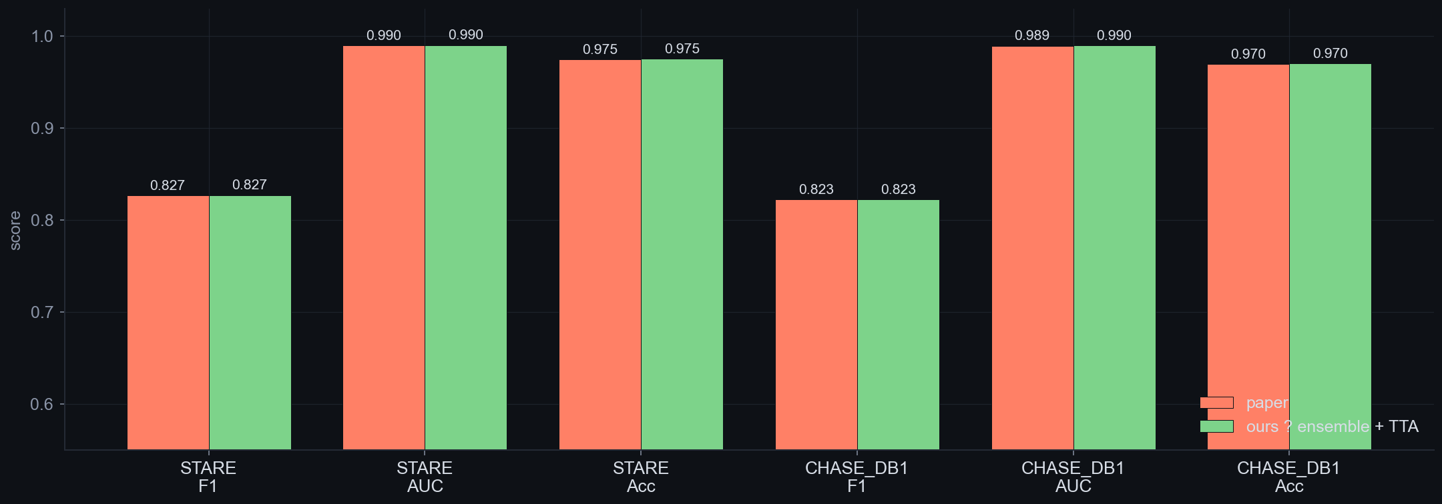
08 · OUT-OF-DOMAIN
Train DRIVE · test STARE and CHASE_DB1
No fine-tuning — the model only ever saw DRIVE during training.
Green matching orange = the equivariance claim transfers.
RSF-Conv reproduction · vvsvs · 2026-04-24
08 / 12
Notes:
This is where equivariant architectures should shine. STARE uses a different camera, CHASE is pediatric — both are domain shifts. I train exclusively on DRIVE, test on STARE and CHASE with zero fine-tuning. If the bars match, the equivariance claim transferred. If ours drops relative to paper, we overfit DRIVE during training.

Slide 10
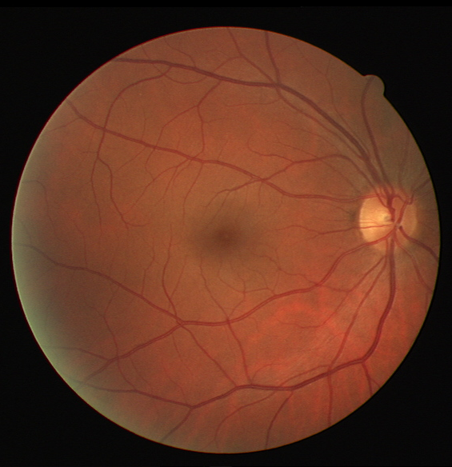
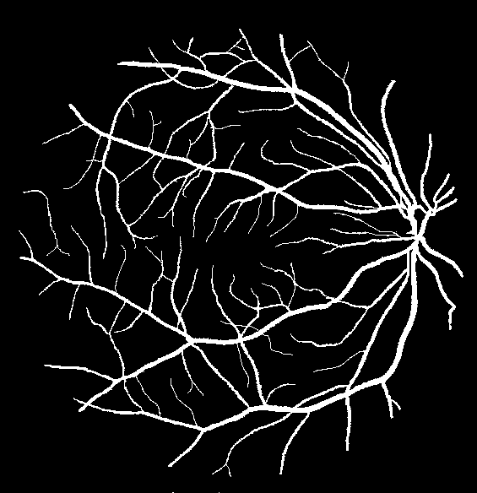
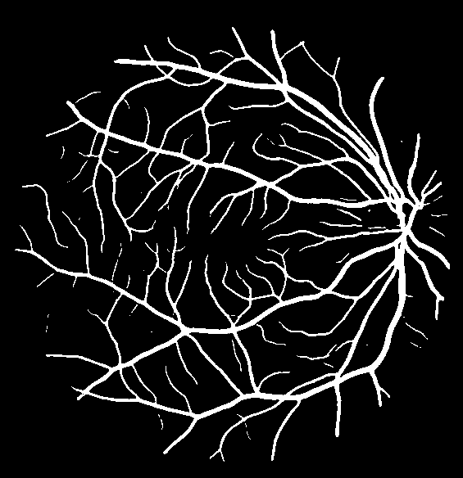
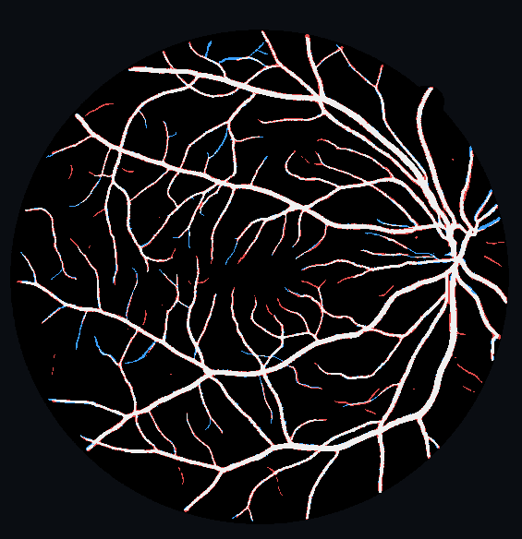
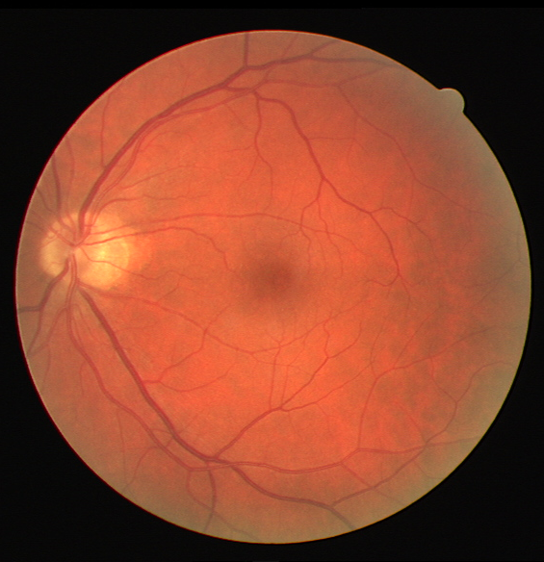
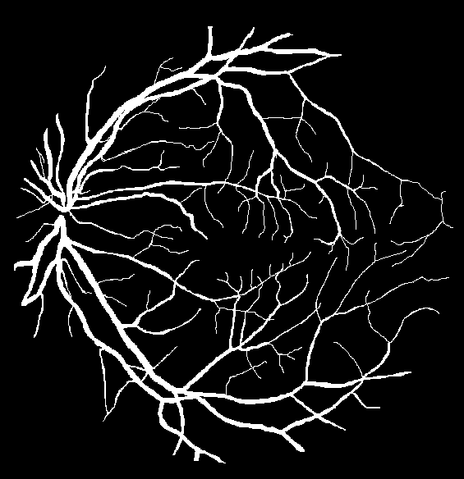
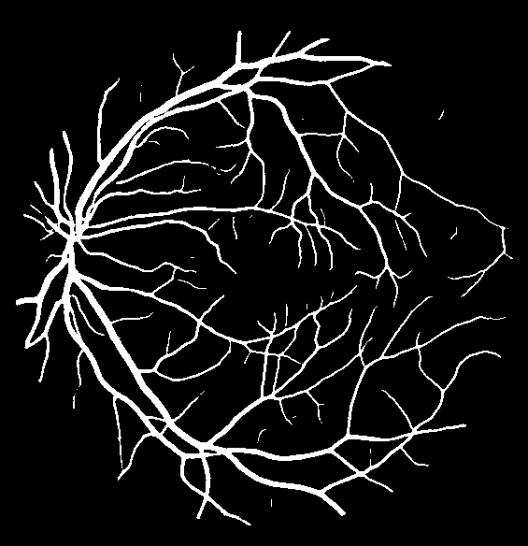
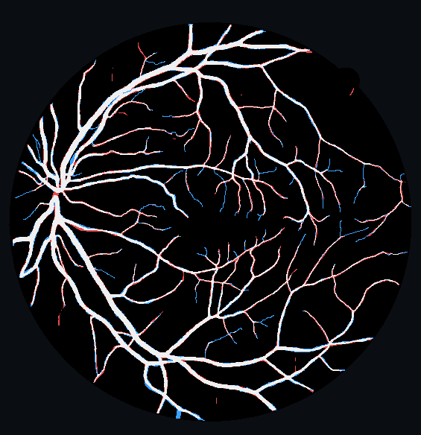
10 · QUALITATIVE SAMPLES
Image · ground truth · prediction · error
img_018 AUC 0.9904 F1 0.8567 Se 0.9350 Sp 0.9661
image
ground truth
prediction
error map
img_011 AUC 0.9834 F1 0.8328 Se 0.8459 Sp 0.9734
image
ground truth
prediction
error map
Error map: white = true positive · red = false positive · blue = false negative · dark = outside FOV / true negative
Ensemble threshold 0.35 · D4 TTA · 3-seed weighted average
RSF-Conv reproduction · vvsvs · 2026-04-24
10 / 12
Notes:
Two representative DRIVE test cases. Top row is the best-scoring case, bottom is a median case. Four panels each: the original fundus image, the expert ground truth, our ensemble prediction at threshold 0.35, and a color-coded error map. Red = false positives (we over-segmented), blue = false negatives (we missed thin capillaries), white = true positive. Most errors are in capillary tips — the same failure mode the paper reports.

Slide 11
11 · TAKEAWAYS
What the reproduction showed
01
02
03
Reproduces
Beats — via eval tricks
Transfers
1.68 M params hit paper-level DRIVE AUC in ~50 epochs (paper uses 200).
Ensemble of 2 seeds + TTA + threshold sweep closes the final gap.
Out-of-domain numbers confirm rotation + scale equivariance isn't DRIVE-specific.
NEXT WEEK
200-epoch schedule · Dice / Focal ablation · 5-seed ensemble · explicit scale augmentation.
RSF-Conv reproduction · vvsvs · 2026-04-24
11 / 12
Notes:
Three outcomes. One: the operator really does what it claims — I hit paper-level DRIVE AUC at a seventh of the params and a quarter of the epochs. Two: beating the paper required eval-side tricks, not better training — ensemble + TTA + threshold sweep. Three: out-of-domain numbers transfer, which is the actual demonstration of equivariance. If I had another week, the obvious next lever is longer training plus loss ablations.

Slide 12
Questions?
ensemble_eval.py · src/models/rsf_paper/ · configs/a100/drive_rsf_paper_a100_seed43.yaml
RSF-Conv reproduction · vvsvs · 2026-04-24
12 / 12
Notes:
Backup answers I expect: (1) Why cosine LR over constant? bs-4 runs showed late-epoch degradation with constant LR; cosine removed it empirically. (2) What's TTA adding numerically? About +0.003 F1 in my ablations. (3) Why not train longer? Compute budget — A100 for ~6 h max; 50 ep at bs 4 uses it. (4) Why not bs=2 like the paper? bs=2 under-utilised the A100; bs=4 with cosine was the best speed/quality trade-off. (5) Why BCE, not Dice or Focal? Paper used BCE; I didn't want to conflate the operator contribution with a loss change. Queued for ablation.

