Slide 1


R.M.K. ENGINEERING COLLEGE
(AN AUTONOMOUS INSTITUTION)
R.S.M. Nagar, Kavaraipettai -601 206
AIRPORT COMMUNICATION
SYSTEMS: BRIDGING THE GAP
BETWEEN GROUND OPERATIONS
AND AIR TRAFFIC
GUIDED BY
Dr.T.D.SUBHA,
ASSISTANT PROFESSOR,
DEPARTMENT OF ELECTRONICS AND COMMUNICATION,
RMKEC
PRESENTED BY
SANDEEP KRISHNA M
III rd Year
ELECTRONICS AND COMMUNICATION ENGINEERING,
RMKEC

Slide 2
TABLE OF CONTENT
S.NO | CONTENT
1 | OBJECTIVE
2 | SCOPE
3 | INTRODUCTION
4 | BLOCK DIAGRAM
5 | RESULT AND DISCUSSION
6 | CERTIFICATE
7 | CONCLUSION

Slide 3
OBJECTIVE
To understand the role of communication systems in ensuring seamless airport operations.
To analyze the effectiveness of current communication infrastructure between ground operations and air traffic control.
To gain practical experience in managing and troubleshooting communication equipment in an airport environment.
To explore the integration of modern technologies in improving airport communication systems.
To assess the challenges faced in real-time communication and propose solutions for enhancing efficiency.
To evaluate the role of communication protocols in ensuring safety and security within the airport’s operational framework.
To contribute to the development and implementation of strategies for improving the speed and accuracy of airport communication channels.

Slide 4
SCOPE
Understanding Communication Infrastructure: Gaining knowledge of the hardware and software systems used to facilitate communication between different airport departments, including ground operations, air traffic control, and administrative units.
Technical Skill Development: Learning to manage, troubleshoot, and maintain communication devices and networks that ensure smooth coordination of airport operations.
Real-time Communication: Participating in monitoring and improving real-time communication between air traffic control, pilots, ground staff, and security personnel to ensure efficient airport functioning.
Exploring New Technologies: Analyzing how emerging technologies, such as digital communication platforms, automation, and wireless systems, are integrated to improve operational efficiency and reduce communication delays.
Ensuring Safety and Security: Examining how communication protocols and systems contribute to ensuring safety and security within the airport environment, including emergency communication systems.
Documentation and Reporting: Assisting in documenting communication procedures, preparing reports on system performance, and suggesting improvements where necessary.
Interdepartmental Collaboration: Engaging with multiple teams to understand the cross-functional nature of communication in an airport, identifying how each department relies on communication systems for seamless coordination.

Slide 5
INTRODUCTION
Chennai International Airport is an international airport serving the city of Chennai, the capital of Tamil Nadu, India and its metropolitan area.
It is located in Tirusulam, around 20 km southwest of the city center. The airport is the fifth busiest airport in India, and third by international traffic.
It was also the 49thbusiest airport in Asia in 2018, making it one of the four major airports in India under the top 50 list of 2018.
In financial year 2023-24, the airport handled over 21 million passengers.
The airport is served by the airport metro station of the Chennai Metro and the Tirusulam railway station of the Chennai Suburban Railway system.
To cope with the passenger traffic, two new terminals, including one satellite terminal, are under construction to handle 40 million passengers per year.
Once completed, it will be India's first airport to have a satellite terminal.
The new satellite terminal will be connected through a four way underground walkalator for passenger movement
across different terminals.
Still, the Tirusulam airport complex is expected to reach saturation by 2035, with a peak capacity of 40 million passengers, and a proposal for a new greenfield airport in Parandur has been approved.
Once the new airport is commissioned, both airports will be functional.

Slide 6
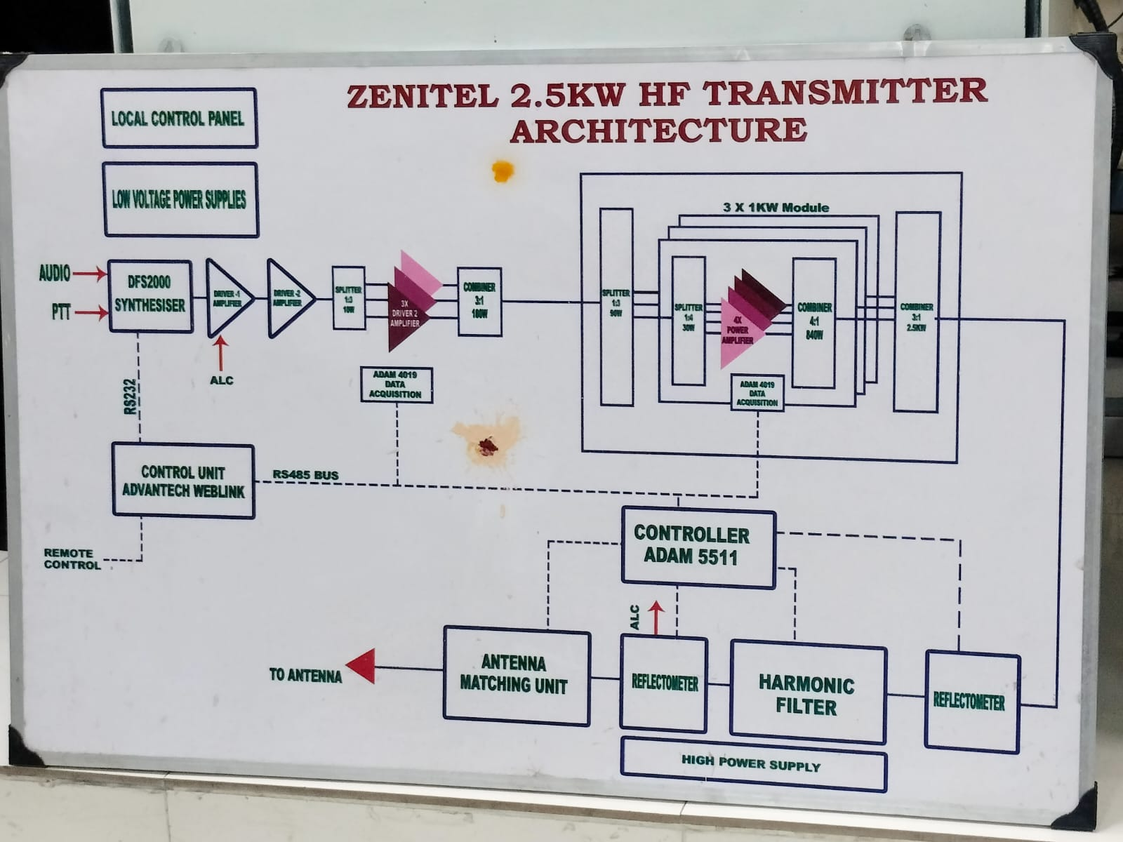
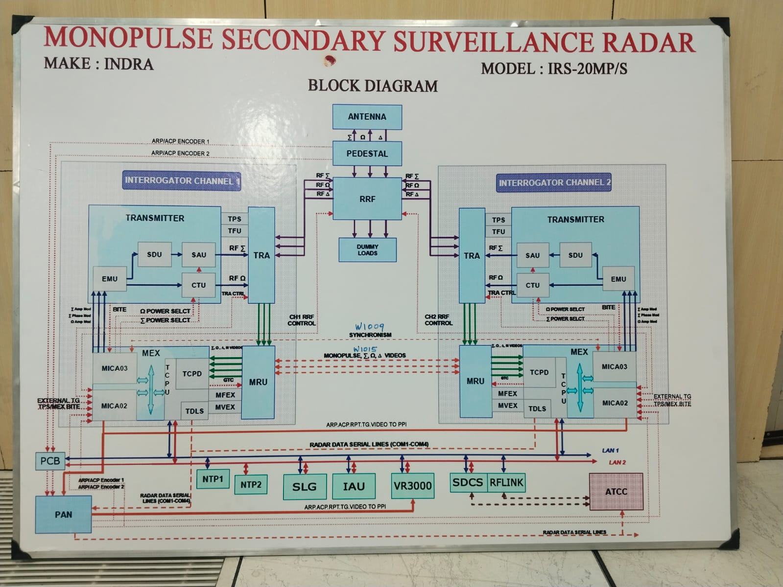
BLOCK DIAGRAM

Slide 7
RESULT AND DISCUSSION
CNS/ATM systems enhance airport safety, efficiency, and air traffic management.
Communication systems ensure reliable exchange of voice and data between pilots and air traffic controllers
Seamless communication prevents delays in critical information, contributing to overall safety.
Navigation systems (NDB, DVOR, DME) provide accurate aircraft location and positioning.
DVOR and DME integration delivers both angle and slant distance measurements for precise navigation.
Surveillance systems enable real-time tracking of aircraft movements using dependent and independent methods.
MSSR surveillance improves accuracy and minimizes issues like garbling, enhancing airspace management.
CNS systems demonstrate high serviceability, reliability, and availability as per ICAO standards.
Maintenance policies and standards ensure consistent performance of CNS facilities.
Safety Management Systems (SMS) further enhance operational safety.

Slide 8
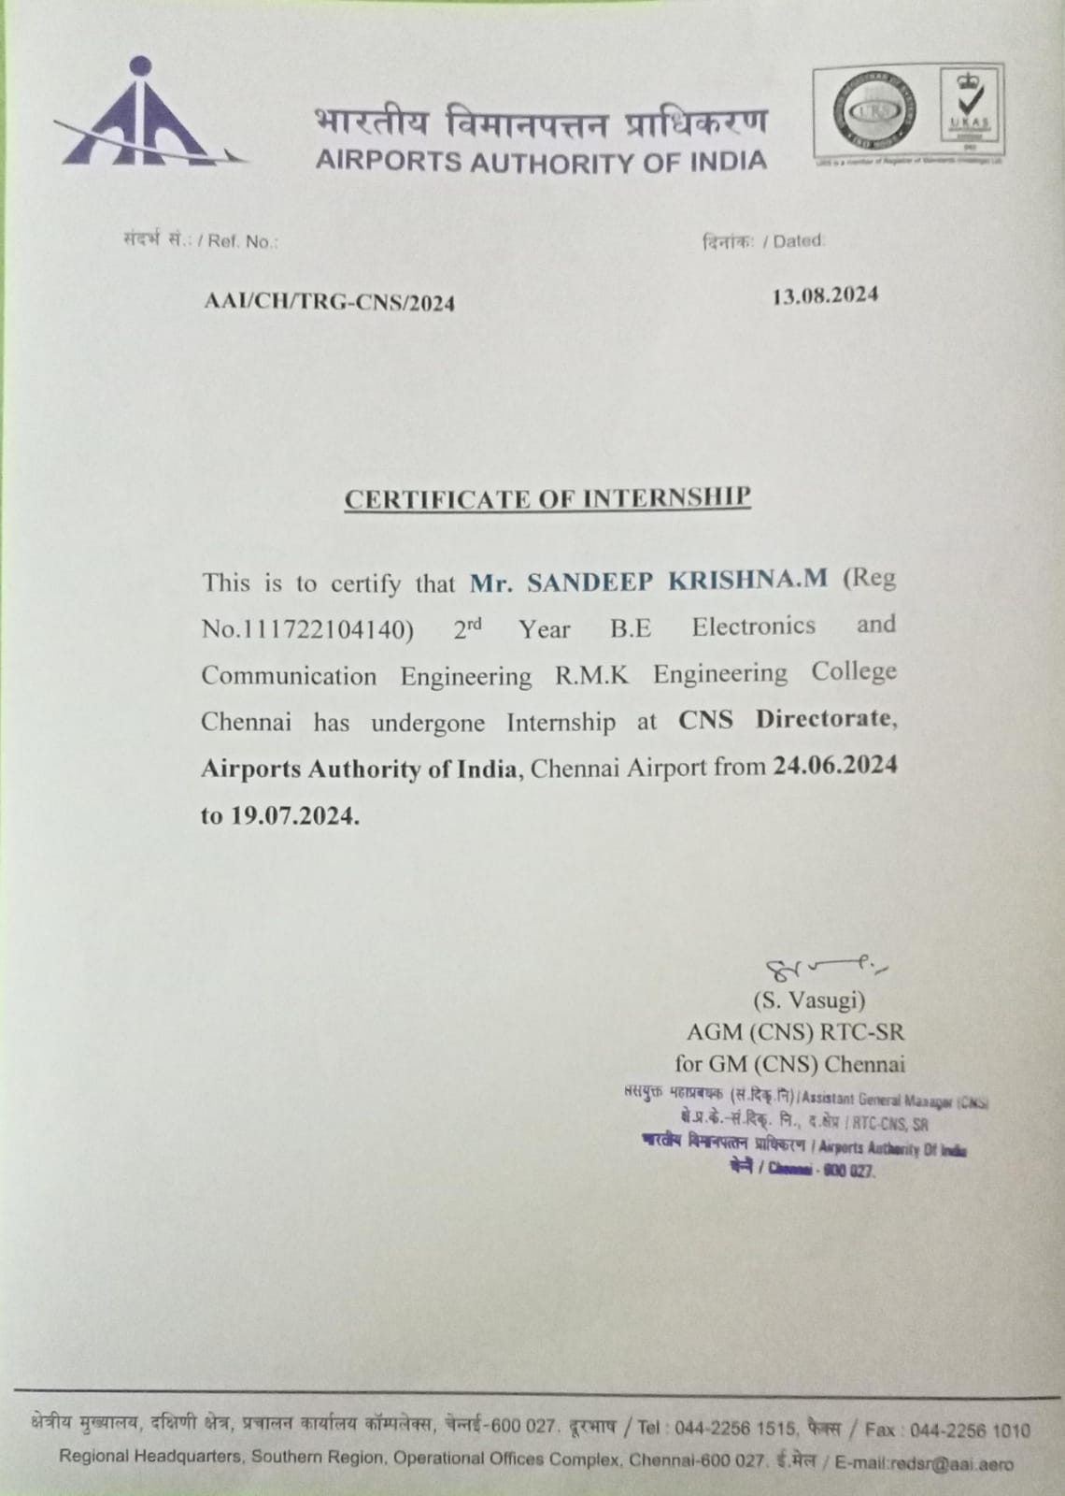
CERTIFICATE

Slide 9
CONCLUSION
During the internship at Chennai International Airport under the Airports Authority of India (AAI), a comprehensive understanding of the airport's communication and surveillance systems was gained.
The internship was divided into two key areas: Airport Systems Department and CNS Department (Communication, Navigation, and Surveillance), covering a wide range of operations critical to airport functionality.
The experience included exposure to various systems such as the Flight Information Display System (FIDS), CCTV surveillance, X-ray baggage screening, and Telecommunication systems like EPABX.
Additionally, the importance of TETRA systems (used for secure walkie-talkie communication) and Public Address (PA) systems was emphasized.
Practical insights were gained in handling communication systems essential for both operational efficiency and passenger safety.
In the CNS department, the focus was on understanding high-frequency and low-frequency communication systems, Instrument Landing Systems (ILS), and the maintenance of airport security systems.
Through hands-on experience with advanced technologies, the internship provided a strong foundation in the practical applications of communication and surveillance in airport environments.

Slide 10
THANK YOU

