Slide 1
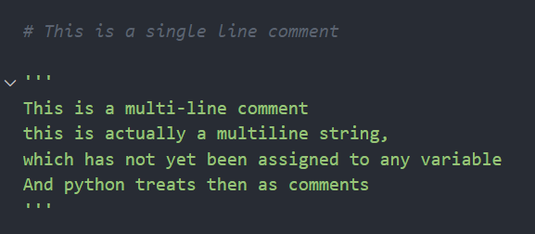
COMMENTS

Slide 2
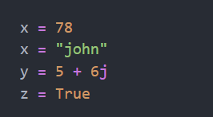

VARIABLES
Datatype Need not be specified
Multiple declaration

Slide 3
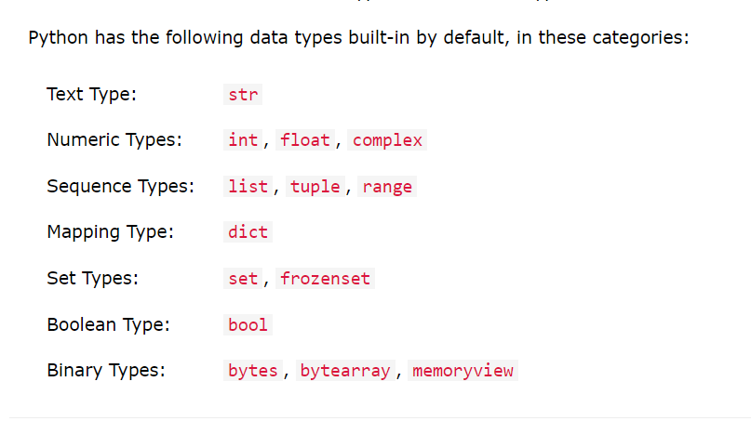
DATATYPES

Slide 4
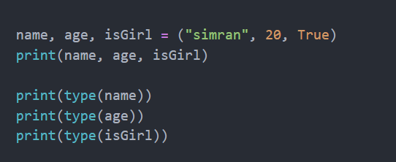
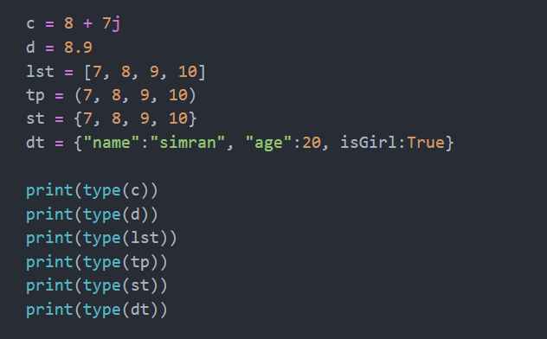

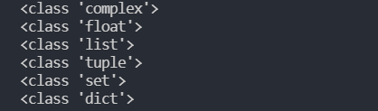
DATATYPES
Datatype of a variable can be found using the type() operator

Slide 5
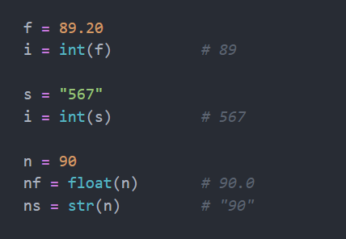
DATATYPES
Type Casting
Changing the datatype of a value stored in a variable.
It is done with the help of the constructor functions of the data type to which the value has to be converted.
Here, int() float() str() complex() etc.
are called "constructor functions“
of the respective datatypes

Slide 6
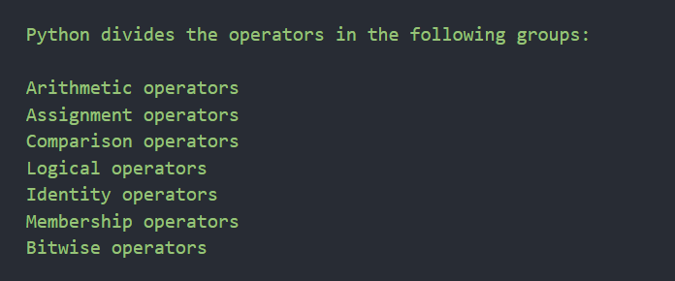
OPERATORS

Slide 7
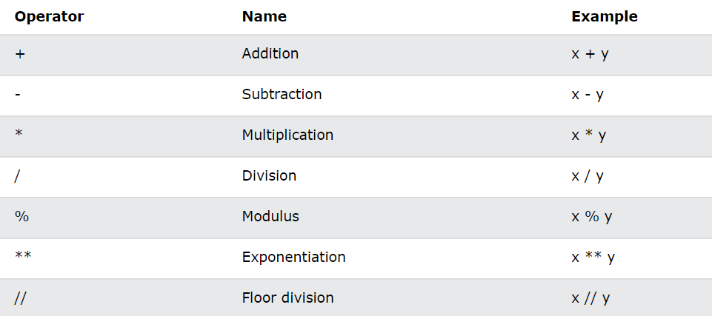
OPERATORS
Arithmetic Operators

Slide 8
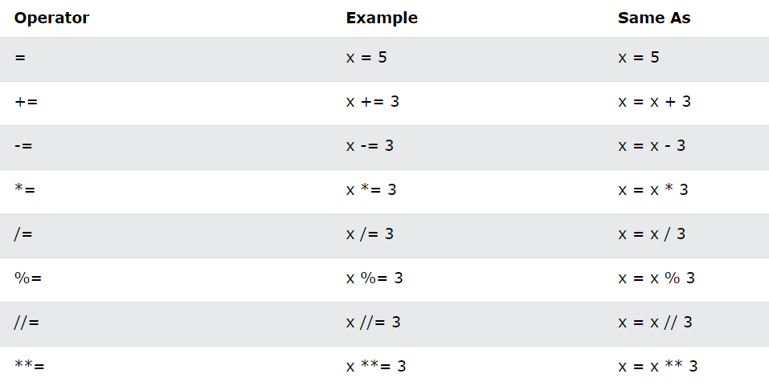
OPERATORS
Assignment Operators

Slide 9
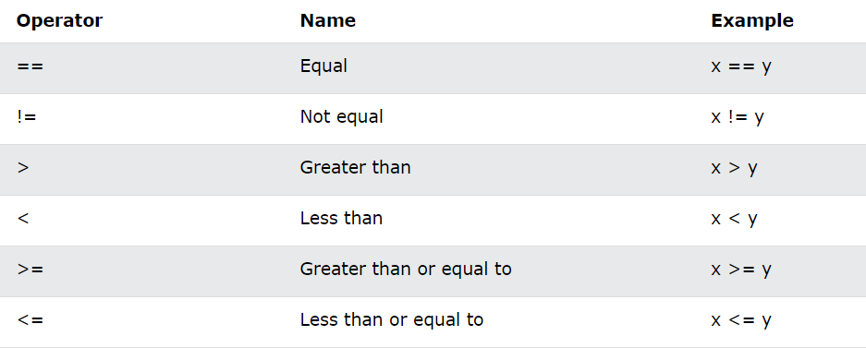
OPERATORS
Comparison Operators

Slide 10
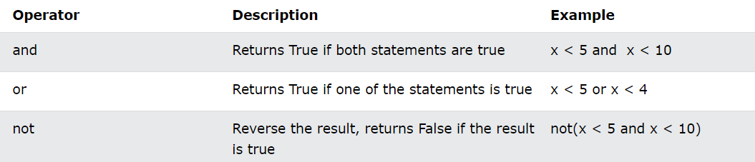
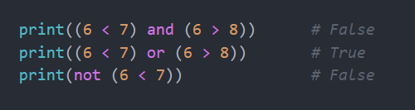
OPERATORS
Logical Operators

Slide 11
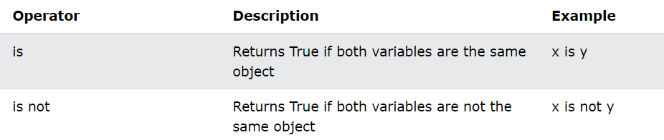
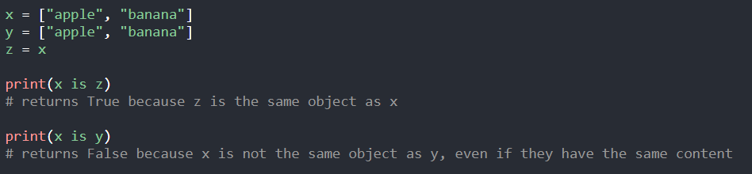
OPERATORS
Identity Operators
Used to compare the objects, not if they are equal, but if they are actually the same object, with the same memory location:

Slide 12
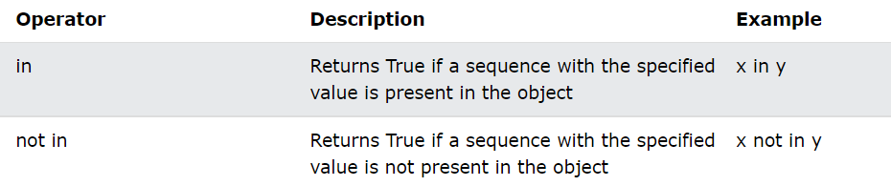
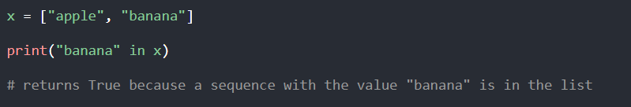
OPERATORS
Membership Operators
Membership operators are used to test if a sequence is presented in an object:

Slide 13
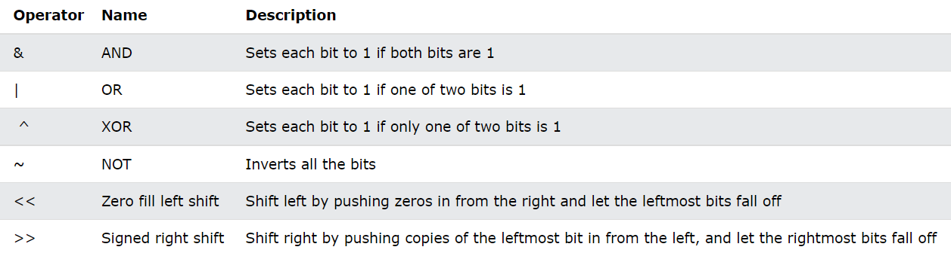
OPERATORS
Bitwise Operators

Slide 14

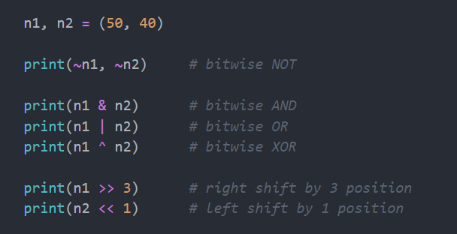
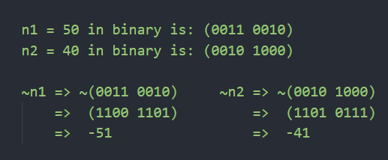
Bitwise Operations
Reference Code:
NOT

Slide 15
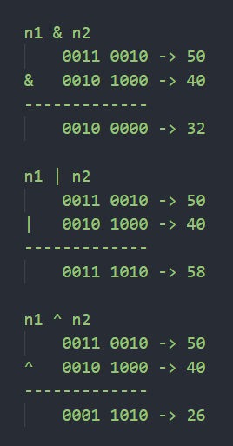
Bitwise Operations
AND, OR, XOR
Reference Code:

Slide 16
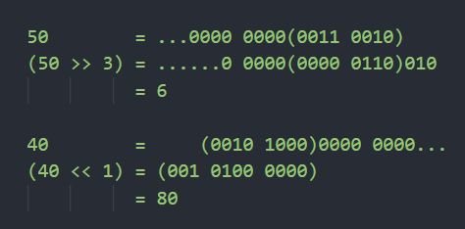
Bitwise Operations
Reference Code:
Right Shift, Left Shift

Slide 17
What’s Ahead?
Numbers
Strings
Booleans
Lists
Tuples
Sets
Dictionaries

Slide 18
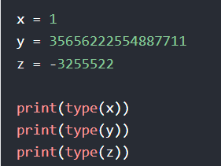
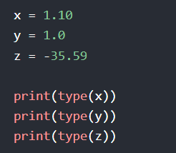
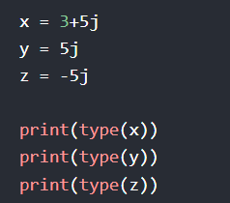
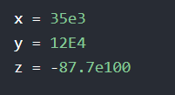
NUMBERS
int
float
complex
Float can also be scientific numbers with an "e" to indicate the power of 10.

Slide 19
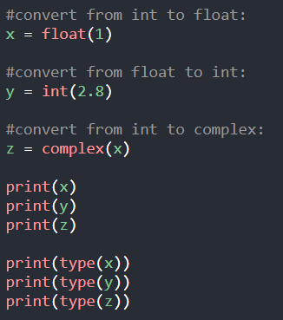
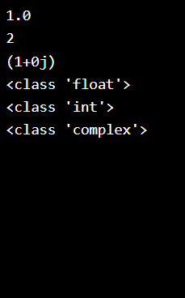
NUMBERS
Inter-Conversion
Numbers of Complex type cannot be converted to any other type.

Slide 20
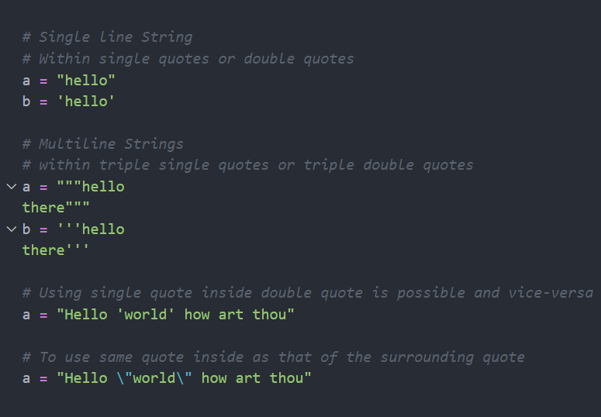
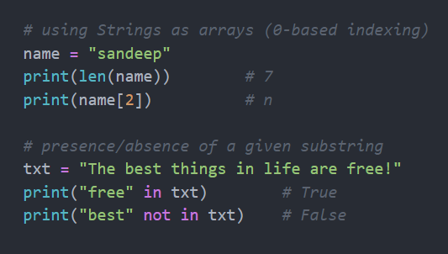
STRINGS

Slide 21
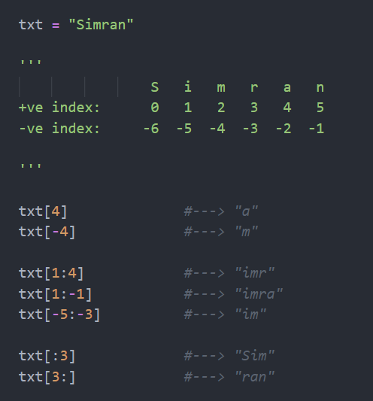
STRINGS
Slicing a string:
If index is negative then calculated from end, with the last element indexed as -1
Range is denoted by a colon [a:b]
Inclusive of index a
Exclusive of index b
If a is omitted, then assume a = 0
If b is omitted, then assume b = len(txt)

Slide 22
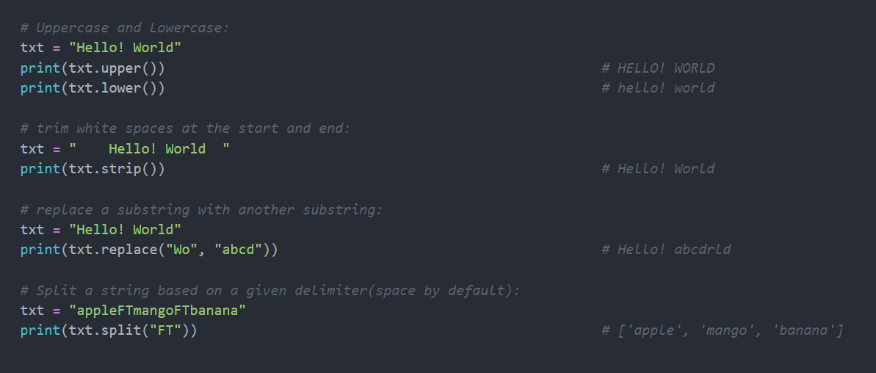
STRINGS
Modifications in a string:

Slide 23
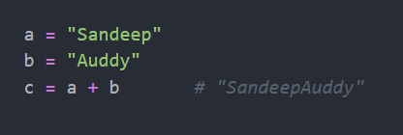
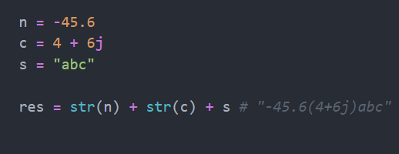
STRINGS
Concatenate strings:
Simply using the plus(+) operator
Concatenate non-strings:
Using the plus(+) operator
But first converting each non-strings to a string by Type-Casting

Slide 24

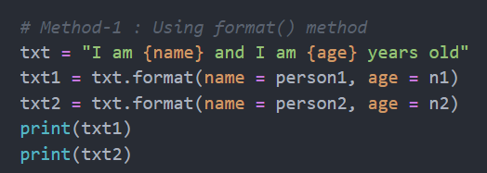
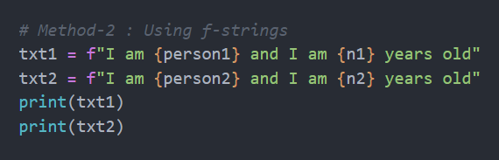

STRINGS
Format strings:

Slide 25
STRINGS
Reference to all other string methods:
https://www.w3schools.com/python/python_strings_methods.asp

