Slide 1
Whizlabs sample test questions https://www.whizlabs.com/learn/course/google-cloud-certified-professional-cloud-architect/239/quiz/14777/report/6154892

Slide 2
Case Study --Helicopter racing league – HRL question reference : Q1. How can you manage both live streaming and live annotation (Wizlab)
https://cloud.google.com/video-intelligence/docs/streaming/live-streaming-overview
https://cloud.google.com/blog/products/data-analytics/streaming-video-using-cloud-data-platform
Q17. There is a need to transform media in to different streaming format , so as to optimize for different format.
https://cloud.google.com/transcoder/docs/concepts/overview
Telemetry – is important for this case study and in this link you can study about ISTIO telemetry solution and how it can help a customer - https://www.coursera.org/lecture/hybrid-cloud-service-mesh-anthos/telemetry-and-observability-in-service-mesh-jeANQ

Slide 3
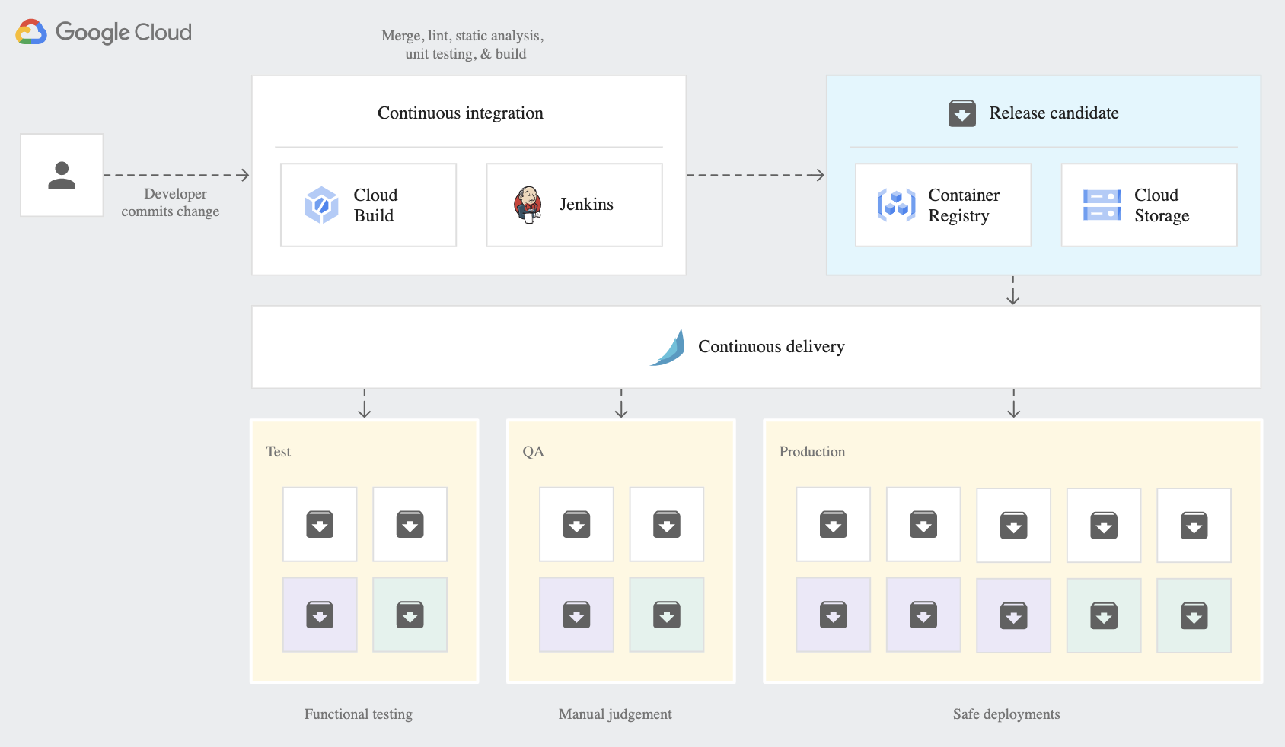
Case study -- EHR healthcare
--How to design its CI-CD --difference between Google build and spinnaker and jenkin
Spinnaker - https://cloud.google.com/architecture/continuous-delivery-toolchain-spinnaker-cloud
google CI-CD - https://cloud.google.com/docs/ci-cd?hl=en
A CI-CD pipeline using Spinnaker and cloud build

Slide 4
Case Study – Mountkirk Games

Slide 5
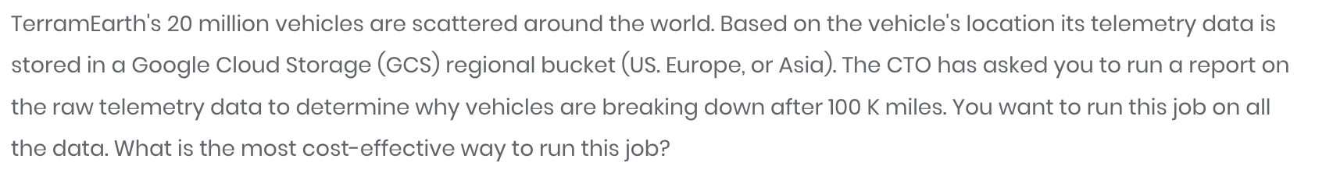
Case Study – Terram Earth

Slide 6
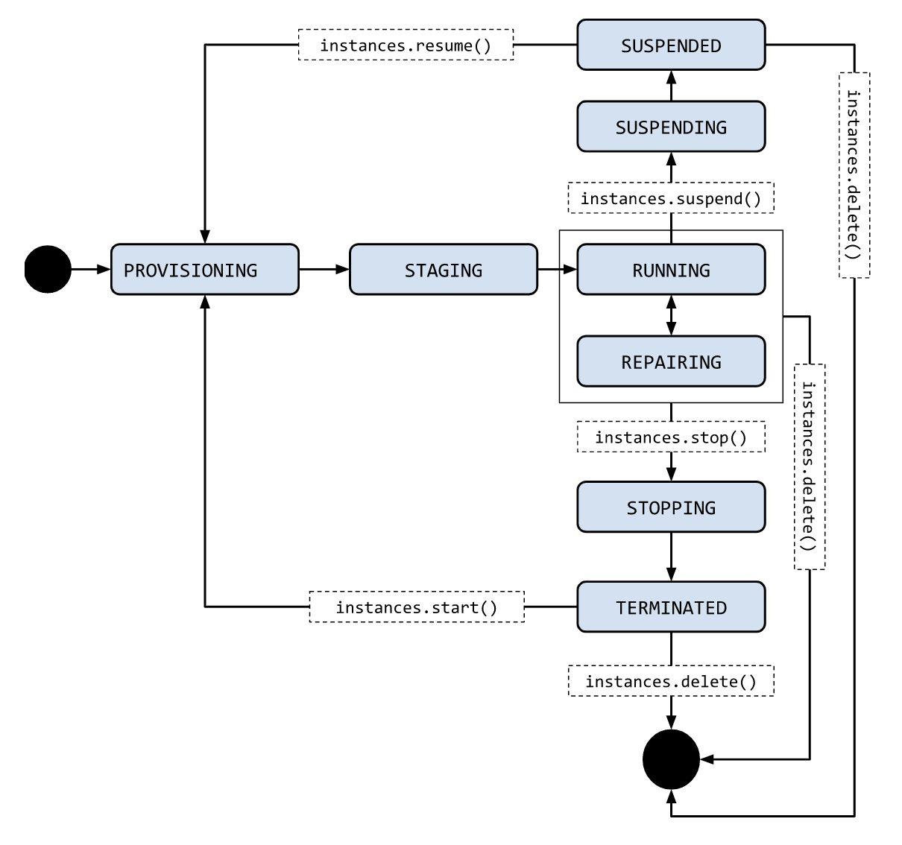
 | Stopping | Suspending | Resetting
Billing | Google does not charge for VM resources while they are in the TERMINATED state. | Google charges for storing the preserve state of suspended VMs. | Because the VM remains in the RUNNING state when it is resetting, Google charges for VMs according to standard VM prices.
VM state | TERMINATED | SUSPENDED | RUNNING
Persistent disks | Persistent disks are maintained, even when persistent disks are marked for auto-delete. You are charged for a persistent disk that is associated with a stopped VM, just like you are charged for a persistent disk that is not associated with a VM. | Persistent disks are maintained, even when persistent disks are marked for auto-delete. You are charged for a persistent disk that is associated with a stopped VM, just like you are charged for a persistent disk that is not associated with a VM. | Persistent disks are maintained, even when persistent disks are marked for auto-delete. You are charged for persistent disks as long as the VM remains in a RUNNING state.
RAM and VM state | Reset to power-on state, no data is saved. | Guest OS and application state is preserved and restored when the VM is resumed. You are charged a specific rate for storing preserved data. For more information, see Billing for suspended instances. | Reset to power-on state, no data is saved.
GPUs | GPUs are not charged when a VM is stopped. A GPU that is attached to a TERMINATED VM doesn't count against your project quota. | Not supported. If a GPU is attached to a VM, you cannot suspend the VM. | You are charged standard GPU prices.
Local SSDs | Not supported. You cannot stop a VM that has a local SSD attached to it. | Not supported. You can suspend a VM that has a local SSD, but you must explicitly discard the local SSD data in the process. | Local SSDs are maintained.
External ephemeral IPs | Ephemeral IPs are released when a VM is stopped, but a new ephemeral IP address is acquired when the VM restarts. | Ephemeral IPs are released when a VM is suspended, but a new ephemeral IP address is acquired when the VM restarts. | Ephemeral IPs are released when a VM is reset, but a new ephemeral IP address is acquired when the VM restarts.
External static IPs | Static external IPs are maintained. Static IPs that are assigned to VMs in the TERMINATED state are charged as if they aren't attached to any VM. For more information, see pricing. | Static external IPs are maintained. Static IPs that are assigned to VMs in the SUSPENDED state are charged as if they aren't attached to any VM. For more information, see pricing. | Static external IPs are maintained.
Internal IPs or MAC addresses | Internal IPs and MAC addresses are maintained. | Internal IPs and MAC addresses are maintained. | Internal IPs are released when a VM is deleted. MAC addresses are generated based on the internal IP. If you want to reuse the MAC address, set the same internal IP address or use a reserved internal IP.
VM metadata | VM metadata is maintained. | VM metadata is maintained. | VM metadata is maintained.
Instance life cycle - https://cloud.google.com/compute/docs/instances/instance-life-cycle
Reference question : https://www.whizlabs.com/learn/course/google-cloud-certified-professional-cloud-architect/239/quiz/14777/report/6154892

Slide 7
Cloud deployment manager Q1. business risk to migrate to the deployment manager
https://cloud.google.com/deployment-manager/docs/deployments/deleting-deployments
Select a delete policy
The delete policy you use determines how the resources in the deployment are handled. You can use one of these policies:
DELETE [Default]: Deletes the underlying resource. This is permanent and cannot be undone.
ABANDON: This deletes the deployment, but does not delete the underlying resources. For example, if you have a VM instance in the deployment, it will still be available for you to use after the deployment is deleted.
If you need to re-create a deployment that you deleted, you can use the original configuration file. However, the deployment is considered a new deployment, with new resources.
Access control ---- https://cloud.google.com/deployment-manager/docs/access-control
-- To create other Google Cloud resources, Deployment Manager uses the credentials of the Google APIs Service Agent to authenticate to other APIs. The Google APIs Service Agent is designed specifically to run internal Google processes on your behalf. This service account is identifiable using the email:
How to - https://cloud.google.com/deployment-manager/docs/manage-cloud-resources-deployment Best Practicing - https://cloud.google.com/deployment-manager/docs/best-practices
Role | Permissions
Deployment Manager Editor (roles/deploymentmanager.editor) Provides the permissions necessary to create and manage deployments. Lowest-level resources where you can grant this role: Project | deploymentmanager.compositeTypes.* deploymentmanager.deployments.cancelPreview deploymentmanager.deployments.create deploymentmanager.deployments.delete deploymentmanager.deployments.get deploymentmanager.deployments.list deploymentmanager.deployments.stop deploymentmanager.deployments.update deploymentmanager.manifests.* deploymentmanager.operations.* deploymentmanager.resources.* deploymentmanager.typeProviders.* deploymentmanager.types.* resourcemanager.projects.get resourcemanager.projects.list serviceusage.quotas.get serviceusage.services.get serviceusage.services.list
Deployment Manager Type Editor (roles/deploymentmanager.typeEditor) Provides read and write access to all Type Registry resources. Lowest-level resources where you can grant this role: Project | deploymentmanager.compositeTypes.* deploymentmanager.operations.get deploymentmanager.typeProviders.* deploymentmanager.types.* resourcemanager.projects.get resourcemanager.projects.list serviceusage.quotas.get serviceusage.services.get
Deployment Manager Type Viewer (roles/deploymentmanager.typeViewer) Provides read-only access to all Type Registry resources. Lowest-level resources where you can grant this role: Project | deploymentmanager.compositeTypes.get deploymentmanager.compositeTypes.list deploymentmanager.typeProviders.get deploymentmanager.typeProviders.getType deploymentmanager.typeProviders.list deploymentmanager.typeProviders.listTypes deploymentmanager.types.get deploymentmanager.types.list resourcemanager.projects.get resourcemanager.projects.list serviceusage.quotas.get serviceusage.services.get
Deployment Manager Viewer (roles/deploymentmanager.viewer) Provides read-only access to all Deployment Manager-related resources. Lowest-level resources where you can grant this role: Project | deploymentmanager.compositeTypes.get deploymentmanager.compositeTypes.list deploymentmanager.deployments.get deploymentmanager.deployments.list deploymentmanager.manifests.* deploymentmanager.operations.* deploymentmanager.resources.* deploymentmanager.typeProviders.get deploymentmanager.typeProviders.getType deploymentmanager.typeProviders.list deploymentmanager.typeProviders.listTypes deploymentmanager.types.get deploymentmanager.types.list resourcemanager.projects.get resourcemanager.projects.list serviceusage.quotas.get serviceusage.services.get serviceusage.services.list

Slide 8
Firewall rules :

Slide 9
Amazon S3 transfers- https://cloud.google.com/bigquery-transfer/docs/s3-transfer
Required permissions
Before creating an Amazon S3 transfer:
Ensure that the person creating the transfer has the following required permissions in BigQuery:
bigquery.transfers.update permissions to create the transfer
Both bigquery.datasets.get and bigquery.datasets.update permissions on the target dataset
The bigquery.admin predefined IAM role includes bigquery.transfers.update, bigquery.datasets.update and bigquery.datasets.get permissions. For more information on IAM roles in BigQuery Data Transfer Service, see Access control reference.
Consult the documentation for Amazon S3 to ensure you have configured any permissions necessary to enable the transfer. At a minimum, the Amazon S3 source data must have the AWS managed policy AmazonS3ReadOnlyAccess applied to it.
Limitations
Amazon S3 transfers are subject to the following limitations:
Currently, the bucket portion of the Amazon S3 URI cannot be parameterized.
Transfers from Amazon S3 are always triggered with the WRITE_APPEND preference which appends data to the destination table. See configuration.load.writeDisposition in the load job configuration for additional details.
Depending on the format of your Amazon S3 source data, there may be additional limitations. For more information, see:
CSV limitations
JSON limitations
Limitations on nested and repeated data
The minimum interval time between recurring transfers is 24 hours. The default interval for a recurring transfer is 24 hours.

Slide 10
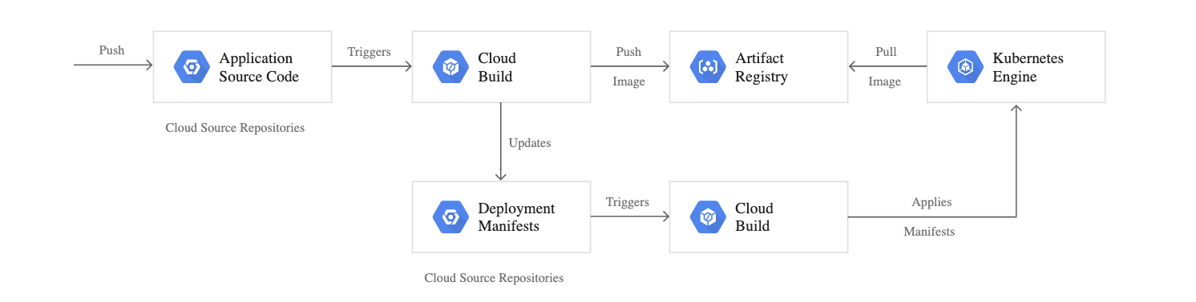
CI-CD/ gitOps ----------→> https://cloud.google.com/kubernetes-engine/docs/tutorials/gitops-cloud-build
GitOps - A key part of GitOps is the idea of "environments-as-code"

Slide 11
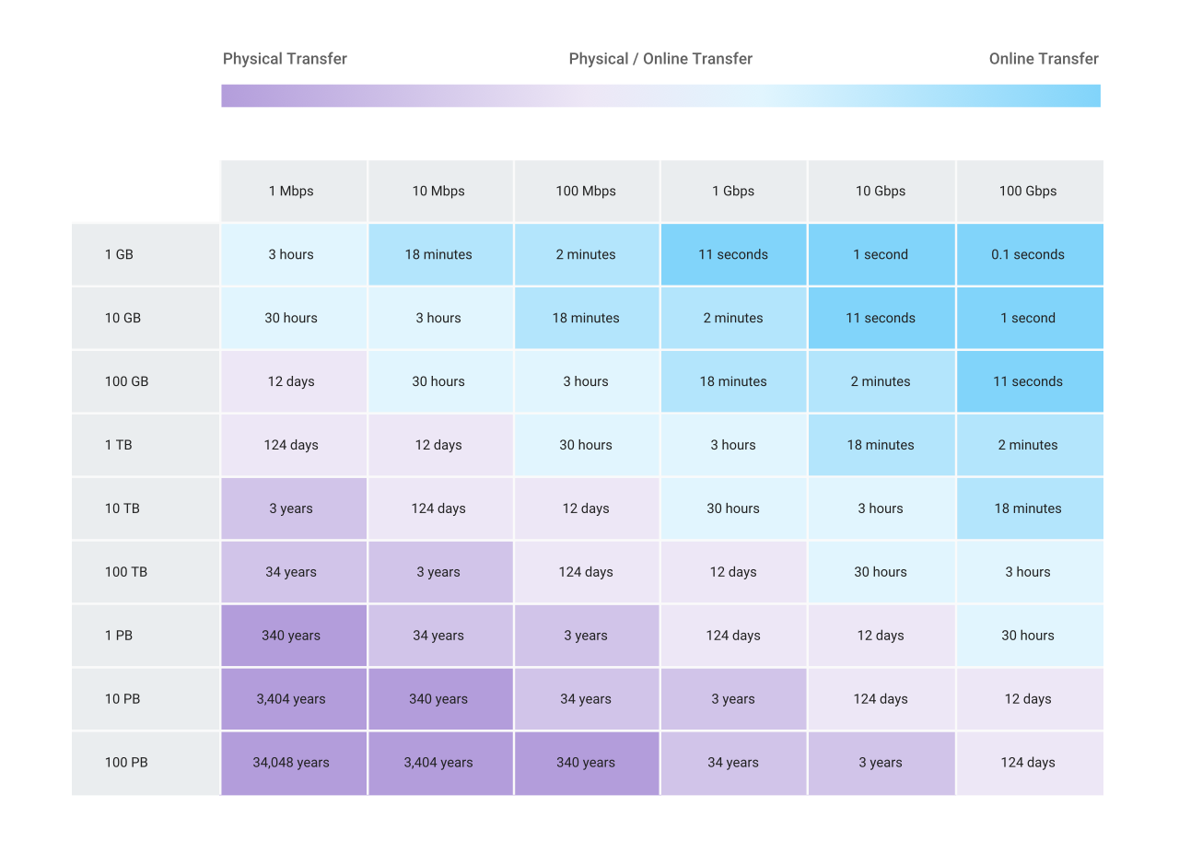
Data transfer questions
Storage transfer service → https://cloud.google.com/storage-transfer/docs/overview
When to use gsUtill
Transferring from another cloud storage provider | Use Storage Transfer Service.
Transferring less than 1 TB from on-premises | Use gsutil.
Transferring more than 1 TB from on-premises | Use Transfer service for on-premises data.
Transferring less than 1 TB from another Cloud Storage region | Use gsutil.
Transferring more than 1 TB from another Cloud Storage region | Use Storage Transfer Service.
Access Type | IAM roles
Full access | Storage Transfer Admin
Submitting transfers | Storage Transfer User
Viewing or listing transfer jobs and operations | Storage Transfer Viewer Note: Transfer service for on-premises data doesn't support the Storage Transfer Viewer role. Note ** Storage Transfer Service currently does not provide an SLA
Transfer appliance → https://cloud.google.com/transfer-appliance/docs/4.0/overview important point of upload table → → → > 10 TB and < 100 mbps -> use appliance
< 10 TB + 100 mbps -> online transfer
10 TB + > 100 mbps -> online transfer

Slide 12
Data transfer questions
Gsutill commands - https://cloud.google.com/storage/docs/gsutil/commands/cp#parallel-composite-uploads
Commands
gsutil cp <src> <des > | Copy file and objects
gsutil cp –n <src> <des > | You can use the -n option to prevent overwriting the content of existing files. The following example downloads text files from a bucket without clobbering the data in your directory:
gsutil cp -r dir gs://my-bucket | Use the -r option to copy an entire directory tree. For example, to upload the directory tree dir:
gsutil -m cp -r dir gs://my-bucket | If you have a large number of files to transfer, you can perform a parallel multi-threaded/multi-processing copy using the top-level gsutil -m option (see gsutil help options):

Slide 13
Storage Questions
-- How to store data of 6000 clicks per min with burst to 8500 clicks per sec
Quotas and limitation of big table - https://cloud.google.com/bigtable/quotas

Slide 14
Shared VPC
Q18 – one shared VPC + 3 project + 2 subnet in Host project . One subnet is shared in 2nd project, but that project is also able to see subnet 2 .. Why ??
https://cloud.google.com/vpc/docs/shared-vpc
https://cloud.google.com/vpc/docs/provisioning-shared-vpc
BEST -- https://www.youtube.com/watch?v=um3I4raPZFE

Slide 15
Cloud Composer : https://cloud.google.com/composer/ Service that create , schedule monitor and manage workflow, without dealing with the management of infrastructure
--A fully managed workflow orchestration service built on Apache Airflow.

Slide 16
Snapshots
Q - How incremental snapshots works - https://cloud.google.com/compute/docs/disks/snapshots
Q - Difference between snapshots / images / instance template
https://cloud.google.com/compute/docs/machine-images#when-to-use

Slide 17
Google Cloud's operations suite (formerly Stackdriver)

Slide 18
Customer-managed encryption keys - https://cloud.google.com/storage/docs/encryption/customer-managed-keys
Q1- When it is used

Slide 19
Google Cloud's operations suite (formerly Stackdriver)

Slide 20
VM Migration -- https://cloud.google.com/architecture/migrating-vms-migrate-for-compute-engine-getting-started

Slide 21
Shutdown script for a Preemptible VM - https://cloud.google.com/compute/docs/shutdownscript

Slide 22
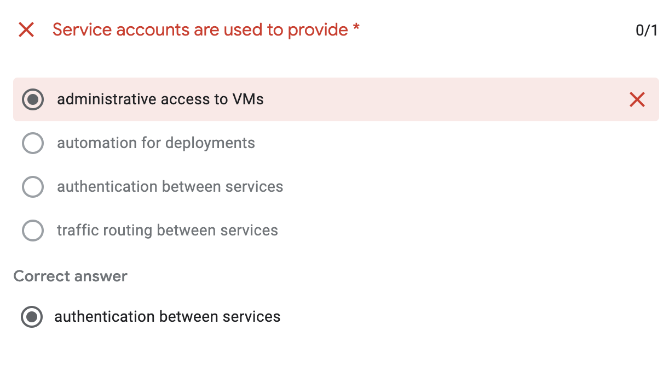
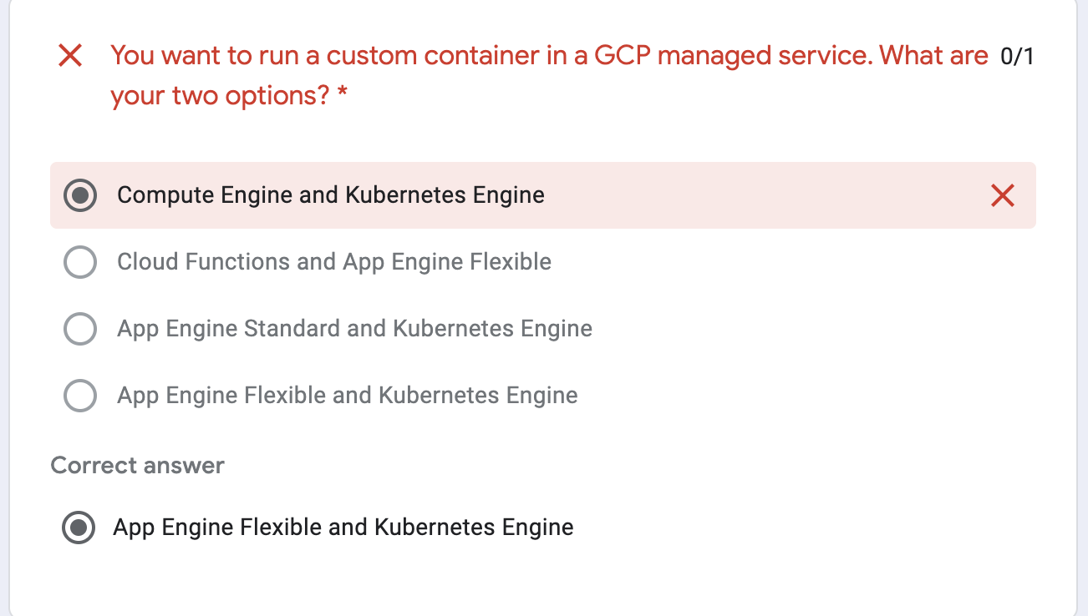
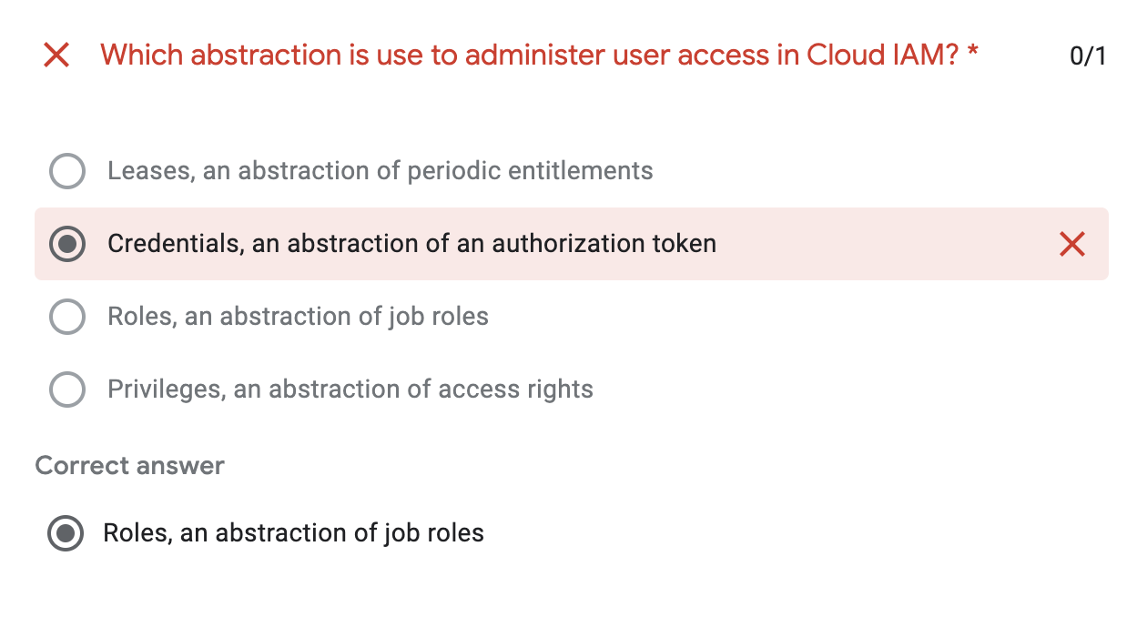
Week 2 quiz
https://docs.google.com/forms/d/e/1FAIpQLSdZwJTphDHlq_rl-ITDEUyJvbgm5q12HJYTwr09VfLCC9oLIA/viewform

Slide 23
Test 1 Whizlab. --→ https://www.whizlabs.com/learn/course/google-cloud-certified-professional-cloud-architect/239/quiz/14776/report/6216091

Slide 24
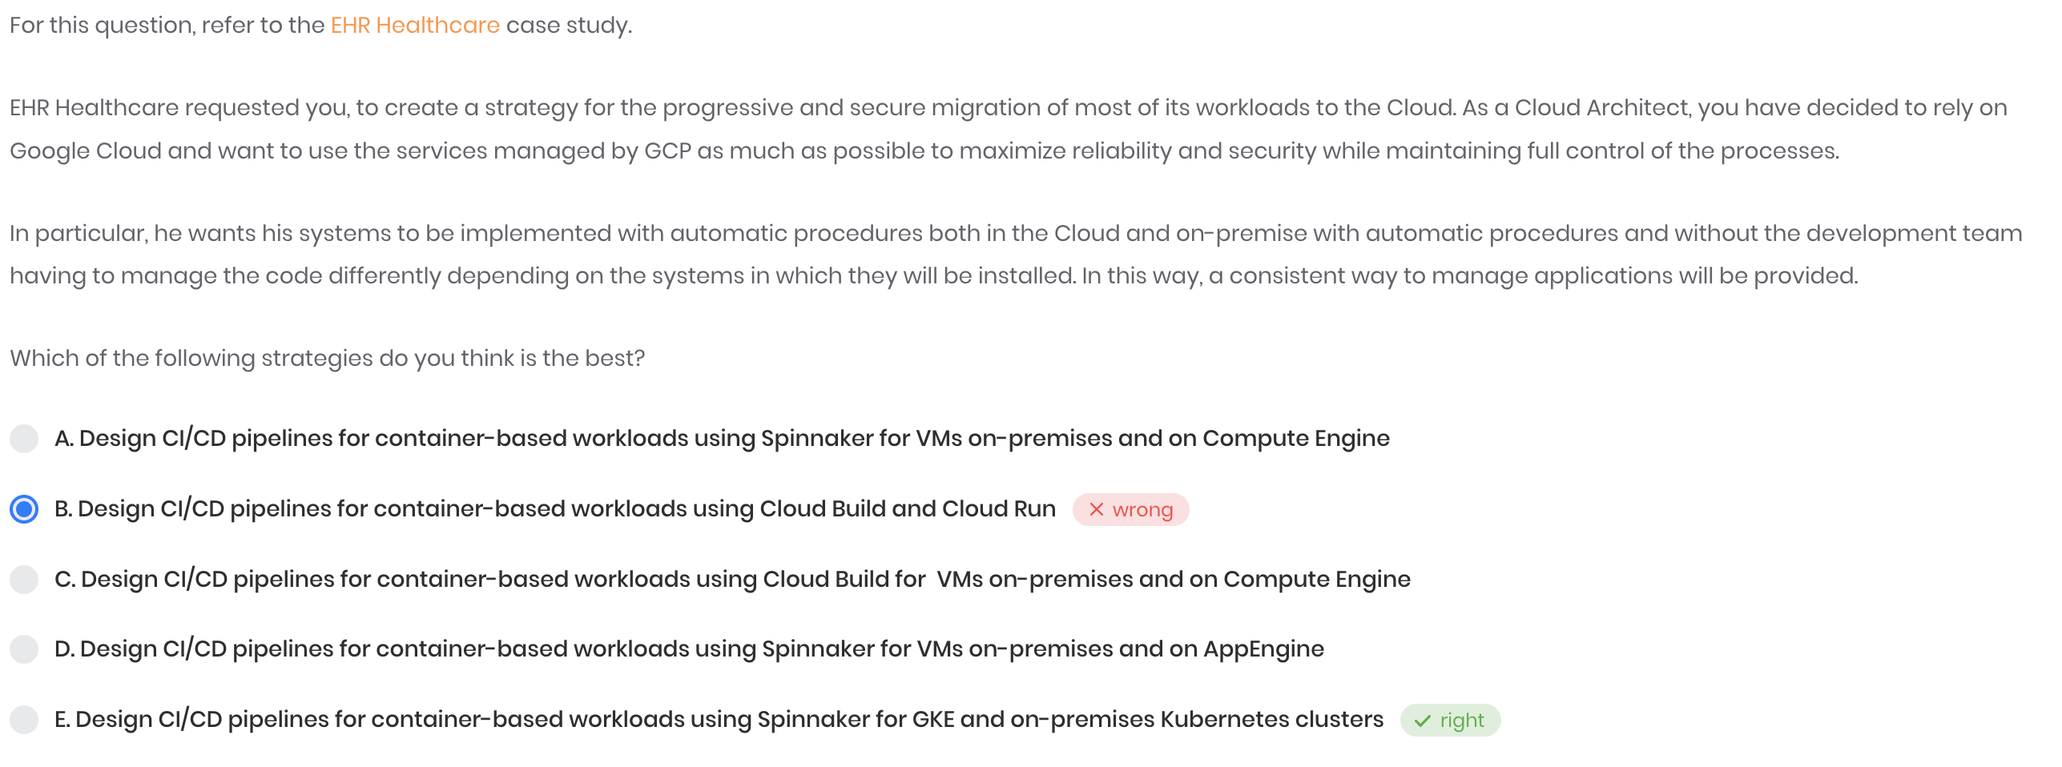
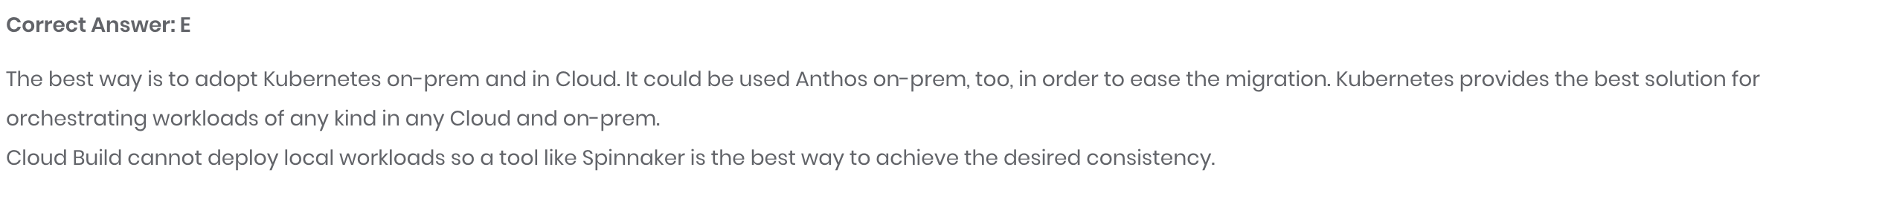
Ci-cd required for on – premises also , that is why cloud build is not a right option
https://cloud.google.com/anthos/docs/setup/on-premises

Slide 25
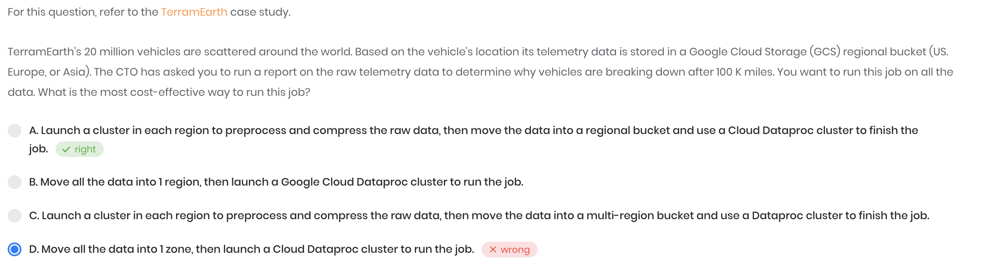
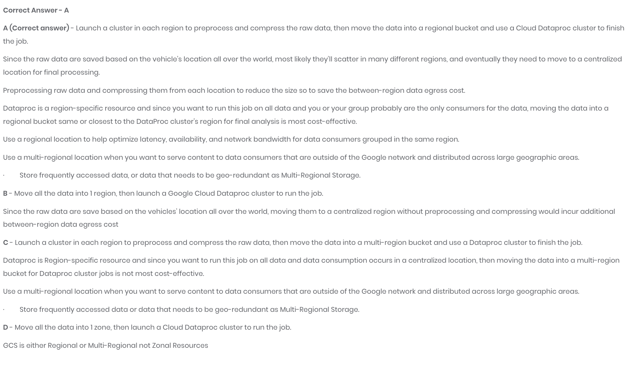

Slide 26
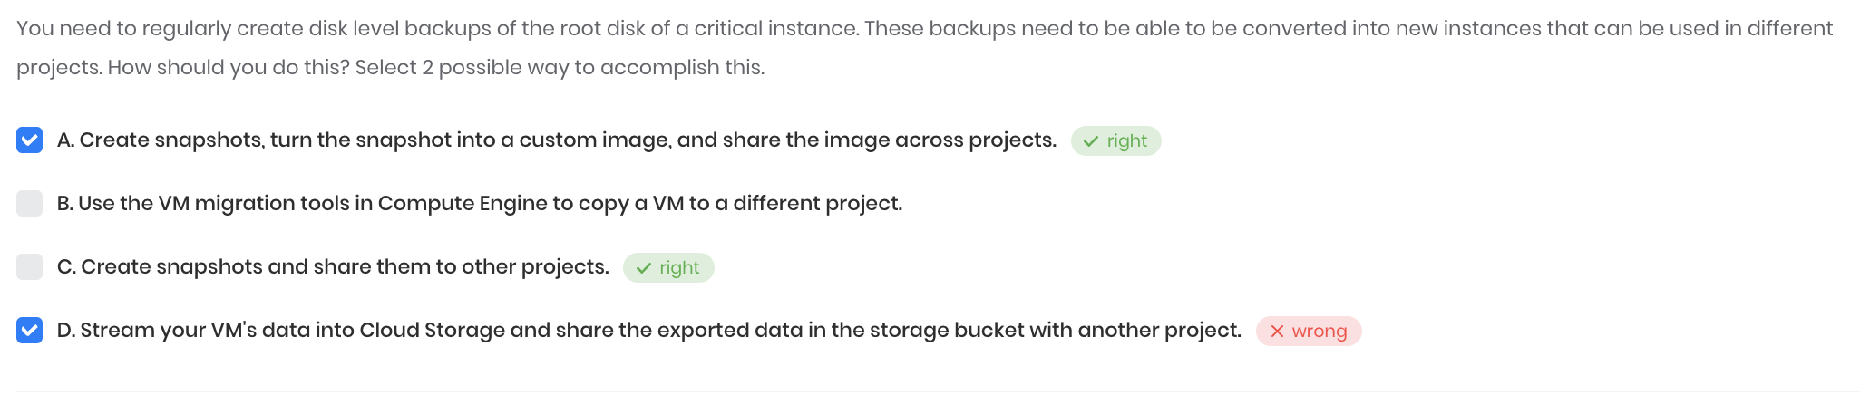
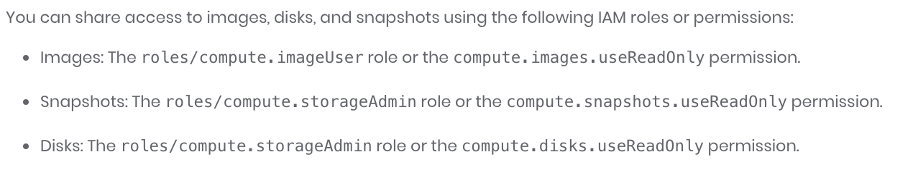
Q - How can transferring a snapshot to other projects work? Isnt snapshot local to a project unless it is image it wont work for other projects?
You cannot change the storage location of an existing snapshot. If you need to move a snapshot from one region or multi-regional location to another, you must create a new snapshot and specify its location, and delete the previous snapshot. When you create a snapshot, you can only specify one multi-regional location or one regional location. If you need to store a snapshot in more than one location, you must create a snapshot in each location.
For snapshot of one project to another: https://stackoverflow.com/questions/29585381/google-compute-engine-use-snapshot-from-another-project?utm_medium=organic&utm_source=google_rich_qa&utm_campaign=google_rich_qa
You can share the snapshot in between different project also - https://cloud.google.com/compute/docs/disks/create-snapshots#:~:text=You%20can%20create%20snapshots%20from,also%20share%20snapshots%20across%20projects. You can share disks in between projects via snapshots also. -- https://cloud.google.com/compute/docs/disks/create-snapshots#sharing_snapshots

Slide 27
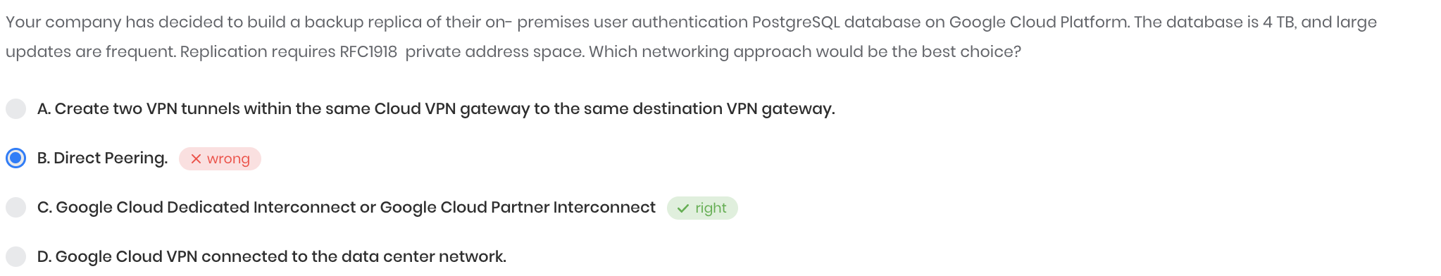

RFC 1918
VPC network peering support internal address (which can be RFC1918 (private access )) - but direct peering does not support RFC 1918
https://cloud.google.com/vpc/docs/vpc-peering Shared VPC support internal IP communication - https://cloud.google.com/vpc/docs/shared-vpc cloud interconnect ( and partner ) support – RFC 1918 - https://cloud.google.com/network-connectivity/docs/interconnect/concepts/overview
Your VPC network's internal IP addresses are directly accessible from your on-premises network. You don't need to use a NAT device or VPN tunnel to reach internal IP addresses.
Difference between different connectivity options (VPN / Interconnect / peering )

Slide 28
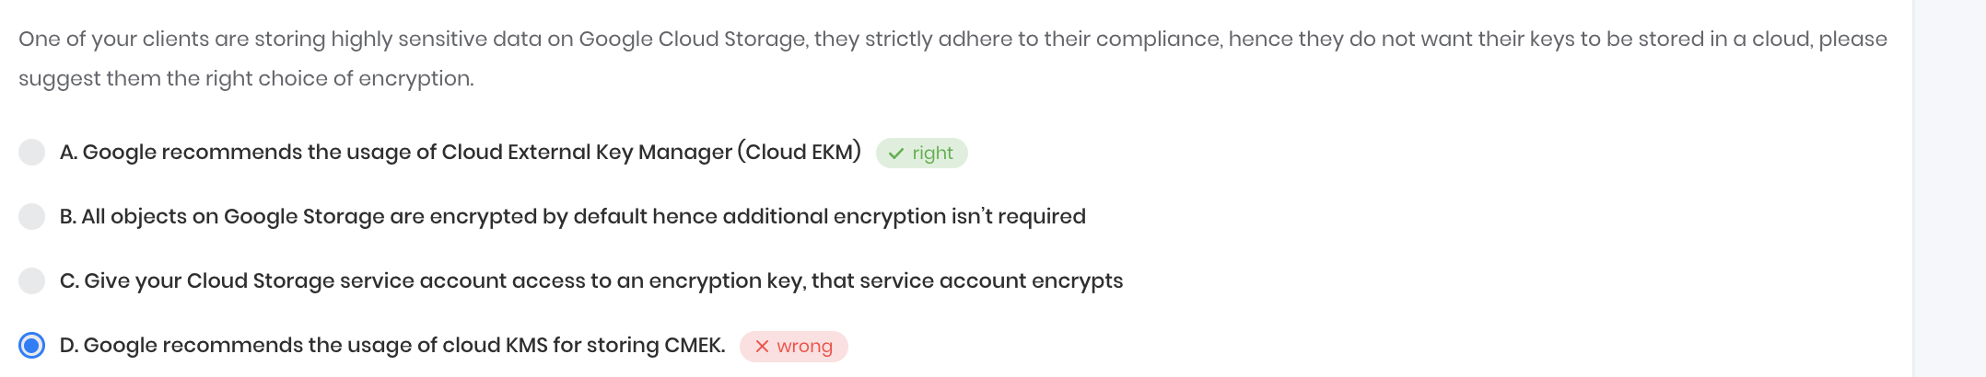
EKM vs KMS
EKM – external key manager - https://cloud.google.com/kms/docs/ekm
CMEK / CSEK / DMK / KMS -- understanding

Slide 29
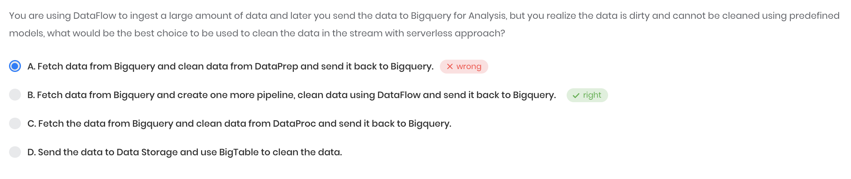
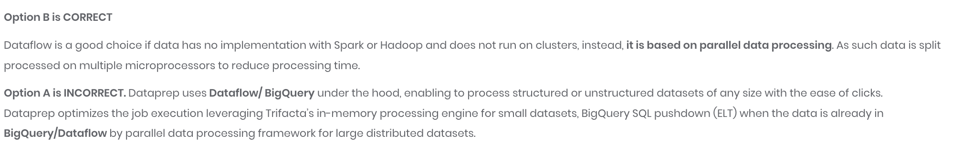
Why again data flow and not DataPrep → because iits mentioned that data can not be cleaned using predefined models , means needed more flexibility which can be provided by data flow
1] Dataprep uses Dataflow or BigQuery under the hood, enabling you to process structured or unstructured datasets of any size with the ease of clicks, not code. 2] Dataprep optimizes the job execution leveraging Trifacta’s in-memory processing engine for small data sets, BigQuery SQL pushdown (ELT) when the data is already in BigQuery, or Dataflow parallel data processing framework for large distributed datasets.
https://cloud.google.com/dataprep
https://www.trifacta.com/blog/why-upgrade-cloud-dataprep-professional/

Slide 30
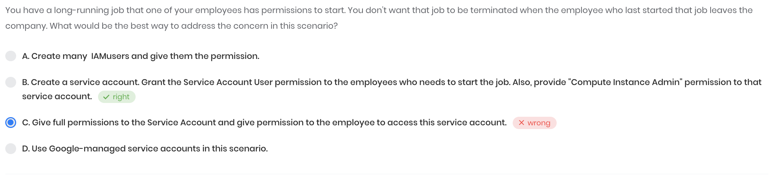
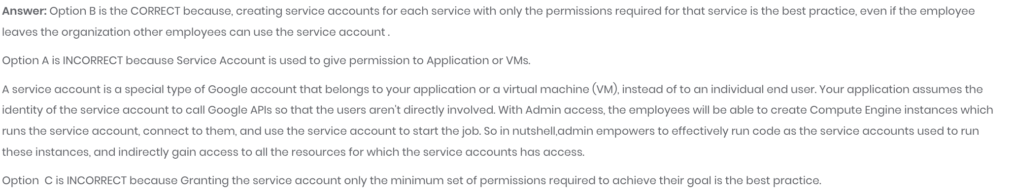
https://cloud.google.com/iam/docs/understanding-service-accounts

