Slide 1

DWASNOW SUPPLIER LLP
LLP Identification Number:AAO-8370
PAN : AAPFD9444A
TAN : HYDD10004B

Slide 2
PROBLEM BEING ADDRESSED
Delay and no appropriate household goods delivery
Small scale , whole sale business are been destroyed by some companies .
on the other side , customers also have to wait for that delivery , and they need to respond for those delivery calls

Slide 3






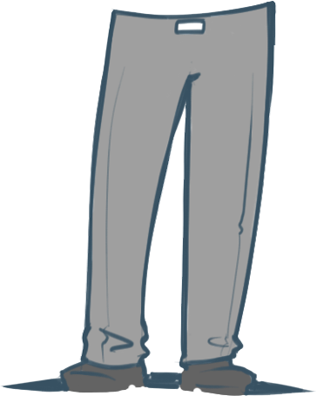
SOLUTION:
our mission today is to help you…
We make use of the existing sellers, whole sale shops and autowalas , to make it happen easily by the means of a usable application for both the user and the delivery person.
By this we can solve small scale ,whole seller problem by providing him with customers , within his range.
This is a short radius localized sector business , so the order would be delivered within 2hrs

Slide 4
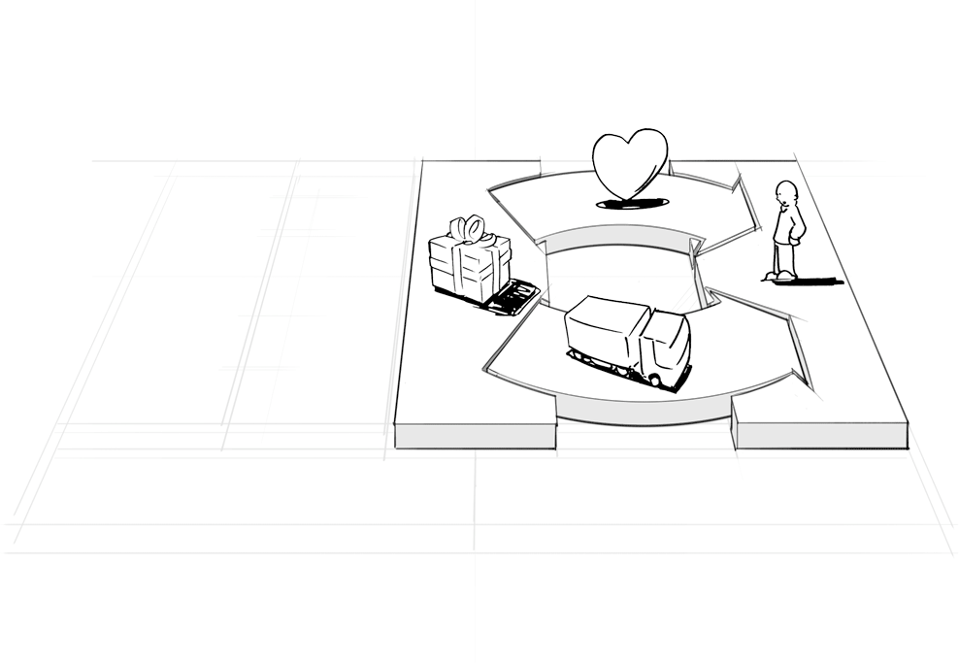
Customer satisfaction is what dwasnow needs

Slide 5
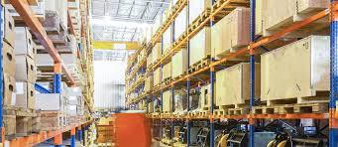
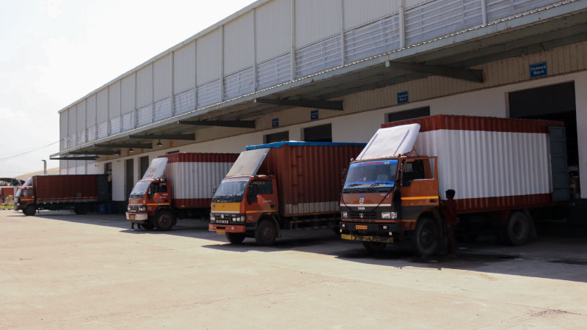
PRODUCT/SERVICE:
Now-a-days, many companies have come into the market for household products delivery.
PROBLEMS WITH THOSE COMPANIES
So, now people in many areas are with the problem of calling up a water delivery person ,and to remove this problem for users , we are going to make use of existing water purification units , wholesale retailer of that particular local sector for household goods and the autowalas to deliver them.

Slide 6
Market
Our market is basically with two types of customers i.e,
Seller who is present in our localized radial sector , and buyer who is present in that radius.
Dwasnow is one who provides seller with the customers order , and seller with lightening delivery
Seller
Buyer

Slide 7
MARKET
Major customers for our business would be all the people who drink water , as this is the major problem which all people do face and there is no efficient online platform which sells water.
As this business is a combination of many localized clusters , basically as far as the primary survey is concerned , we have around 1300 families who are interested in this sort of facilities for a short radius.
Our team can now be able to supply the needs of these customers at a time slot of 2hours each.

Slide 8
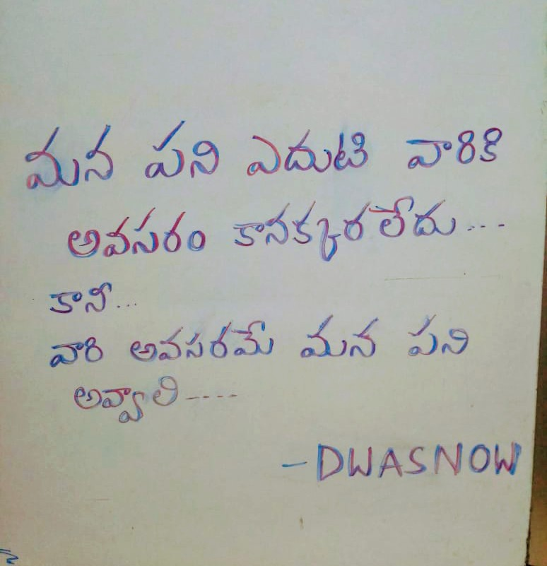

Slide 9
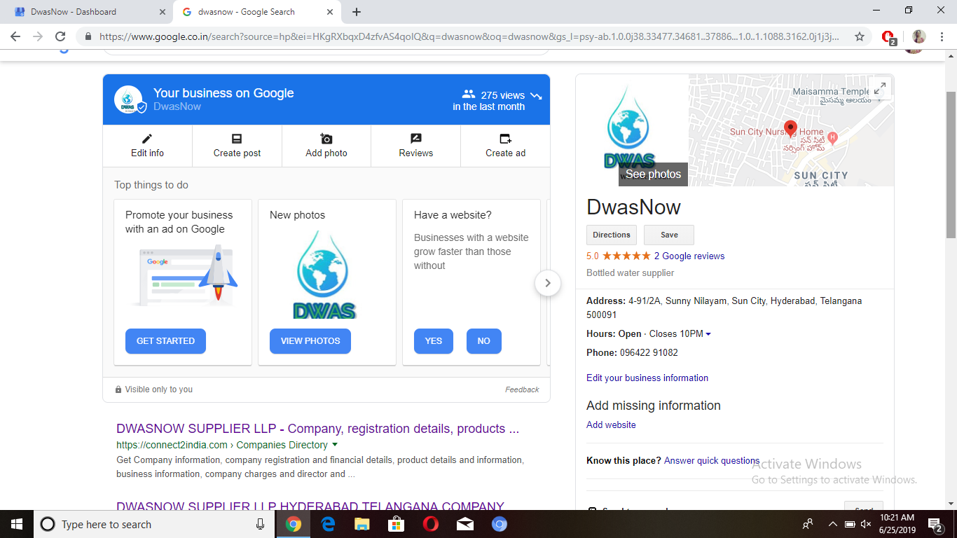

Slide 10
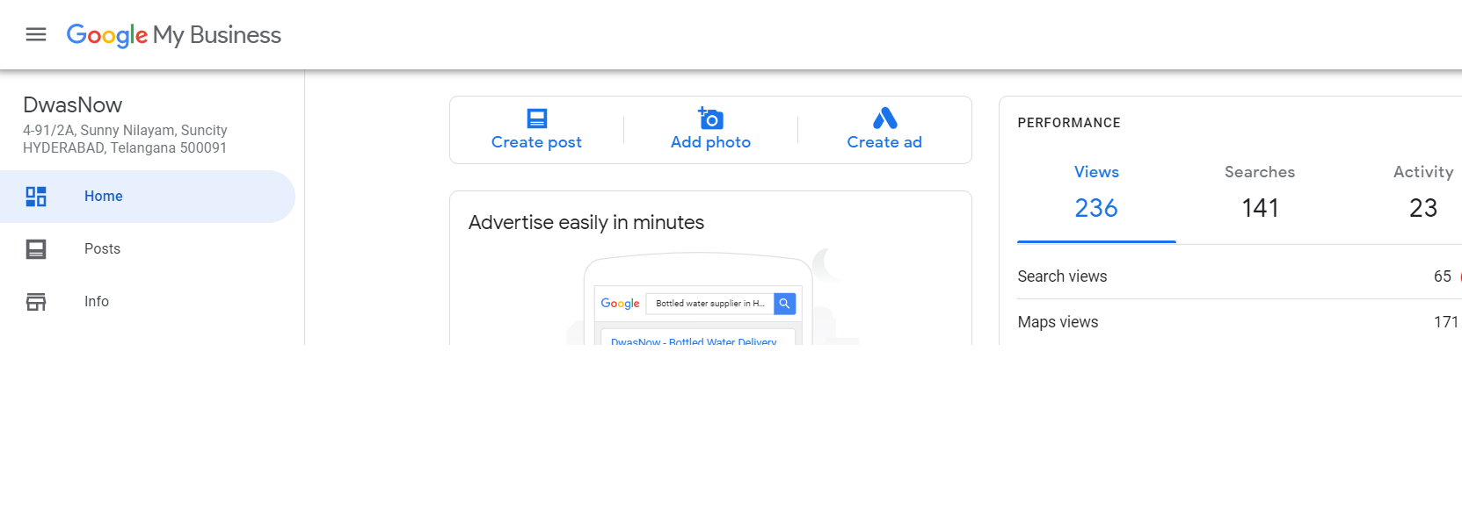
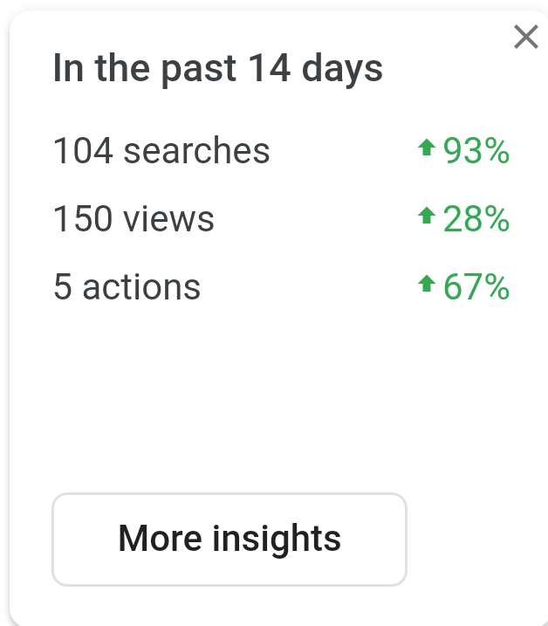
Calls : Around 350

Slide 11
Competition
Competitors make their market with a global manner where they spend lots of money for transportation ,but we are implementing this by localized manner formula , we can make faster delivery and at some less price .
Warehouse industries.
60%
Regular suppliers
40%

Slide 12

* Our customers would be at their houses itself , delivery executives would be delivering them to the door step.
* We are going to use marketing people to reach out each and every house, and the major part of our investment is with this promotion .
* In – person visit , pamphlets , Banner publicity over all the local sector, making agreement with colony president’s such that dwasnow would help in development of their society in future .

Slide 13
House hold goods , rice bags ..etc would be giving us with 2-4% profits.
Revenue Model
2-4%
^{4-6%}
If we expect a minimal of these profits from each localized sector, then as sectors get increased ,profits also gets good
From Water , soft drink sellers we would be getting around 6% , so this would fetch us money ………………………………

Slide 14

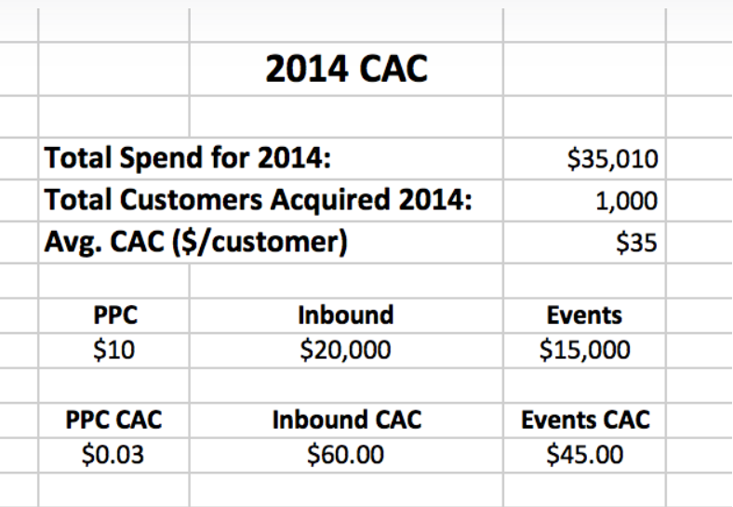
Formal Marketing

Slide 15
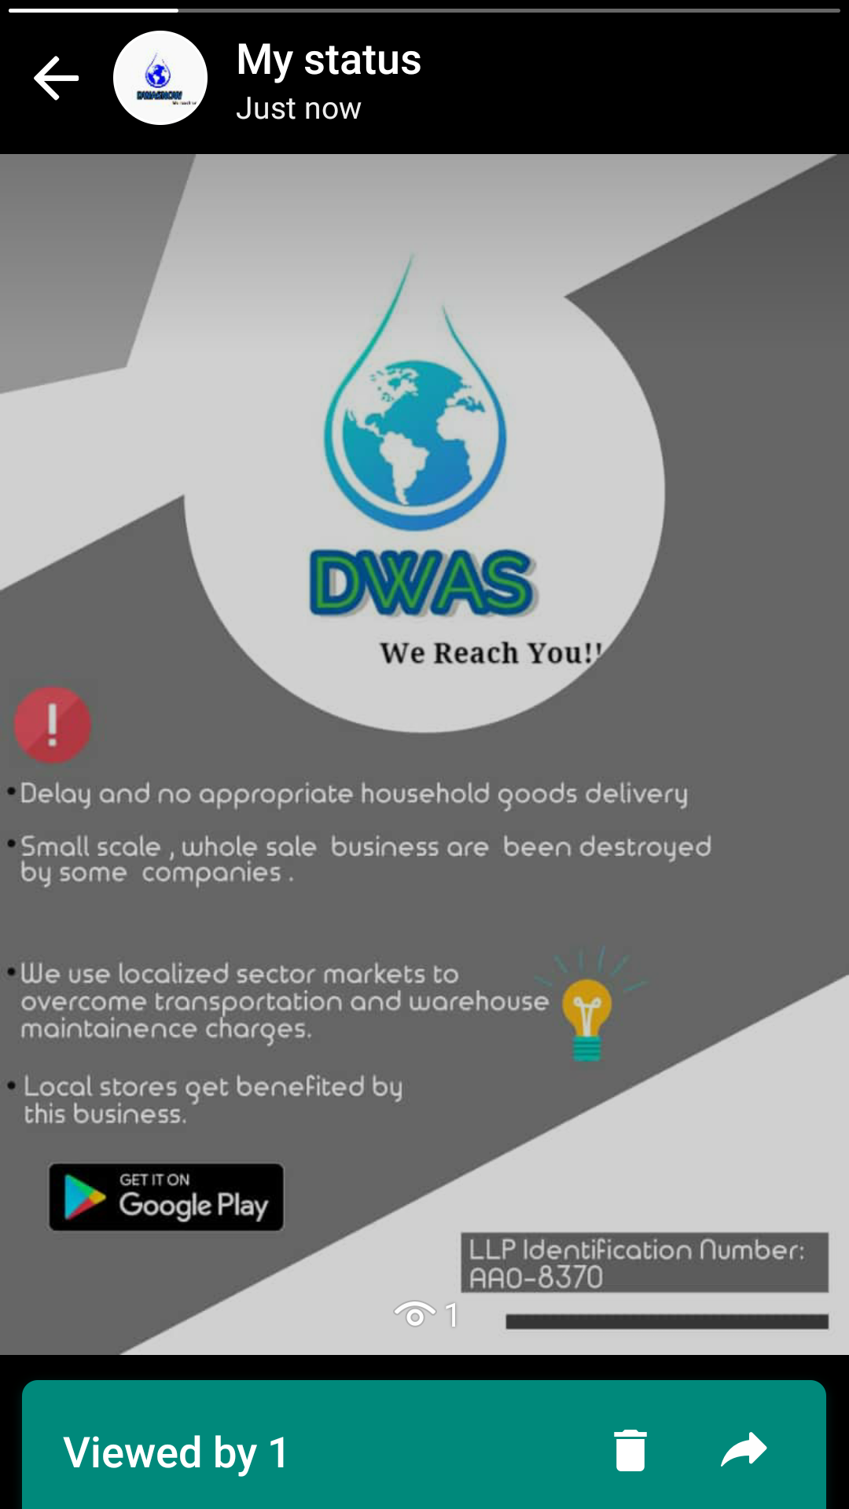
Each View : 25p
Usually cost of acquiring customer takes around 1800
But now with the same 1800 rupees
We can reach out 7200 Customers
Using this means of promotion would reduce the cost of acquisition

Slide 16
Plan of action
0-9 days
Manually taking the orders from customers through in person visit
10-17 days
Provided customers with apk and now they themselves are making orders
18-30 days
Continuing the second phase and increasing the number of customers, and rectifying the basic flaws

Slide 17
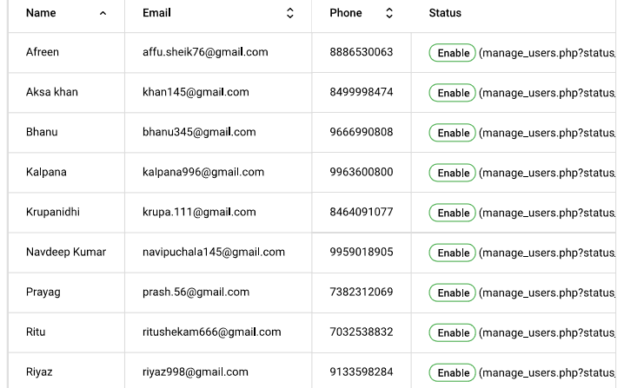
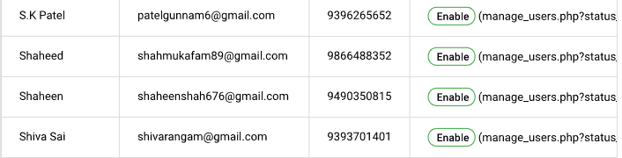
Present Customers

Slide 18
FINANCIALS
This business would have its investment in just promoting the app , apart from that we don’t need to make any manufacturing of the products.
Therefore , this business would not cost more than around 40-50k to start and get better customers.

Slide 19
Fund Estimation : 5lakhs
Financial Funding
Workspace , accessories
28%
Technical development
32%
Promotion
32%
Other (Revolving fund, emergency)
8%

Slide 20
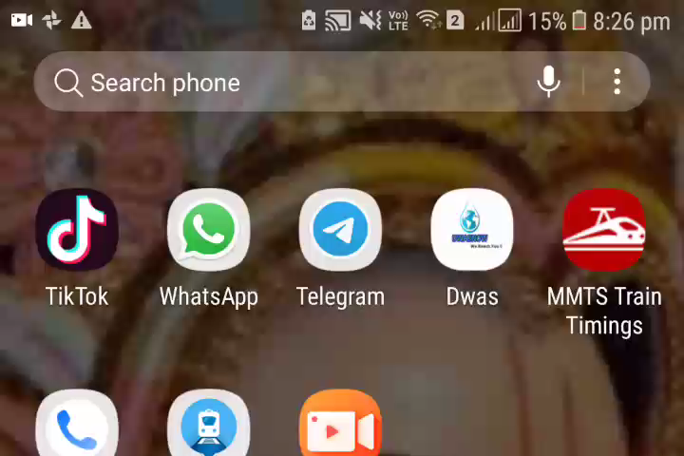

Slide 21
OUR TEAM
P .Saketh Reddy- Android developer, web developer –Team Leader
R .Vaishnavi –Android developer, web developer –Technical Head
P. Sharan kumar –Customer relationship – Promotion and support team
R.Divya- Web Developer –Technical Support

