Slide 1

SMart scheme app
- Making a people's Govt.

Slide 2
PROblem & Solution
Government implemented many schemes for the welfare of people but they are not reaching people in a right way and are not able to use the services effectively.
Our product is a Mobile Application that links all the schemes to the people, connecting the Govt and people.

Slide 3
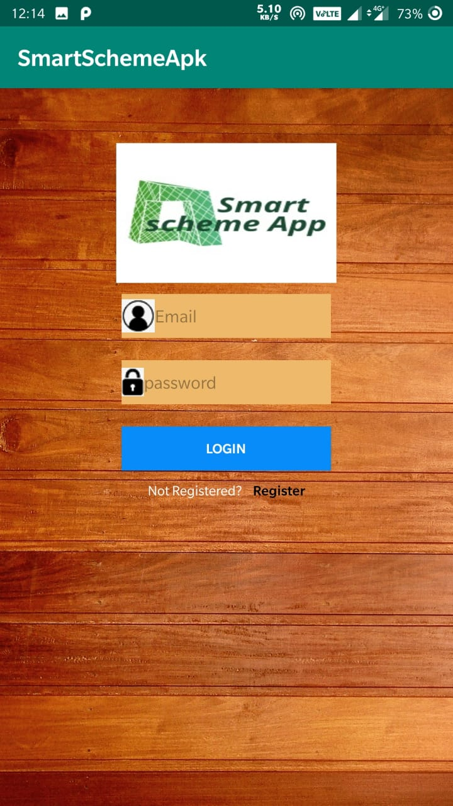
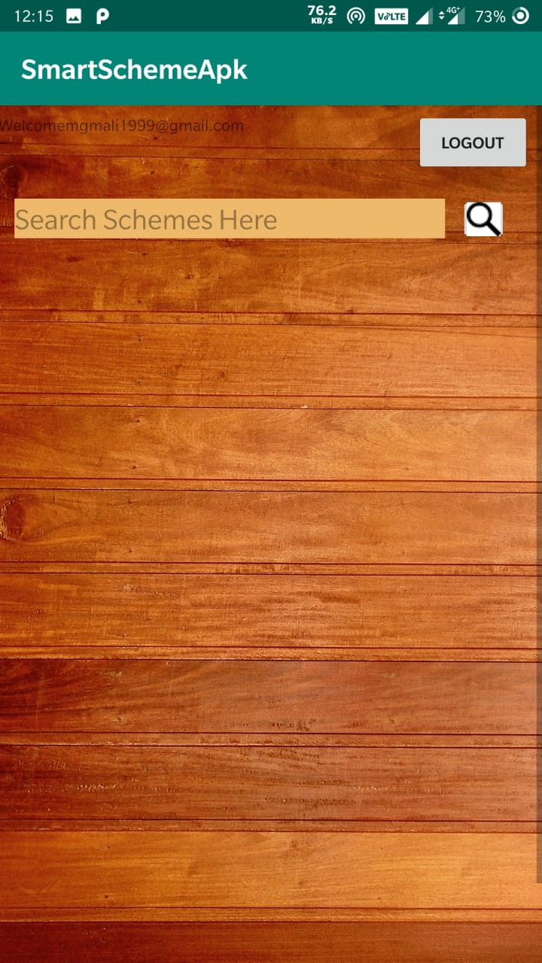
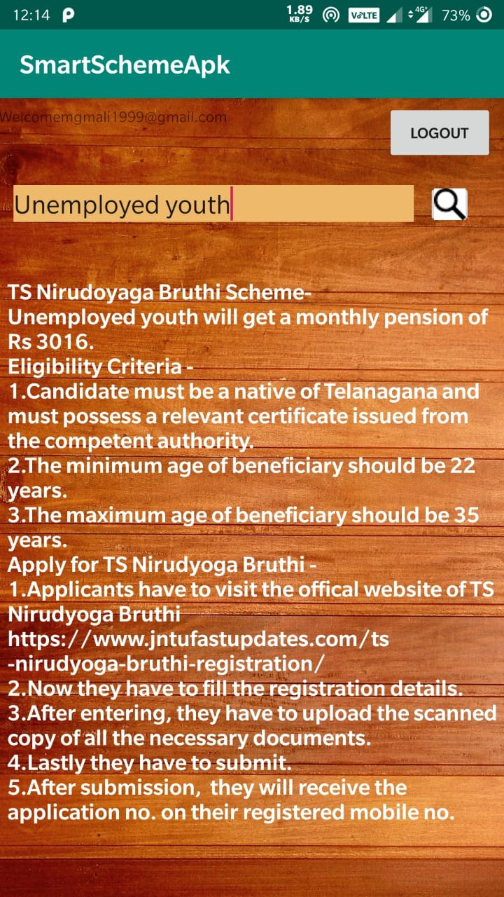
Product

Slide 4
value proposition
“Helps people to connect the government”.
For the citizens of India who are not receiving the benefits of targeted schemes, our app is a provision of information that connect people and government.

Slide 5


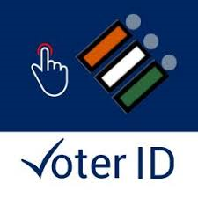
competition
Umang app, My Gov app and India Voter list app etc.they are some of our competitors who have worked on similar apps to providevservices to people.
All such apps are working in a general user perspective but our app can be customised according to the user input, addressing the user needs effectively.

Slide 6
market size
Our product is a digital platform service so the smartphone users are our customers.
The age group of 16-60 yrs are the working population, and among the working population 35% are the smartphone users that constitute our market.
As our app is a special purposed, penetration rate of app will be less.
Potential market volume would be around a lakh.
According to a survey 70% of the students use smart phones.So Students will also be our customers.

Slide 7

market strategy
We would launch it in the digital platform and we can also give some premium features such as guidance from people for the first 3 months to attract the market.
Our survey found that most of the people know about information via newspapers
Social media is another way of spreading awarness about the app.( Facebook, Whatsapp etc)

Slide 8
business model
It is a Freemium app, Users can download the app for free.For development of app we can use advertising and search optimisation techniques to generate revenue.
Once the app gets legalised we can connect with the Govt. and work under government.
Our app is built using open source softwares so it is free of cost in building the app.If we use advertising as a medium of generating revenue then around

Slide 9
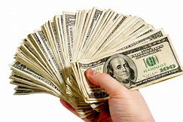
financials
Our app is built using open source softwares so it is free of cost in building the app.
If we use advertising as a medium of generating revenue then we can make money around 20$.

Slide 10
team
M.G.M Ali (B-Tech, III year, EIE)
Development of the product
Indu Konduru (B-Tech, III year, EIE)
Market Research

Slide 11

Ask

Slide 12


