Slide 1

SMART MEDICAL KIT
EXCITE 2K19
ACE ENGINEERING COLLEGE

Slide 2
PROBLEM STATEMENT
To handle the problem of “absentia” faced by people these days.

Slide 3

SOLUTION
We provide a device is to help the user about their particular medication timings.

Slide 4
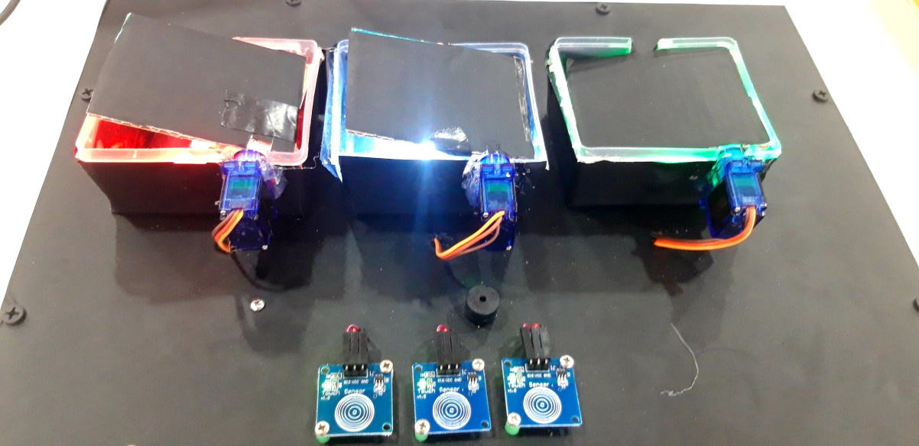
PRODUCT DISCRIPTION
It is an automatic and user friendly device. It alerts the user regarding the medication timings accordingly. It also warns the user about the capacity of the container.

Slide 5
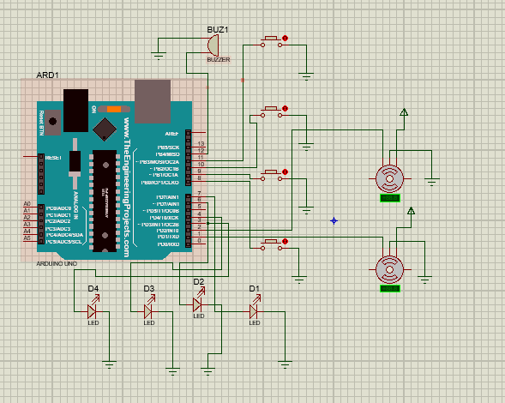
PRODUCT CIRCUIT

Slide 6
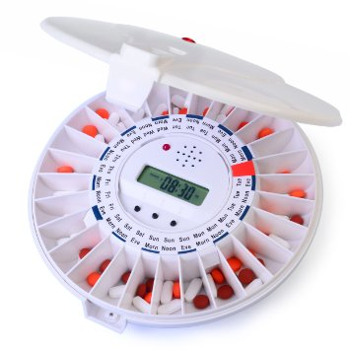
EXISTING PRODUCT
https://www.amazon.com/LiveFine-Automatic-Dispenser-Electronic-Medication/dp/B00FL623G2

Slide 7
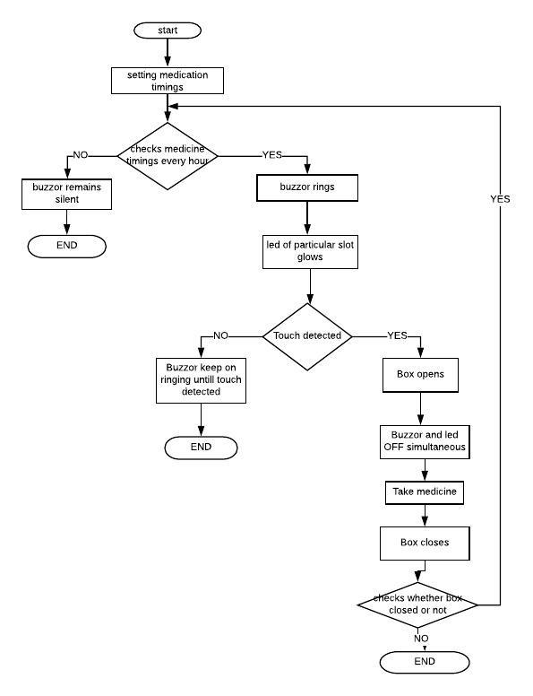
FLOW CHART

Slide 8
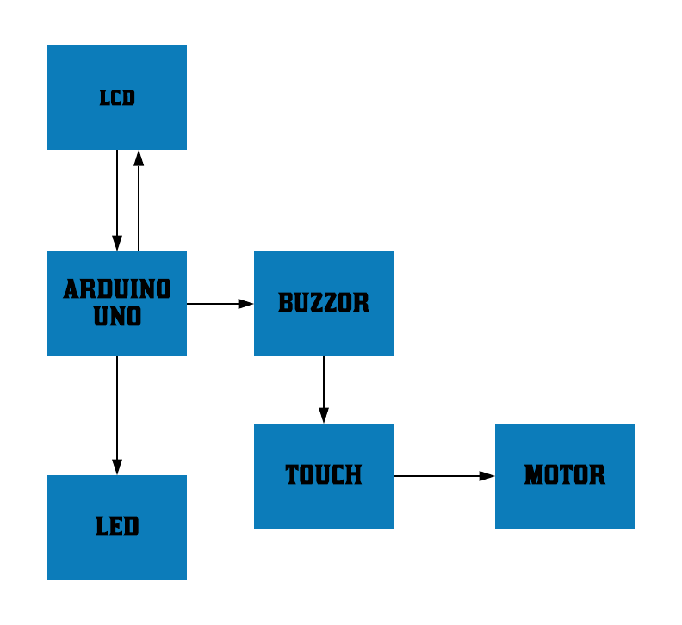
BLOCK DIAGRAM OF PROTOTYPE

Slide 9
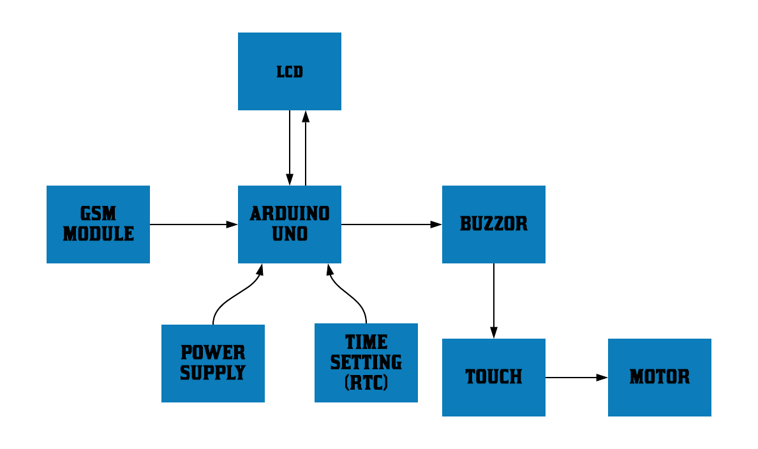
BLOCK DIAGRAM OF PRODUCT

Slide 10
MARKET
Hospital
Households
Old age homes

Slide 11
Revenue Model
Buy the product at store
Online stores
Retail store
Marketing with hospitals

Slide 12
FINANCE
Making charges include sensors which costs around: Rs 3000.
Labor cost per unit : 500
Cost per unit: Rs 3500
Selling Prize: Rs 6000
Our monthly revenue around: RS 3,60,000

Slide 13
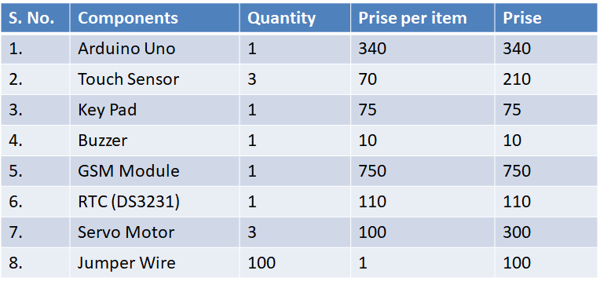
TECHNOLOGY & MATERIAL COST
SOFTWARE – Arduino platform

Slide 14
TEAM
NAME OF THE STUDENT | QUALIFICATION | ROLE
N.SAI SATHYAK | B.TECH III YEAR, CSE | EXECUTOR
R.DIVYA | B.TECH III YEAR, CSE | EXECUTOR
P.THARUN KUMAR | B.TECH III YEAR, ECE | CODING
LENDALE RUSHALI | B.TECH III YEAR, CSE | CODING

Slide 15


Slide 16


