Slide 1
Non Invasive GlucoHaemo Meter

Slide 2
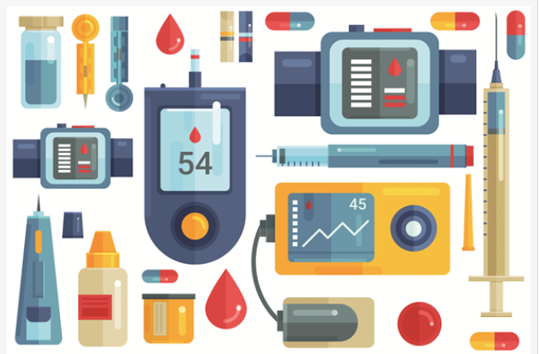
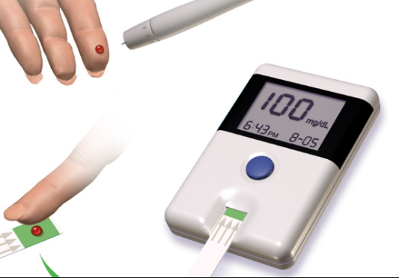
PROBLEM
Difficulties faced by Diabetic and Anaemiac patients in monitoring their blood glucose and haemoglobin levels using invasive devices.

Slide 3
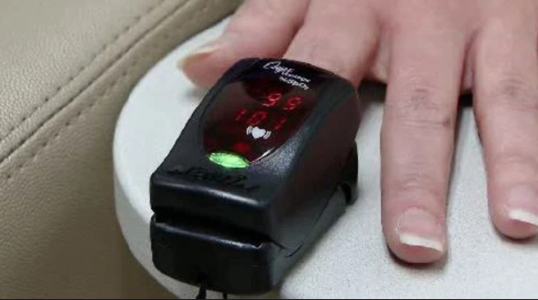
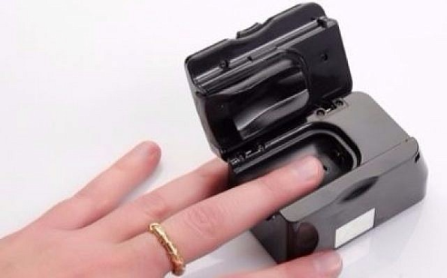
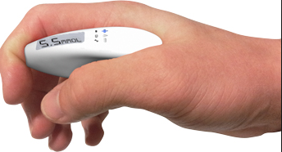
SOLUTION
A portable , easy to use Non Invasive device which monitors Glucose and haemoglobin levels of a person accurately

Slide 4
PRODUCT
Our product is a low cost Non Invasive Device which monitors the blood glucose and Hemoglobin levels accurately without using a needle or causing a break in the skin
Along with features of portability, ease of use and durability

Slide 5
TECHNOLOGY STACK
Arduino IDE
Android Studio
Image Processing
Regression Analysis

Slide 6
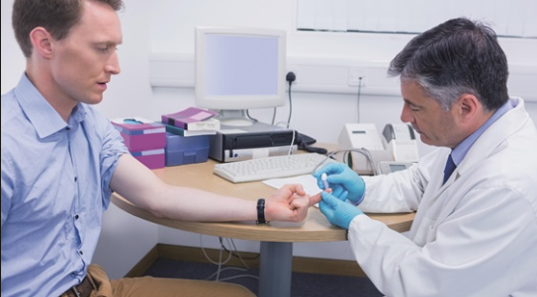
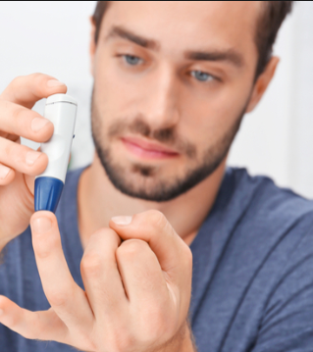
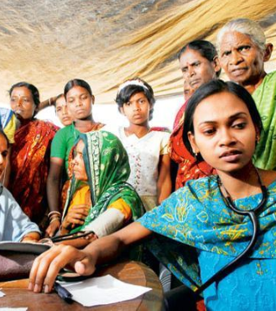
MARKET
Our customers are Diabetic & Anemic patients ,PHC's, Rural Health Care centers
Prospective Customers are Diabetic and Anemic patients in urban area for now
We can address the patients nearby our locality.

Slide 7
VALUE PROPOSITION
No pain
Saves time
Patient friendly
Wellness
Low cost

Slide 8
COMPETITORS
DiaMonTech is a German company which is working on the Non Invasive Glucometer and it has succeed in making a device of a shoe box size and it is yet to be released in the German market but it is of high price.
Another company Integrity has released its Non Invasive GlucoTrack device in European states but it only measures the glucose levels of type 2 diabetic patients.
To measure Haemoglobin people and diagnostic centers still use the procedure of taking the blood sample and analyzing it.
In India the research is still going on the device which measures only the glucose levels but there is no device which can measure both Haemoglobin and Glucose levels.

Slide 9
MARKETING STRATEGY
Targeted Customers
Diabetic and Anemic patients
PHC's
Channels
Direct selling
Through Pharmaceutical stores and retailers.
Advertisements and posters.
Diagonostic Centers

Slide 10
Status
We are able to get values of the glucose levels but they are not accurate , we have to fix that issue.
To measure haemoglobin , we are able to capture the images of the palm and could get the values of total redness through image processing , converting it in to the Hb values is remaining.

Slide 11
Team
M.Sarica(Team Lead)
Qualification: B.Tech 2nd year , ECE
N.Sai Chandana
Qualification: B.Tech 2nd year , ECE
C.Jahnavi Sai Sirisha
Qualification: B.Tech 2nd year , ECE
M.Sai Preethi
Qualification: B.Tech 2nd year , ECE

Slide 12
THANK YOU

