Slide 1
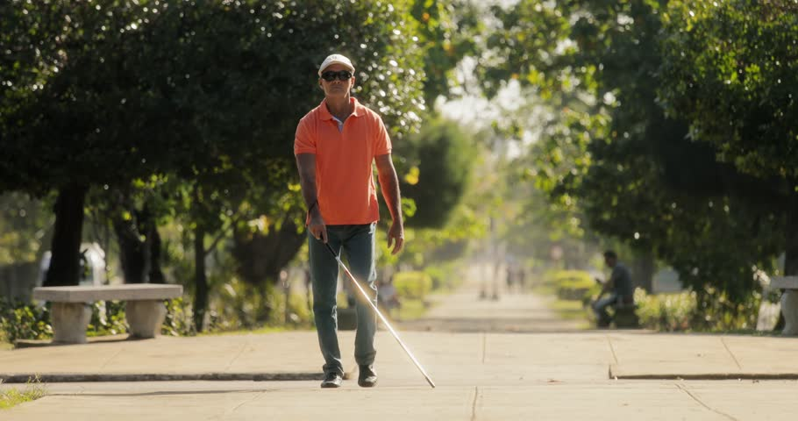
SMART CANE

Slide 2
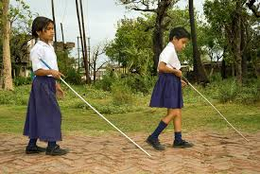
PROBLEM
Visually impaired people face a lot of problem during navigation (like obstacle detection) and need human assistance for safety.
SOLUTION:
A cane which gives alerts on obstacle, fire, water detection and also enables the user to send message and location to trusted contacts

Slide 3
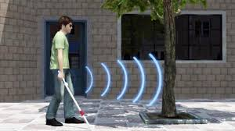
PRODUCT/SERVICE
A cane which gives alerts on obstacle.
Navigates the user by audio instructions .
Detects fire and water using sensor and alerts the user.
Sends an alert message to one of the guardian’s among the trusted contacts using GSM.

Slide 4
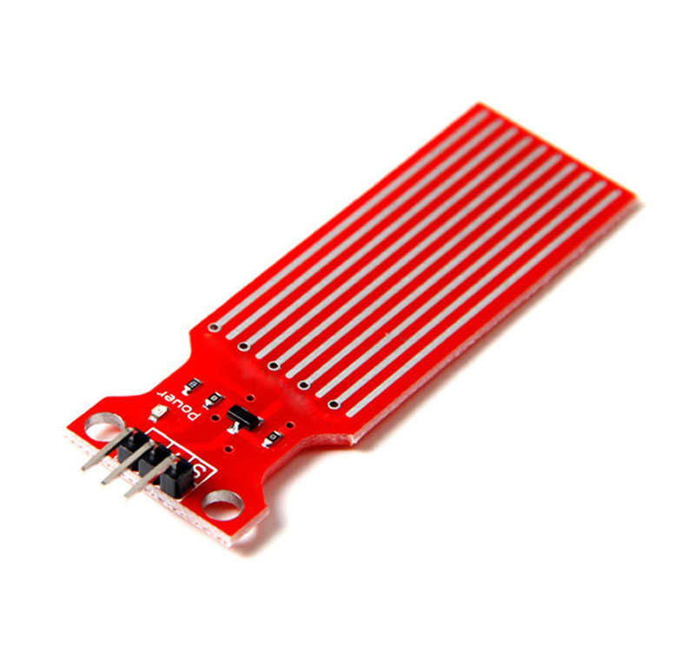
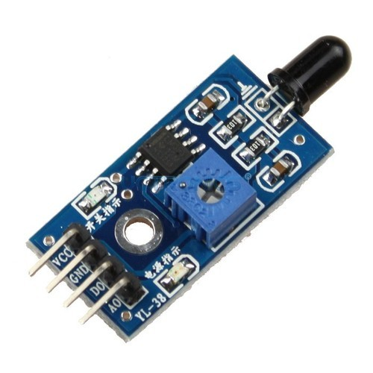
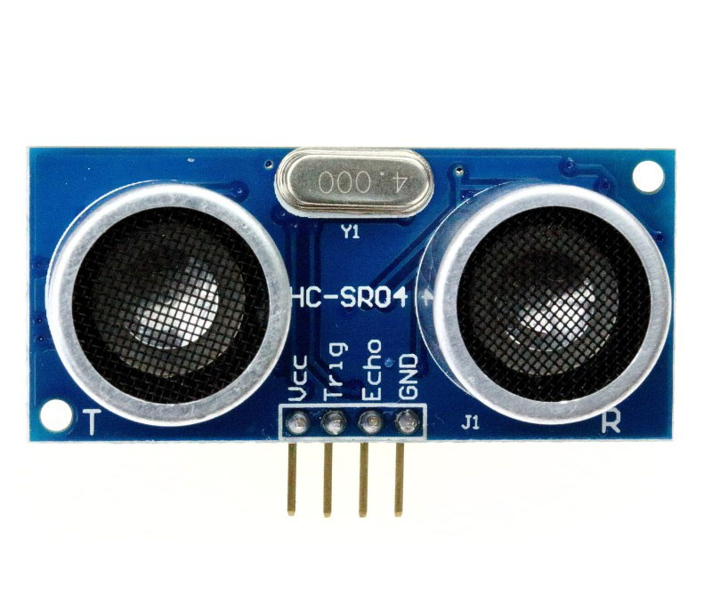
SENSORS
Ultrasonic sensor is used for
obstacle detection
Flame sensor is used to detect fire.
Water sensor is used to detect water.

Slide 5
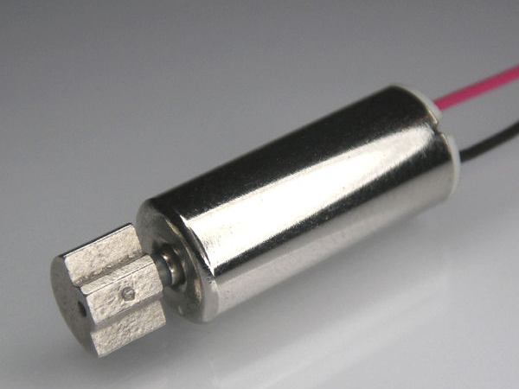
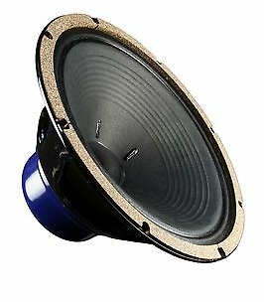
OUTPUT DEVICES
Speaker gives audio alerts to the user..
The vibrator vibrates when an obstacle
is encountered which helps in alerting
the blind person.

Slide 6
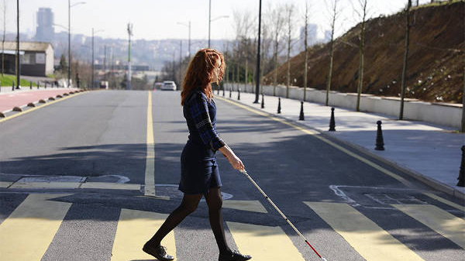
MARKET
Visually impaired/blind people are
our customers.
We can address the people in blind
schools and orphanages.

Slide 7
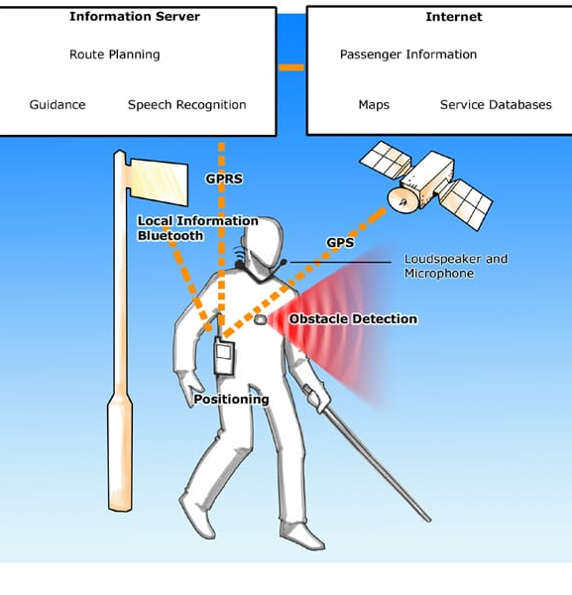
COMPETITION
Supersonic stick : wrist band which communicates in the form of vibrations.
Guide cane : Scans for edges and steps.
Communication diagram of NOPPA

Slide 8
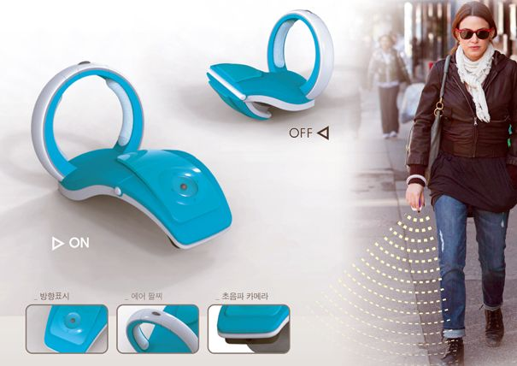
SUPERSONIC STICK
It sends out ultrasonic pulses to detect any incoming obstacles.
It then gives instructions to the user in the form of vibrations and beeps.

Slide 9
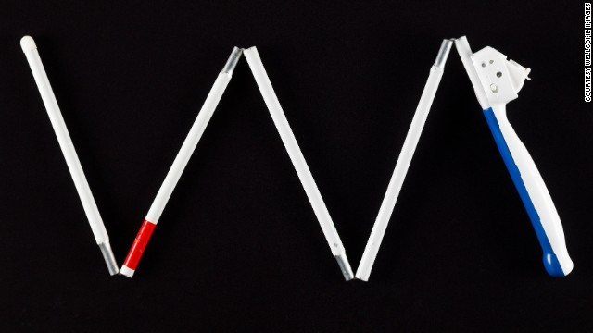
GUIDE CANE
Guide cane is also a competitor in the present market.
They have succeeded by providing obstacle detection and flexible sizes of the sticks.

Slide 10

DIFFERENCES
Our device has a flame sensor as
Well as a water sensor to detect fire
and water.
It also has GPS and GSM so that the
user’s information is sent to the registered
contacts when he/she is in danger.

Slide 11
REVENUE MODEL
Revenue through sales .
Revenue through NGO’S.

Slide 12
MARKETING STRATEGY
Through blind schools.
Distribution through NGO’S.
Advertising through radios.
Live demonstration of usage of stick at hospitals and public places .

Slide 13
FINANCIALS
The total cost of making the product is 2000-2500.
The total expenditure for one month is about 2,10,000.
Infrastructure – 3000
Labour - 30,000
Raw materials for 100 units - 1,50,000
Assembling - 20,000
Transport - 2000
Research - 5000

Slide 14
TEAM
V. L. Prathyoosha (B-Tech, IV year, ECE)
Development, Team Leader.
P. Varshini (B-Tech, IV year, ECE)
Market research.
P. Sahana (B-Tech, IV year, ECE)
Research on different technologies.

Slide 15
Q&A

Slide 16



