Slide 1
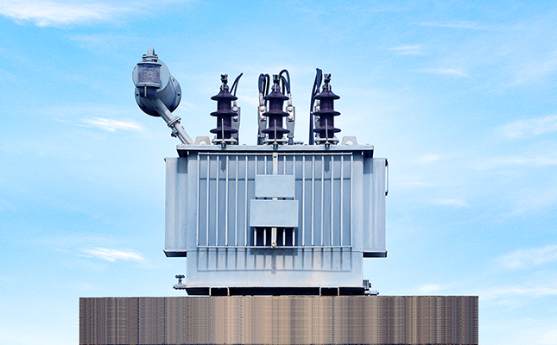
Health index of transformer
HH=HHEALTH INDEX OF TRANSFORMER

Slide 2
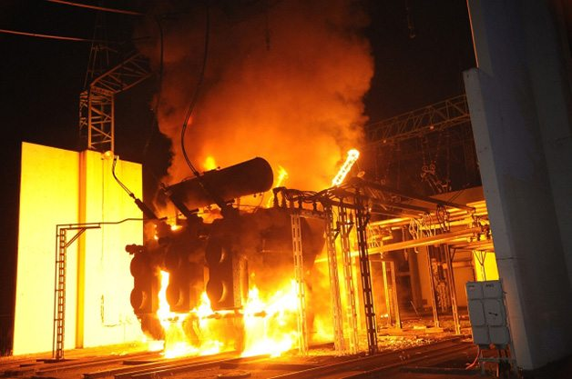
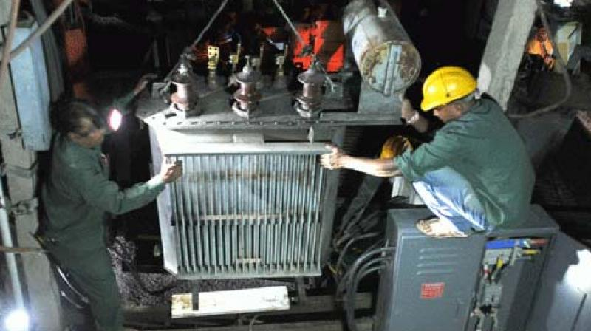
Problem
To find the health condition of transformer
Improper maintenance 2) Service Life 3) Linemen - Manually

Slide 3
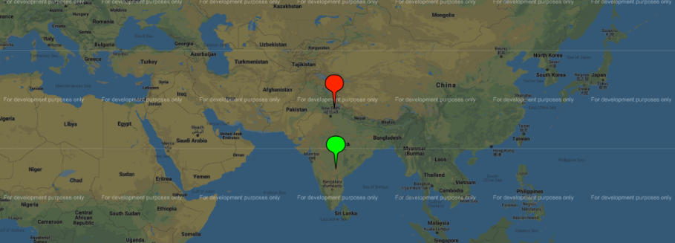
SOLUTION
A device which enables online monitoring of transformer continuously.
Red – About to damage
Green – Good Condition

Slide 4
Proof of concept
Transformer depends on
1) Voltage (200 – 415V)
2) Current (Depends on load)
3) Temperature (Above 50 C)
If they are high above the rated values they are in bad condition.

Slide 5
Uses
Regular monitoring of transformer
Service life can be increased
Transformer failure can be prevented

Slide 6

technology
Java Server Pages (JSP)

Slide 7

Market
Telangana State Southern Power Distribution Limited Company
Market Strategy
By proposing our idea to electrical board authorities

Slide 8
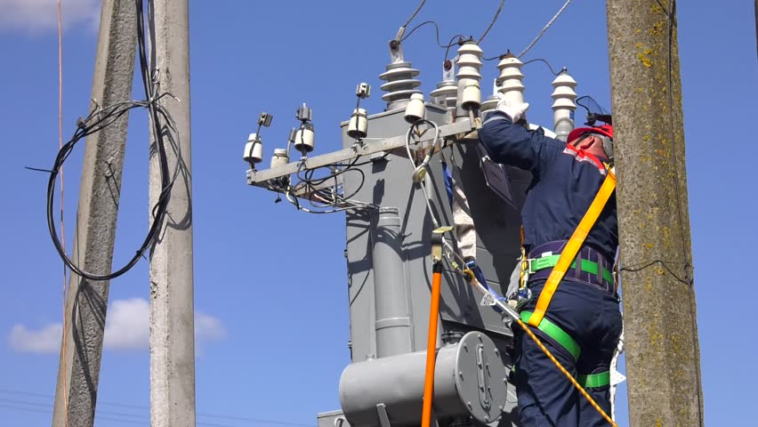
Competition
Linemen – Manually
1) Improper maintenance
2) Man effort
3)Time Saving

Slide 9
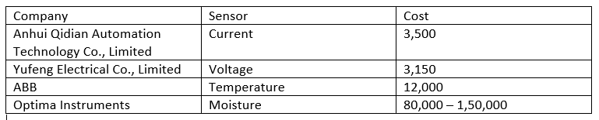
Cost analysis
Total : 1,70,000

Slide 10
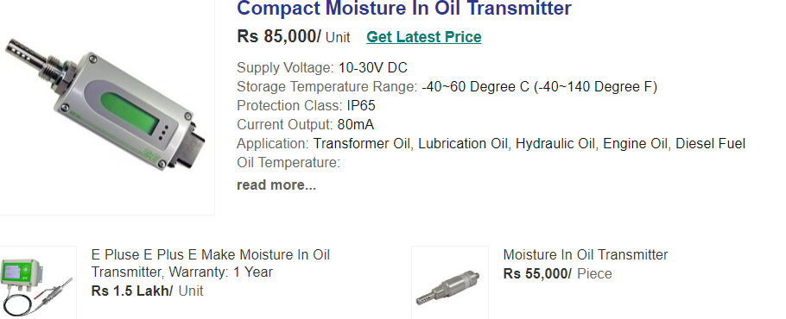

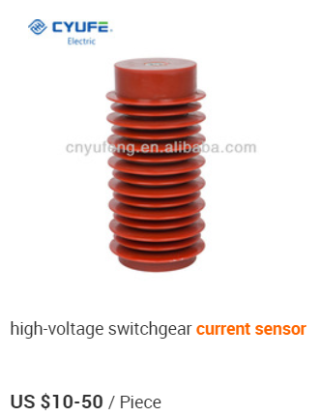
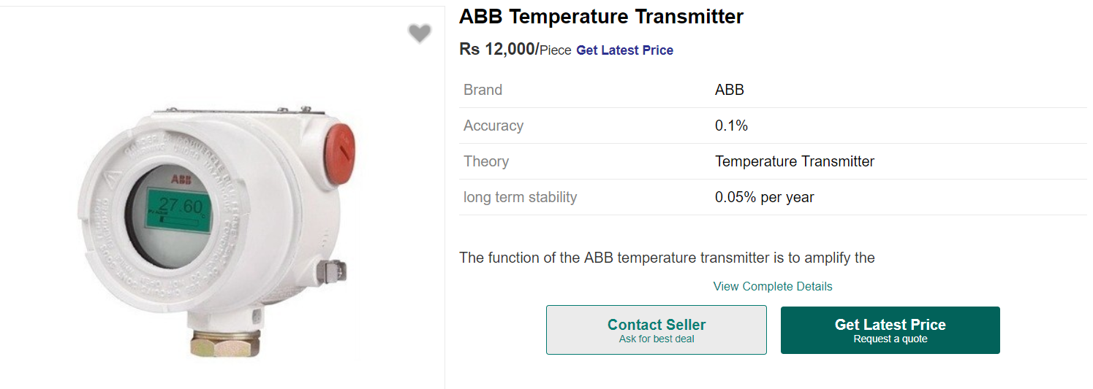
SENsors

Slide 11
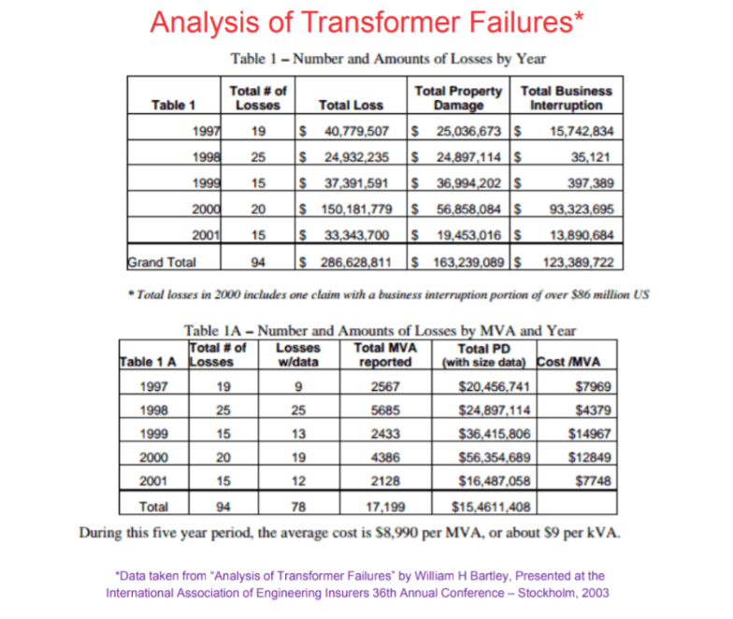
Transformer failure analysis

Slide 12
Team
Thallapally Anupama
Rakesh
Vadluri Pallavi
Charan
Chitti Ramya

Slide 13
Thank YOU!

