Slide 1

SASS
Syntactically Awesome Style Sheets
- CSS WITH SUPERPOWERS

Slide 2
Introduction to SASS
Sass stands for Syntactically Awesome Stylesheet
Sass is an extension to CSS
Sass is a CSS pre-processor
Sass is completely compatible with all versions of CSS
Sass reduces repetition of CSS and therefore saves time
Sass was designed by Hampton Catlin and developed by Natalie Weizenbaum in 2006
Sass is free to download and use

Slide 3
WhY TO USE SASS
Stylesheets are getting larger, more complex, and harder to maintain. This is where a CSS pre-processor can help.
Sass lets you use features that do not exist in CSS, like variables, nested rules, mixins, imports, inheritance, built-in functions, and other stuff.

Slide 4
How DOES SASS WORKS ?
A browser does not understand Sass code. Therefore, you will need a Sass pre-processor to convert Sass code into standard CSS.
This process is called transpiling. So, you need to give a transpiler (some kind of program) some Sass code and then get some CSS code back.

Slide 5
SCSS VS SASS
The basic difference is the syntax.
While SASS has a loose syntax with white space and no semicolons, the SCSS resembles more to CSS.

Slide 6
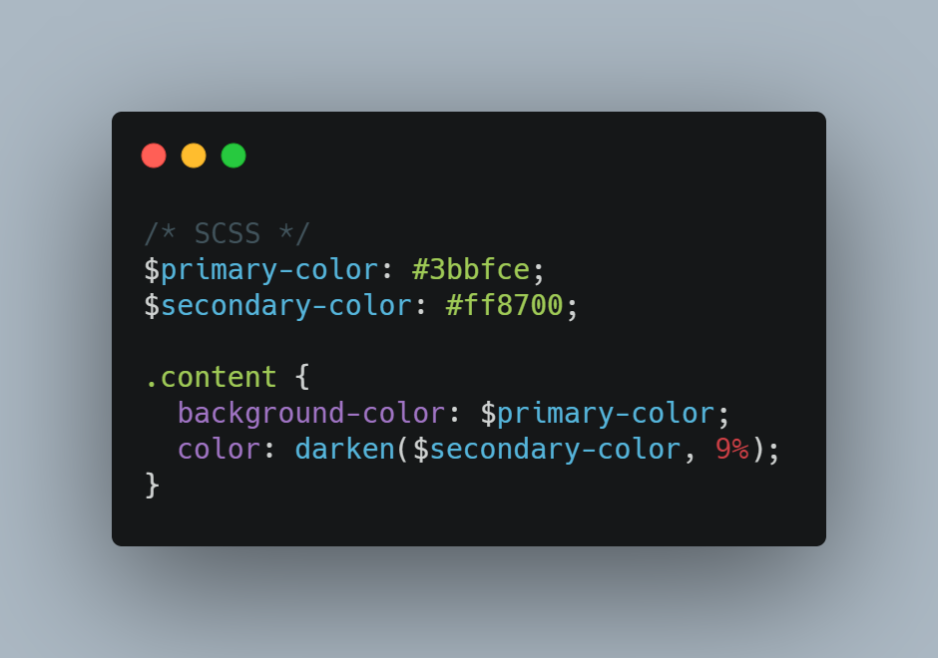
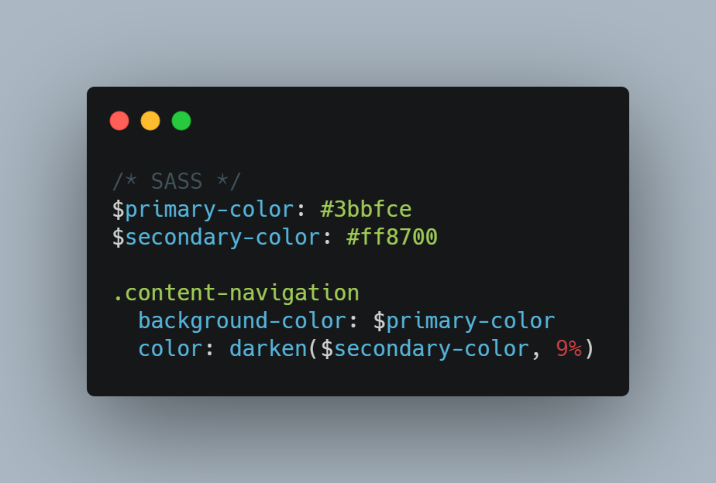
MAJOR DIFFERENCE BETWEEN SCSS AND SASS
SCSS
SASS

Slide 7
THANK YOU
SEE YOU IN NEXT VIDEO

