Slide 1
CAPSTONE PROJECT REVIEW - III
AI Smart Attendance and Interactive Learning Ecosystem.
BATCH NUMBER: 17
Under the guidance of
Dr. Shaik Jakeer Hussain, Associate Professor,
CSE – (AI & ML).
Presented by
Tavva Sandeep Kumar Reddy(23951A66H0),
Pavan (23951A66C0),
Kishore(24955A6651).

Slide 2

Contents of the Presentation
REVIEW – 3:
  INPUT MODELLING
  METHODOLOGY FLOW
  SYSTEM DESIGN AND ARCHITECTURE
  EXPECTED RESULTS
2

Slide 3
1.Input Modelling
Primary Data Sources:
  User Profiles: Student Roll Nos, Faculty IDs, and Admin Credentials stored in MongoDB.
  Input Streams: Real-time QR scans from student mobile profiles real-time Manual Override logs from the Faculty dashboard for exception handling.
Input Parameters:
  Attendance Data: Timestamps, Subject Codes, and Roll Call status (Present/Absent).
  Performance Metrics: Daily coding scores (integrated via API) and weekly schedule data.
Data Structure:
  Format: Dynamic JSON packets transmitted via REST API.
  Student Input Shape: (Student_ID, Course_ID, Timestamp, Location_Verify).
Notes:
This architecture merges deterministic logic (cut-offs) and intelligent prediction (ML), ensuring accuracy + transparency.

Slide 4
2. Methodology Flow
Step 1: Multi-Mode Acquisition
  Faculty chooses a mode: QR Scan (Instant), Manual (Roll-call), or Bulk Manual Entry..
  Data is captured via the mobile/web interface and sent to the Node.js backend.
Automated Validation:
  The system cross-verifies QR timestamps against the Master Timetable to prevent 'buddy punching’.
Step 3: Verification & Validation
  Cross-referencing the timestamp with the Master Timetable to ensure attendance is being marked for the correct scheduled hour.
Notes:
This architecture merges deterministic logic (cut-offs) and intelligent prediction (ML), ensuring accuracy + transparency.

Slide 5
2. Methodology Flow
Step 4: Gamification & Analysis (Leaderboards)
  The system aggregates "Coding Scores" and updates the Leaderboard in real-time.
  Faculty/Admin views are updated with class-wide performance trends.
Step 5: Alerting & Reporting
  If a student's attendance falls below the threshold (e.g., 75%), a real-time alert is triggered on their dashboard.
  Admin generates a "Master Report" for the entire department.
Notes:
This architecture merges deterministic logic (cut-offs) and intelligent prediction (ML), ensuring accuracy + transparency.

Slide 6
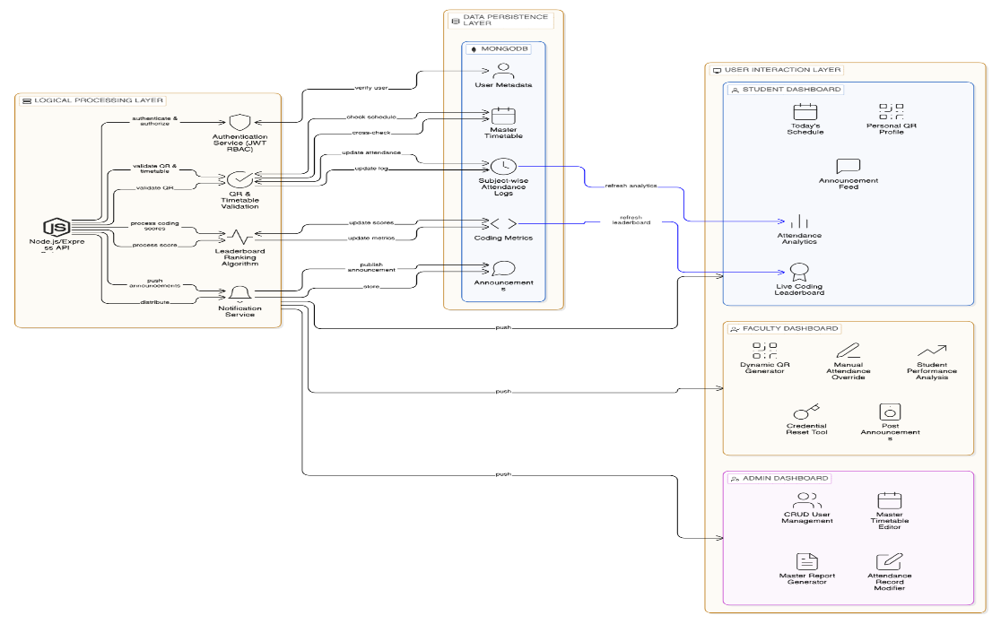
3.Proposed System Architecture

Slide 7
3.Proposed System Overview
Layer 1: Frontend (User Experience)
- Role-specific dashboards for Admin, Faculty, and Students.
Layer 2: API Gateway (Node.js)
- Handles authentication (JWT) and high-speed data routing.
Layer 3: Data Layer (MongoDB)
- Stores Master Timetables, Attendance Logs, and Coding Ranks.
Notes:
This architecture merges deterministic logic (cut-offs) and intelligent prediction (ML), ensuring accuracy + transparency.

Slide 8
4. Expected Results and Discussions
Efficiency Target: Reducing attendance marking time... to <30 seconds via optimized QR flows.
Engagement Target: Improving student participation in technical coding by providing daily rank-based visibility.
Administrative Accuracy: 100% record accuracy through the Admin's ability to modify records and correct manual errors.
Scalability: The system is designed to handle 100+ simultaneous classes and thousands of student logs without latency.
Notes:
This architecture merges deterministic logic (cut-offs) and intelligent prediction (ML), ensuring accuracy + transparency.

Slide 9
Thank You

