Slide 1
Healthcare Revenue Cycle Management
Sandeep Reddy Mooraka
Notes:
1

Slide 2


Project Objective & Scope
Automate Ingestion
Clean & Standardize
Load with History
Seamlessly collect raw claim data from diverse hospital CSV sources.
Implement robust cleaning and transformation rules to ensure data quality.
Load into a structured database, preserving historical changes via SCD Type-2.
This pipeline transforms raw, disparate data into a reliable, auditable asset crucial for efficient Revenue Cycle Management.
Notes:
3

Slide 3

Architectural Overview: Data Flow
Our ETL pipeline efficiently moves and processes hospital claim data, ensuring a clean and historically accurate dataset.
Import CSV Files
ETL Processing
Data Transformation
Load to PostgreSQL
This streamlined architecture provides a clear path for data integrity and accessibility.
Notes:
4

Slide 4
Modular Design & Workflow
3. Load: load.py & scd_type2.py
2. Transform: transform.py
1. Extract: extract.py
Performs data cleaning, validation, and standardization, resolving inconsistencies and preparing data for loading.
Loads processed data into the PostgreSQL database, implementing SCD Type-2 logic for historical tracking of changes.
Reads raw CSV files from multiple hospital systems, handling various formats and initial data ingestion.
This modular approach ensures maintainability, scalability, and reusability across different data sources.
Notes:
5

Slide 5





Data Pipeline Flow: Source to Analytics
Our robust ETL pipeline orchestrates the journey of hospital claim data from disparate sources to a unified, analytics-ready cloud data warehouse.
Python ETL
Analytics KPIs
MySQL DBs
Google BigQuery
This streamlined process ensures timely, accurate, and comprehensive data for critical revenue cycle insights.
Notes:
11

Slide 6
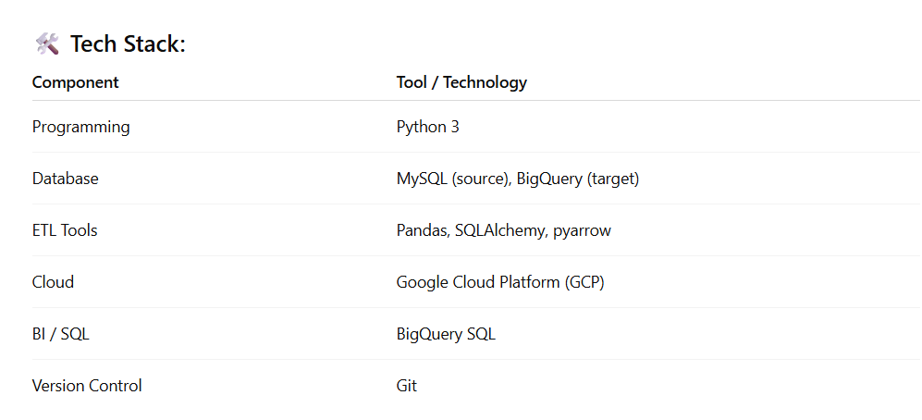
Notes:
6

Slide 7
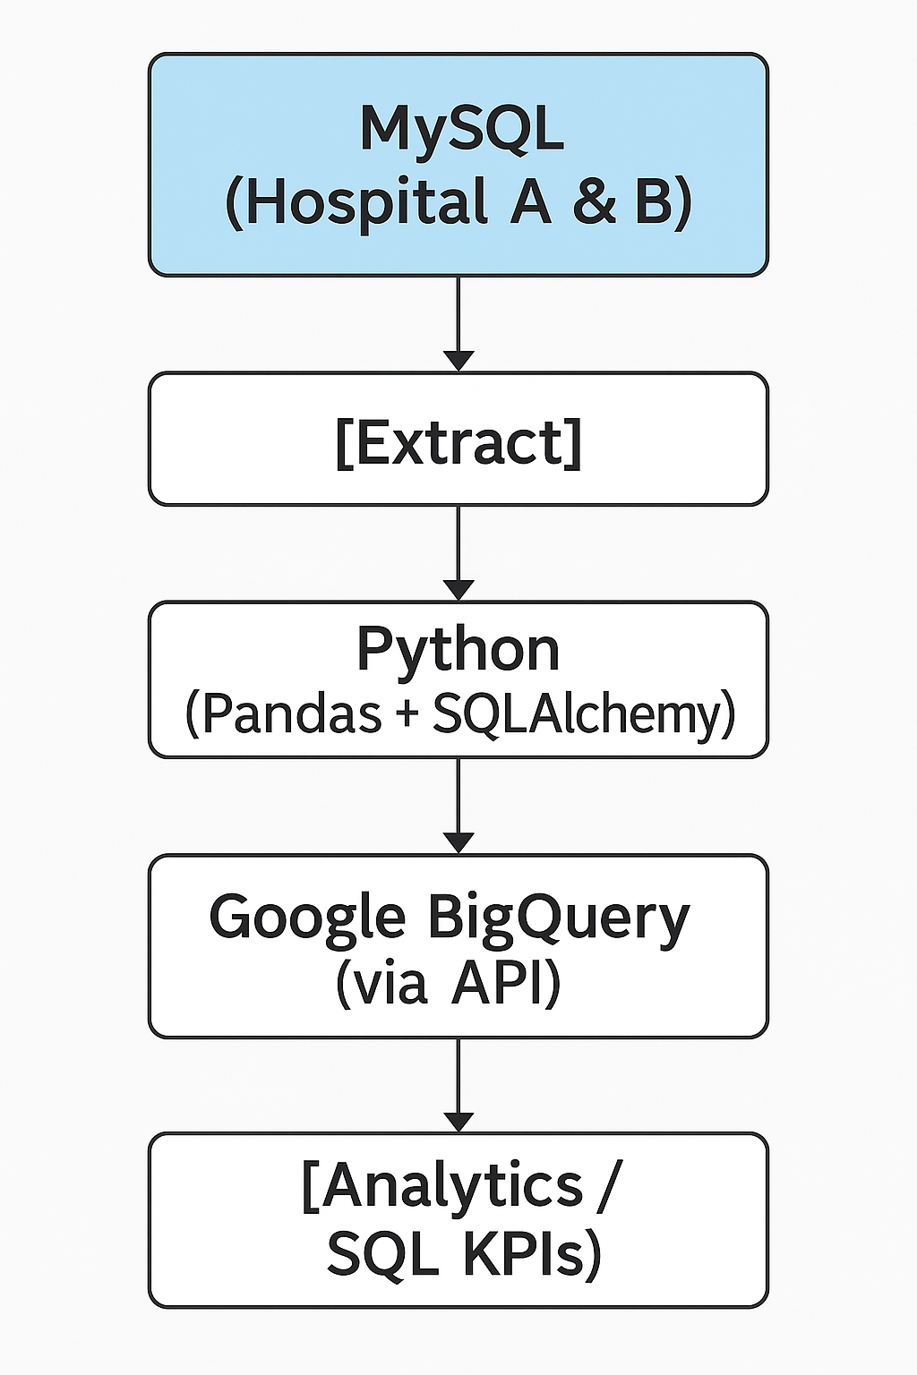
Workflow Diagram

Slide 8




Key Performance Indicators (KPIs)
Our ETL pipeline provides critical data for tracking key performance indicators across the revenue cycle:
Total Revenue
Denial Rate
Monitor real-time revenue streams and identify trends for optimized financial performance.
Track claim denial percentages to pinpoint issues in billing and reduce revenue loss.
Revenue by Department
Encounter Trends by Type
Analyze revenue generated by different hospital departments for resource allocation and strategic planning.
Understand patient encounter patterns to forecast demand and improve operational efficiency.
Final Project Results
Processed ~10,000 patient records and ~20,000 transactions with high accuracy.
Successfully created a business-ready cloud data warehouse on Google BigQuery.
Enabled SQL-based insights directly for executive dashboards, facilitating data-driven decisions.
Notes:
12

Slide 9
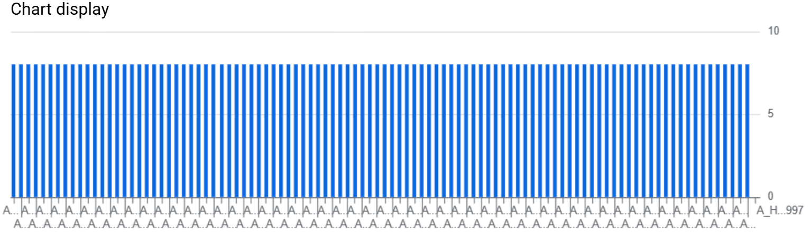
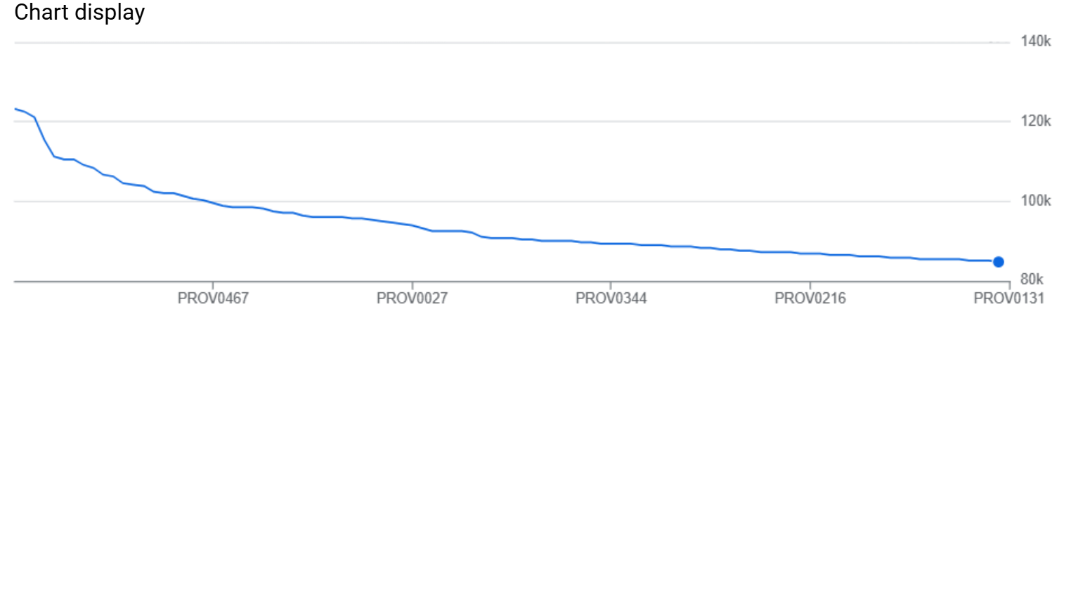
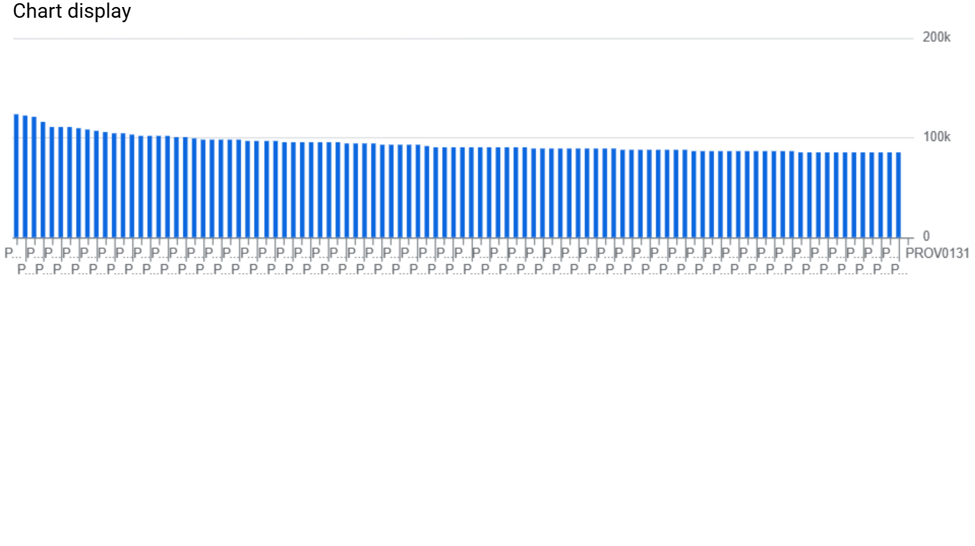
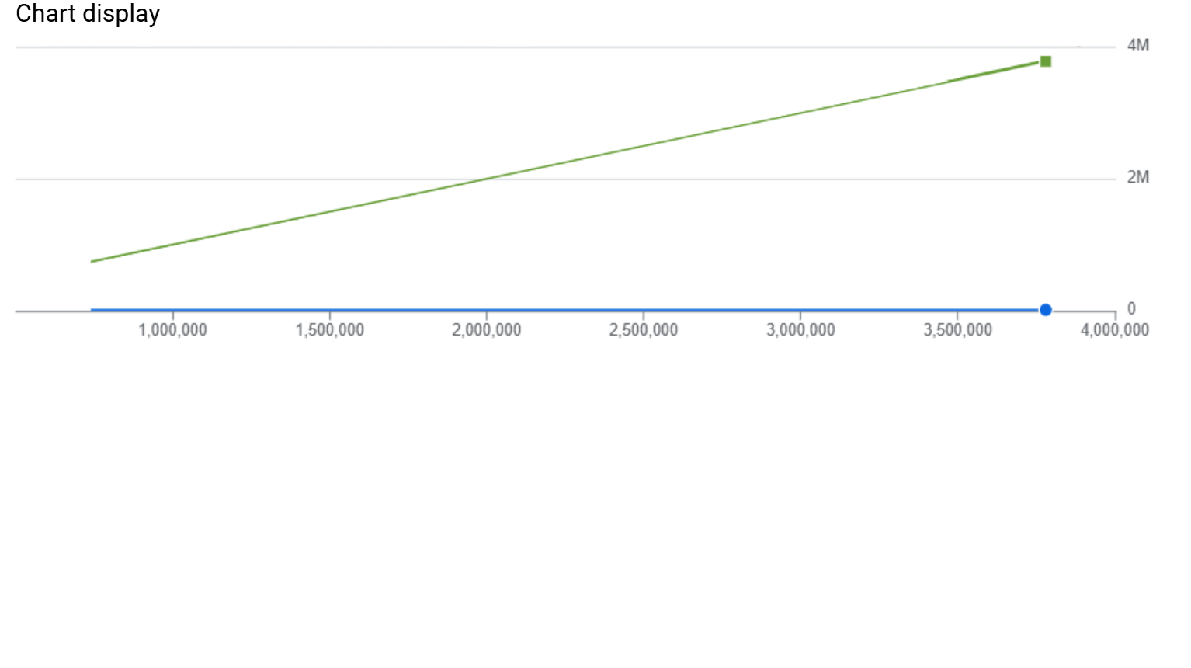
Key Insights & Visualizations

Slide 10

Challenges & Solutions
Challenge: Schema Inconsistency
Challenge: Preserving Data History
Hospitals provided claim data in varied CSV formats, leading to significant schema and column naming discrepancies.
Requirement to track changes to patient claim records over time, not just overwrite existing data.
Solution: SCD Type-2 Implementation
Solution: Dynamic Mapping
Integrated Slowly Changing Dimensions Type-2 logic to maintain full historical versions of records, ensuring auditable data lineage.
Implemented a flexible configuration-driven mapping system to dynamically adjust to different input schemas, ensuring consistent processing.
Notes:
8

Slide 11

Thank You
Notes:
14

