Slide 1


Chatbot for Breast Cancer Health
Team
Gopesh Krishna Mohan
Venkata Prudhvi Raj
Sandeep Reddy
Veerendra Patil

Slide 2
Overview
Introduction
Background and Motivation
Role of Chatbot
Project Timeline
Conclusion
Design Modules

Slide 3
Introduction
Breast cancer is a critical health concern, affecting millions of women worldwide.
Accroding to WHO there are 2.3M cases globally in the year 2020.
More than 200,000 US cases per year.
685,000 deaths worldwide in the year 2020.

Slide 4
What is the problem ?
Lack of easily accessible resources and support systems for individuals affected by breast cancer.
Many people feel overwhelmed, confused, or anxious when navigating the complexities of breast cancer detection, diagnosis, treatment, and survivorship.
Disparities in healthcare access and knowledge, particularly for underserved communities or those in remote areas.
Financial Barriers
Geographic Barriers

Slide 5
Why choose this ?
Address critical need for accessible and reliable information and support regarding breast cancer.
1
Overcome barriers to accessing accurate information, guidance, and support.
2
Empower individuals to take control of their breast health.
3
Personalized suggestions based on user's previous interaction with the chatbot.
4

Slide 6

How are we going to solve this problem

Slide 7
Role of Chatbot
Provide information about breast cancer risk factors, symptoms, and prevention
Answer user queries related to breast health.
Support patients during their healthcare journey.

Slide 8
Design Modules
Data Extraction
Chatbot Model Design
Front End and Backend Design
Integration and Deployment

Slide 9
Data Extraction
We are not trying to use the existing data sets rather we are trying to do get the real time data from the websites where we get the legitimate info.
Websites We chose For
Medscape - https://www.medscape.com/
Medline - https://medlineplus.gov/breastcancer.html/
American Cancer Society - https://www.cancer.org/cancer/types/breast-cancer.html
Center for Disease Control - https://www.cdc.gov/cancer/breast/index.html

Slide 10
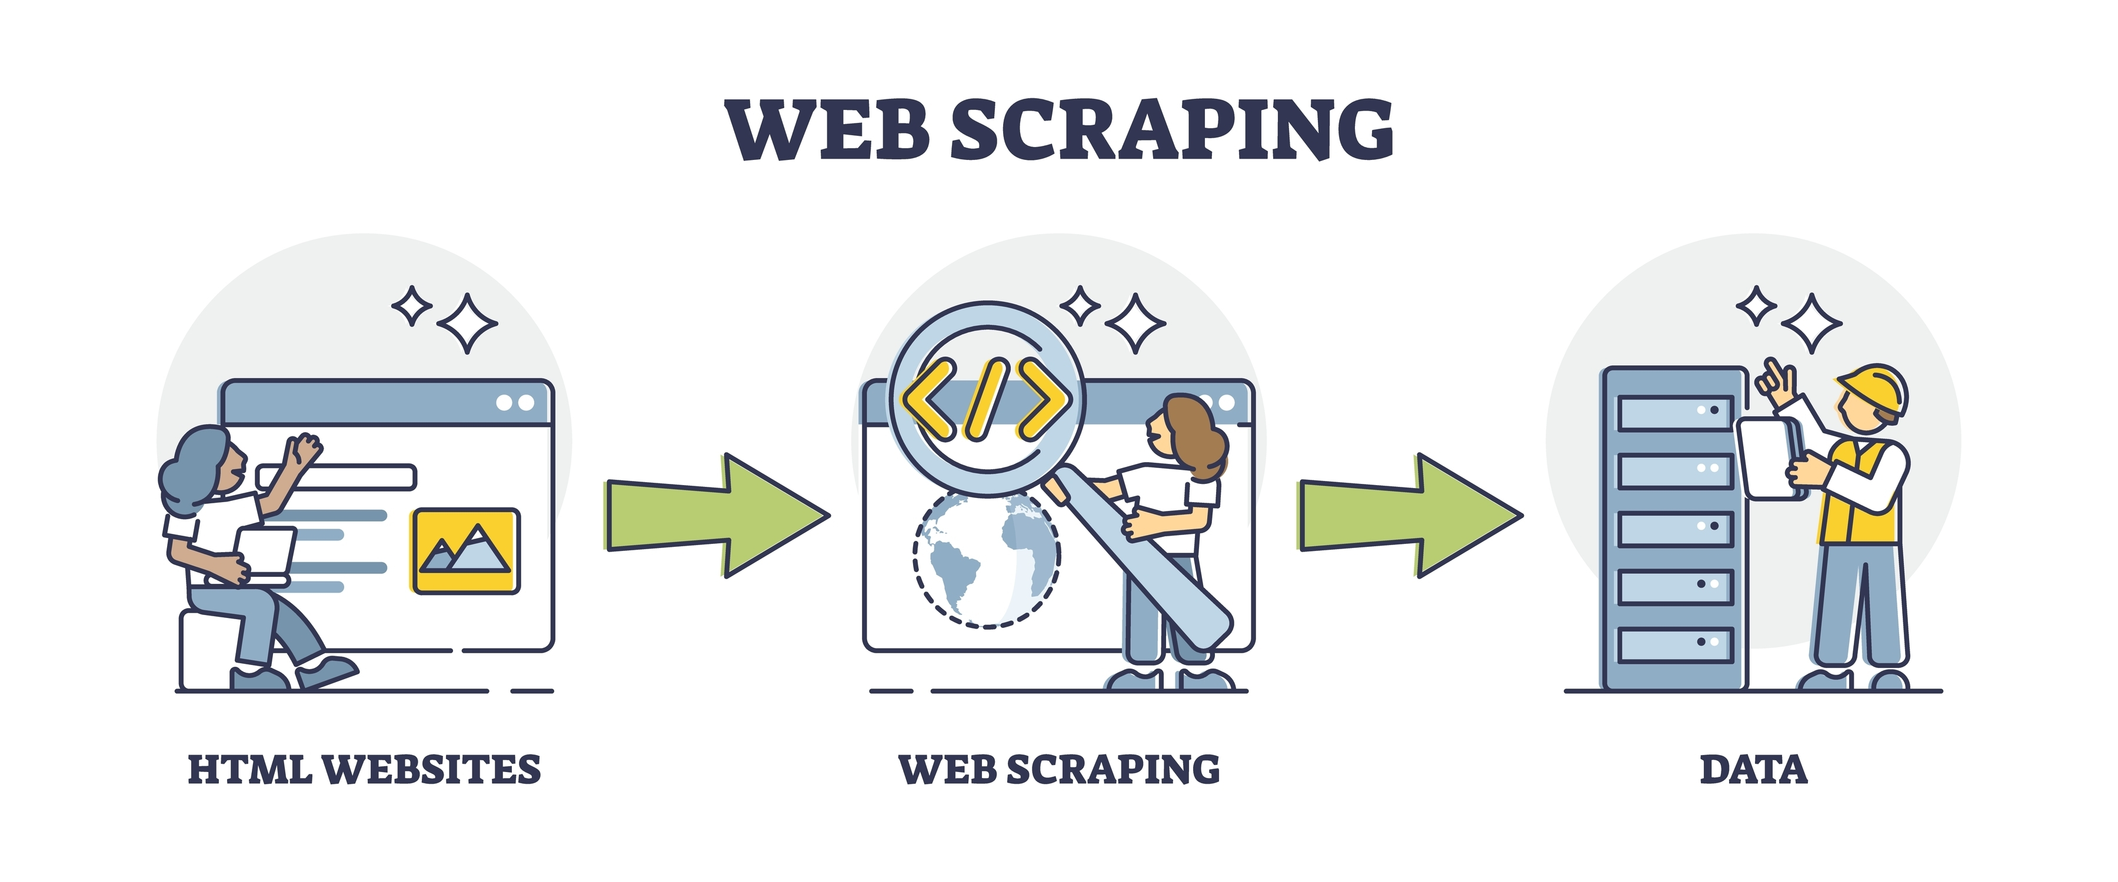
•⁠ ⁠Automated extraction of data from online sources for real-time information retrieval.
•⁠ ⁠Identification of target websites hosting the desired data.
•⁠ ⁠Accessing web pages using HTTP requests.
•⁠ ⁠Parsing HTML content to extract relevant information.
•⁠ ⁠Utilization of techniques such as Regular Expressions, XPath, or CSS Selectors for precise data extraction.
Tools and Technologies Used: Selenium, Beautiful Soup, Scrapy

Slide 11
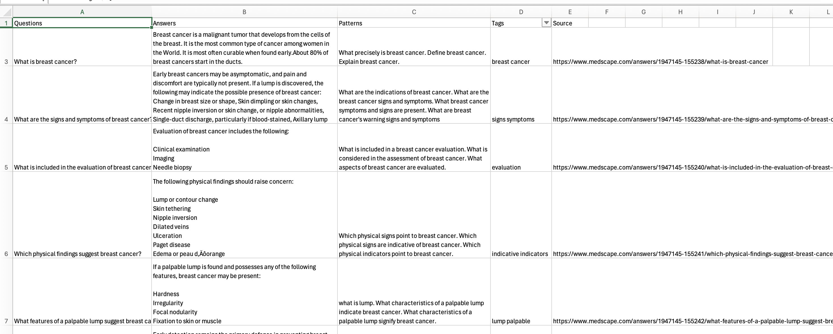
Desired Data Format
This is the way we are trying to extract the data in this format
Question | Answer | Patterns | Tags | Source

Slide 12
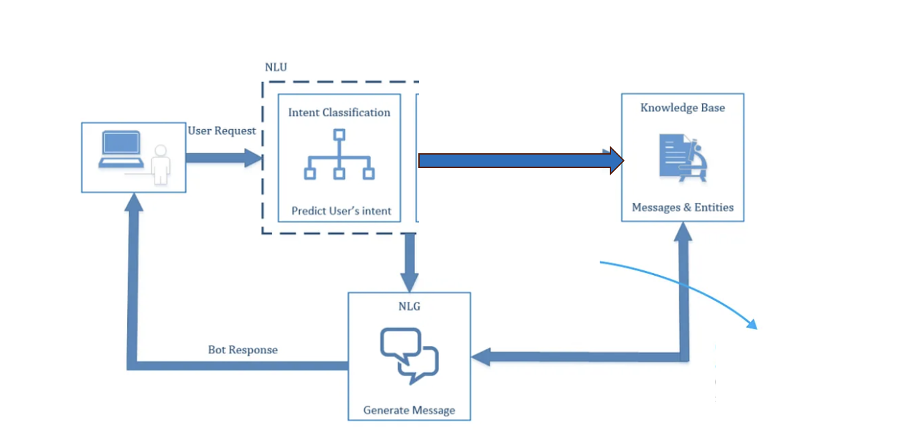
High Level System Design

Slide 13
Intent Classification
Imagine having a chatbot that can truly grasp the intent behind our words.
The Intent Classification is the key to unlocking this capability.
It utilizes advanced techniques to interpret our messages accurately, making the chatbot’s responses feel more human-like and intuitive.
Based on the user Request , the chatbot tries to classify the intent of the question and tries to generate the response based on the intent.

Slide 14
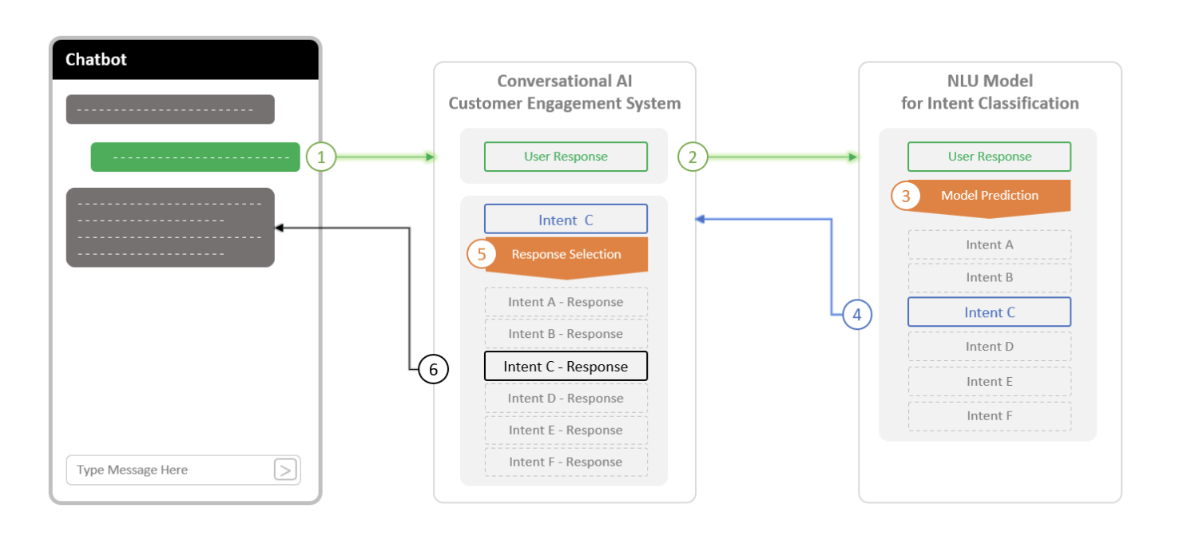
How the intent Classification Works?

Slide 15
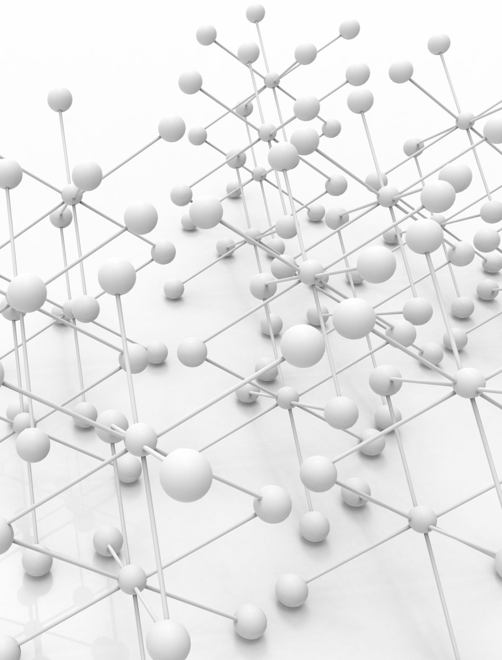
To achieve this task We employed Transformers
Self-Attention Mechanism - Allows it to weigh the importance of different words in a sentence when encoding or decoding.
Multi-Head Attention - The Transformer uses multiple attention heads in parallel to capture different types of information.
Positional Encoding: - Positional encodings are fixed-length vectors added to the input embeddings based on the position of each word in the sequence. They enable the model to distinguish between words at different positions.
Feed-Forward Neural Networks: feed-forward neural networks (FFNNs) applied independently to each position in the sequence. These FFNNs introduce non-linearities and help the model learn complex patterns in the data.
Encoder-Decoder Architecture: The Transformer architecture consists of an encoder and a decoder. The encoder processes the input sequence and produces a sequence of context vectors, capturing the input's representations. The decoder takes these context vectors as input and generates the output sequence step by step.

Slide 16
BERT (Bidirectional Encoder Representations from Transformers)
It leverages a transformer-based neural network to understand and generate human-like language.
BERT employs an encoder-only architecture.
In the original Transformer architecture, there are both encoder and decoder modules.
The decision to use an encoder-only architecture in BERT suggests a primary emphasis on understanding input sequences rather than generating output sequences.

Slide 17
Models that we are planning to use
BERT: The original BERT model is a strong performer across various NLP tasks, including intent classification.
Distil BERT: A distilled version of BERT, Distil BERT offers comparable performance with reduced computational resources, making it ideal for scenarios where efficiency is crucial.
Electra: This model introduces an efficient pre-training approach focused on token replacement, resulting in faster training and inference times compared to BERT, suitable for resource-constrained environments.

Slide 18
Front End and Backend Design
Chat Interface: Develop a user-friendly interface where users can type their messages and receive responses from the chatbot.
Input Box: Provide a text input box for users to type their messages.
Message Display Area: Display messages from both the user and the chatbot in a conversational format.
Scrolling: Implement scrolling functionality to handle long conversations.
UI Elements: Include buttons, quick replies, or other interactive elements for users to select options or perform actions.

Slide 19
Deployment
We are trying to deploy this project using
FLASK
It is an open-source framework to easily build and share your web app.
Using FLASK, can create and deploy your ML model as a python service

Slide 20
RESULTS
Model | Accuracy | F1-Score | Precision | Recall
BERT | 0.64 | 0.595 | 0.601 | 0.62
Distil BERT | 0.71 | 0.648 | 0.647 | 0.674
Electra | 0.67 | 0.596 | 0.60 | 0.628

Slide 21
Conclusion
In this project, we aim to develop a chatbot that helps in answering all the breast cancer related questions
To ensure that the project is effectively finished, our team has a clear plan and duties that are clearly defined.
For this development, we will employ classic and advanced NLP techniques that are covered in the course syllabus.

Slide 22
Future Scope
We can enhance this project by implementing
Named Entity Recognition System in this Chat Bot.
But the challenge is to get the real time medical data which needs in developing this system
Also to extend this project for all other diseases.

Slide 23


