Slide 1
Coding Simple Calculator with Graphical Interface using PYTHON
Sandeep Sharma
01-09-2024

Slide 2
INTRODUCTION
OBJECTIVE : Code a simple calculator using python as programming language
Scope : Function catered in calculators are Addition/ Subtraction/ Multiplication/Division and Square Root
Tools Used : Python programming language with Tkinter for basic GUI support

Slide 3
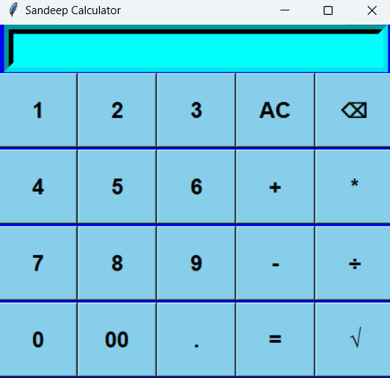
Basic gui

Slide 4
Overview
Calculator Features:
The application caters to Basic arithmetic operations
It is very User-friendly interface and almost replica of pocket calculator used
Approach:
Simple code in python for arithmetic operation.
Graphical User Interface (GUI) with libraries like Tk inter

Slide 5
Interface
Components:
Input: User provides numbers and operation (+, -, *, /, √)
Processing: Perform the chosen arithmetic operation
Output: Display the result (using =)
AC are used to clear screen
Entry Box : To display the results.
Flow:
User inputs numbers and operator
Calculator processes the input
Result is displayed

Slide 6
Future integration
Features:
Advanced mathematical functions (e.g., Percentage)
Memory functions (e.g., memory recall, memory store)

Slide 7
Conclusion
Summary: A simple yet functional calculator built with Python.
Key Takeaways:
Basic arithmetic operations implemented
Option to expand with GUI and additional features

Slide 8
Thanks! Best Regards Sandeep sharma

