Slide 1











ClassicRealm

Slide 2





Submitted by:
Khushbu Koul ( 2006943)
Sandeep Singh (2006947)
Shivam Nagi (2006948)
Manprit Singh Bahl (2106793)
arcade
TetrIs
Flappy
adventure

Slide 3

Table of Contents
Introduction
Features
Objectives
Purpose
Scope of the Project
Requirements
Screenshots
Conclusion

Slide 4




INTRODUCTION
VS

Slide 5


v
ClassicRealmis a classical multiplayer game application.
The aim of this project is to recreate and celebrate the timeless classics that have stood the test of time, allowing players to connect and compete in beloved titles.
It is an application which has both single player and multiplayer games which players can play both off-line and on-line.
This project is built as a part of our android development journey in the famous programming language Java along with Google Firebase (that helps mobile app developers build, deploy and scale their apps) all of this done in Android studio.
Lastly, ClassicRealm is a great application for anyone who wants to relive the experience of playing classical games with their friends or alone.

Slide 6




FEATURES

Slide 7
1. Classic Game Library: A collection of timeless classic games, including chess, checkers, tic-tac-toe, card games, and more, for users to enjoy.
2. Single Player Mode: Play classic games against AI opponents, providing entertainment for solo players.
3. Multiplayer Mode: Challenge friends or connect with players worldwide for exciting online multiplayer matches.
4. Offline Play: Enjoy games without an internet connection, making it ideal for on-the-go gaming.
5. Leaderboards: Track and display high scores and rankings to encourage healthy competition among players.
6. User-Friendly Interface: Design an intuitive and visually appealing user interface that is easy to navigate.

Slide 8

OBJECTIVE

Slide 9

v
1. Built an android multiplayer gaming application containing multiple single player and multiplayer games that could be played both off-line and on-line by using a set up of Game Code to enter the gaming environment.
2. Created a gaming platform with a score board section which will show users progress and create a multiplayer battle platform which users can use to track their progress and scores.
3. Created an easy to use and understand User Interface so that user can have a wonderful gaming experience.

Slide 10

PURPOSE

Slide 11
v
1. Recreating Classic Games: Revive timeless multiplayer classics for new and nostalgic players.
2. Entertainment and Recreation: Provide diverse classic games for fun and relaxation.
3. Multiplayer Interaction: Foster social connections with offline and online multiplayer modes.
4. Mobile Gaming: Make classics accessible on Android devices anytime, anywhere.

Slide 12



SCOPE OF THE PROJECT

Slide 13

v
1. Game Selection: The project includes a well-curated selection of classic multiplayer games. The scope could involve continually expanding the game library based on user demand.
2. Platform: ClassicRealm is designed for Android devices, but the scope may include potential expansion to other platforms like iOS or web-based versions in the future.
3. Gameplay Modes: The project includes both single-player and multiplayer modes, both online and offline. Expanding or enhancing these modesis scope of this project.
4. Features: The scope encompasses features like chat functionality, user profiles, leaderboards, and customization options. Additional features may be added to enhance user experience.

Slide 14





REQUIREMENTS

Slide 15
v
Hardware Requirement
1. Computer/Laptop
•x86 64-bit CPU (Intel / AMD architecture).
•8GB RAM (16GB preferable).
•5GB free storage.
2. Android Device
• Android 7Nougat or above.
Software Requirement
1. Operating system:
•Windows 10 or 11
•Mac OS X 10.11 or higher, 64-bit
•Linux: RHEL 6/7, 64-bit
Android Studio
Web Browser (For Firebase Console).

Slide 16
VS
SCREENSHOTS

Slide 17
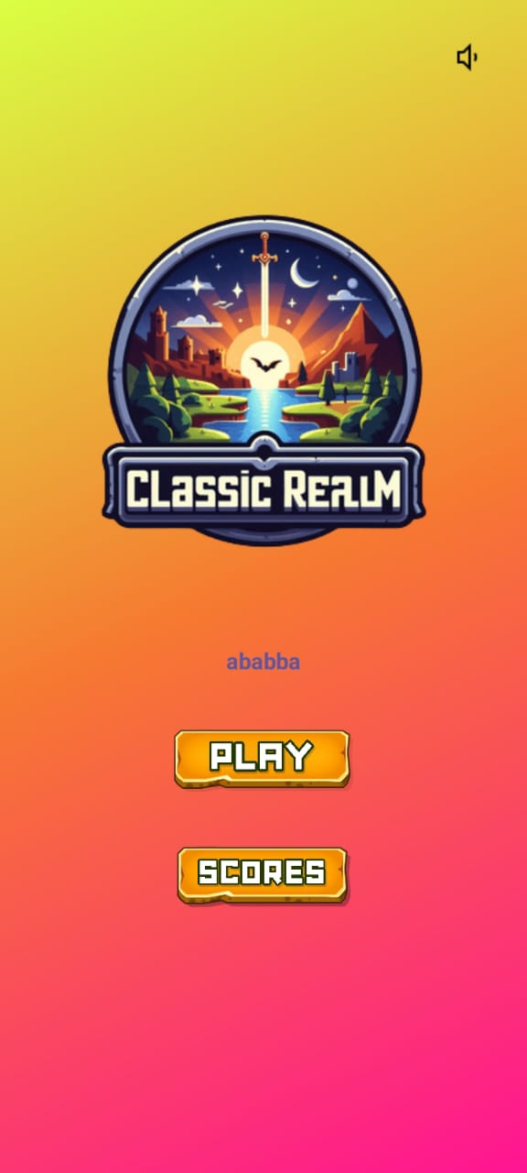

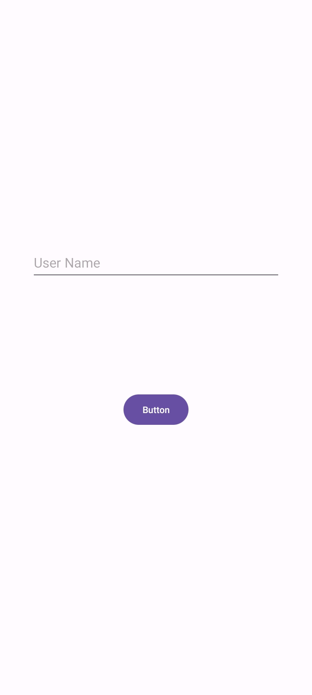
v

Slide 18
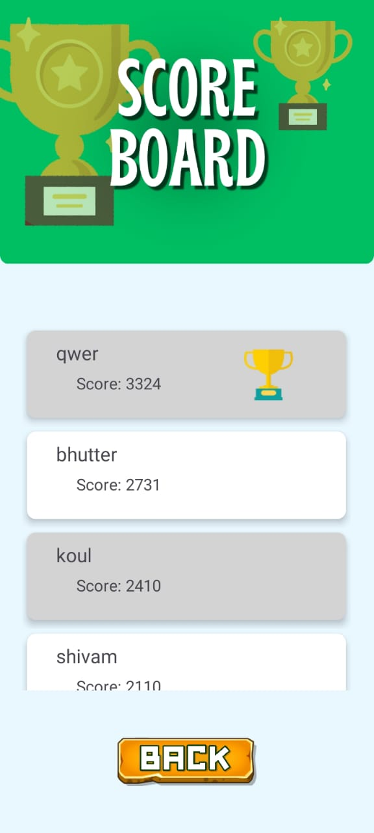
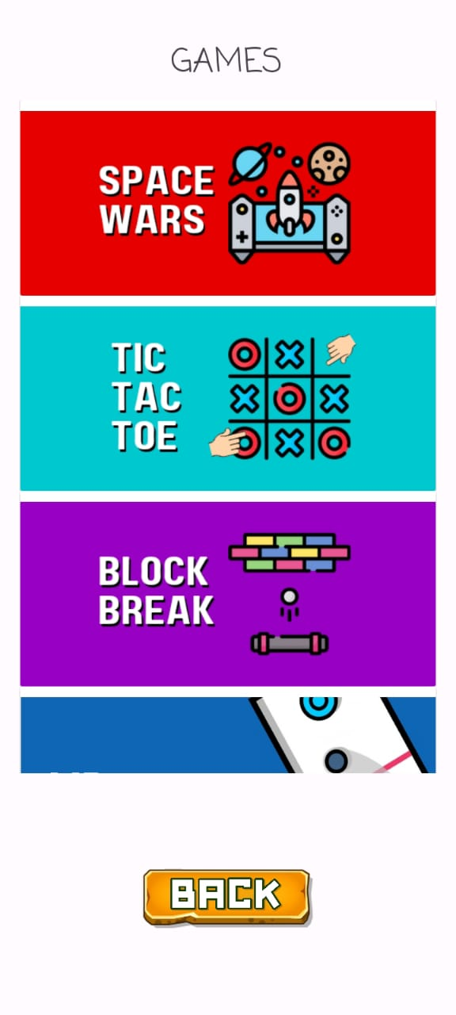
v

Slide 19

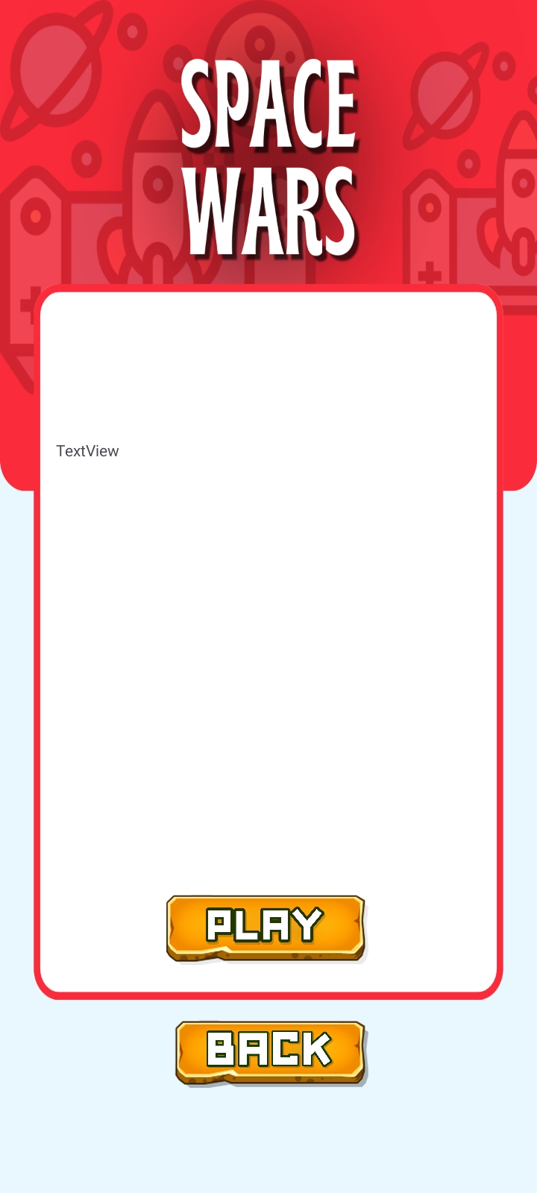
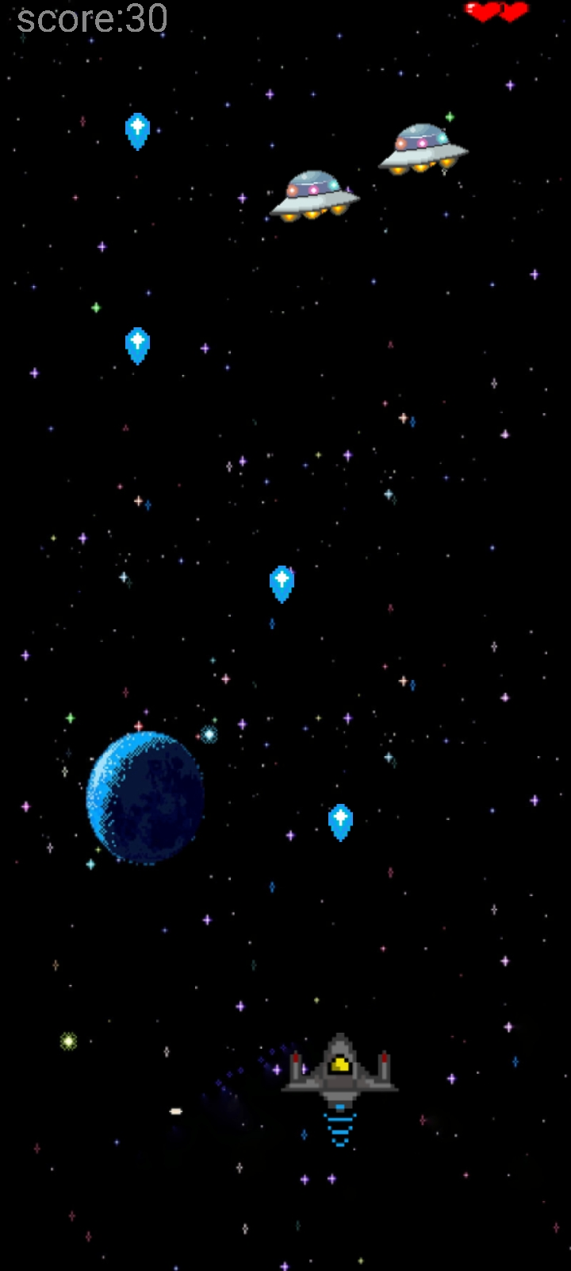
v

Slide 20
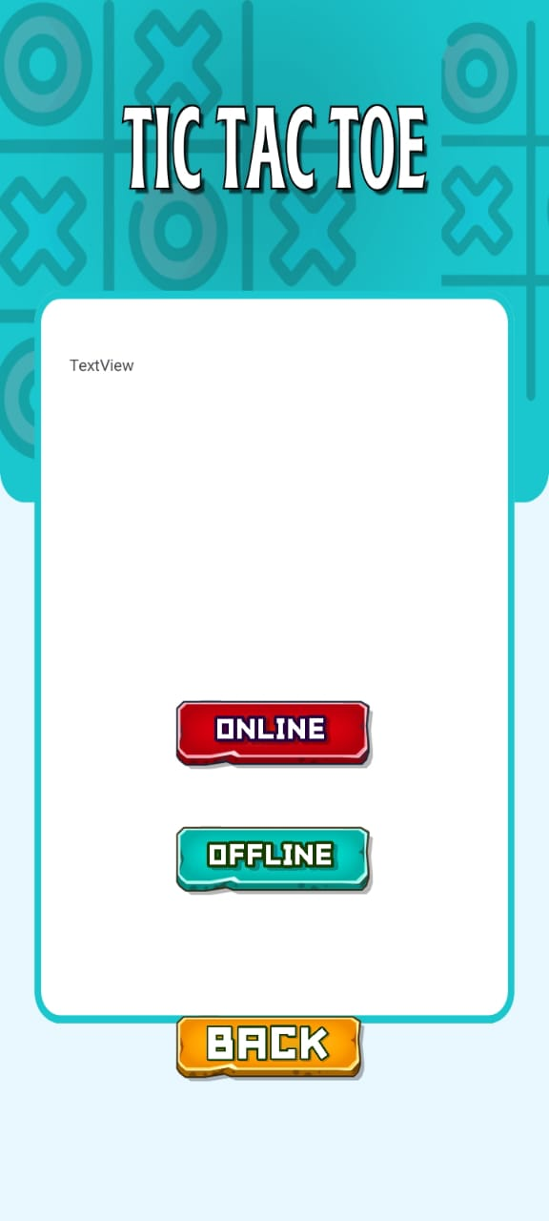
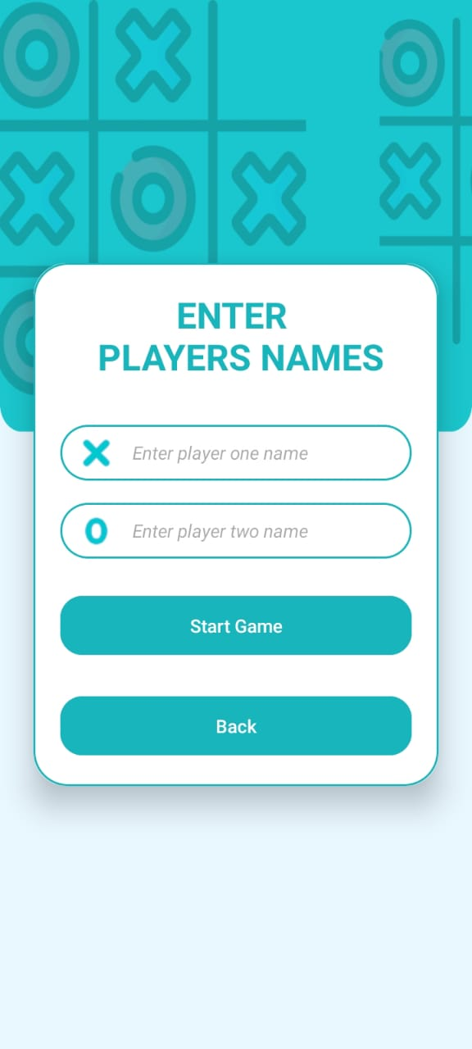
v

Slide 21
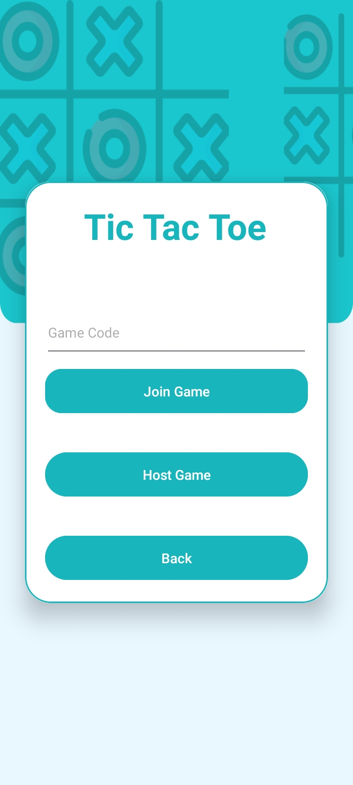
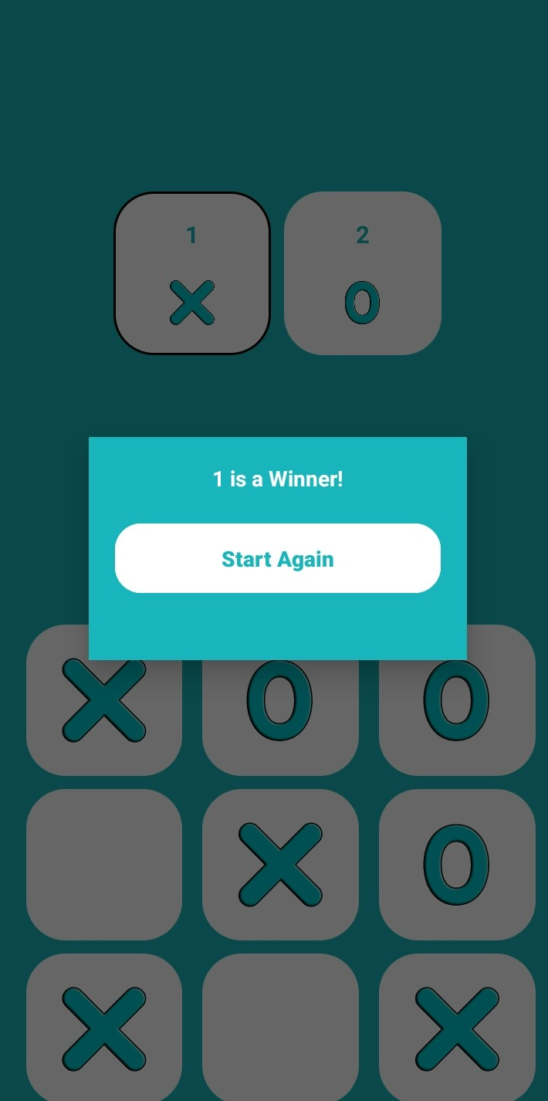
v

Slide 22
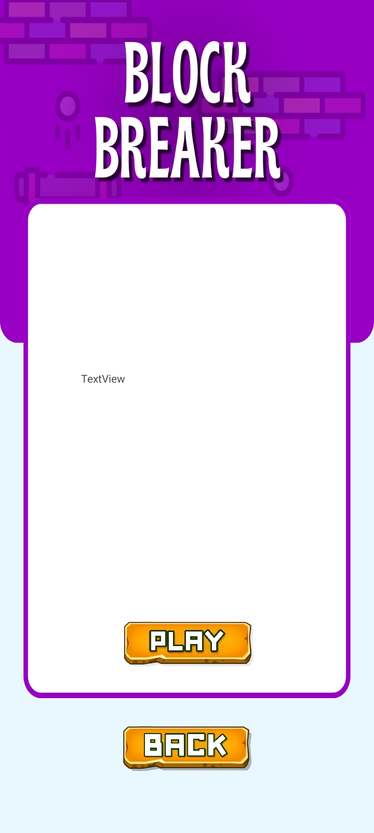


v

Slide 23
CONCLUSION

Slide 24
v
The ClassicRealm project successfully achieves its goal of providing a platform for both single and multiplayer classic games. By leveraging Java and Google Firebase in Android Studio, the application offers robust performance and scalability. The unique feature of generating a game code for online mode enhances the flexibility and accessibility of the gaming experience, allowing players to connect with friends anytime, anywhere.
The inclusion of a scoreboard adds a competitive edge and encourages players to continually improve their skills. This feature, which is rarely found in similar applications, sets ClassicRealm apart from its competitors.
ClassicRealm effectively combines nostalgia with modern gaming convenience, offering a unique and engaging gaming experience. It is a testament to the timeless appeal of classic games and their ability to connect players across generations. The project serves as a valuable contribution to the gaming community and stands as a remarkable achievement in the field of Android development.

Slide 25
THANK YOU FOR PLAYING WITH US!

