Slide 1
Court Case Management System
By
SRIKANTH GADALA (1017448330)
CHANDRALEKHA CHILUMULA (1017459000)
PRATYUSHA BODALA (1017441790)
RAJA ROHITH GUNDETI (101743180)

Slide 2
Introduction
A court is a government institution with the authority to adjudicate the legal disputes between clients and carry out the administration in accordance with the rule of law. These days there is a huge spike in cases to the court within different departments and storing(or)accessing those data through file-based systems or in the form of hard copies became much more difficult for the administration department of the court.

Slide 3
Existing System
Before the implementation of the court case management system, courts used to maintain their information either in a file-based system or in the form of documents. These Information can be court details, list of judges, attorney details of the court along with all the client details and their disputes, and so on.
Disadvantages
1. Difficult to maintain a huge set of data
2. Takes time to retrieve the data
3.No chance to retrieve the data once it’s lost
4. More data redundancy

Slide 4
Proposed Approach
With the implementation of a court case management system, everything related to court is stored in the database and this database will be in the cloud
Advantages
1.Easy to maintain a huge amount of data
2.Easy to update and delete (Manipulation) information
3.Faster retrieval and access to data

Slide 5
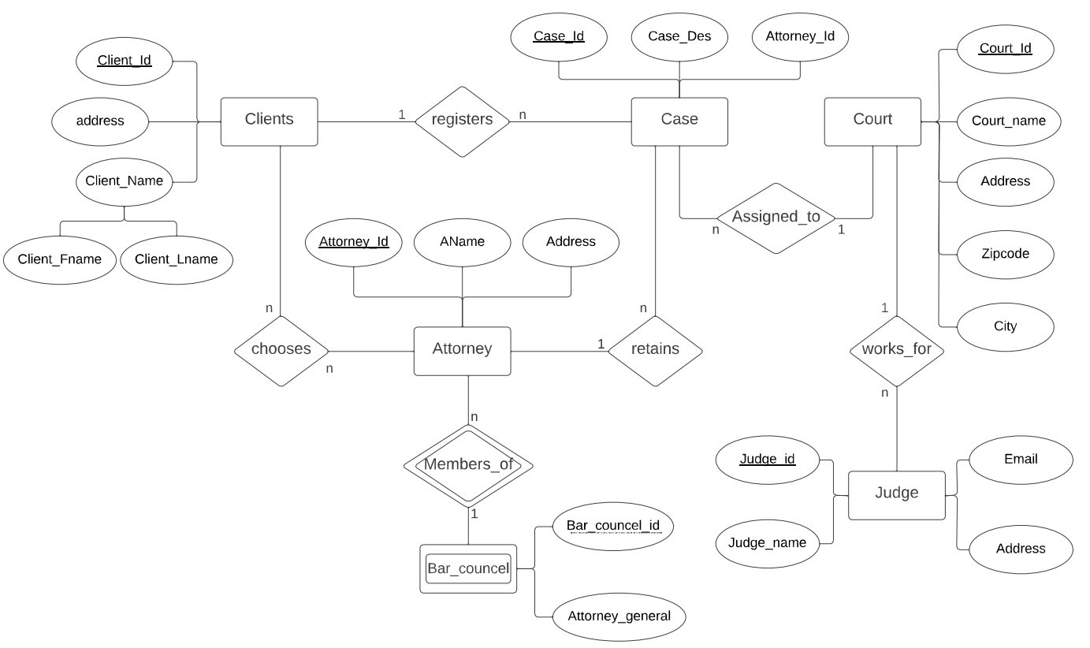
ER Diagram

Slide 6
TABLE SCHEMA
Case
Field | Data Type | Constraint
Case Description | VARCHAR(25) | NOT NULL
Case ID | Number(4) | PRIMARY KEY

Slide 7
Court
Field | Data Type | Constraint
City | VARCHAR2(15) | NOT NULL
Zipcode | VARCHAR2(15) | NOT NULL
Address | CHAR(9)
Case ID | NUMBER(10)
Court Name | VARCHAR(20)
Court ID | NUMBER(4) | PRIMARY KEY

Slide 8
Attorney
Field | Data Type | Constraint
Attorney ID | NUMBER(4) | PRIMARY KEY
Attorney Name | VARCHAR(15)
Address | VARCHAR(50)
Case ID | NUMBER(4)

Slide 9
Clients
Field | Data Type | Constraint
FName | VARCHAR(15) | NOT NULL
LName | VARCHAR(15) | NOT NULL
Address | VARCHAR(50)
Sex | CHAR
Client ID | NUMBER(10) | PRIMARY KEY
Case ID | NUMBER(4)

Slide 10
Bar Council
Field | Data Type | Constraint
Attorney General | VARCHAR(25) | NOT NULL
Attorney ID | NUMBER(4) | PRIMARY KEY
Bar Council ID | NUMBER(4)

Slide 11
Judge
Field | Data Type | Constraint
Judge ID | NUMBER(10) | PRIMARY KEY
Judge Name | VARCHAR2(15)
Address | VARCHAR2(50)
In Service | NUMBER(2)
Court ID | NUMBER(4)

Slide 12
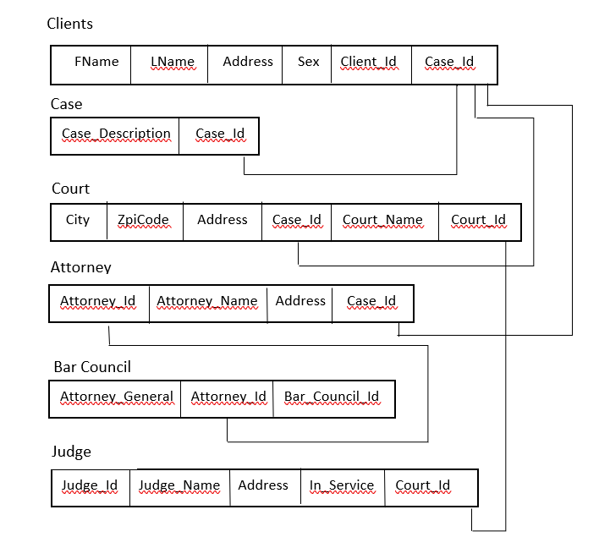
Relational Schema

Slide 13
Entities
Clients
Case
Court
Judge
Attorney
Bar Council

Slide 14
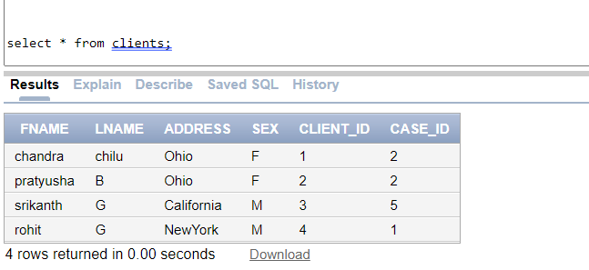
1. Clients Table select * from clients;

Slide 15
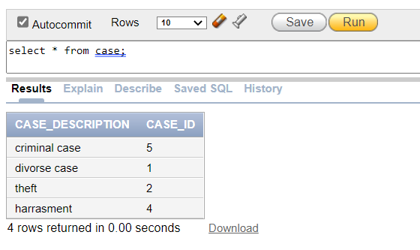
2. Case Table select * from case;

Slide 16
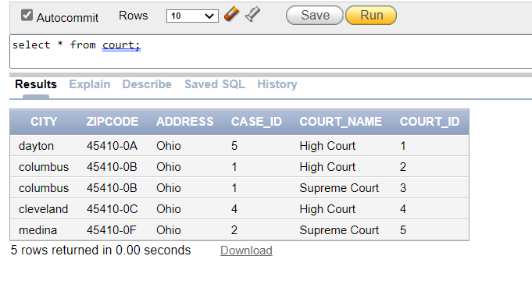
3.Court Table select * from court;

Slide 17
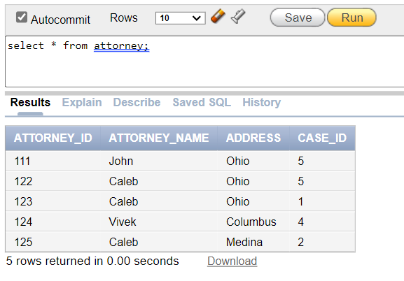
4.Attorney Table select * from attorney;

Slide 18
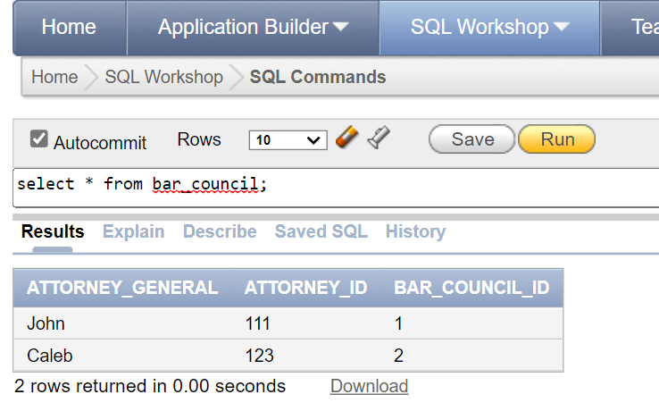
5.Bar Council Table select * from bar_council;

Slide 19
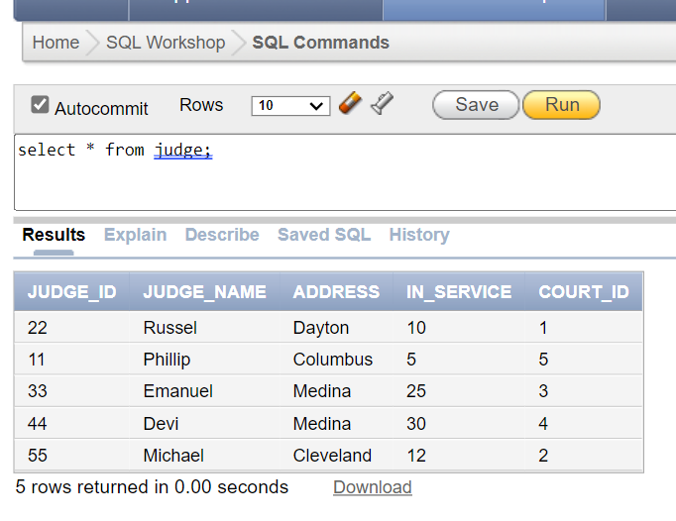
6.Judge Table select * from judge;

Slide 20
DATA MANIPULATION
CREATE
SELECT
DELETE
UPDATE
INSERT

Slide 21
CREATE
CREATE command or query is used to create different database objects such as database, tables, user defined functions, stored procedures and so on.
EXAMPLE TO CREATE TABLE
DROP TABLE court CASCADE CONSTRAINTS;
CREATE TABLE court (city varchar2(15) not null, zipcode varchar2(15) not null, address char(9), case_id number(10), court_name varchar(20), court_id number(4) not null, primary key (court_id), foreign key (case_id) references case(case_id));

Slide 22
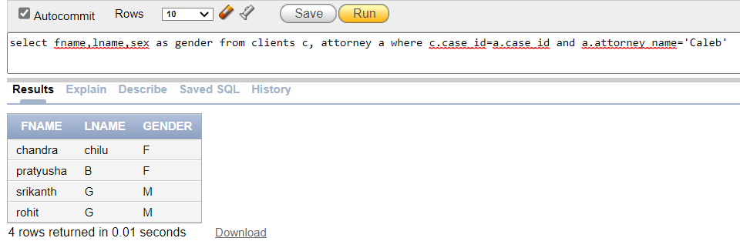
SELECT SELECT query is used to retrieve the data from the database table.
1.Retrieve all the clients FullName and gender whose cases are handled by attorney ‘Caleb’

Slide 23
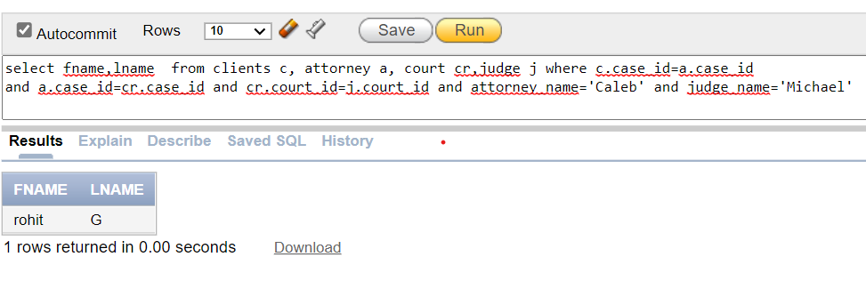
2.select all the clients fullname whose cases are handled by Caleb and judged by Micheal

Slide 24
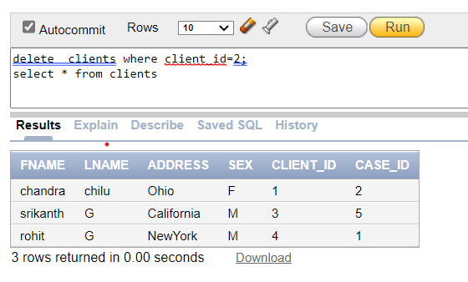
DELETE
Delete Query is used to delete a record in a table.

Slide 25
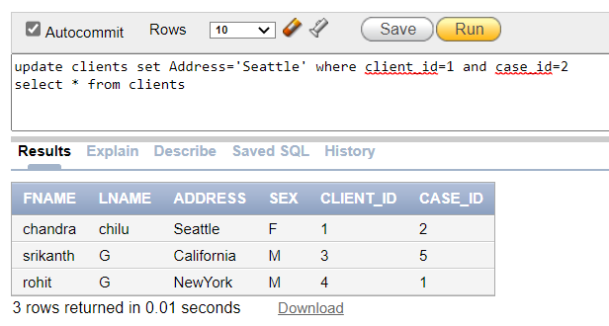
UPDATE
UPDATE query is used to modify the data from the database table.
EXAMPLE TO UPDATE RECORD IN DATABASE TABLE

Slide 26
CONCLUSION
The Court Case Management System project offers details on the various judges employed by the Court, the number of clients served by various attorneys, the issues faced by clients, and a summary of their cases. The following are some benefits of this project:
Less redundancy.
Information retrieval is simple.
Updates and removals are easily accomplished.

Slide 27
Thank You

