Slide 1

Presentation On-
By-
Sandeep Urankar
202CS18047

Slide 2


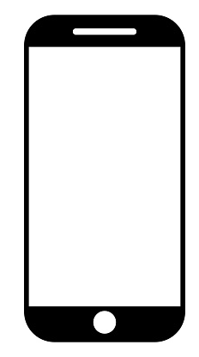
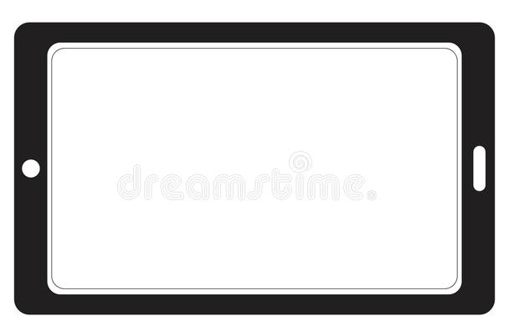
WHAT IS ANDROID?
Android is a operating system based on a modified version of the Linux kernel and other open source software.
Designed primarily for touchscreen mobile devices such as smartphones and tablets.

Slide 3
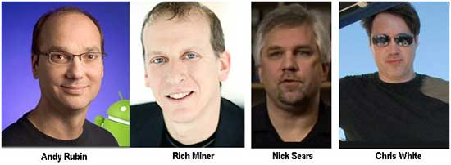
ORIGIN OF ANDROID-
Android was founded in Palo Alto, California in October 2003 by Andy Rubin, Rich Miner, Nick Sears and Chris White who work at Google.

Slide 4
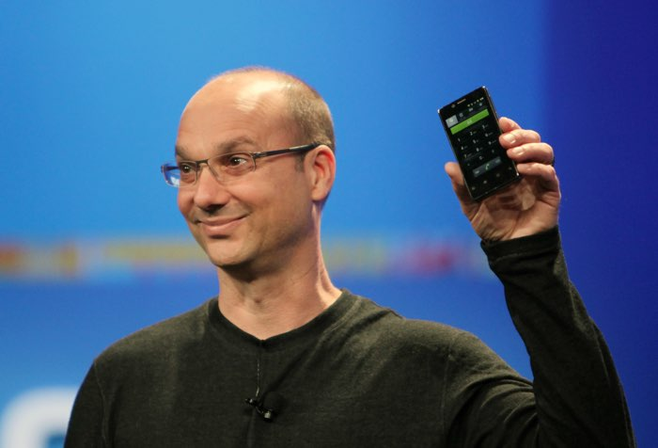
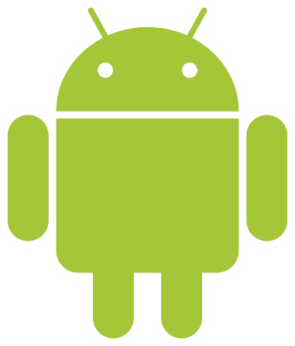
ANDY RUBIN-
He was nicknamed "Android" by his co-workers at Apple in 1989 due to love of robots, with the nickname eventually becoming the official name of the Android operating system.

Slide 5
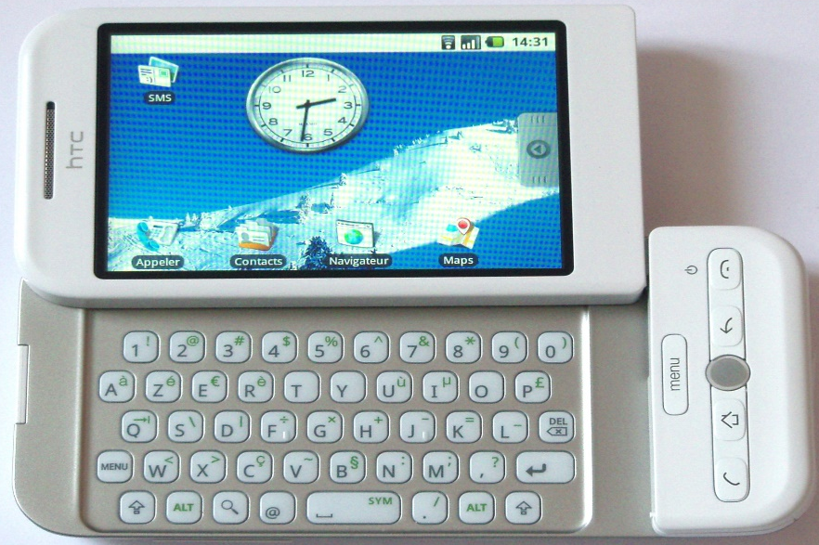
ORIGIN OF ANDROID CONTD.
Android was purchased by the Google in August 2005 for $50 million.
HTC Dream was the first
android device launched
in September 2008.
Now, android covers 72.92% of worldwide smartphones as of October 2020.

Slide 6


HISTORY OF ANDROID LOGO-
First Android logotype (2007–2014)
Second Android logotype (2014–2019)
Third Android logotype (2019–present)

Slide 7




FEATURES-
Android supports wireless communication using – 2G, 3G, 4G Network, Wi-Fi Networks, Bluetooth Connectivity.
Developing an android applications is not tough, using SDK and java emulator we can easily develop application that we want.

Slide 8
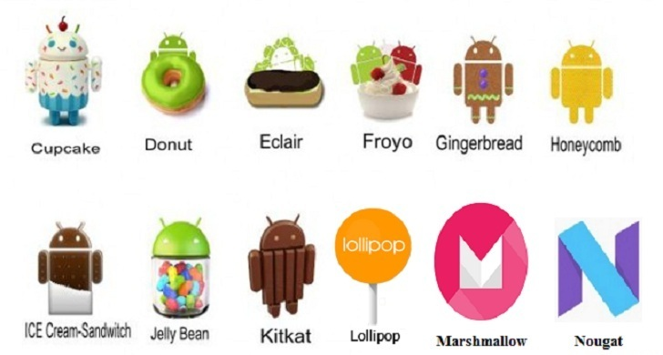
ANDROID VERSIONS -
Version Number | Name | Release Date
1.0 | No official codename | September 23, 2008
1.1 | No official codename | February 9, 2009
1.5 | Cupcake | April 27, 2009
1.6 | Donut | September 15, 2009
2.0 – 2.1 | Éclair | October 26, 2009
2.2 – 2.2.3 | Froyo | May 20, 2010
2.3 – 2.3.7 | Gingerbread | December 6, 2010
3.0 – 3.2.6 | Honeycomb | February 22, 2011
4.0 – 4.0.4 | Ice Cream Sandwich | October 18, 2011

Slide 9



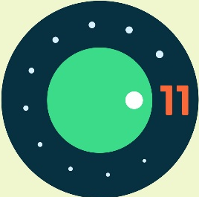
ANDROID VERSIONS CONTD-
Oreo
Version Number | Name | Release Date
4.1 – 4.3.1 | Jelly Bean | July 9, 2012
4.4 – 4.4.4 | KitKat | October 31, 2013
5.0 – 5.1.1 | Lollipop | November 12, 2014
6.0 – 6.0.1 | Marshmallow | October 5, 2015
7.0 – 7.1.2 | Nougat | August 22, 2016
8.0 – 8.1 | Oreo | August 21, 2017
9 | Pie | August 6, 2018
10 | Android 10 | September 3, 2019
11 | Android 11 | September 8, 2020
Pie
Q or 10
11

Slide 10
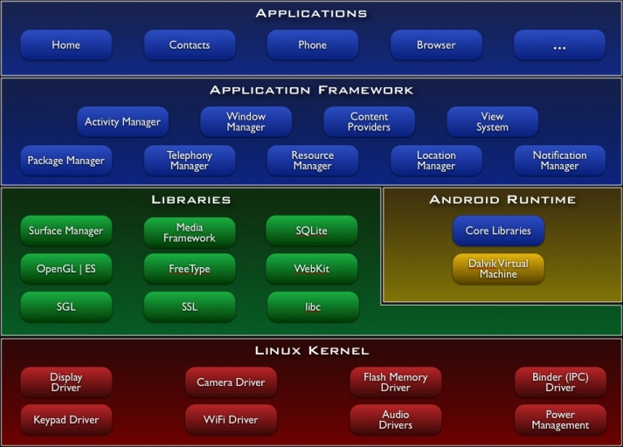
ANDROID ARCHITECTURE -

Slide 11
LINUX KERNEL -
At the bottom of the layers is Linux kernel.
Memory Management
Process Management
Device Drivers

Slide 12
LIBRARIES -

Slide 13
REFERENCES-
https://en.wikipedia.org/wiki/Android_(operating_system)
https://en.wikipedia.org/wiki/Andy_Rubin
https://www.statista.com/statistics/272698/global-market-share-held-by-mobile-operating-systems-since-2009/#:~:text=Android%20maintained%20its%20position%20as,of%20the%20global%20market%20share. (For Stats)
https://en.wikipedia.org/wiki/Android_version_history
https://www.tutorialspoint.com/android/android_architecture.htm
Images – Google.com

