Slide 1

Group #4
Sandeep Yedla
Vandana Bellani
Vaishnavi Jhamtani
Arzoo Sanjay Jiwani
Yukun Li

Slide 2
Problem Statement
Objective
As a fleet manager at ANT, we need to ensure that all the drivers in the fleet are in compliance with the rules and regulations of the corporation and do not present an insurance risk due to various factors including speeding, unsafe following, lane departure, and other unsafe driving practices.
Objective of this project is to use the truck fleet data to refine and analyze the truck’s movement in order to meet the organizational goal of better understanding risk and identifying the dangerous commercial truck drivers in California.
Highlight the drivers who has the riskfactor threshold greater than or equal to 7.0.

Slide 3






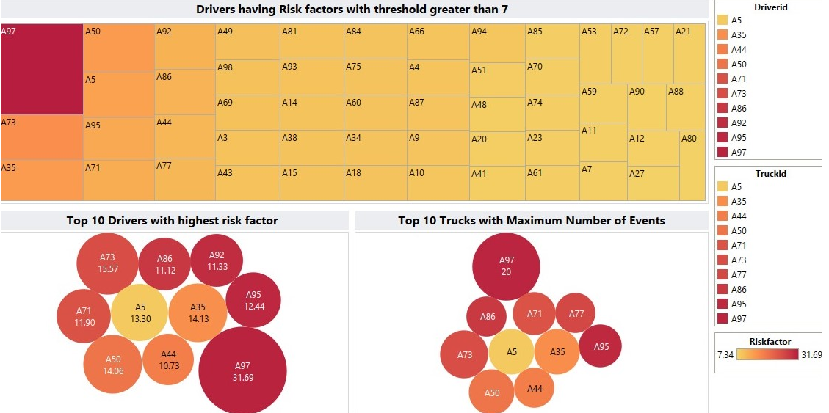

Process Workflow
Download the data
$scp<filename>training@<Ip add>/home/training
Using SCP command files are moved from local to HDFS
Performing Exploratory Data Analysis
Create tables in Hive
Skills Used:
Statistics
Big Data
Data Visualization
Tools & Technologies Used:
MS Excel
VMWare Workstation Player
HDFS
Apache Hive
Impala
Tableau
Geolocation and trucks data is inserted into tables
Hive
Import data in Hive using LOAD DATA INPATH command
Impala
Import data into Tableau
Create Visualizations in Tableau

Slide 4
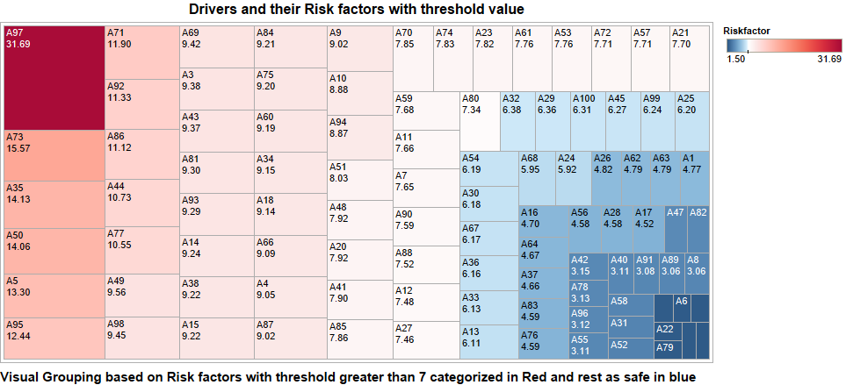
Risk factor per driver with threshold value

Slide 5
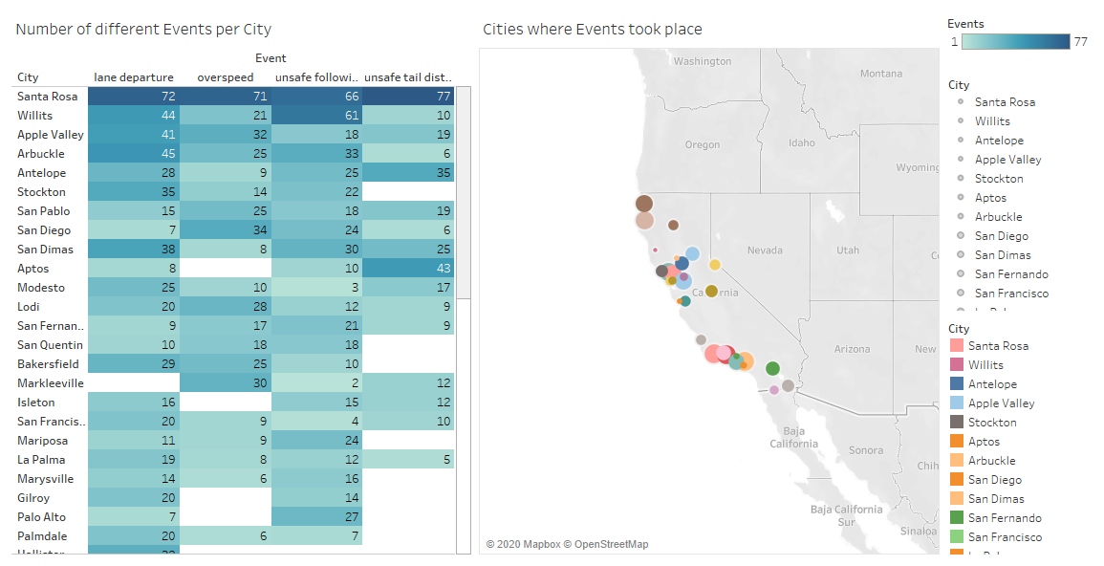
Number of Events per City with its Geolocations

Slide 6
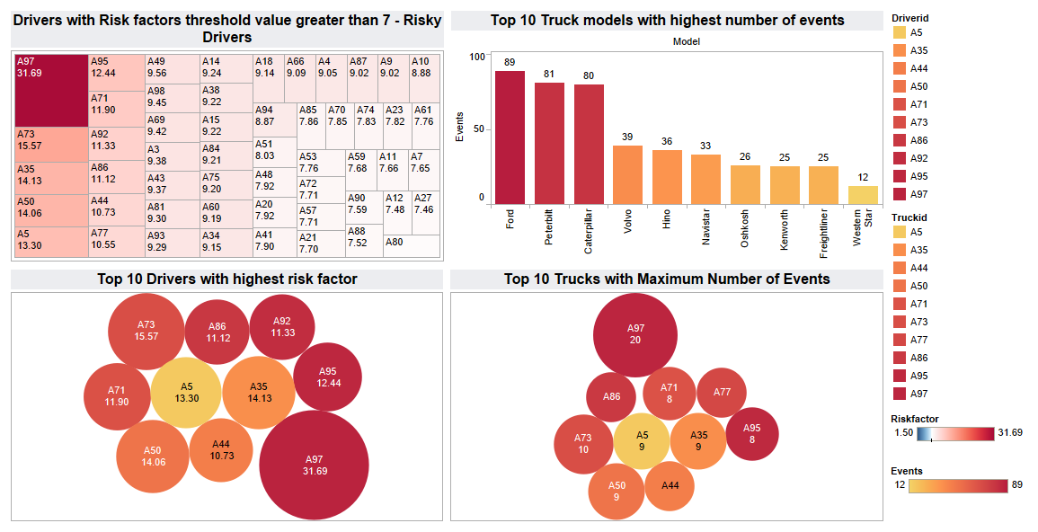
Dashboard shows top 10 most risky drivers and trucks

Slide 7
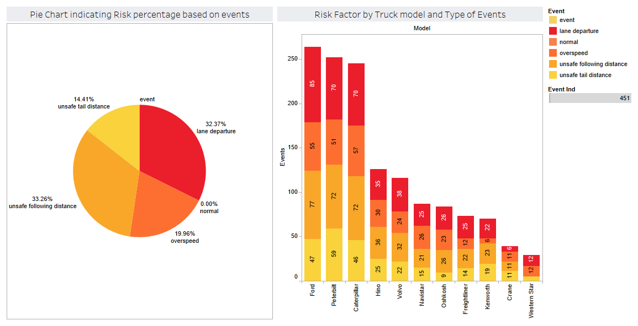
Risk Factor by Truck Model and Type of Events

