Slide 1


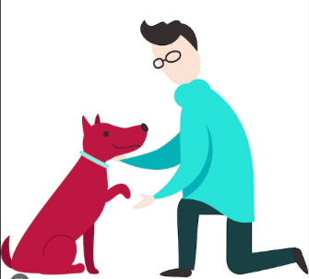
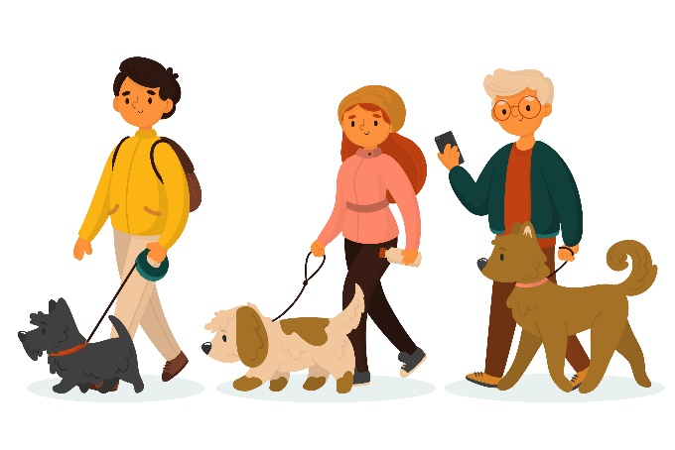
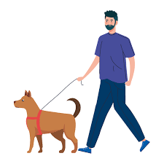

Services
Make communities (Groups)
Can post pictures and videos of their pets through profiles
Keep all health records of the pet
Forums
Offers
veterinarian
Provides
“BarkMeow” Application
Contributes
Create business accounts
Pet day-care
Connects
Interact
Pet trainers
Pet community
Stores
User

