Slide 1
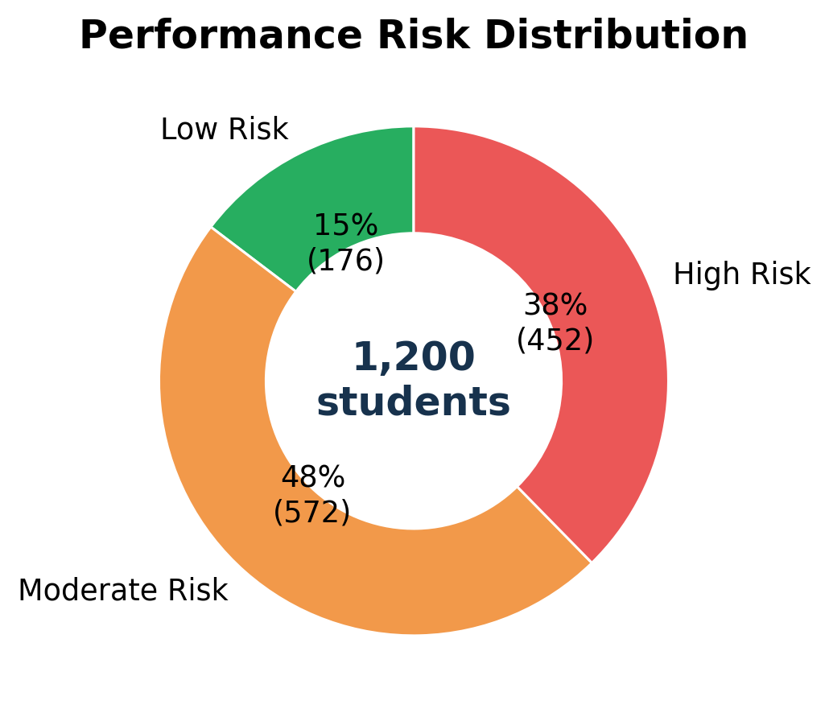
Hybrid Student Performance
Data analysis, risk patterns, and a simple application demo
Dataset: 1,200 student responses with academic, wellness, habits, and career-readiness variables.
1,200
students
36
variables
3
risk levels
Presented by: Person 1 - Person 8
Hybrid Student Performance | MSDS 5033
1

Slide 2
Presentation Roadmap and Team Flow
Person 1
01
Project motivation + dataset Presenter: Person 1
02
Cleaning + analysis approach Presenter: Person 2
03
Risk overview Presenter: Person 3
04
Academic and study patterns Presenter: Person 4
05
Attendance, consistency, and wellness Presenter: Person 5
06
Distractions + career readiness Presenter: Person 6
07
Application demo Presenter: Person 7
08
Findings + recommendations Presenter: Person 8
Golden standard used: one key message per slide, readable charts, clear labels, and a demo that connects analysis to an application output.
Hybrid Student Performance | MSDS 5033
2

Slide 3
Dataset Snapshot: What We Measured
Person 1
1,200
student records
36
columns
0
duplicate student IDs
3
performance risk levels
Academic profile Year/class, program stream, CGPA category, satisfaction, attendance, assignments.
Study behavior Study hours, revision frequency, focus duration, consistency, tasks on time.
Wellness and barriers Sleep, energy, stress, routine, distractions, internal barriers, external pressure.
Career readiness Career interest, online courses, projects/internships, programming foundation, events.
Goal: identify patterns that explain why some students fall into high, moderate, or low performance-risk groups.
Hybrid Student Performance | MSDS 5033
3

Slide 4
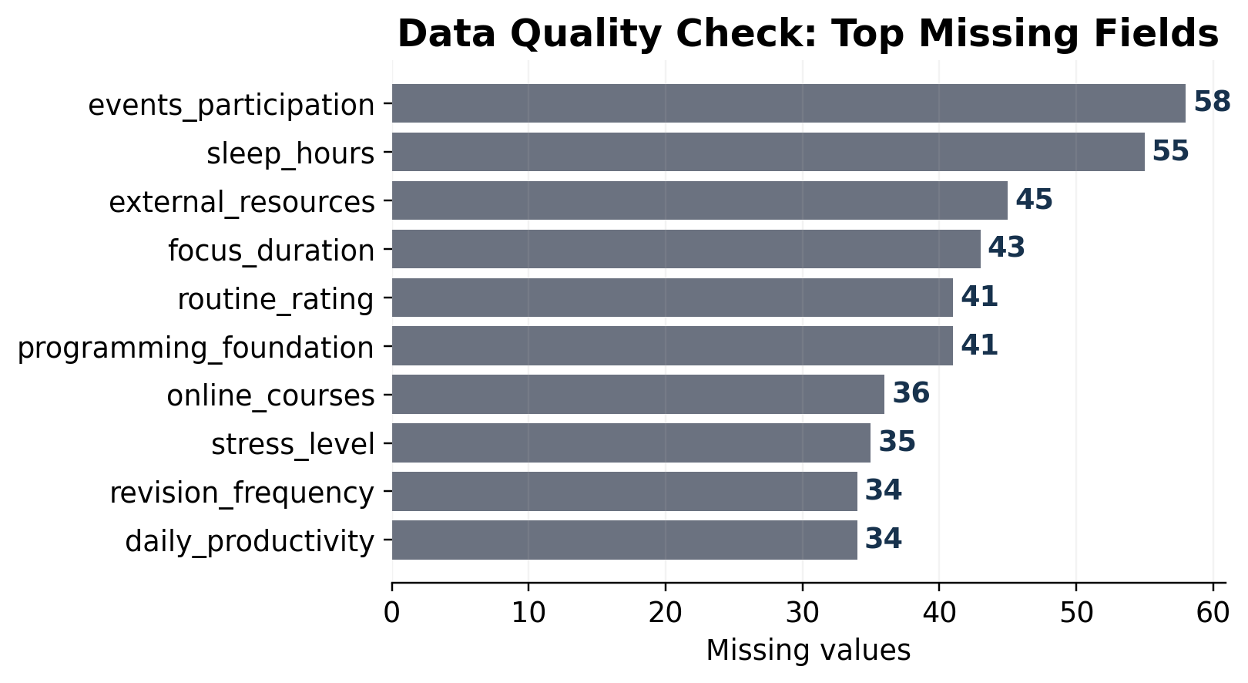
Cleaning and Analysis Approach
Person 2
1. Load data Read CSV using Windows-1252 encoding and validate row/column counts.
2. Clean fields Standardize categories, inspect missing values, and keep meaningful labels.
3. Analyze patterns Use cross-tabs, percentages, group averages, and charts by risk level.
4. Report results Generate charts and summarize findings for students and faculty.
Most missingness is small compared with 1,200 rows, so the analysis can still support clear directional insights.
Hybrid Student Performance | MSDS 5033
4

Slide 5
Risk Overview: Most Students Need Support, Not Rescue
Person 3
Key message Moderate Risk is the largest segment. This means many students are not failing, but they may need consistent support before risk becomes serious.
✓ Moderate Risk: 572 students (48%)
✓ High Risk: 452 students (38%)
✓ Low Risk: 176 students (15%)
Interpretation: the project should not only focus on high-risk students. The biggest opportunity is shifting moderate-risk students toward low-risk habits.
Hybrid Student Performance | MSDS 5033
5

Slide 6
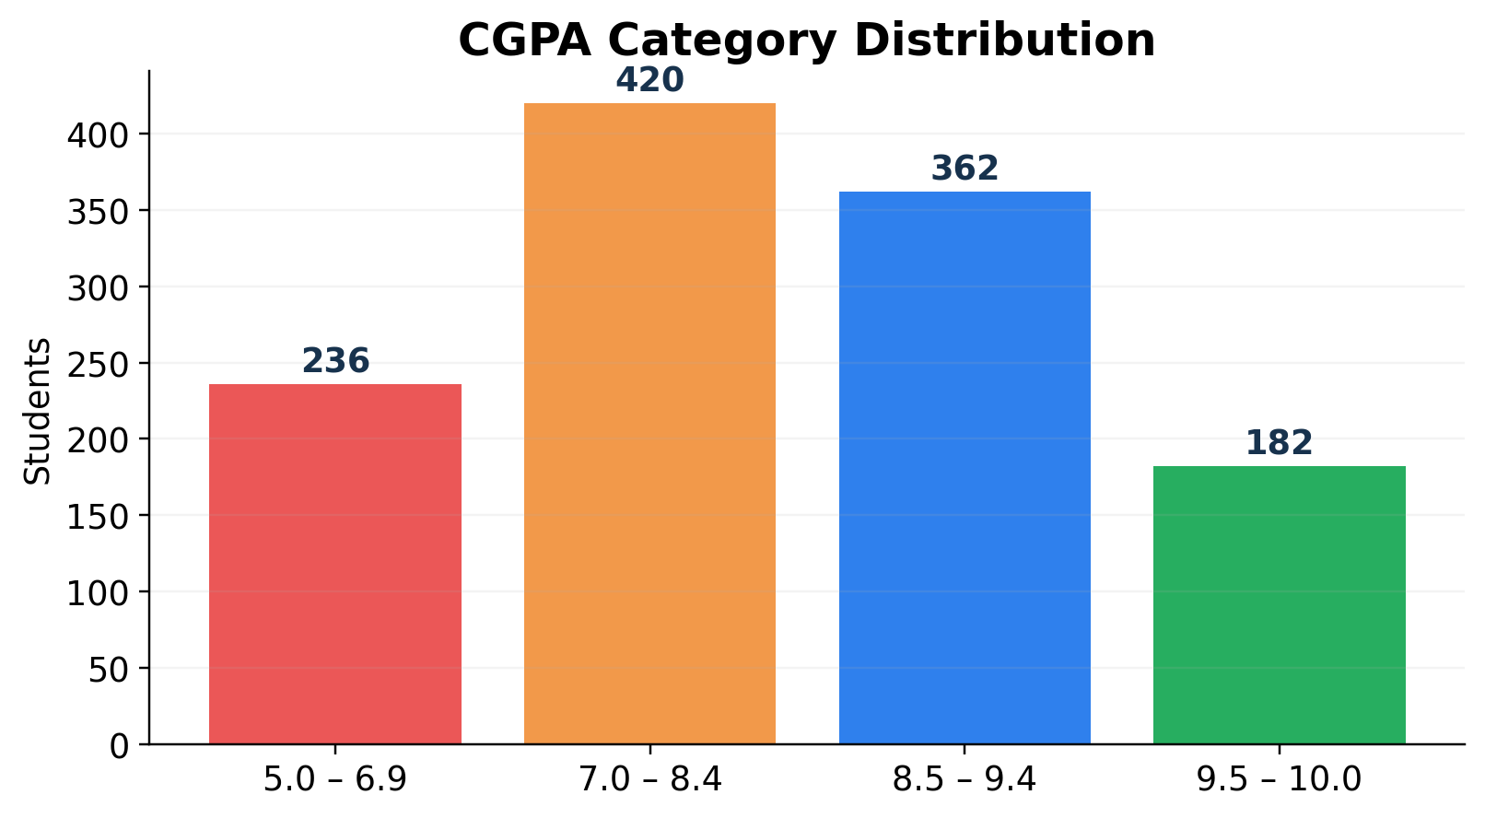
Academic Profile: Good Grades Do Not Remove Risk
Person 3
What stands out Many students are in the 7.0-8.4 and 8.5-9.4 CGPA ranges, but risk still exists because performance is influenced by habits, attendance, wellness, and preparation.
Why this matters A student can have a decent CGPA and still struggle with consistency, procrastination, focus, or stress. Our analysis looks beyond grades.
Conclusion: CGPA is only one part of the story. Behavioral and wellness signals help explain risk more clearly.
Hybrid Student Performance | MSDS 5033
6

Slide 7
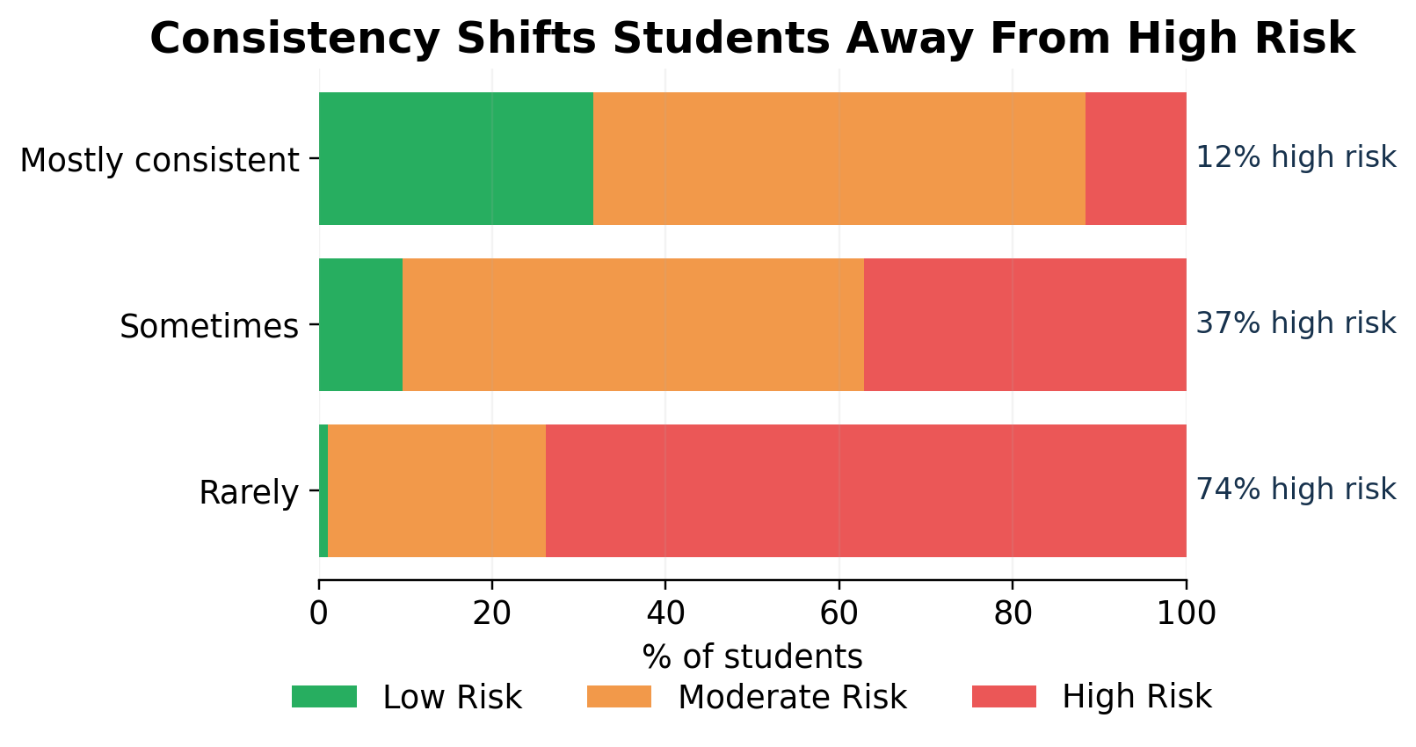
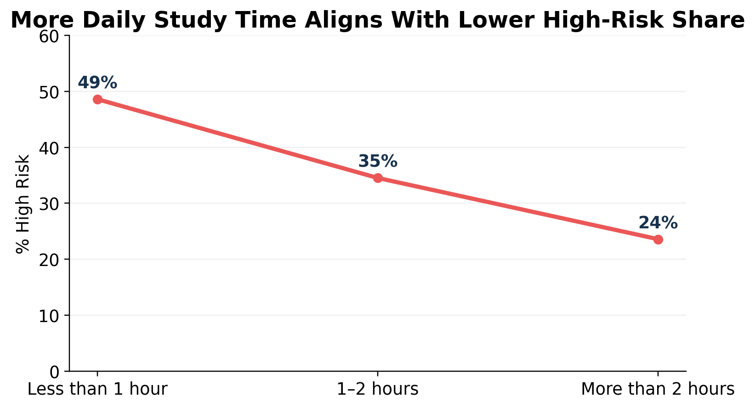
Study Habits: Consistency Is the Clearest Pattern
Person 4
Takeaway Students who rarely study consistently have a much higher high-risk share. More daily study time also aligns with lower high-risk share.
Hybrid Student Performance | MSDS 5033
7

Slide 8
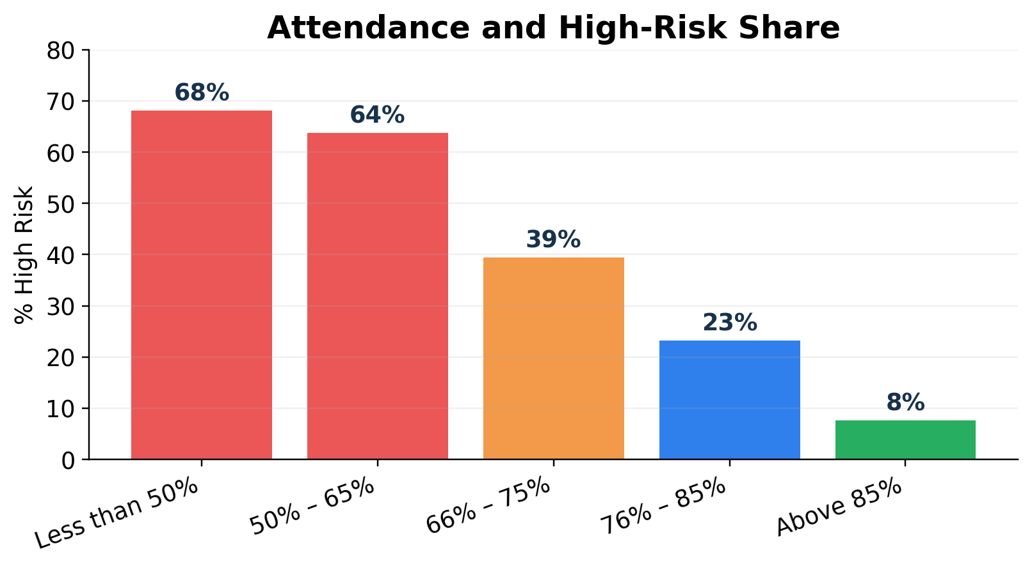
Attendance: The Strongest Academic Warning Signal
Person 5
Pattern High-risk share drops sharply as attendance improves. Students above 85% attendance have the lowest high-risk share.
Actionable insight A simple attendance alert can identify students early, before final exam or placement pressure becomes too high.
Possible support Weekly check-ins, attendance nudges, study groups, and task trackers can help students move from irregular to consistent behavior.
Hybrid Student Performance | MSDS 5033
8

Slide 9
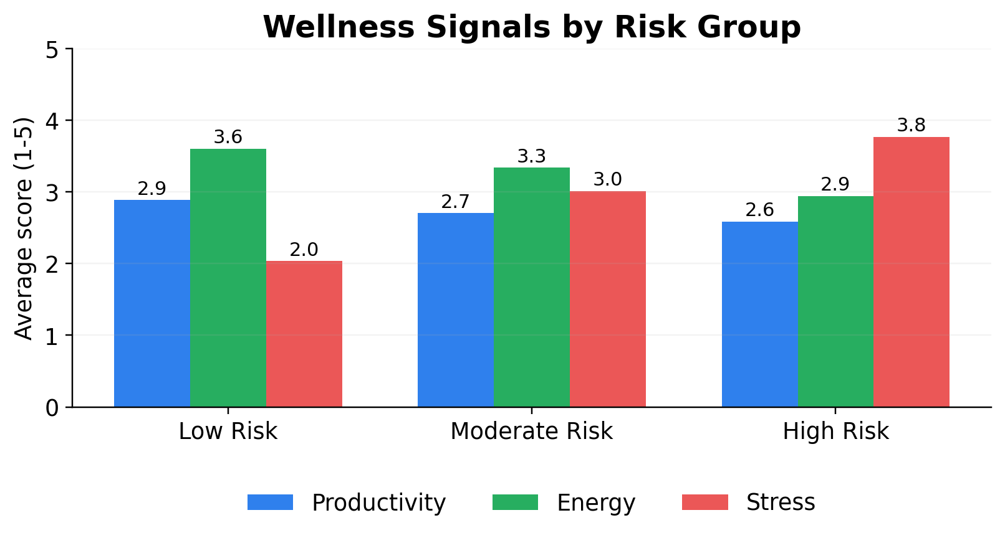
Wellness Signals: High Risk Connects With Stress and Low Energy
Person 5
High-risk profile Higher stress average, lower energy average, and slightly lower productivity score.
Low-risk profile Lower stress and stronger energy, suggesting that wellness and routine support academic performance.
Interpretation: performance support should include routine-building and stress-management, not only academic reminders.
Hybrid Student Performance | MSDS 5033
9

Slide 10
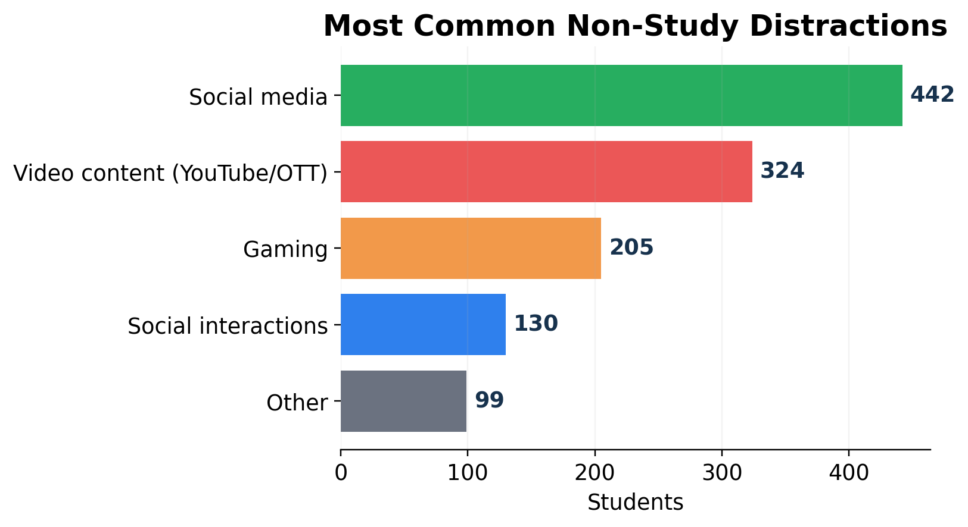
Distractions: Digital Attention Is a Major Challenge
Person 6
Most common distractors Social media and video content are the top two distractors in the dataset.
Classroom implication Hybrid learning requires digital devices, but the same devices can create attention leakage.
Practical response Use focused study blocks, app limits, scheduled breaks, and progress tracking instead of asking students to simply “avoid screens.”
Hybrid Student Performance | MSDS 5033
10

Slide 11
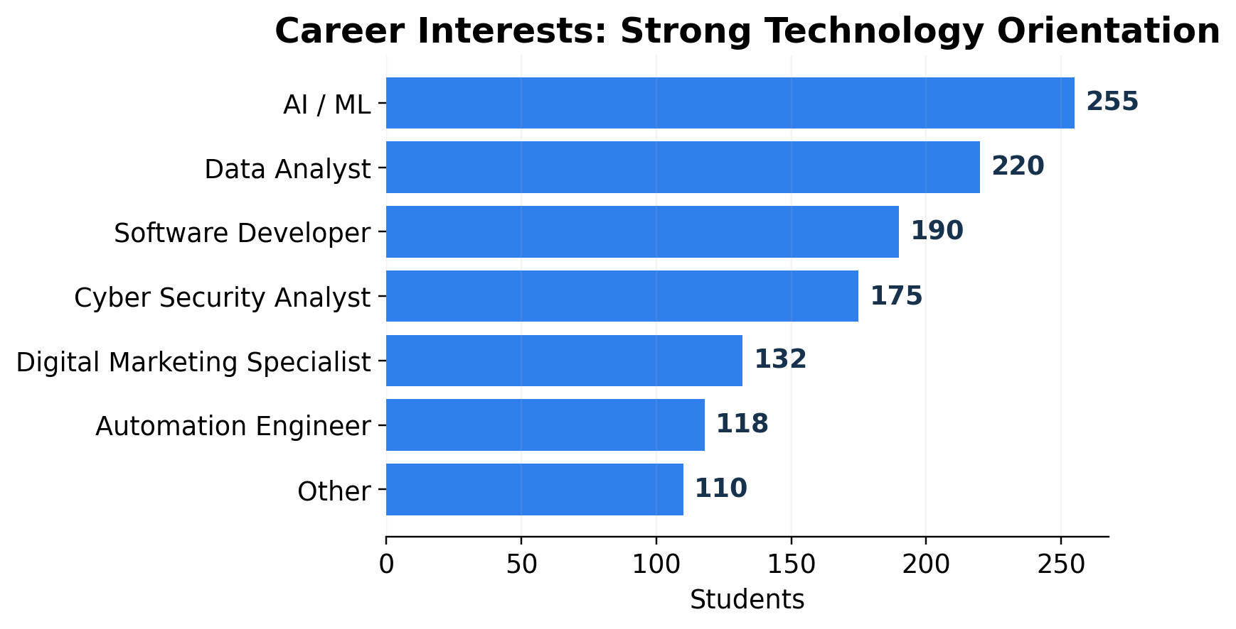
Career Readiness: Students Are Interested, but Need Structure
Person 6
Interest is strong AI / ML, data, cybersecurity, automation, and software roles appear as major career interests.
Readiness gap Interest alone is not enough; projects, internships, programming practice, and online learning convert interest into readiness.
Recommendation Create a simple roadmap: foundation skills -> small project -> certification/course -> internship or portfolio.
Hybrid Student Performance | MSDS 5033
11

Slide 12
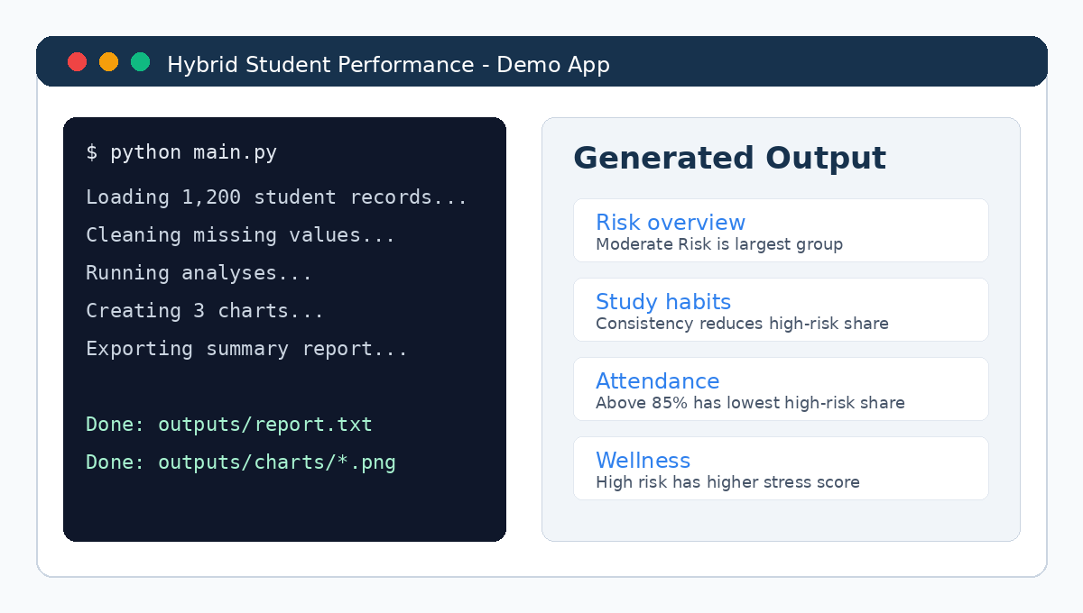
Demo: Python Application Walkthrough
Person 7
Demo flow 1) Run main.py
2) Load and clean the CSV
3) Produce analysis tables
4) Save charts to outputs/charts
5) Generate a text summary report
What to show live Open the project folder, run the program, show the terminal output, then open one chart and the summary report.
Demo goal Prove that the project is not only slides. It is a working Python workflow that turns raw data into usable outputs.
Hybrid Student Performance | MSDS 5033
12

Slide 13
Key Findings: What the Data Suggests
Person 8
1. Moderate Risk is largest Most students are not in the lowest-risk group, so prevention matters.
2. Consistency matters Rarely consistent students show the highest high-risk share.
3. Attendance is powerful Higher attendance aligns with a strong reduction in high-risk share.
4. Wellness connects to performance High-risk students show higher stress and lower energy.
5. Career interest needs structure Students have technology-oriented goals, but need roadmaps and project practice.
Overall conclusion: a strong support strategy should combine academic tracking, habit-building, wellness support, and career-readiness guidance.
Hybrid Student Performance | MSDS 5033
13

Slide 14
Recommendations and Next Steps
Person 8
Early warning dashboard Track attendance, consistency, study hours, and stress indicators weekly.
Student support plan Offer check-ins, peer groups, habit trackers, and focused study sessions.
Career roadmap Help students convert interest into projects, certifications, and internship readiness.
Demo improvement Build a simple Streamlit or Tkinter interface so users can upload a CSV and generate visuals.
Model improvement Use better scoring, train/test validation, and explainable machine learning if the course allows.
Team reflection We learned how to clean data, analyze patterns, build charts, and communicate insights clearly.
Thank you
Questions?
Hybrid Student Performance | MSDS 5033
14

