Slide 1
Hybrid Student Performance
A master's-level student analysis using Python, charts, and a simple demo workflow
Instead of making the slides look like a corporate report, we keep the story clear and classroom-ready: what the data says, how we analyzed it, and what we can show live.
data.csv
1,200
student records
36
dataset columns
3
risk levels
Person 1 to Person 8
Topic: Hybrid student performance and risk patterns
MSDS 5033 Python Group Assignment | Hybrid Student Performance
1

Slide 2
1. What are we trying to understand?
Person 1
Main question
Why this matters Hybrid learning gives flexibility, but it also makes self-management very important. Students may struggle even when they are attending online and submitting some work.
Which student habits and academic signals are most related to performance risk in a hybrid learning setting?
Our plan Use Python to clean the CSV, summarize categories, build charts, and connect the results to a simple application demo.
End goal Find patterns that could help a faculty member or advisor identify support areas early.
MSDS 5033 Python Group Assignment | Hybrid Student Performance
2

Slide 3
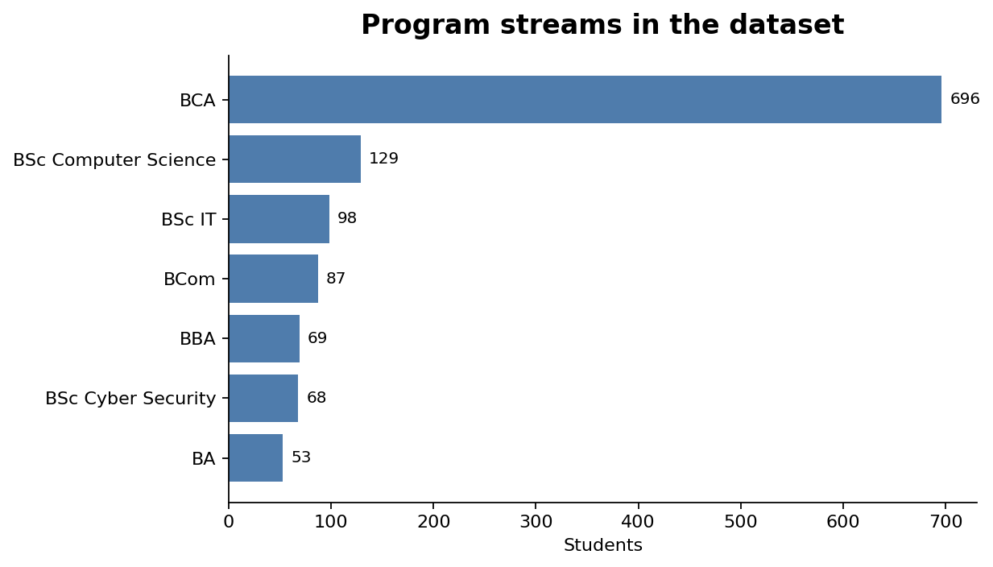
2. Dataset snapshot: what is inside the CSV?
Person 2
1,200
rows
36
columns
7
program streams
Columns are not only grades The file includes CGPA category, attendance, study habits, consistency, stress, sleep, distractions, and career readiness.
Target variable performance_risk_level has three categories: Low Risk, Moderate Risk, and High Risk.
This is useful because performance risk is treated as a combination of academics, behavior, and wellness.
MSDS 5033 Python Group Assignment | Hybrid Student Performance
3

Slide 4
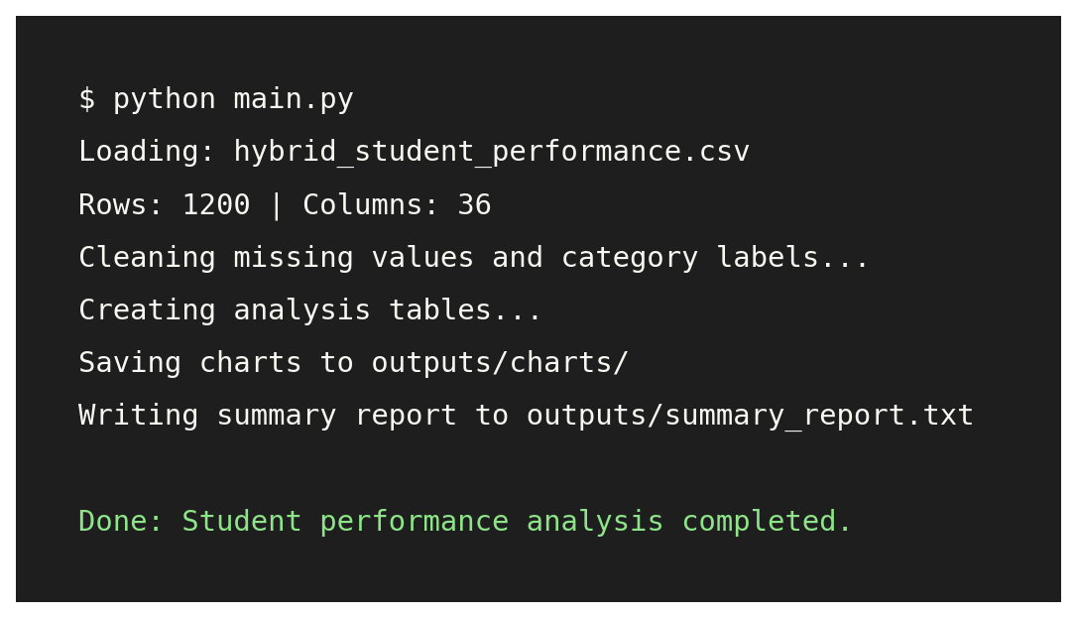
3. Data cleaning and Python workflow
Person 2
Step 1: Read the CSV Load the file with the correct encoding, then check rows, columns, and column names.
Step 2: Clean labels Fix dash/encoding symbols, keep readable categories, and check missing values.
Step 3: Analyze Use value counts, group averages, and cross-tabs by risk level.
Step 4: Export outputs Save charts and a short summary report for the demo.
This slide prepares the audience for the demo later, so they understand that the final output comes from code.
MSDS 5033 Python Group Assignment | Hybrid Student Performance
4

Slide 5
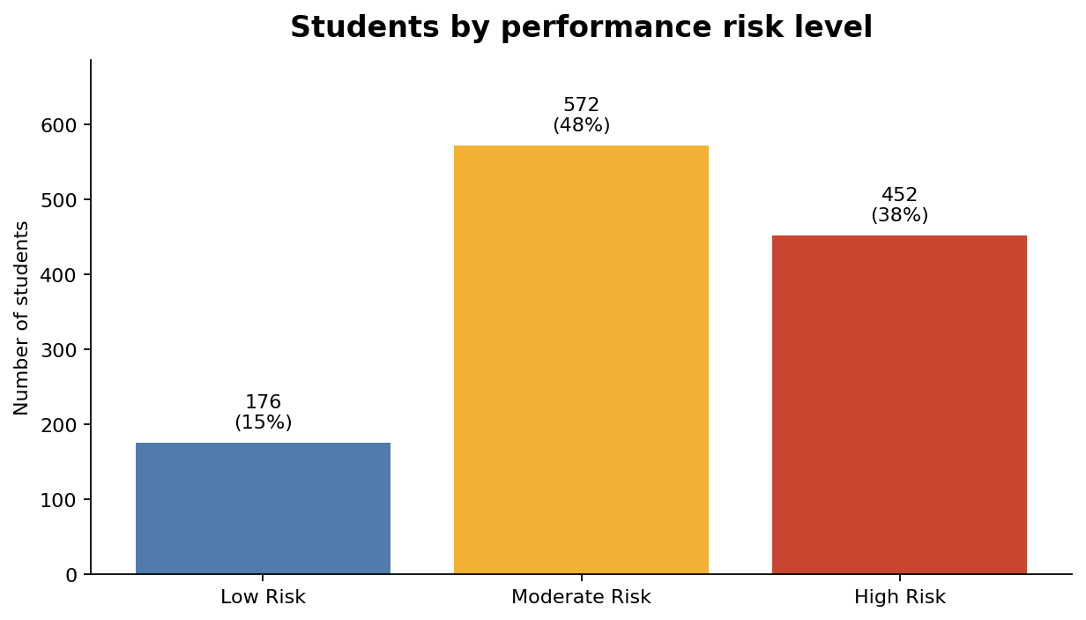
4. Finding 1: many students are in the middle-risk group
Person 3
What we see Moderate Risk is the largest group, followed by High Risk. Low Risk is the smallest group.
How we interpret it This means the dataset is not only about students who are already in trouble. A large group may improve with earlier support.
Presentation wording “The main opportunity is prevention. We want to move moderate-risk students toward better habits before they become high-risk.”
MSDS 5033 Python Group Assignment | Hybrid Student Performance
5

Slide 6
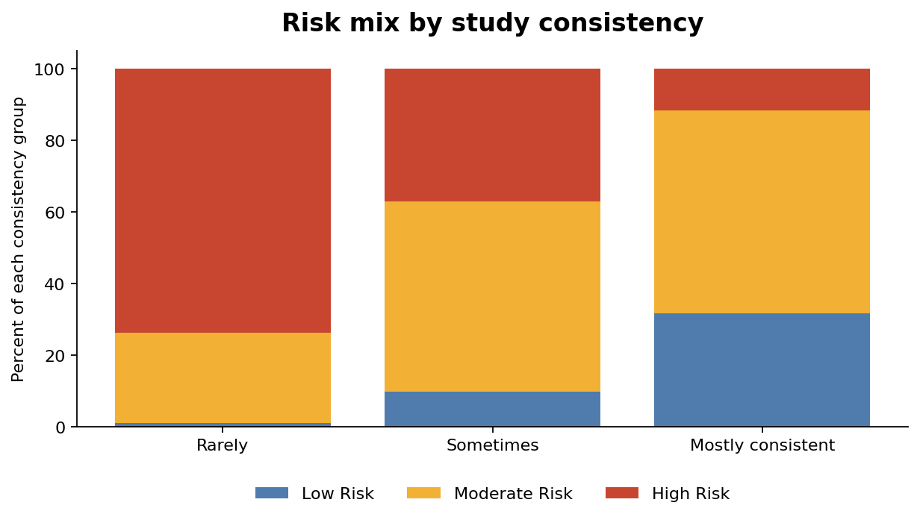
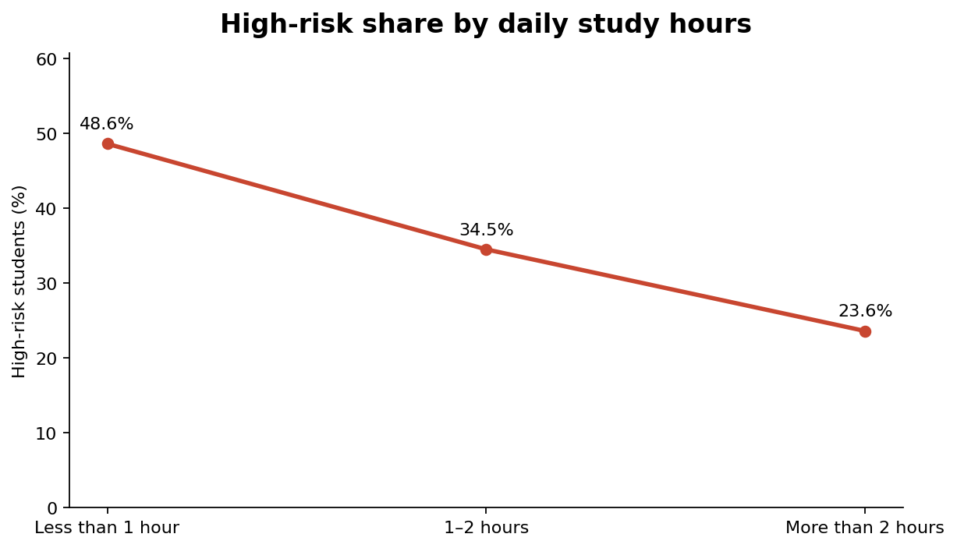
5. Finding 2: study consistency matters more than just intention
Person 4
Simple takeaway Students who rarely study consistently show the weakest risk profile. More daily study time also reduces high-risk share.
MSDS 5033 Python Group Assignment | Hybrid Student Performance
6

Slide 7
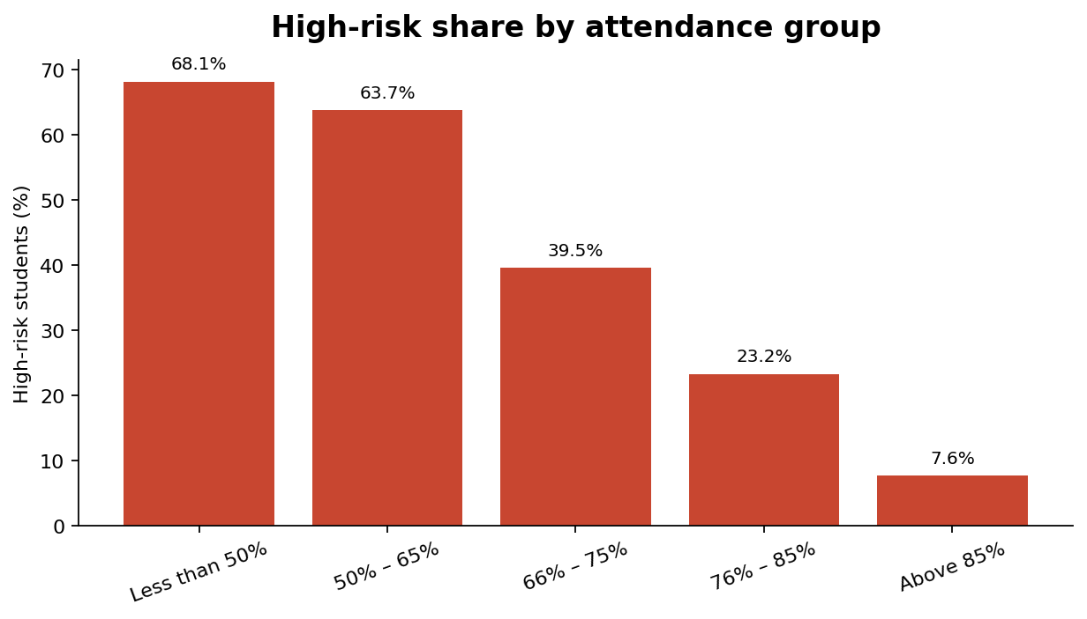
6. Finding 3: attendance is a strong warning sign
Person 5
What the chart says High-risk percentage is very high for students with low attendance and much lower for students above 85% attendance.
Why this is useful Attendance is easy to track compared with hidden factors like motivation. It can be used as an early alert.
Student-level explanation We are not saying attendance alone causes performance. We are saying it is a clear signal that deserves attention.
MSDS 5033 Python Group Assignment | Hybrid Student Performance
7

Slide 8
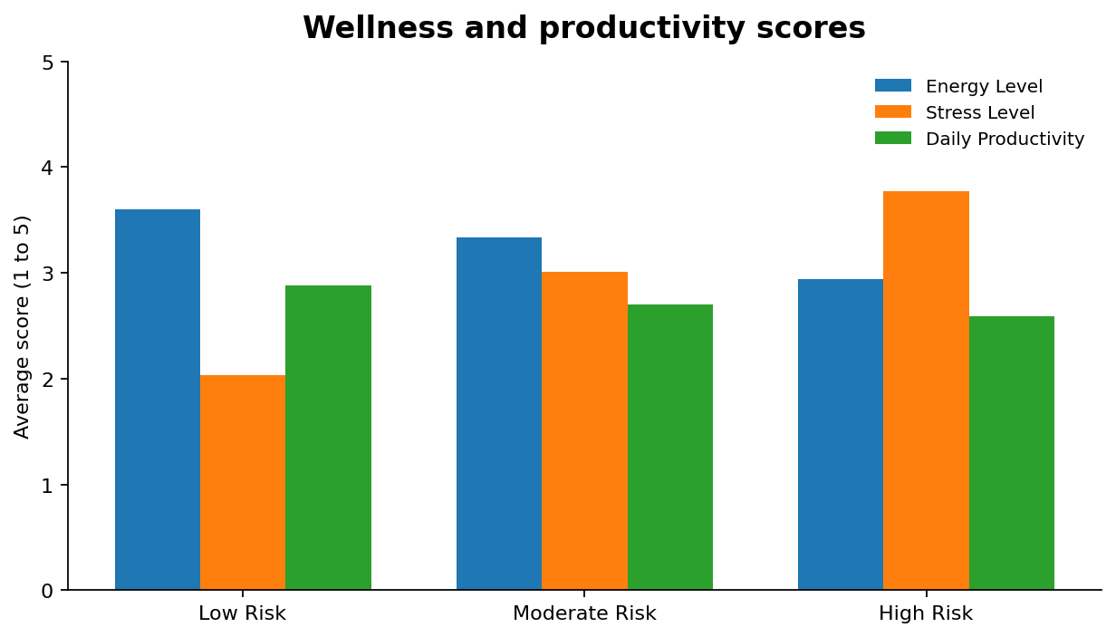
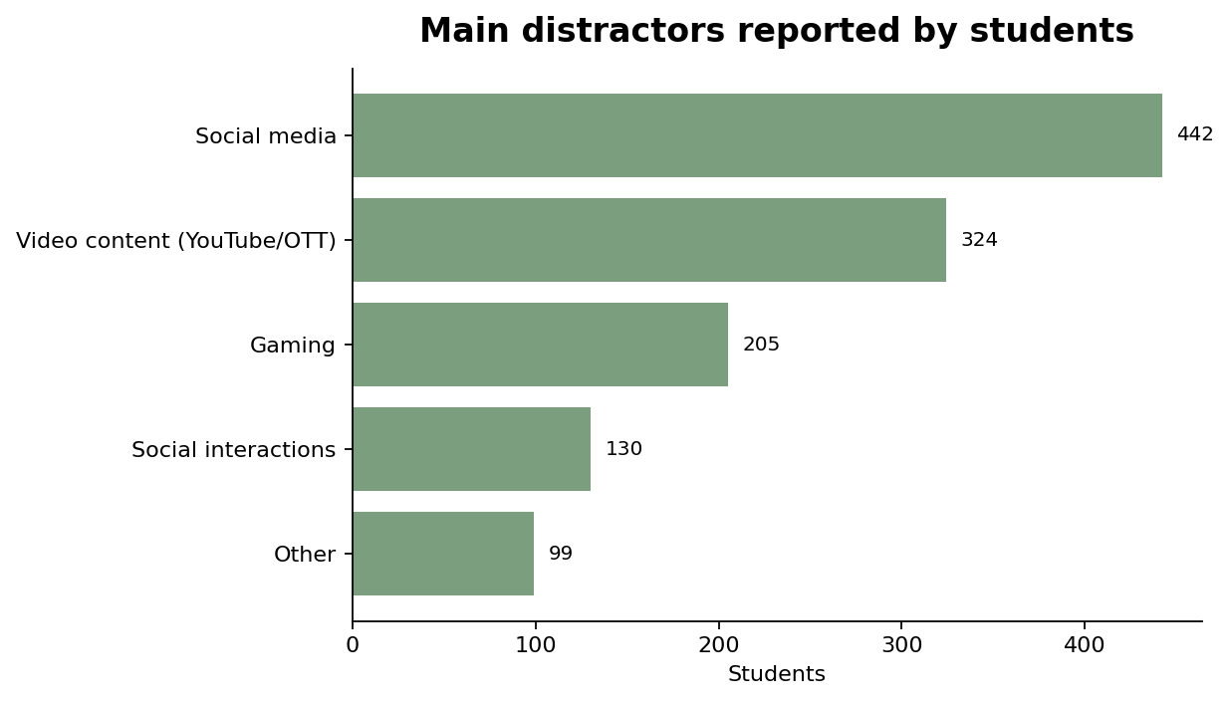
7. Finding 4: wellness and distractions also show patterns
Person 6
Wellness side High-risk students have lower average energy and productivity, while stress stays high.
Distraction side Social media and video content are the most common distractors, which matters in hybrid learning because students use screens constantly.
MSDS 5033 Python Group Assignment | Hybrid Student Performance
8

Slide 9
8. Career readiness: interest is present, but structure is needed
Person 6
What we looked at Career interest, online courses, projects/internships, programming foundation, events participation, and preparation status.
Skills
Project
Course
Internship
Student interpretation A student may be interested in AI, data, cybersecurity, or software, but interest does not automatically mean readiness.
This part connects the analysis to practical student development, not only marks or attendance.
Suggested support Give students a simple pathway: improve foundations, complete one small project, join one event, and track progress monthly.
MSDS 5033 Python Group Assignment | Hybrid Student Performance
9

Slide 10
9. Demo slide: what we will show live
Person 7
Live demo steps 1. Open the project folder
2. Run main.py
3. Show row/column count
4. Generate charts
5. Open summary_report.txt
What this proves The project is not only a presentation. The Python program can take the raw CSV and create useful outputs.
Backup plan If the live run has an issue, show the saved terminal screenshot and the generated chart images from outputs/charts.
MSDS 5033 Python Group Assignment | Hybrid Student Performance
10

Slide 11
10. Limitations and what we would improve next
Person 8
Limitation 1 The dataset is survey-style, so some answers may be self-reported and subjective.
Limitation 2 Our analysis mainly shows relationships and patterns. It does not prove cause and effect.
Limitation 3 Some missing values exist, so we should be careful with very small subgroup conclusions.
Improvement 1 Build a simple Streamlit or Tkinter app for uploading a file and generating charts automatically.
Improvement 2 Add a scoring model or machine learning model only after validating the features carefully.
Improvement 3 Compare results across semesters to see if risk patterns are stable over time.
MSDS 5033 Python Group Assignment | Hybrid Student Performance
11

Slide 12
11. Closing: what each person contributes
Person 8
Person 1 Introduction + research question
Person 2 Dataset + cleaning workflow
Person 3 Risk-level overview
Person 4 Study habits and consistency
Person 5 Attendance and academic warning signs
Person 6 Wellness, distractions, and career readiness
Person 7 Demo walkthrough
Person 8 Limitations, recommendations, and closing
Final message: Hybrid performance risk is not caused by one factor. It is a mix of attendance, consistency, wellness, distractions, and readiness habits.
Questions?
MSDS 5033 Python Group Assignment | Hybrid Student Performance
12

