Slide 1
Topic : String Day7_of_100_Days_Of_Code_Challenge
A string is a sequence of character.
A string is initiated as follows.
String Name;
Name=new String(“ I am Sandeep Kumar")
Note: String is a class but used like a datatype.
String name=“ Sandeep“
Note : String are immutable and cannot be changed.

Slide 2
#String Methods
String methods operate on java String. They can be used to find length of the String convert to lowercase etc.
Some of the commonly used String Method are-
String name = “ Sandeep”;

Slide 3
# String Method 1→ Name. Length()
It shows the length of Strings.
Ex- String name=“Sandeep"
Return length of String name = 7 in the case.

Slide 4
# String Method 2→ Name.toLowercase()
Return a new String which has all the lowercase character from the
String name.
Example:- String Name=“SANDEEP KUMAR”
Name.toLowercase()
OUTPUT:
sandeep kumar

Slide 5
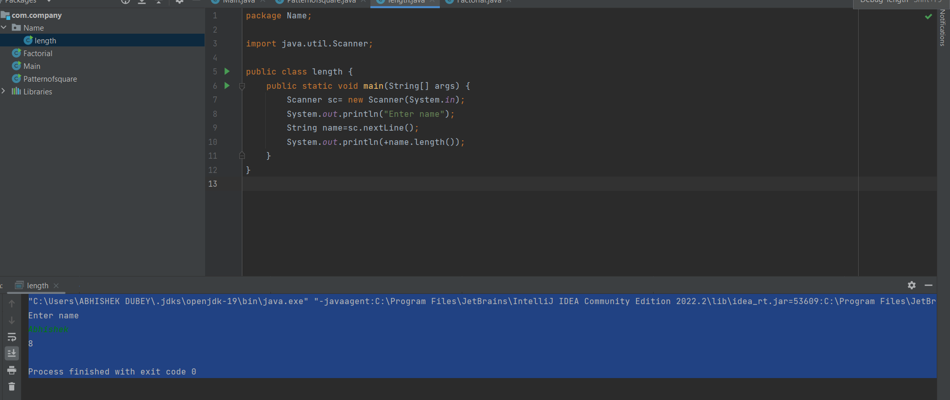

Slide 6
