Slide 1
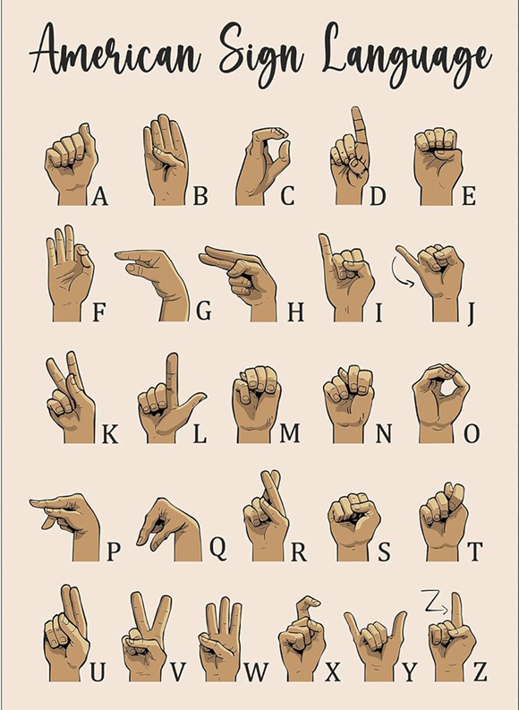
Vision-Based ASL Alphabet Recognition with Deep Learning
CIS 550 - Advanced Machine Learning
Group -> 32 – FINAL PROJECT
S.NO. | Name | Student ID
29 | Venkata Sai Sandeep Kasiraju | 02084046
18 | Supreeth Mohan | 02036259
06 | Aryan Bhalla | 02107402

Slide 2
Our Project :
Objective
Significance of Sign Language
To develop a machine learning solution for converting American Sign Language (ASL) alphabets A to Z into their corresponding English alphabet characters.
Sign language serves as a vital communication mode for the deaf and hard of hearing community.
The main objective is to empower individuals with hearing impairments through the provision of a dependable tool for clear communication and self-expression and bring inclusivity.
Humanitarian Impact

Slide 3
Steps: Implementing ML Pipeline
Step 1: DATA COLLECTION
Step 2: PREPROCESSING
Step 3: MODEL CREATION/TRAINING
Step 4: MODEL EVALUATION
Step 5: MODEL TESTING

Slide 4
Data Collection
Dataset Source
Data Diversity
The dataset is accessible through the following Kaggle source link:
https://www.kaggle.com/datasets/grassknoted/asl-alphabet
Dataset Contents
The dataset comprises images and labels representing the American Sign Language (ASL) alphabets from A to Z.
The dataset's diverse array of ASL alphabet images enables comprehensive training and evaluation of our model's performance.

Slide 5
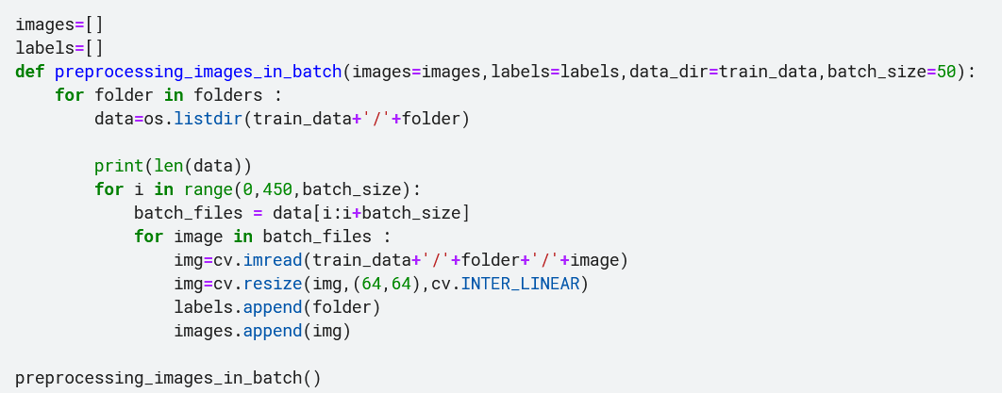
Pre-processing
The dataset structure follows a folder hierarchy where images corresponding to each sign language alphabet are contained within separate folders. For instance, images depicting the sign language alphabet 'A' are located within a folder labeled 'A'. This hierarchical organization assists, processing of upscaling or downscaling as required.

Slide 6
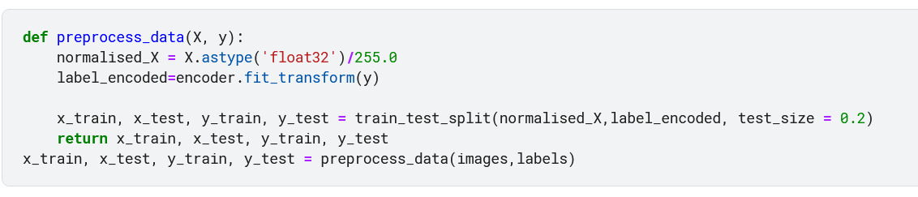
Normalization & Label Encoding
The preprocess data function is crafted to manage input images (X) and their associated labels (y)
It guarantees proper normalization of images by converting them into floating-point format and rescaling their pixel values to fit within the [0, 1] range
Labels undergo encoding into numerical representations via a label encoder
Following this, the function splits the data into training and testing sets
employing the train_test_split function, with an 80-20 split ratio
This partitioning results in four arrays: x_train, x_test, y_train, and y_test.

Slide 7
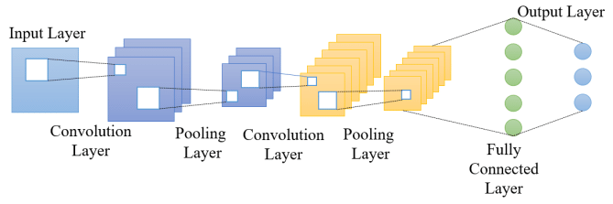
Model Architecture

Slide 8
Creating and Training the Model
Sequential Model
The Keras Sequential object is utilized to enable sequential layer stacking, ensuring a structured progression of layers.
Convolutional Layers:
Kernel Size Parameter:
Pooling Layers:
Flatten Layer:
Fully Connected (Dense) Layers:
Two Dense Layers are included, with the first dense layer comprising 204 neurons and utilizing ReLU activation. Additionally, a Dropout Layer is introduced after the first dense layer, set at a rate of 20% to mitigate overfitting.
Final Dense Layer:
Activation Function:
Four sets of Convolutional Layers: Conv2D layers extract learnable features from the input image.
Specifies filter dimensions for convolution, determining the size of the learnable feature detectors applied to the input image.
After each Convolutional Layer, MaxPool2D layers are utilized to execute max pooling, capturing crucial features while diminishing computational complexity.
Subsequent to Convolutional and Pooling Layers, is incorporated to reshape multi-dimensional feature maps into a 1D vector, facilitating processing by connected layers.
29 neurons are configured to align with the number of classification classes in the final Dense Layer.
The Rectified Linear Unit (ReLU) activation function is employed within the neural network architecture.

Slide 9
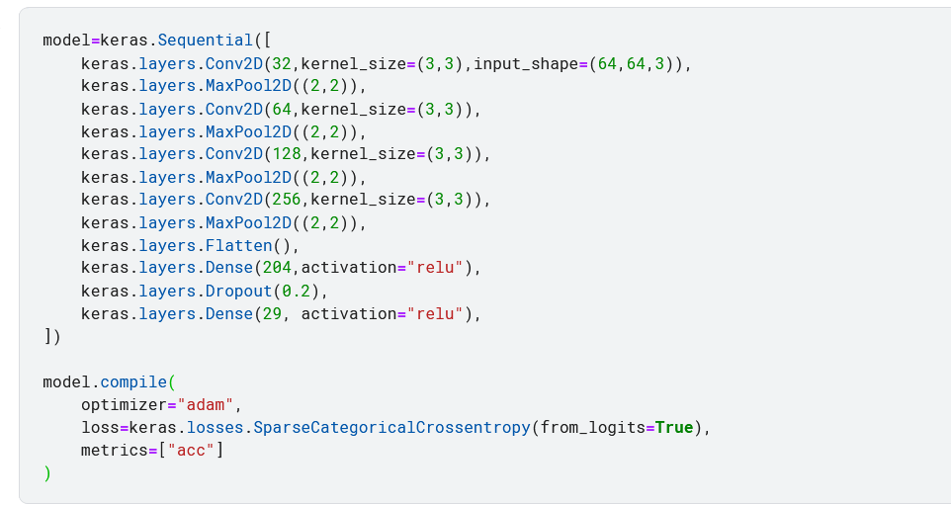
Model Creation and training

Slide 10
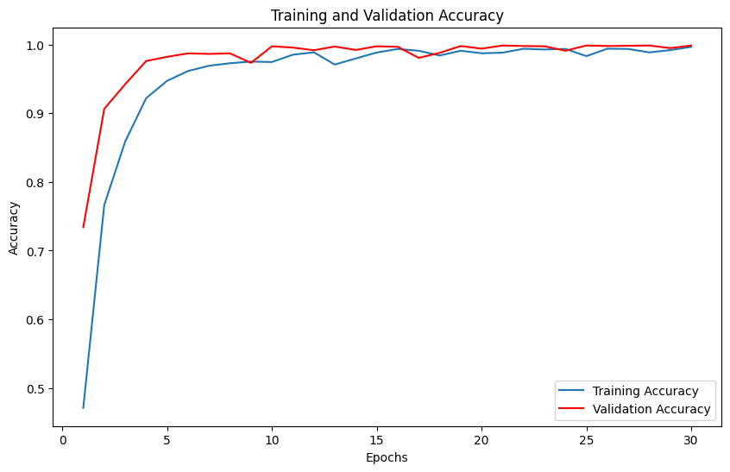
Model Evaluation
Test - Accuracy: 0.99885 ~ 99%

Slide 11
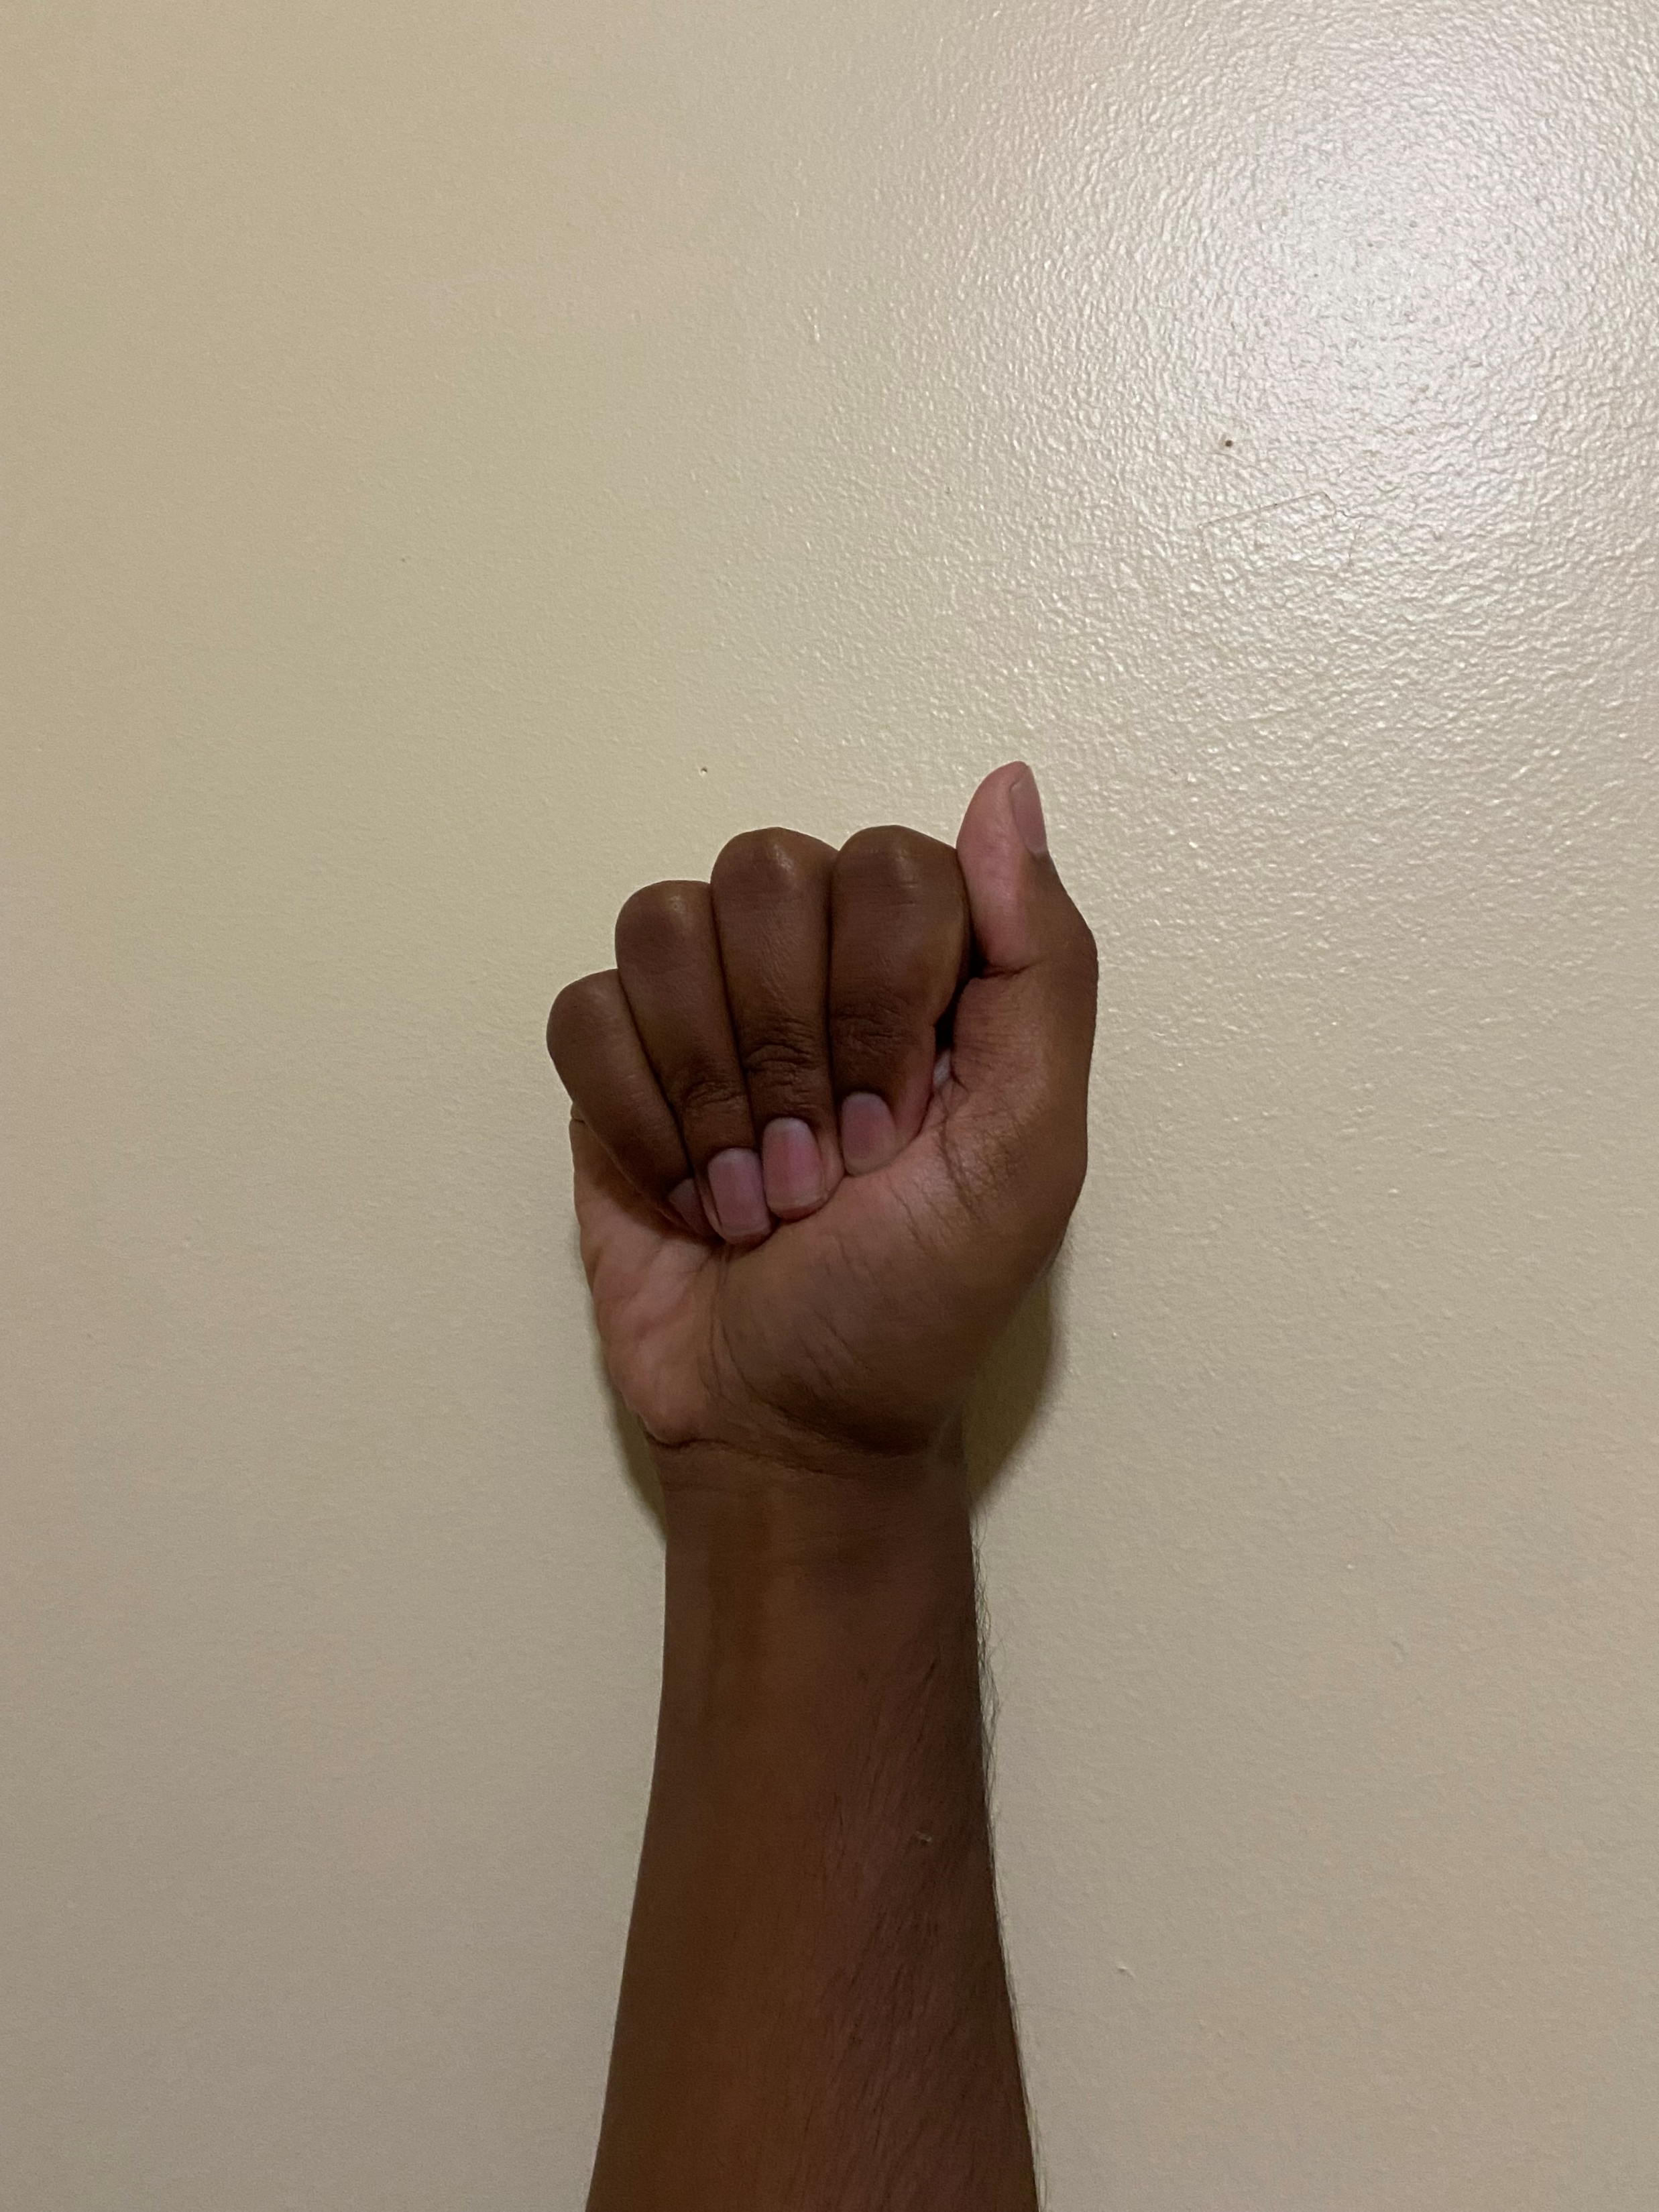
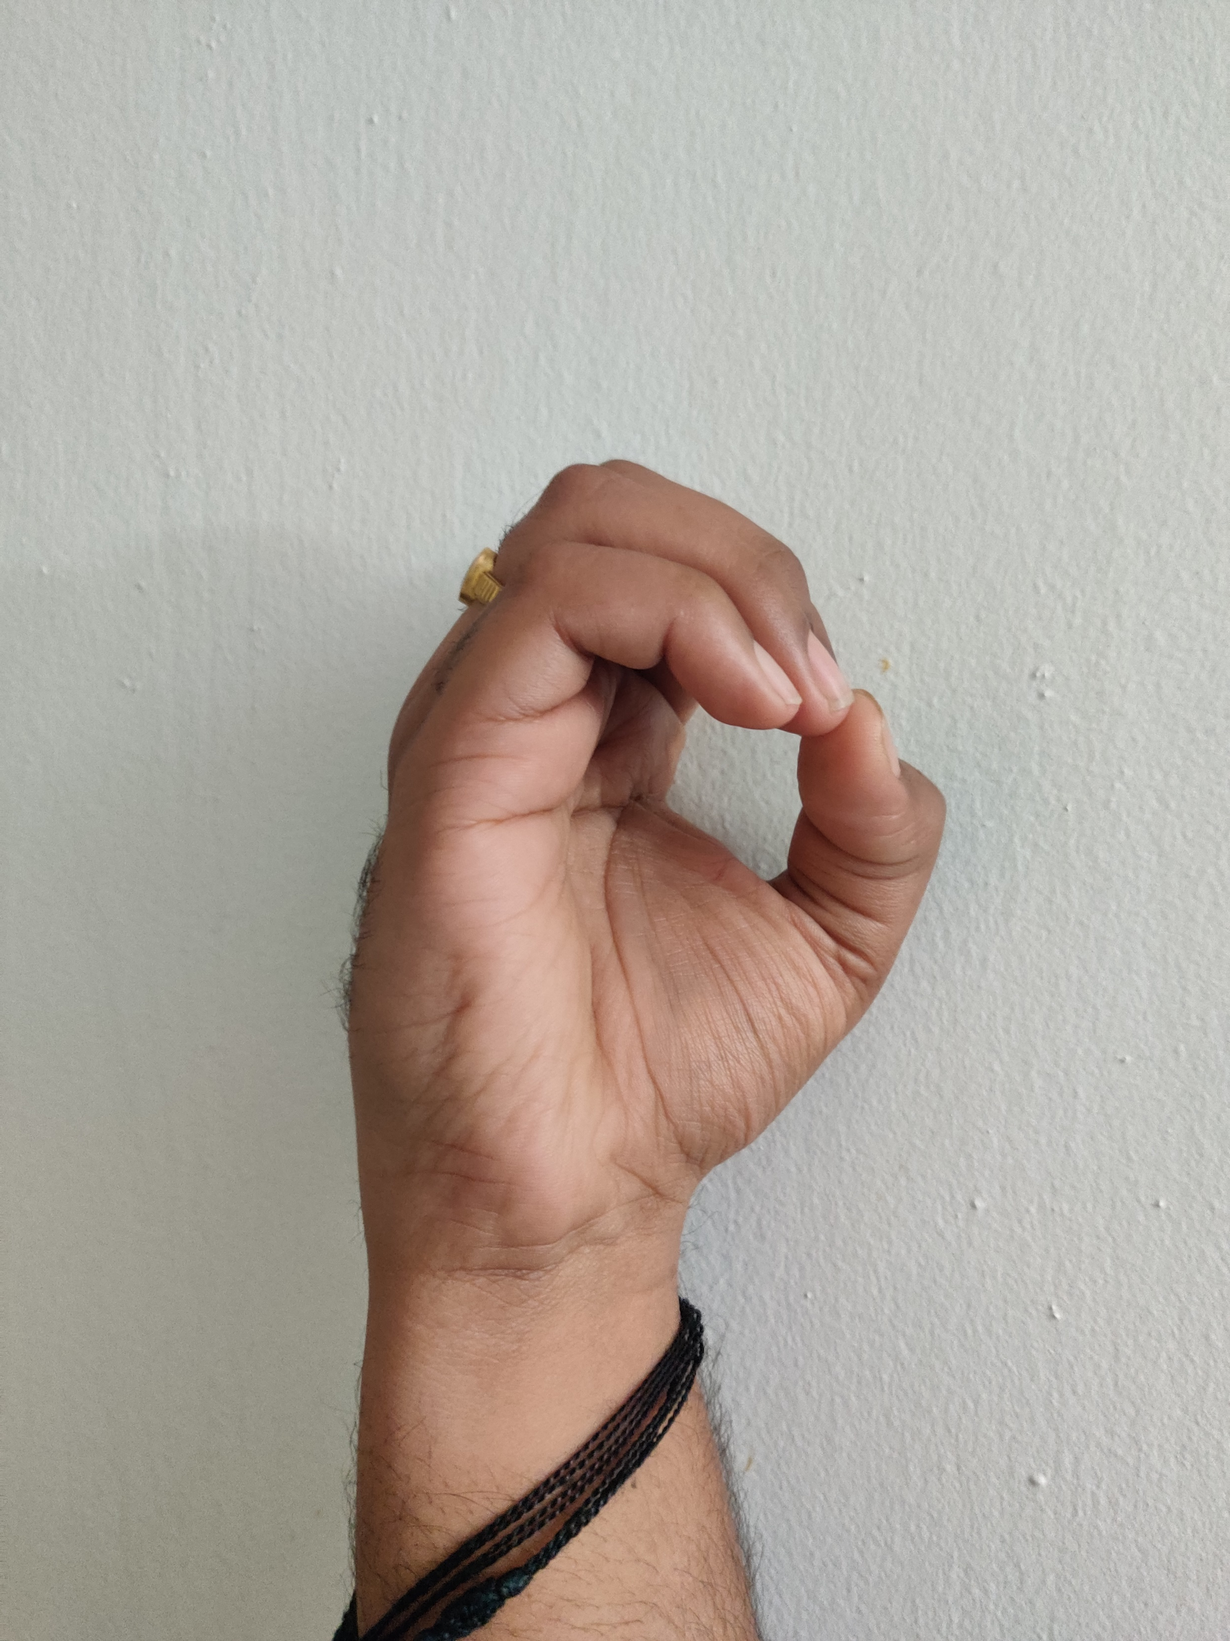
Model Testing
Predicted Class: A
Predicted Class: O

Slide 12
References and Citations
Convolution Neural Networks:
https://www.geeksforgeeks.org/convolutional-neural-network-cnn-in-machine-learning/
https://www.analyticsvidhya.com/blog/2021/05/convolutional-neural-networks-cnn/
American Sign Language Dataset:
https://www.kaggle.com/datasets/grassknoted/asl-alphabet

Slide 13


Questions &
Comments

