Slide 1
Design Patterns Presented by: Vilas Varghese Dated:

Slide 2
Agenda
Design Patterns

Slide 3
Introduction Design Patterns
Proven solutions to common design problems
Design patterns
Are proven solutions to recurring design problems;
Guidelines on how to tackle certain problems.
They are not implementations classes, packages or libraries that you can plug into your application and wait for the magic to happen.
These are, rather, guidelines on how to tackle certain problems in certain situations.

Slide 4
Introduction Design Patterns
Design patterns are not a silver bullet to all your problems.
Do not try to force them;
bad things are supposed to happen, if done so.
Keep in mind that design patterns
are solutions to problems,
not solutions finding problems; so don't overthink.
If used in a correct place in a correct manner, they can prove to be a extremely helpfu; or else they can result in a horrible mess of a code.

Slide 5
Types of Design Patterns
Creational Pattern
Creational patterns are focused towards how to instantiate an object or group of related objects.
Factory, Abstract Factory, Singletone [Builder, Prototype]
Behavioral Pattern
It is concerned with assignment of responsibilities between the objects.
What are the responsibilities of services?
Diff with Structural: Also speak how they communicate.
Strategy, Observer [Chain of Resp, Command, Iterator, Mediator, Memento, Visitor, State, Template]
Structural Pattern
Structural patterns are mostly concerned with object composition or in other words how the entities can use each other.
Proxy, Facade [Adapter, Bridge, Composite, Flyweight]

Slide 6
Design Patterns
Lab1: Property File loaded into the memory. How would you do that?
Can be done using Factory

Slide 7
Design Patterns
Lab2: How would you design for creating various types of computers? Remember we can have new type of computers tomorrow.
Can be done using AbstractFactory

Slide 8
Design Patterns
Lab4: I want to design a social media application which allows me to connect to my friends on all social platforms i.e. Facebook, Google Plus, Twitter and Orkut (for example sake) or something new that can come tomorrow.

Slide 9
Design Patterns
Lab5: A light should glow when ever there is a chance of Natural calamity.

Slide 10
Factory Method
Definition
Factory method pattern
defines an interface for creating an object
but lets subclasses decide which class to instantiate it
(and how to instantiate it).
Practical example
Consider a Program Manager
Defines the interface he will provide to the customers.
Actual implementation of those would be done by Engineers.

Slide 11
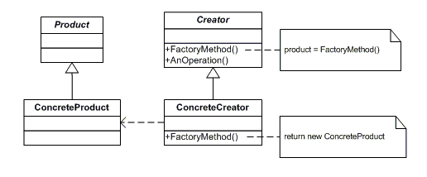
Factory Patterns
Lab1: Property File loaded into the memory with NLP support. How would you do that?
Can be done using Factory

Slide 12
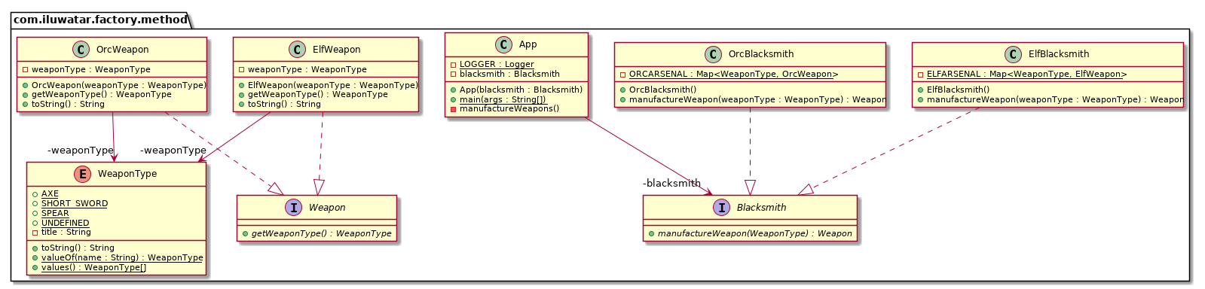
Design Patterns
Lab1:Design and create a weapon manufacturer. Based on the demand create different customer weapon

Slide 13
Design Patterns
Lab1: Property File loaded into the memory. How would you do that?

Slide 14
Design Patterns
Lab1: Property File loaded into the memory with NLP support. How would you do that?
Can be done using Factory

Slide 15
Abstract Factory
Definition
Abstract Factory Pattern
define an interface or abstract class for
creating families of related (or dependent) objects but
without specifying their concrete sub-classes.
Abstract Factory lets a class returns a factory of classes.
Practical example
Manufacturing a car

Slide 16
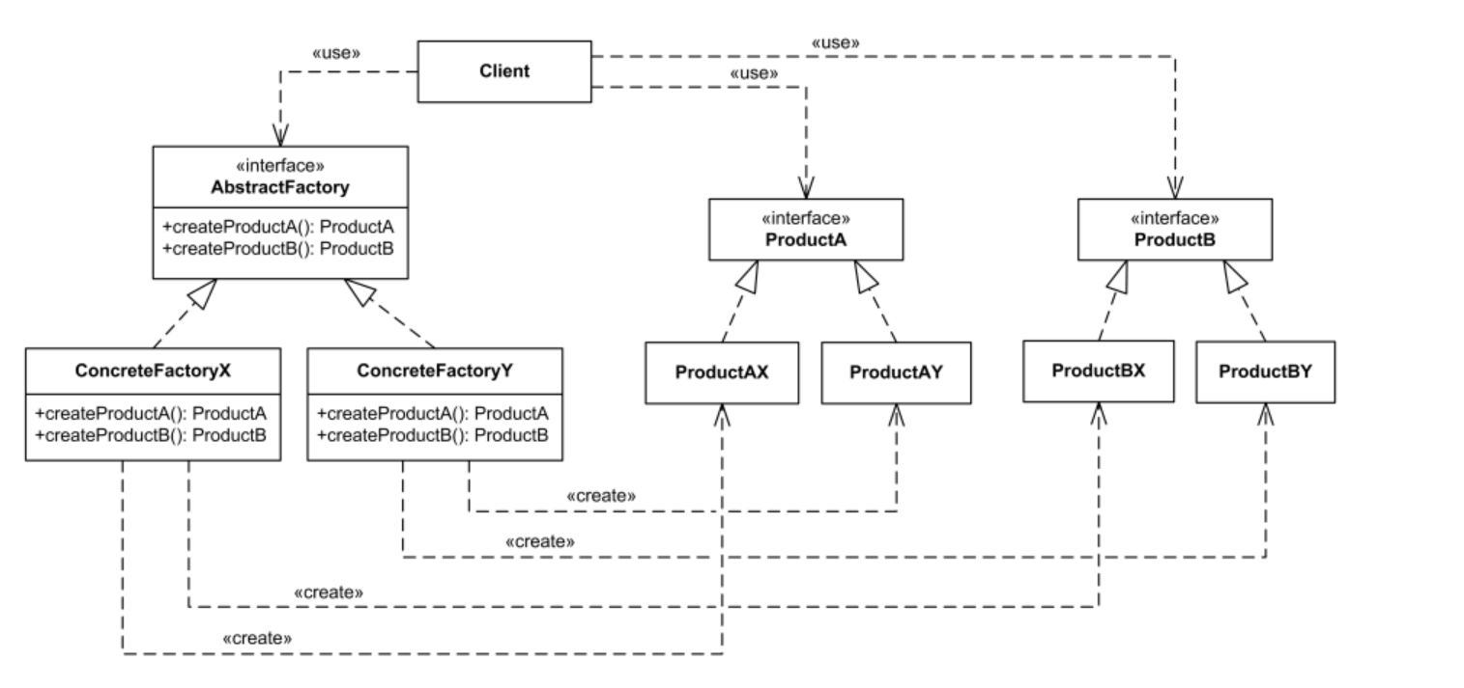
Abstract Factory Patterns

Slide 17
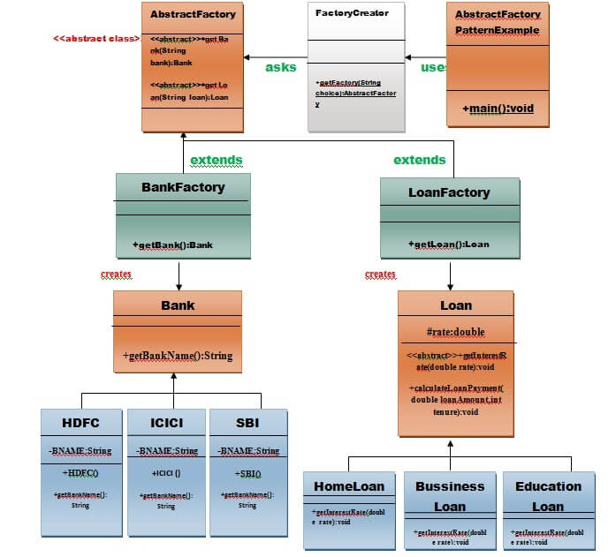
Abstract Factory Patterns

Slide 18
Singleton
Definition
The singleton pattern is used to limit creation of a class to only one object.
E.g.
caches,
thread pools, and
registries.
Practical Example
President of a Country

Slide 19
Singleton
Disadvantages of Singleton
Antipattern
Tight coupling
Complicate situation
Debugging can be complex
Reduce performance in multi-threading

Slide 20
Strategy
Definition:
Defines a family of algorithm
Encapsulates each one of them
Make them interchangeable
Strategy lets the algorithm vary independent of the clients that uses them.
Practical example
Consider the example of sorting, we implemented bubble sort but the data started to grow and bubble sort started getting very slow. In order to tackle this we implemented Quick sort. But now although the quick sort algorithm was doing better for large datasets, it was very slow for smaller datasets. In order to handle this we implemented a strategy where for small datasets, bubble sort will be used and for larger, quick sort.

Slide 21
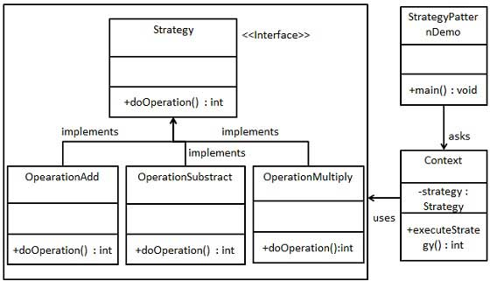
Strategy
a

Slide 22
Strategy
Definition:
E.g. calculator – does
Addition
Subtraction
Multiplication
Division

Slide 23
Observer
Definition
An object,
named the subject,
maintains a list of its dependents,
called observers,
notifies them automatically of any state changes,
usually by calling one of their methods.
Practical example
Job seekers subscribing to a job portal site. Would be intimated when there is a matching job.
New paper subscribers.

Slide 24
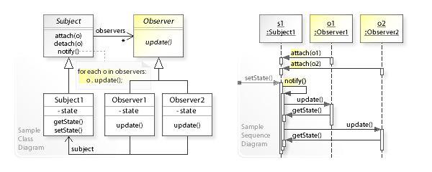
Observer
a

Slide 25
Proxy
Definition:
In proxy pattern, a class represents functionality of another class.
Practical example
Sonia Gandhi was accused as a proxy Prime Minister during the UPA government.
Bal Thackeray was also accused similarly.

Slide 26
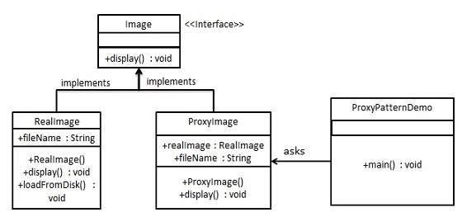
Proxy
a

Slide 27
Facade
Definition:
Practical example:
How do you turn on the computer? "Hit the power button" you say! That is what you believe because you are using a simple interface that computer provides on the outside, internally it has to do a lot of stuff to make it happen. This simple interface to the complex subsystem is a facade.

Slide 28
Facade
Lab1: Property File loaded into the memory. How would you do that?
Can be done using Factory

