Slide 1
Product Architecture Presented by: Vilas Varghese Dated:

Slide 2
Agenda
Introduction to Production Architecture

Slide 3
Product Architecture
Product architecture is the scheme by which the functional elements of the products are arranged into physical chunks and by which the chunks interact.
These chunk become the building blocks of the product.
The definition links architecture to system-level design and the principles of system engineering.
Architecture also has profound implications for how the product is designed, made, sold, used, repaired etc..
Architecture makes its influence felt during assembly.

Slide 4
What is product architecture
Define: During product development
How families and platforms are structured
How functions are realized
How to reuse and standardization are accomplished
How development work is divided up
Where subassembly and module boundaries are
Where DFC's (Distributed feature composition) go?
In the product
In the organization
Along the supply chain

Slide 5
What is product architecture cntd..
Define: During production system design
Assembly sequences
Reuse of facilities and knowledge
Planning for flexibility
Sharing of facilities to match capacity to demand
Define: During manufacturing and assembly
Where production happens
How customer orders are fulfilled

Slide 6
What is product architecture ctnd..
Define: During consumption
How services are delivered
How the product is updated
How the product is recycled

Slide 7
Architecture should
Architecture of a Building.
Product architecture is determined early in the development process.
Development:
Implementation of architectural decisions.
Testing and Refinement:
Implementation of test strategy.
Production Ramp-up:
Implementation of the deployment and rollout strategy.
Without an Architecture
Without an architecture we are clueless on what to do at what stage.

Slide 8
Principles of Product architecture
Principles are general rules and guidelines, intended to be enduring and seldom amended
Criteria
Understandable
Robust
Complete
Consistent
Stable

Slide 9
Self-contained System (SCS)
Architecture that focuses on
separation of the functionality into many independent systems
making the complete logical system
a collaboration of many smaller software systems.
SCS includes
UI and
everything else which can make it complete.
[Hence] They are different from Microservices

Slide 10
Software Design Principles
Software design principles are a set of guidelines that helps developers to make a good system design.
Following are the most used and known design principles
1. SOLID
2. DRY (Don’t repeat yourself)
3. KISS (Keep it simple and stupid)

Slide 11
SOLID principles
S: Single responsibility principle
O: Open-closed principle
L: Liskov substitution principle
I: Interface segregation principle
D: Dependency inversion principle

Slide 12
S: Single Responsibility Principle
public class UserDetailsUpdater
{
public void changeEmail(User user){
if(checkAccess(user)) {
//Grant option to change
}
}
public boolean checkAccess(User user){
//Verify if the user is valid.
}
}
Notes:
What if CheckAccess logic changes?

Slide 13
S: SRP
What is the responsibility of a Class?
SRP talks about Class responsibility and not Object responsibility.
What if a class had multiple responsibilities?
What if I had multiple responsibilities?
Class should have only one and only responsibility.
There should be only one reason due to which a class has to change
Based on separation of concern
Vary each concern independent of the other.
Understanding MVC

Slide 14
SRP
Design and code an application which can read some data from a database and write to a file.
What are the classes you would define?
What are the methods in those classes?
What are the unit test cases and integration test cases you would design?

Slide 15
SRP
Change the db.
What are the impact on the design?
What are the impacts on test cases?
What if I need to read from more than one db?
Any additional testing required?
What are the impacts to the unit and integration test cases we wrote.

Slide 16
SRP
Better code organization
Easy to maintain
Testing is easier
The class will have fewer test cases.
Less cost
Easy to understand
Each class will be responsible for a single work
Number of lines in each class will be less.
Facilitates in understanding the code quickly.

Slide 17
SRP
Design a ScoreRecorder

Slide 18
O: Open-closed principle
Software entities should be open for extension, but closed for modification
Bertrand Mayer, Object-Oriented Software Construction [1988]
Similar to Jenkins plugin, Browser plugin
Extension can be through
composition or
Inheritance
Calculate areas of various shapes
Implement using inheritance
Implement using composition

Slide 19
OCP
Open for extension
Behavior of the module can change can by
extending vertically (Extending) or horizontally (Composition).
Extending the behavior of a module
With adding new code
With configuration (no code change) but part of binary
Without change in binary – e.g. ENV in Docker
Closed for modification
Extending the behavior of a module
Should not result in changes to the source or binary code of the module.

Slide 20
OCP
Writing something very specific to solve some specific problem
Can lead to duplicate code
Can create maintainability issues.
Reused abstraction principle
if we have multiple abstractions which are not being used by the concrete class
it is a sign of poor designing and abstractions.
Don’t design interfaces – Instead discover them.
Start with the concrete behaviour and discover the abstraction as commonality emerges.
Rule of three –
Unless and until we have three places with duplicate code
Don’t abstract out the functionality.

Slide 21
OCP
Software entities should be open for extension, but closed for modification
Bertrand Mayer, Object-Oriented Software Construction [1988]
Similar to Jenkins plugin, Browser plugin
Extension can be through
composition or
Inheritance
Calculate areas of various shapes
Implement using inheritance
Implement using composition

Slide 22
L: Liskov substitution principle
Every subclass or derived class should be substitutable for their parent or base class
“is-a” relationship
avoids misusing inheritance
Applicable only for about polymorphism (inheritance)
Named after Barbara liskov, in 70’s
Client can consume any implementation without changing the correctness of the system
We can change the behaviour of the system
Correctness of the system can be said as the implementation of the interface A should not crash the application. Similarly implementation of the interface B should also not crash the application (compile time error or a new call itself fails).

Slide 23
Breaking the LSP
When we get the NotSupportedException.
One interesting implementation which violates LSP in C# is
ReadOnlyCollection.
Once the collection is created it cannot be changed.
We cannot add or remove the items from the collection.
So Add , clear and Remove methods in ReadOnlyCollection throw the NotSupportedExceptions.
It can break the correctness of the system
because suppose if one part of the client is accepting only the ICollection
if we substitute it with ReadOnlyCollection,
it will break for Add, Clear and Remove methods and thus putting the correctness of the system in jeopardy.

Slide 24
Composition Vs Association
What is "is a" relationship?
What is "has a" relationship?
Typical cases where "is a" and "has a" can be confusing.
ApplianceManufacturer Vs FanManufacturere

Slide 25
LSP
Lab2: Identify 10 objects in “is a” and “has a” relationship.
Lab3: Multiple questions like below?
Identify the relation between Cashier, deposit, withdraw, BankManager, Bank
What is the relation between TV, micky mouse, donald duck, parle G advertisement.
Vehicle - Car - AmbassidorCar relationship

Slide 26
I: Interface segregation principle
Clients should not be forced to implement unnecessary methods which they will not use.
ISP is SOLID design principle which is used to help us achieve the LSP by having more granularity.
Clients should not depend on methods they do not use.
Interface are introduced to achieve loose coupling
Clients define the interface
there is no need for a client to define a method in the interface
if the client doesn’t need the method in the interface.
Prefer role based interfaces over header interfaces.
Role base: Interfaces that you recognize based on functionality
Header interfaces: Design the class and move all methods to a header interface.
If client need to define the interface it only need to define a very few methods in the interface. These are role interface.

Slide 27
ISP
There are many ways by which we can extend the functionality of the class
e.g. by inheritance,
by using generics or
by using extension methods.
But there are very less way by which we can reduce the methods in the class.
Indeed there is only one way and that is ISP.

Slide 28
ISP
interface Bird{
public void fly();
}
Penguin implements Bird{
fly //what do we do with fly now? Give a dummy implementation?
}
How do you solve this?
FlyingBird?

Slide 29
Interface segregation principle (ISP)
Lab: Identify 10 role based interfaces and classes implementing them.

Slide 30
D: Dependency inversion principle
Lab: Identify 10 role based interfaces and classes implementing them.

Slide 31
D: DIP
For e.g.
Car to
Battery relation is done using DIP (can be injected anytime)
Owner of the car (injected during constructor)
Browser to Plugin
Selenium to Browser
House to furniture

Slide 32
DIP related terms
Principles
Inversion of Control
Dependency inversion principle
Pattern
Dependency Injection
Framework
IoC Container

Slide 33
Inversion of Control
Class Car requires battery.
Instead of directly building battery (new Battery()),
We get it from BatterFactory (BatteryFactory.createBattery())
Advantage
If the logic of Battery manufacturing changes, Car manufacturer doesn’t need to bother
Refrer : D:\PraiseTheLord\HSBGInfotech\Freshers\Edureka\SOLID\InversionOfControlInversionOfControl.java

Slide 34
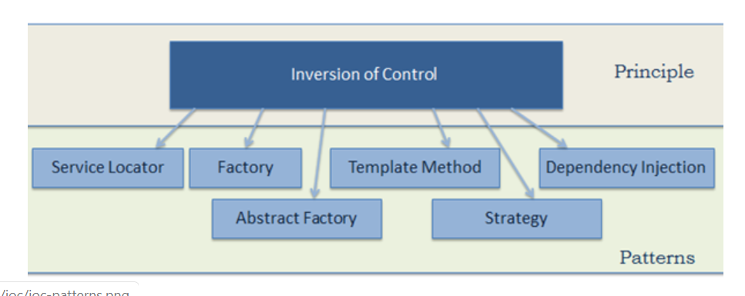
Possible IOC Implementations
Principles
Inversion of Control
Dependency inversion principle
Pattern
Dependency Injection
Framework
IoC Container

Slide 35
D: DIP
High-level modules should not depend on low-level modules. Both should depend on abstractions.
A high-level: Module which depends on other modules.
Car in InversionOfControl.java
Battery is a low level module
Abstractions should not depend on details. Details should depend on abstractions.
Abstractions in DIP can be Abstract class or Interface.
Interaction between high level and low level module should be abstract.
Refer D:\PraiseTheLord\HSBGInfotech\Freshers\Edureka\SOLID\DIP.java
Notes:
https://www.tutorialsteacher.com/ioc/introduction
https://www.tutorialsteacher.com/ioc/inversion-of-control
https://www.tutorialsteacher.com/ioc/dependency-inversion-principle
https://www.tutorialsteacher.com/ioc/dependency-injection

Slide 36
Dependency Injection
Dependency Injection (DI) is a design pattern used to implement IoC.
Allows creation of dependent objects outside of a class and provides those objects to a class through different ways.
Using DI, we move the creation and binding of the dependent objects outside of the class that depends on them.

Slide 37
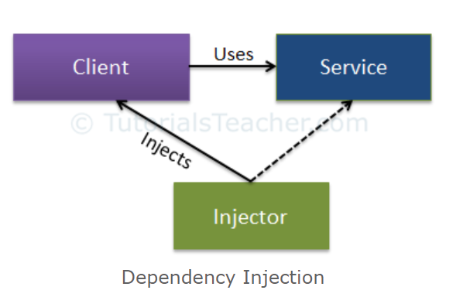
Dependency Injection
DI involves 3 types of classes.
Client Class / dependent class:
Depends on the service class
Service Class:
Provides service to the client class.
Injector Class:
Creates and injects the service class object into the client class.

Slide 38
Types of Dependency Injection
Constructor Injection:
Injector injects the service (dependency) through the client class constructor.
Property Injection aka the Setter Injection :
Injector injects the dependency through a public property of the client class.
Method Injection:
Client class implements an interface
Interface declares the method(s) to supply the dependency
Injector uses this interface to inject the dependency to the client class.

Slide 39
Dependency Inversion Principle
Lab2:
Design an AreaCalculator. The design should scale to calculate area of a circle, square rectangle, polygon, hexagon ect…. Design should work for new shapes that can come up tomorrow.

Slide 40
SOLID Principles
Few important Design smell SOLID Principles solve are
Rigidity –
The design is difficult to change.
Without proper use of abstraction the design becomes very rigid.
Impact: Significant increase in development and testing time.
Fragility –
Design is easy to break.
A small change: very high chances of the whole design going for a toss.
Immobility –
The design is difficult to reuse.
Unable to extend the current design.
Viscosity –
It is difficult to do the right thing.
Needless Complexity –
Over design.

Slide 41
Dry (Don’t repeat yourself)
Don’t write duplicate code
Use Abstraction to abstract common things in one place
Students may have a method called learn
Employees also may have a method called learn
Are they duplicate?
How do you solve this?
Abstraction
Should we use inheritance or composition?

Slide 42
Strategy Pattern
Better cover all design patterns together?

Slide 43
Strategy Pattern
Better cover all design patterns together?
Design for changes
Encapsulate what changes.

Slide 44
Association over Inheritance
Commonly used terms
Composition, Inheritance, Association, Aggregation
Types of Association
Composition
Aggregation
Inheritance
Is a
But Employee is a Person
Composition is preferred over inheritance inspite of that.
Person picks up the functionality of Employee for some period.
Person gives up the functionality of Employee after that.

Slide 45
Composition over Aggregation
Composition
Lab1:
Animal and heart, heart don’t exist separate of an Animal.
Has a
Aggregation
Lab1:
Employees in bank.
Employees can exist outside bank.
Bank can decide to automate some work which employees did
Employees can change their profession.
Is [currently] part of a

Slide 46
Composition over Aggregation
Composition is a tight binding.
Relationship where the child cannot exist independent of the parent.
e.g. Animal and heart, heart don’t exist separate to a Animal.
Has-a relationship.
Heart was born inside Animal.
Delete animal and heart also gets deleted.
Heart can be transplanted before Burial.
How would you manage that?

Slide 47
Composition over Aggregation
Aggregation
Relationship where the child can exist independently of the parent.
Loosely coupled.
(Currently) Part-of relationship.
e.g. Employees in bank.
Employees were born outside bank.
They joined the bank.
They can quit the bank.
Bank get closed - employees still exist

Slide 48
Lab for SOLID and OOPS
Exercise
Design a company onboarding process.
Company has divisions like HR, product dev, QE, teachers, sales, marketing.
What is company to division relationship.
Employees are part of company. They join a division.
How about CEO's? CFO's ect.
Executive also can be a division.
What is the people to division relationship?
People can switch divisions. How do you manage?
How would we code onboarding?
What if we want to add a new process to onboarding?
Where do we code the switch division?

Slide 49
Lab
Design and implement a Simple Calculator
Modify it to make it a Scientific Calculator

Slide 50
Lab
Design and implement an Alarm Clock

Slide 51
Lab
Design and implement a Simple Calculator
Modify it to make it a Scientific Calculator

Slide 52
Lab
Design and implement a Simple Calculator
Modify it to make it a Scientific Calculator

Slide 53
Lab
Design and implement a Simple Calculator
Modify it to make it a Scientific Calculator

Slide 54
Program for Interface
Program for interface.
Switch a fan on
Drive a car
Program for Class.
Kubernetes Examination
Closer look reveals lot of abstraction (interfaces)
This is very rigid.
Will fail if you change.
Relatively less

Slide 55
Program for Interface
Why?
Loosely coupled
Can work with any implementation – even one which evolves tomorrow.

