Slide 1
M. DURGA SAI SANDEEP
Final Project

Slide 2
Keylogger and Security
GitHub Link:- https://github.com/Sandeepmopidevi/Keylogger-Security-Project

Slide 3


AGENDA
Understanding Key logger Threats
Importance of Security Measures
Detection and Prevention Techniques
Implementation of a Key logger
Role of End Users in Security
Best Practices for Security Implementation

Slide 4

PROBLEM STATEMENT
Keyloggers secretly record keystrokes, capturing sensitive information like passwords and personal data. They can be introduced through malware, phishing, and physical access, often bypassing traditional security measures. Effective strategies are needed to prevent, detect, and respond to keylogger threats to protect user data and privacy.

Slide 5

PROJECT OVERVIEW
Developing robust keylogger detection and security protocols is crucial for protecting sensitive data and maintaining system integrity. These measures enhance user privacy and bolster overall cybersecurity posture. Implementing such strategies requires ongoing maintenance and resource allocation. Balancing the benefits of enhanced security with the challenges of resource-intensive implementation is essential. By prioritizing keylogger detection and security, organizations can mitigate risks and safeguard against unauthorized access to sensitive information. This proactive approach strengthens resilience against evolving cyber threats, ensuring the integrity and confidentiality of data across various computing environments.

Slide 6
Implementation of a Keylogger
Our keylogger is implemented using Python with the following features:
Key Capture: Captures each keystroke and logs it.
Logging Mechanism: Logs data in both text and JSON format.
Real-time Monitoring: Captures key presses and releases in real-time.
GUI Interface: Simple GUI to start and stop the keylogger.

Slide 7

WHO ARE THE END USERS?
Hackers: Individuals who may use keyloggers maliciously.
IT Companies: Organizations that need to understand and defend against keyloggers.

Slide 8

SOLUTION AND ITS VALUE PROPOSITION
Value Proposition:
Effective Detection: Our software swiftly identifies and blocks keyloggers, protecting sensitive data and user privacy.
Proactive Defense: With advanced algorithms, it preemptively detects threats, minimizing the risk of data breaches.
User-Friendly Interface: Easy-to-use interface facilitates seamless integration and operation.
Cost-Effective Security: Provides robust protection at an affordable price, reducing financial risks associated with breaches.
Comprehensive Protection: Ensures data integrity and confidentiality, safeguarding against evolving cyber threats.

Slide 9

THE WOW IN YOUR SOLUTION
Wow Factor: Our software swiftly detects and neutralizes keyloggers, ensuring your data's safety.
9

Slide 10
Code Snippet
import tkinter as tk
from tkinter import CENTER
from pynput import keyboard
import json
keys_used, keys, flag = [], "", False
def generate_text_log(key):
pass
def generate_json_file(keys_used):
pass
def on_press(key):
pass
def on_release(key):
pass
def start_keylogger():
pass
def stop_keylogger():
pass
root = tk.Tk()
root.title("Keylogger")
frame = tk.Frame(root, padx=10, pady=10)
frame.pack(expand=True)
status_label = tk.Label(frame, text='Click "Start" to begin keylogging.', anchor=CENTER)
status_label.pack(pady=5)
button_frame = tk.Frame(frame)
button_frame.pack(pady=5)
start_button = tk.Button(button_frame, text="Start", command=start_keylogger)
start_button.pack(side=tk.LEFT, padx=5)
stop_button = tk.Button(button_frame, text="Stop", command=stop_keylogger, state='disabled')
stop_button.pack(side=tk.RIGHT, padx=5)
root.geometry("300x150")
root.mainloop()

Slide 11
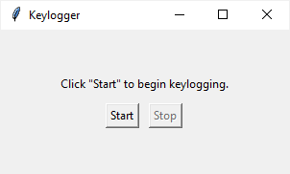
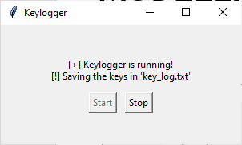
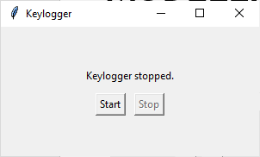
MODELLING
before start of keylogger
After start of keylogger
Keylogger Stopped
11

Slide 12
RESULTS
Incorporating wireframes into keylogger and security modeling enhances clarity, collaboration, and efficiency throughout the development lifecycle. It provides a visual representation of security measures, improving communication among stakeholders and developers. Wireframes facilitate rapid prototyping and iteration, leading to early detection and resolution of usability and security issues. This ensures that security features align with user needs, resulting in a more user-friendly and effective security solution. Overall, wireframes streamline the development process and reduce the risk of security vulnerabilities in keylogger and security systems.
12

