Slide 1

DevSecOps Pipeline & Rollout Strategy
Automated Security Controls, Pipeline Gates & Enterprise Adoption Plan for OWASP Juice Shop.
Presenter Sandeep Sain
Role Application Security Engineer
Date 31 July 2026

Slide 2





Executive Agenda
1. Risk Assessment
2. Pipeline Architecture
3. Rollout & Governance
Top 5 baseline security risks, attack scenarios, and business impact for executive management.
Automated security controls: SAST, Secret Scanning, SCA, SBOM & Container Hardening.
3-phase adoption framework across 40 microservices, exception SLAs, and success KPIs.

Slide 3


Project Overview & Requirements
Objective
Key Implemented Deliverables
Step in as a Security Consultant for Acme Financial Services to build end-to-end automated security controls around OWASP Juice Shop without modifying application source code.
✅ 1-Page Risk Brief ✅ Semgrep SAST with 2 Custom Rules ✅ Gitleaks Secret Scanning Gate ✅ Trivy SCA & CycloneDX SBOM ✅ Hardened Non-Root Dockerfile ✅ Trivy Container Image Scan ✅ GitHub Actions CI/CD & Security Gates

Slide 4
Top Security Risks & Priorities
Risk Item | Severity | Justification & Impact
Hardcoded Secrets | CRITICAL | API keyscommitted in Git allow direct database and cloud access.
Vulnerable Dependencies | CRITICAL | Known open-source CVEs can be exploited without writing new attack code.
Unsafe Code Patterns | HIGH | Unsanitized eval() and SQL string concatenation lead to injection attacks.
Unhardened Containers | HIGH | Running containers as root enables host-level breakout and privilege escalation.
Missing Pipeline Gates | MEDIUM | Builds do not block critical findings, allowing vulnerabilities to reach production.
Remediation Priority: Immediately enforce pre-merge secret scanning and branch protection rules to block 80% of accidental breaches without impacting developer speed.

Slide 5






DevSecOps Pipeline Architecture
STEP 1
STEP 2
STEP 3
STEP 4
STEP 5
GATE CHECK
Code Push / PR
Gitleaks
Semgrep
Trivy SCA
Docker Scan
Pass / Fail
Developer submits Pull Request
Secret Scanning
SAST & Custom Rules
SCA & CycloneDX SBOM
Hardened Image Check
Enforce Deployment
Every push automatically triggers these jobs in parallel on GitHub Actions, providing feedback within 60 seconds.

Slide 6
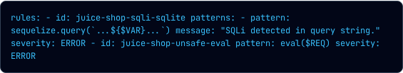

Static Application Security Testing
Semgrep Engine & Custom Rules
Results & Suppressions
Integrated Semgrep SAST to scan JavaScript/TypeScript code for OWASP Top 10 vulnerabilities.
Scanner Results: 309 rules executed, successfully flagging unsafe and unparameterized SQL queries.
False Positive Handling: Developers can suppress verified false positives inline with auditable comments:

Slide 7


Secrets Detection & Validation
Gitleaks Pipeline Gate
Gate Validation Workflow
Configured Gitleaks to scan full commit histories and pull requests for leaked credentials, API tokens, AWS keys, and JWT private keys.
1. Test Branch: Created a temporary branch and committed a dummy credential pattern ().
Prevents credentials from ever reaching the remote repository or production environment.
2. Gate Failure: Pipeline immediately failed and blocked PR merge.
3. Remediation: Removed secret; pipeline returned to green status.

Slide 8


Software Composition Analysis & SBOM
Trivy SCA Vulnerability Gate
CycloneDX SBOM Artifact
Parses application package manifests () to identify known open-source CVEs.
Automated generation of Software Bill of Materials (SBOM) in CycloneDX JSON format on every release build.
Configured pipeline threshold to automatically fail builds on Critical or High severity vulnerabilities.
Uploaded as a build artifact to satisfy supply chain security compliance and audit requirements.

Slide 9
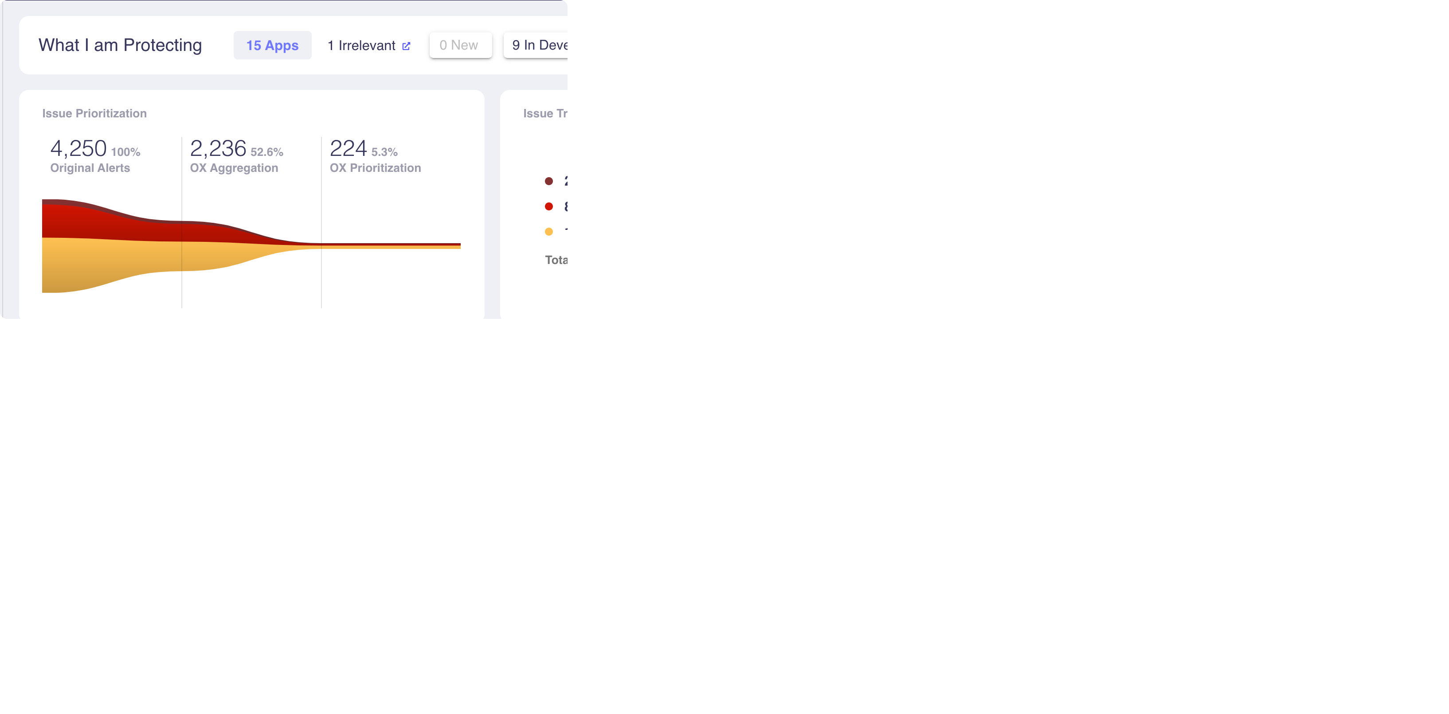
Container Security & Hardening
Dockerfile.hardened Strategy
Minimal Base: Switched from heavy Debian image to (90% attack surface reduction).
Non-Root User: Enforced execution to prevent host privilege escalation.
Multi-Stage Build: Dropped build compilers and package manager caches in production runtime.

Slide 10
Pipeline Security Controls
Branch Protection
Automated Gates
GitHub Security
Enforce minimum 1 peer review and passing status checks before code can be merged into .
Pipeline blocks automatically if secrets, Critical SAST bugs, or High container CVEs are detected.
Scans upload SARIF files to GitHub Code Scanning tab for central visibility and developer tracking.

Slide 11
3-Phase 40-Microservice Rollout
Phase 1: Pilot
Phase 2: Expansion
Phase 3: Governance
Weeks 1–2 (Tier-1 Services)
Weeks 3–5 (15–20 Services)
Weeks 6–8 (All 40 Services)
Deploy SAST & Secrets scanning in Warn-Only mode on Payment & Auth services. Establish vulnerability baseline.
Enable mandatory blocking for Critical secrets & High CVEs on Order & Catalog services. Conduct office hours.
Full CI/CD gating across all repositories. Automated SBOM creation, central exception SLA tracking, and KPI reviews.

Slide 12


Lessons & Future Roadmap
Lessons Learned
Future Improvements
• Security automation must run early in PRs, not post-deployment. • Warn-only mode builds developer trust before activating blocking gates. • Custom SAST rules significantly reduce noise compared to generic rule sets.
• DAST Integration: OWASP ZAP dynamic scanning in staging. • IaC Security: Checkov/Trivy for Terraform configurations. • Kubernetes Security: OPA/Kyverno policy enforcement at runtime.

Slide 13
Questions & Live Demo
Thank you! Let's walk through the working GitHub Actions pipeline.
Sandeep Sain | Application Security Engineer Proposal

Slide 14

Image Sources
DevSecOps container security and cloud infrastructure dashboard
http://googleusercontent.com/image_collection/image_retrieval/3501788798942617211_0

Slide 15

Image Sources
https://www.ox.security/wp-content/uploads/2023/10/ox-dashboard-screen-shot.png
Source: www.ox.security

