Slide 1
Cryptography

Slide 2
Cryptography
Cryptography - it is a method of storing and transmitting data in a form that only those it is intended for can read and process.
It is considered a science of protecting information by encoding it into an unreadable format.
Plaintext - Any data which is readable without requiring any additional efforts or processing.
Ciphertext - Any data that appears as random and is not readable unless additional efforts or processing is taken.
Cryptosystem - Any system or product that provides encryption and decryption.

Slide 3
Cryptography
Encryption - A process or method that converts plaintext into ciphertext and makes data unreadable.
Decryption - A process or method that converts back the ciphertext to plaintext so the data is readable.
The algorithm, the set of rules or mathematical formula also known as the cipher, dictates how enciphering and deciphering take place.
In encryption, the key (cryptovariable) is a value that comprises a large sequence of random bits.
An algorithm contains a keyspace, which is a range of values that can be used to construct a key.

Slide 4
Cryptography
When the algorithm needs to generate a new key, it uses random values from this keyspace.
The larger the keyspace, the more available values that can be used to represent different keys—and the more random the keys are, the harder it is for intruders to figure them out.
Cryptanalysis - It is the science of studying and breaking the secrecy of encryption processes, compromising authentication schemes, and reverseengineering algorithms and keys.
Cryptology - It is the study of Cryptanalysis and cryptography.

Slide 5
Cryptography
Goals of Cryptography
Security practitioners use cryptographic systems to meet four fundamental goals: confidentiality, integrity, authentication, and nonrepudiation.
Confidentiality ensures that data remains private in three different situations: when it is at rest, when it is in transit, and when it is in use.
Integrity ensures that data is not altered without authorization.
If integrity mechanisms are in place, the recipient of a message can be certain that the message received is identical to the message that was sent.

Slide 6
Cryptography
Similarly, integrity checks can ensure that stored data ​was not altered between the time it was created and the time it was accessed.
Authentication verifies the claimed identity of system users and is a major function of cryptosystems.
Nonrepudiation provides assurance to the recipient that the message was originated by the sender and not someone masquerading as the sender.
It also prevents the sender from claiming that they never sent the message in the first place (also known as repudiating the message).

Slide 7
Cryptography
Symmetric cryptosystems - It is a cryptosystem that uses a single key (same key) for encrypting the data and while decrypting that data.
In other words it uses a shared secret key available to all users of the cryptosystem.
This type of encryption requires each user to keep the key a secret and properly protected.
If an intruder were to get this key, they could decrypt any intercepted message encrypted with it.
The security of the symmetric encryption method is completely dependent on how well users share, protect and update the key.

Slide 8
Cryptography
Symmetric cryptosystems can provide confidentiality, but they cannot provide authentication or nonrepudiation.
There is no way to prove through cryptography who actually sent a message if multiple people are sharing the same key.
The Symmetric cryptosystems have so many problems and flaws, but still they are used because they are very fast and can be hard to break.
It is also difficult to uncover data encrypted with a symmetric algorithm if a large key size is used.
As the number of users increase the key management becomes tedious.

Slide 9
Cryptography
Asymmetric Cryptosystem - It is a system that uses two different keys for encryption and decryption process.
The two different asymmetric keys are mathematically related such that If a message is encrypted by one key, then only other key can decrypt the message.
In a public key system, the pair of keys is made up of one public key and one private key.
The public key can be known to everyone, and the private key must be known and used only by the owner.
If confidentiality is the most important security service to a sender, she would encrypt the file with the receiver’s public key.

Slide 10
Cryptography
This is called a secure message format because it can only be decrypted by the person who has the corresponding private key.
If authentication is the most important security service to the sender, then she would encrypt the data with her private key.
This provides assurance to the receiver that the only person who could have encrypted the data is the individual who has possession of that private key.
If the sender encrypted the data with the receiver’s public key, authentication is not provided because this public key is available to anyone.

Slide 11
Cryptography
Data encrypted with the sender’s private key is known an open message format because anyone with a copy of the corresponding public key can decrypt the message.
Thus Confidentiality is not ensured.
An asymmetric algorithm works much more slowly than a symmetric algorithm, because symmetric algorithms carry out relatively simplistic mathematical functions on the bits during the encryption and decryption processes.
Asymmetric systems also provide for easier and more manageable key distribution than symmetric systems and do not have the scalability issues of symmetric systems.

Slide 12
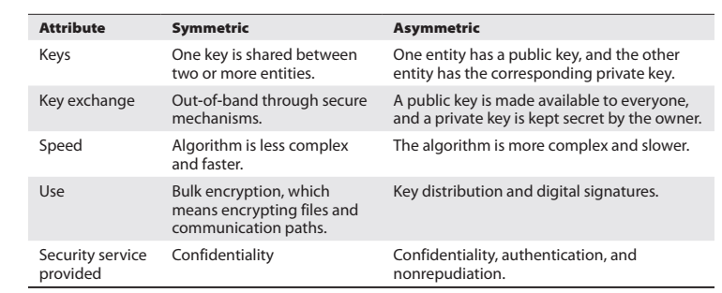
Cryptography

Slide 13
Cryptography
Exclusive OR
This logical function is perhaps the most important and most commonly used in cryptographic applications—the exclusive OR (XOR) function.
It’s referred to in mathematical literature as the XOR function and is commonly represented by the ⊕ symbol.
The XOR function returns a true value when only one of the input values is true.
If both values are false or both values are true, the output of the XOR function is false.

Slide 14
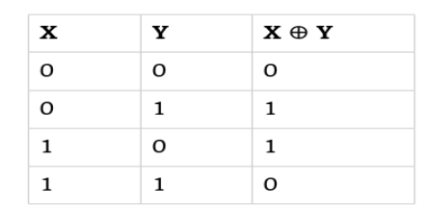
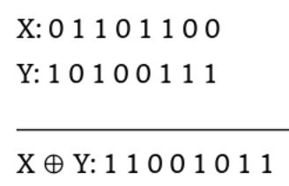
Cryptography
Exclusive OR
Modulo Function ​
The modulo function is extremely important in the field of cryptography.
The modulo function finds the remainder value left over after a division operation of two numbers is performed.

Slide 15
Cryptography
The modulo function is r represented in equations by the abbreviation mod, although it’s also sometimes represented by the % operator.
Some examples of Modulo function
8 mod 6 = 2
6 mod 8 = 6
10 mod 3 = 1
10 mod 2 = 0
32 mod 8 = 0
One-Way Functions
A one-way function is a mathematical operation that easily produces output values for each possible combination of inputs but makes it impossible to retrieve the input values.

Slide 16
Cryptography
Nonce
Cryptography often gains strength by adding randomness to the encryption process.
One method by which this is accomplished is through the use of a nonce.
A nonce is a random number that acts as a placeholder variable in mathematical functions.
When the function is executed, the nonce is replaced with a random number generated at the moment of processing for one-time use.
The nonce must be a unique number each time it is used.

Slide 17
Cryptography
One of the more recognizable examples of a nonce is an initialization vector (IV), a random bit string that is the same length as the block size and is XORed with the message.
IVs are used to create unique ciphertext every time the same message is encrypted using the same key.
A salt is also similar and mostly used in hashing passwords.

Slide 18
Cryptography
Codes vs. Ciphers
Codes, are cryptographic systems of symbols that represent words or phrases, are sometimes secret, but they are not necessarily meant to provide confidentiality.
Ciphers, on the other hand, are always meant to hide the true meaning of a message.
They use a variety of techniques to alter and/or rearrange the characters or bits of a message to achieve confidentiality.

Slide 19
Cryptography
Substitution Ciphers
Substitution ciphers use the encryption algorithm to replace each character or bit of the plaintext message with a different character.
Transposition Ciphers
Transposition ciphers use an encryption algorithm to rearrange the letters of a plaintext message, forming the ciphertext message.
The decryption algorithm simply reverses the encryption transformation to retrieve the original message.

Slide 20
Cryptography
Caesar Cipher
One of the earliest known cipher systems was used by Julius Caesar to communicate with Cicero in Rome while he was conquering Europe.
To encrypt a message, you simply shift each letter of the alphabet three places to the right.
For example, A would become D, and B would become E.
If you reach the end of the alphabet during this process, you simply wrap around to the beginning so that X becomes A, Y becomes B, and Z becomes C.

Slide 21
Cryptography
For this reason, the Caesar cipher also became known as the ROT3 (or Rotate 3) cipher.
The Caesar cipher is a substitution cipher that is mono-alphabetic.
Try to encrypt following sentence using caesar cipher.
DO YOU WANT A BREAK ?
A B C D E F G H I J K L M N O P Q R S T U V W X Y Z.

Slide 22
Cryptography
GR BRX ZDQW D EUHDN ?

Slide 23
Cryptography
You can express the ROT3 cipher in mathematical terms by converting each letter to its decimal equivalent (where A is 0 and Z is 25).
You can then add three to each plaintext letter to determine the ciphertext.
You account for the wrap-around by using the modulo function.
The final encryption function for the Caesar cipher is then this:
C = (P + 3) mod 26
The corresponding decryption function is as follows:
P = (C - 3) mod 26

Slide 24
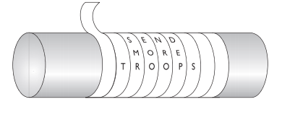
Cryptography
Today, this technique seems too simplistic to be effective, but in the time of Julius Caesar, not very many people could read in the first place, so it provided a high level of protection.
A more recent encryption method used in the 1980s, ROT13 was really the same thing as a Caesar cipher.
Instead of shifting 3 spaces in the alphabet, the encryption process shifted 13 spaces.
The scytale was used by
the Spartans to
encrypt or decrypt
messages.

Slide 25
Cryptography
Although the Caesar cipher is easy to use, it’s also easy to crack.
It’s vulnerable to a type of attack known as frequency analysis.
The most common letters in the English language are E, T, A, O, N, R, I, S, and H.
An attacker seeking to break a Caesar-style cipher encoding a message that was written in English merely needs to find the most common letters in the encrypted text and experiment with substitutions of these common letters to help determine the pattern.

Slide 26
Cryptography
Vigenère Cipher
In the 16th century in France, Blaise de Vigenère developed a polyalphabetic substitution cipher for Henry III.
This was based on the Caesar cipher, but it increased the difficulty of the encryption and decryption process.
The Vigenère cipher uses a single encryption/decryption chart given on the next slide.
You need a key to use the Vigenère system.
For example, the key could be secret.

Slide 27
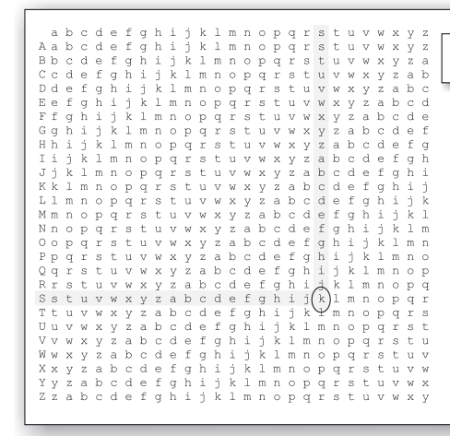
Cryptography

Slide 28
Cryptography
Then, you would perform the following encryption process:
Write out the plaintext.
Underneath, write out the encryption key, repeating the key as many times as needed to establish a line of text that is the same length as the plaintext.
Convert each letter position from plaintext to ciphertext.
1. Locate the column headed by the first plaintext character (a).
2. Next, locate the row headed by the first character of the key (s).
3. Finally, locate where these two items intersect, and write down the letter that appears there (s). This is the ciphertext for that letter position.

Slide 29
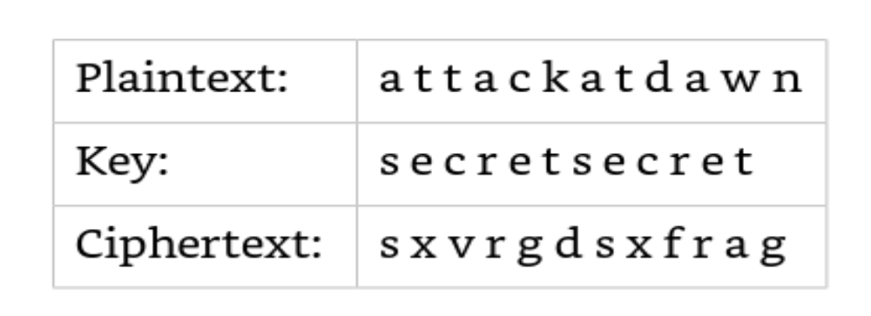
Cryptography
Try converting following sentence using Vigenère Cipher
WelcometoHacking.
use the key EFFORT

Slide 30
Cryptography
Although polyalphabetic substitution protects against direct frequency analysis, it is vulnerable to a second-order form of frequency analysis called period analysis, which is an examination of frequency based on the repeated use of the key.

Slide 31
Cryptography
Steganography
Steganography is a method of hiding data in another media type so the very existence of the data is concealed.
Only the sender and receiver are supposed to be able to see the message because it is secretly hidden in a graphic, Wave file, document, or other type of media.

Slide 32
Cryptography
Block and Stream Ciphers
The two main types of symmetric algorithms are block ciphers, which work on blocks of bits, and stream ciphers, which work on one bit at a time.
Block Ciphers
When a block cipher is used for encryption and decryption purposes, the message is divided into blocks of bits.
These blocks are then put through mathematical functions,one block at a time.
Suppose you need to encrypt a message you are sending and you are using a block cipher that uses 64 bits.

Slide 33
Cryptography
Your message of 640 bits is chopped up into 10 individual blocks of 64 bits.
Each block is put through a succession of mathematical formulas, and what you end up with is 10 blocks of encrypted text.
You send this encrypted message.
The receiver has to have the same block cipher and key, and those 10 ciphertext blocks go back through the algorithm in the reverse sequence and end up in your plaintext message.
A strong cipher contains the right level of two main attributes: confusion and diffusion.

Slide 34
Cryptography
Confusion and Diffusion
Confusion is commonly carried out through substitution, while diffusion is carried out by using transposition.
For a cipher to be considered strong, it must contain both of these attributes to ensure that reverse-engineering is basically impossible.
The randomness of the key values and the complexity of the mathematical functions dictate the level of confusion and diffusion involved.

Slide 35
Cryptography
Confusion pertains to making the relationship between the key and resulting ciphertext as complex as possible so the key cannot be uncovered from the ciphertext.
A very similar concept of diffusion is the avalanche effect.
If an algorithm follows a strict avalanche effect criteria, this means that if the input to an algorithm is slightly modified, then the output of the algorithm is changed significantly.
So a small change to the key or the plaintext should cause drastic changes to the resulting ciphertext.

Slide 36
Cryptography
Stream Ciphers
A stream cipher does not divide a message into blocks.
Instead, a stream cipher treats the message as a stream of bits and performs mathematical functions on each bit individually.
When using a stream cipher, a plaintext bit will be transformed into a different ciphertext bit each time it is encrypted.
Stream ciphers use keystream generators, which produce a stream of bits that is XORed with the plaintext bits to produce ciphertext,

Slide 37
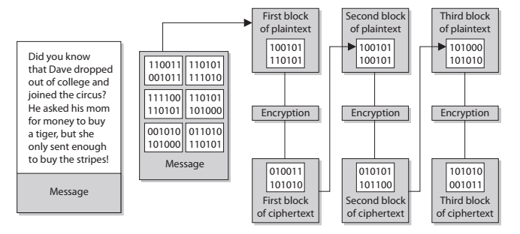
Cryptography
Block Cipher

Slide 38
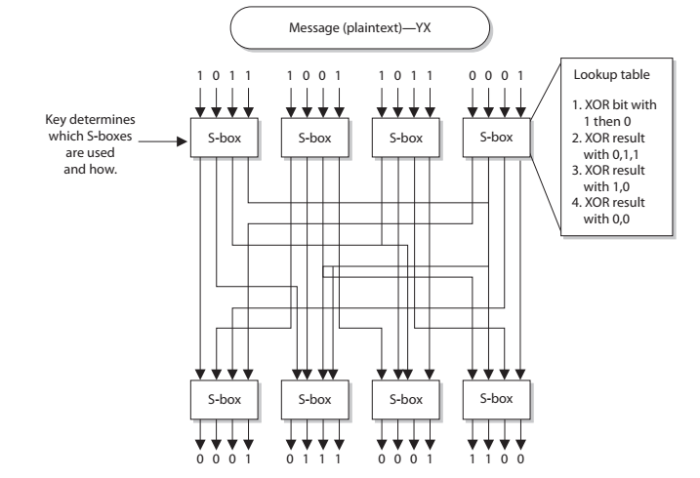
Cryptography
Stream Cipher

Slide 39
Cryptography
Stream ciphers require a lot of randomness and encrypt individual bits at a time.
This requires more processing power than block ciphers require, which is why stream ciphers are better suited to be implemented at the hardware level.
Because block ciphers do not require as much processing power, they can be easily implemented at the software level.
Overall, stream ciphers are considered less secure than block ciphers and are used less frequently.

Slide 40
Cryptography
When real-time applications, as in VoIP or multimedia, have encryption requirements, it is common that stream ciphers are implemented to accomplish this task.
It is also worth pointing out that a computational error in a block encryption may render one block undecipherable, whereas a single computation error in stream encryption will propagate through the remainder of the stream.
Some other techniques used in algorithms to increase their cryptographic strength are listed here:
Compression
Compression functions are run on the text before it goes into the encryption algorithm.

Slide 41
Cryptography
Expansion
Expanding the plaintext by duplicating values. Commonly used to increase the plaintext size to map to key sizes.
Padding
Adding material to plaintext data before it is encrypted.
Key mixing
Using a portion (subkey) of a key to limit the exposure of the key.
Key schedules are used to generate subkeys from master keys.

Slide 42
Cryptography
In a hybrid system, the symmetric algorithm uses a secret key that will be used to encrypt the bulk, or the message, and the asymmetric key encrypts the secret key for transmission.

Slide 43
Cryptography
Types of Symmetric Systems
Several types of symmetric algorithms are used today. They have different methods of providing encryption and decryption functionality.
The one thing they all have in common is that they are symmetric algorithms, meaning the sender and receiver are using two instances of the same key.
Data Encryption Standard (DES)
Triple-DES (3DES)
Advanced Encryption Standard (AES)
International Data Encryption Algorithm (IDEA)
Blowfish
RC4, RC5, and RC6

Slide 44
Cryptography
Data Encryption Standard (DES)
The U.S. government published the Data Encryption Standard in 1977 as a proposed standard cryptosystem for all government communications.
Because of flaws in the algorithm, cryptographers and the federal government no longer consider DES secure.
It is widely believed that intelligence agencies routinely decrypt DES-encrypted information.
DES was superseded by the Advanced Encryption Standard in December 2001.

Slide 45
Cryptography
DES is a 64-bit block cipher that has five modes of operation:
Electronic Code Book (ECB) mode,
Cipher Block Chaining (CBC) mode,
Cipher Feedback (CFB) mode,
output feedback (OFB) mode, and
Counter (CTR) mode.
All of the DES modes operate on 64 bits of plaintext at a time to generate 64-bit blocks of ciphertext.
The key used by DES is 56 bits long.
DES uses a long series of exclusive OR (XOR) operations to generate the ciphertext.

Slide 46
Cryptography
Triple-DES
The Data Encryption Standard’s (DES) 56-bit key is no longer considered adequate in the face of modern cryptanalytic techniques and supercomputing power.
Double-DES was also introduced and has a key length of 112 bits, but there is a specific attack against Double-DES that reduces its work factor to about the same as DES.
Thus, it is no more secure than DES.
3DES uses 48 rounds in its computation, which makes it highly resistant to differential cryptanalysis.

Slide 47
Cryptography
However, because of the extra work 3DES performs, there is a heavy performance hit.
It can take up to three times longer than DES to perform encryption and decryption.
3DES can work in different modes, and the mode chosen dictates the number of keys used and what functions are carried out:
DES-EEE3 Uses three different keys for encryption, and the data is encrypted,encrypted, encrypted.
The Es indicate that there are three encryption operations, whereas the numeral 3 indicates that three different keys are used.

Slide 48
Cryptography
DES-EEE3 has an effective key length of 168 bits.
DES-EDE3 Uses three different keys for encryption, and the data is encrypted,decrypted, encrypted.
This second variant (DES-EDE3) also uses three keys but replaces the second encryption operation with a decryption operation.
The decrypting portion here is decrypted with a different key.
When data is encrypted with one symmetric key and decrypted with a different symmetric key, it is jumbled even more.

Slide 49
Cryptography
So the data is not actually decrypted in the middle function; it is just run through a decryption process with a different key.
DES-EEE2 The same as DES-EEE3, but uses only two keys, and the first and third encryption processes use the same key.
DES-EDE2 The same as DES-EDE3, but uses only two keys, and the first and third encryption processes use the same key.
Both the third and fourth variants have an effective key length of 112 bits.
Technically, there is a fifth variant of 3DES, DES-EDE1, which uses only one cryptographic key.

Slide 50
Cryptography
Advanced Encryption Standard
After DES was used as an encryption standard for over 20 years and it was cracked in a relatively short time once the necessary technology was available.
NIST decided a new standard, the Advanced Encryption Standard (AES), needed to be put into place.
In January 1997, NIST announced its request for AES candidates and outlined the requirements in FIPS PUB 197.
AES was to be a symmetric block cipher supporting key sizes of 128, 192, and 256 bits.

Slide 51
Cryptography
The following five algorithms were the finalists:
MARS ---> Developed by the IBM team that created Lucifer
RC6 ---> Developed by RSA Laboratories
Serpent ---> Developed by Ross Anderson, Eli Biham, and Lars Knudsen
Twofish ---> Developed by Counterpane Systems
Rijndael ---> Developed by Joan Daemen and Vincent Rijmen
Out of these contestants, Rijndael was chosen.
The block sizes that Rijndael supports are 128, 192, and 256 bits.

Slide 52
Cryptography
The number of rounds depends upon the size of the block and the key length:
If both the key and block size are 128 bits, there are 10 rounds.
If both the key and block size are 192 bits, there are 12 rounds.
If both the key and block size are 256 bits, there are 14 rounds.
It has low memory requirements and has been constructed to easily defend against timing attacks.

Slide 53
Cryptography
International Data Encryption Algorithm (IDEA)
International Data Encryption Algorithm (IDEA) is a block cipher and operates on 64-bit blocks of data.
The 64-bit data block is divided into 16 smaller blocks, and each has eight rounds of mathematical functions performed on it.
The key is 128 bits long, and IDEA is faster than DES when implemented in software.
This key is broken up in a series of operations into 52 16-bit subkeys.

Slide 54
Cryptography
The IDEA algorithm offers different modes similar to the modes described in the DES section, but it is considered harder to break than DES because it has a longer key size.
IDEA is used in PGP and other encryption software implementations.
It was thought to replace DES, but it is patented, meaning that licensing fees would have to be paid to use it.
However, the patent expired in 2012, and it is now available for unrestricted use.

Slide 55
Cryptography
Blowfish
Blowfish is a block cipher that works on 64-bit blocks of data.
The key length can be anywhere from 32 bits up to 448 bits, and the data blocks go through 16 rounds of cryptographic functions.
Bruce Schneier, the creator of Blowfish, has stated, “Blowfish is unpatented, and will remain so in all countries.
The algorithm is hereby placed in the public domain, and can be freely used by anyone.”

Slide 56
Cryptography
RC4
RC4 is one of the most commonly implemented stream ciphers.
It has a variable key size, is used in the Secure Sockets Layer (SSL) protocol, and was (improperly) implemented in the 802.11 WEP protocol standard.
RC4 was developed in 1987 by Ron Rivest and was considered a trade secret of RSA Data Security, Inc., until someone posted the source code on a mailing list.
The stolen algorithm is sometimes implemented and referred to as ArcFour or ARC4 because the title RC4 is trademarked.

Slide 57
Cryptography
The algorithm is very simple, fast, and efficient, which is why it became so popular.
But it is vulnerable to modification attacks.
This is one reason that IEEE 802.11i moved from the RC4 algorithm to the AES algorithm.
RC5
RC5 is a block cipher that has a variety of parameters it can use for block size, key size, and the number of rounds used.
It was created by Ron Rivest.

Slide 58
Cryptography
The block sizes used in this algorithm are 32, 64, or 128 bits, and the key size goes up to 2,048 bits.
The number of rounds used for encryption and decryption is also variable.
The number of rounds can go up to 255.
In some resources, you may run across rc5-w/r/b or RC5-32/12/16.
This is a type of shorthand that describes the configuration of the algorithm:
w = Word size, in bits, which can be 16, 32, or 64 bits in length

Slide 59
Cryptography
r = Number of rounds, which can be 0 to 255
b = Key size, in bytes
So RC5-32/12/16 would mean the following:
32-bit words, which means it encrypts 64-bit data blocks
Using 12 rounds
With a 16-byte (128-bit) key
A developer configures these parameters (words, number of rounds, key size) for the algorithm for specific implementations.

Slide 60
Cryptography
The existence of these parameters gives developers extensive flexibility. There were some modifications of the RC5 algorithm to increase the overall speed, the result of which is RC6.
RC6
RC6 is a block cipher that was built upon RC5, so it has all the same attributes as RC5.
The algorithm was developed mainly to be submitted as AES, but Rijndael was chosen instead.

Slide 61
Cryptography
Twofish
The Twofish algorithm developed by Bruce Schneier (also the creator of Blowfish) was another one of the AES finalists.
Like Rijndael, Twofish is a block cipher.
It operates on 128-bit blocks of data and is capable of using
cryptographic keys up to 256 bits in length.
Twofish uses two techniques not found in other algorithms:

Slide 62
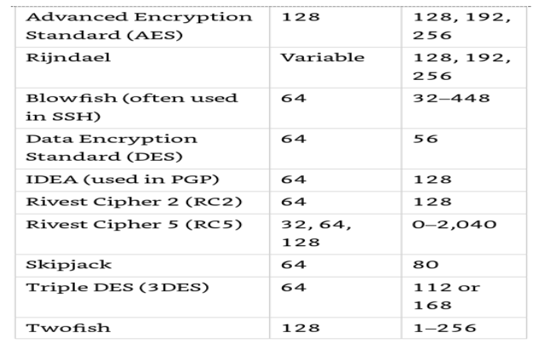
Cryptography
Prewhitening involves XORing the plaintext with a separate subkey before the first round of encryption.
Postwhitening uses a similar operation after the 16th round of encryption.

Slide 63
Cryptography
Skipjack
The Skipjack algorithm was approved for use by the U.S. government in Federal Information Processing Standard (FIPS) 185, the Escrowed Encryption Standard (EES).
Like many block ​ciphers, Skipjack operates on 64-bit blocks of text.
It uses an 80-bit key and supports the same four modes of operation supported by DES.
it supports the escrow of encryption keys. Two government agencies, the National Institute of Standards and Technology (NIST) and the Department of the Treasury, hold a portion of the information required to reconstruct a Skipjack key.

Slide 64
Cryptography
Diffie-Hellman Algorithm
The first group to address the shortfalls of symmetric key cryptography decided to attack the issue of secure distribution of the symmetric key.
Whitfield Diffie and Martin Hellman worked on this problem and ended up developing the first asymmetric key agreement algorithm, called, Diffie-Hellman.
Secure RPC (S-RPC) employs Diffie–Hellman for key exchange.
The communicating parties (we’ll call them Bob and Alice) agree on two large numbers: p (which is a prime number) and g (which is an integer) such that 1 < g < p.

Slide 65
Cryptography
Bob chooses a random large integer r and performs the following calculation:
R = g^{r} mod p
Alice chooses a random large integer s and performs the following calculation:
  S = g^{s} mod p
Bob sends R to Alice and Alice sends S to Richard.
Bob then performs the following calculation:
K = S^{r} mod p

Slide 66
Cryptography
Alice then performs the following calculation:
K = R^{s} mod p
At this point, Richard and Sue both have the same value, K, and can use this for secret key communication between the two parties.
Example.
Bob and Alice agree on prime number P =11 and integer g=8 which satisfies the condition 1< g < p.
Now Bob decides r = 2 and calculates using
    R = g^{r} mod p
    R = 8 ² mod 11 = 64 mod 11 = 9

Slide 67
Cryptography
Alice decides s = 3 and calculates using
    S = g^{s} mod p
    S = 8 ³ mod 11 = 512 mod 11 = 6
Now Bob gives value of R to Alice and Alice gives value of S to Bob.
Now Bob calculates K using
    K = S^{r} mod p
    K = 6² mod 11 = 36 mod 11 = 3
Now Alice calculates K using
        K = R^{s} mod p
        K = 9³ mod 11 = 729 mod 11 = 3
Thus they have got the same key now.

Slide 68
Cryptography
The same calculations can be performed by using Public and private key's.
The Diffie-Hellman algorithm enables two systems to generate a symmetric key securely without requiring a previous relationship or prior arrangements.
The algorithm allows for key distribution, but does not provide encryption or digital signature functionality.
The algorithm is based on the difficulty of calculating discrete logarithms in a finite field.
The original Diffie-Hellman algorithm is vulnerable to a man-in-the-middle attack, because no authentication occurs before public keys are exchanged.

Slide 69
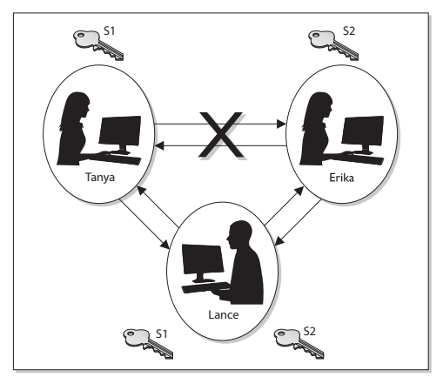
Cryptography

Slide 70
Cryptography
RSA
RSA, named after its inventors Ron Rivest, Adi Shamir, and Leonard Adleman, is a public key algorithm that is the most popular when it comes to asymmetric algorithms.
RSA is a worldwide de facto standard and can be used for digital signatures, key exchange, and encryption.
It was developed in 1978 at MIT and provides authentication as well as key encryption.
The security of this algorithm comes from the difficulty of factoring large numbers into their original prime numbers.

Slide 71
Cryptography
The public and private keys are functions of a pair of large prime numbers.
A prime number is a positive whole number whose only factors (i.e., integer divisors) are 1 and the number itself.
One advantage of using RSA is that it can be used for encryption and digital signatures. Using its one-way function, RSA provides encryption and signature verification, and the inverse direction performs decryption and signature generation.
RSA has been implemented in applications; in operating systems by Microsoft, Apple, Sun, and Novell; and at the hardware level in network interface cards, secure telephones, and smart cards.

Slide 72
Cryptography
It can be used as a key exchange protocol, meaning it is used to encrypt the symmetric key to get it securely to its destination.
The following sequence describes how the RSA algorithm comes up with the keys in the first place:
1. Choose two random large prime numbers, p and q.
2. Generate the product of these numbers: n = pq.
n is used as the modulus.
3. Choose a random integer e (the public key) that is greater than 1 but less than (p – 1)(q – 1) i.e. less than n.
Make sure that e and (p – 1)(q – 1) are relatively prime.

Slide 73
Cryptography
4. Compute the corresponding private key, d, such that de – 1 is a multiple of (p – 1)(q – 1).
5. The public key = (n, e).
6. The private key = (n, d).
7. The original prime numbers p and q are discarded securely.
If you need to encrypt message m with your public key (e, n), the following formula is carried out:
C = m^{e} mod n
Then you need to decrypt the message with your private key (d), so the following formula is carried out:
M = c^{d} mod n

Slide 74
Cryptography
One-Way Functions
A one-way function is a mathematical function that is easier to compute in one direction than in the opposite direction.
When a one-way function is carried out in the easy direction, encryption and digital signature verification functionality are available.
When the one-way function is carried out in the hard direction, decryption and signature generation functionality are available.
This means only the public key can carry out encryption and signature verification and only the private key can carry out decryption and signature generation.

Slide 75
Cryptography
El Gamal
In 1985, Dr. T. El Gamal published an article describing how the mathematical principles behind the Diffie–Hellman key exchange algorithm could be extended to support an entire public key cryptosystem used for encrypting and decrypting messages.
El Gamal is a public key algorithm that can be used for digital signatures, encryption, and key exchange.
It is based not on the difficulty of factoring large numbers, but on calculating discrete logarithms in a finite field.
A discrete logarithm is the power to which we must raise a given integer in order to get another given integer.

Slide 76
Cryptography
In other words, if b and g are integers, then k is the logarithm in the equation b^{k} = g.
When the numbers are large, calculating the logarithm becomes very difficult.
In fact, we know of no efficient way of doing this using modern computers.
This is what makes discrete logarithms useful in cryptography.
El Gamal is actually an extension of the Diffie-Hellman algorithm.

Slide 77
Cryptography
Although El Gamal provides the same type of functionality as some of the other asymmetric algorithms, its main drawback is performance.
When compared to other algorithms, this algorithm is usually the slowest.
Elliptic Curve Cryptosystems
Elliptic curves are rich mathematical structures that have shown usefulness in many different types of applications.
An elliptic curve cryptosystem (ECC) provides much of the same functionality RSA provides: digital signatures, secure key distribution, and encryption.

Slide 78
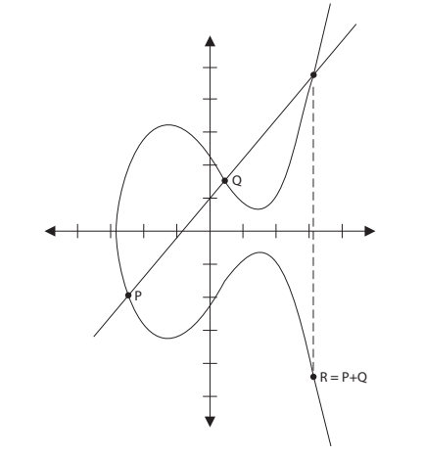
Cryptography
One differing factor is ECC’s efficiency. ECC is more efficient than RSA and any other asymmetric algorithm.

Slide 79
Cryptography
In this field of mathematics, points on the curve compose a structure called a group.
These points are the values used in mathematical formulas for ECC’s encryption and decryption processes.
The algorithm computes discrete logarithms of elliptic curves, which is different from calculating discrete logarithms in a finite field (which is what Diffie-Hellman and El Gamal use).
Some devices have limited processing capacity, storage, power supply, and bandwidth, such as wireless devices and cellular telephones.

Slide 80
Cryptography
With these types of devices, efficiency of resource use is very important.
ECC provides encryption functionality, requiring a smaller percentage of the resources compared to RSA and other algorithms, so it is used in these types of devices.
In most cases, the longer the key, the more protection that is provided, but ECC can provide the same level of protection with a key size that is shorter than what RSA requires.

Slide 81
Cryptography
Knapsack
Over the years, different versions of knapsack algorithms have arisen.
The first to be developed, Merkle-Hellman, could be used only for encryption, but it was later improved upon to provide digital signature capabilities.
These types of algorithms are based on the “knapsack problem,” a mathematical dilemma that poses the following question: If you have several different items, each having its own weight, is it possible to add these items to a knapsack so the knapsack has a specific weight?
This algorithm was discovered to be insecure and is not currently used in cryptosystems.

Slide 82
Cryptography
Message Integrity
Parity bits and cyclic redundancy check (CRC) functions have been used in protocols to detect modifications in streams of bits as they are passed from one computer to another, but they can usually detect only unintentional modifications.
Parity bits cannot identify whether a message was captured by an intruder, altered, and then sent on to the intended destination.
The intruder can just recalculate a new parity value that includes his changes, and the receiver would never know the difference.

Slide 83
Cryptography
For this type of protection, hash algorithms are required to successfully detect intentional and unintentional unauthorized modifications to data.
The One-Way Hash
A one-way hash is a function that takes a variable-length string (a message) and produces a fixed-length value called a hash value.
The hashing algorithm is not a secret—it is publicly known.
The secrecy of the oneway hashing function is its “one-wayness.”

Slide 84
Cryptography
The function is run in only one direction, not the other direction.
This is different from the one-way function used in public key.
The one-way hash functions are never used in reverse; they create a hash value and call it a day.
The receiver does not attempt to reverse the process at the other end, but instead runs the same hashing function one way and compares the two results.
The hashing one-way function takes place without the use of any keys.

Slide 85
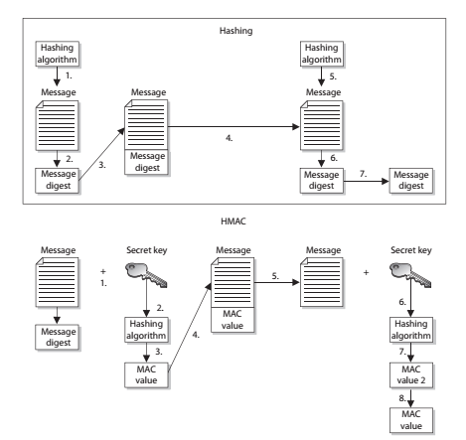
Cryptography
A Message Authentication Code (MAC) function is an authentication scheme derived by applying a secret key to a message in some form.
The three basic types of MAC functions are: a hash MAC (HMAC), CBC-MAC, and CMAC.

Slide 86
Cryptography
The hashing process works as below:
1. The sender puts the message through a hashing function.
2. A message digest value is generated.
3. The message digest is appended to the message.
4. The sender sends the message to the receiver.
5. The receiver puts the message through a hashing function.
6. The receiver generates her own message digest value.
7. The receiver compares the two message digest values. If they are the same, the message has not been altered.

Slide 87
Cryptography
The HMAC function works as below:
1. The sender concatenates a symmetric key with the message.
2. The result is put through a hashing algorithm.
3. A MAC value is generated.
4. The MAC value is appended to the message.
5. The sender sends the message to the receiver. (Just the message with the attached MAC value. The sender does not send the symmetric key with the message.)
6. The receiver concatenates a symmetric key with the message.
7. The receiver puts the results through a hashing algorithm and generates her own MAC value.
8. The receiver compares the two MAC values. If they are the same, the message has not been modified.

Slide 88
Cryptography
This type of technology requires the sender and receiver to have the same symmetric key.
The HMAC function does not involve getting the symmetric key to the destination securely.
CBC-MAC
If a Cipher Block Chaining Message Authentication Code (CBC-MAC) is being used, the message is encrypted with a symmetric block cipher in CBC mode, and the output of the final block of ciphertext is used as the MAC.

Slide 89
Cryptography
MD4
MD4 is a one-way hash function designed by Ron Rivest. It also produces a 128-bit message digest value.
It was used for high-speed computation in software implementations and was optimized for microprocessors. It is no longer considered secure.

Slide 90
Cryptography
MD5
MD5 was also created by Ron Rivest and is the newer version of MD4.
It still produces a 128-bit hash, but the algorithm is more complex, which makes it harder to break.
MD5 added a fourth round of operations to be performed during the hashing functions and makes several of its mathematical operations carry out more steps or more complexity to provide a higher level of security.

Slide 91
Cryptography
Recent research has shown MD5 to be subject to collision attacks, and it is therefore no longer suitable for applications like SSL certificates and digital signatures that require collision attack resistance.
SHA
SHA was designed by NSA and published by NIST to be used with the Digital Signature Standard (DSS).
SHA produces a 160-bit hash value, or message digest. This is then inputted into an asymmetric algorithm, which computes the signature for a message.
SHA is similar to MD4.

Slide 92
Cryptography
It has some extra mathematical functions and produces a 160-bit hash instead of a 128-bit hash, which makes it more resistant to brute-force attacks, including birthday attacks.
SHA was improved upon and renamed SHA-1.
Recently, SHA-1 was found to be vulnerable to collisions and is no longer considered secure for applications requiring collision resistance.
Newer versions of this algorithm (collectively known as the SHA-2 and SHA-3 families) have been developed and released: SHA-256, SHA-384, and SHA-512.
The SHA-2 and SHA-3 families are considered secure for all uses.

Slide 93
Cryptography
SHA-256 produces a 256-bit message digest using a 512-bit block size.
SHA-224 uses a truncated version of the SHA-256 hash to produce a 224-bit message digest using a 512-bit block size.
SHA-512 produces a 512-bit message digest using a 1,024-bit block size.
SHA-384 uses a truncated version of the SHA-512 hash to produce a 384-bit digest using a 1,024-bit block size.
Keccak algorithm is released as the SHA-3 standard.

Slide 94
Cryptography
Attacks Against One-Way Hash Functions
A strong hashing algorithm does not produce the same hash value for two different messages.
If the algorithm does produce the same value for two distinctly different messages, this is called a collision.
An attacker can attempt to force a collision, which is referred to as a birthday attack.
This attack is based on the mathematical birthday paradox that exists in standard statistics.
if a hashing algorithm generates a message digest of 60 bits, there is a high likelihood that an adversary can find a collision using only 230 inputs.

Slide 95
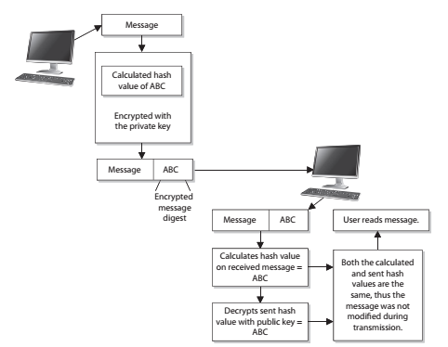
Cryptography
A digital signature is a hash value that has been encrypted with the sender’s private key

Slide 96
Cryptography
The act of signing just means the value was encrypted with a private key.
Different steps and algorithms provide different types of security services:
A message can be encrypted, which provides confidentiality.
A message can be hashed, which provides integrity.
A message can be digitally signed, which provides authentication, nonrepudiation, and integrity.
A message can be encrypted and digitally signed, which provides confidentiality, authentication, nonrepudiation, and integrity.

Slide 97
Cryptography
Because digital signatures are so important in proving who sent which messages, the U.S.government decided to establish standards pertaining to their functions and acceptable use.
In 1991, NIST proposed a federal standard called the Digital Signature Standard (DSS).
It was developed for federal departments and agencies, but most vendors also designed their products to meet these specifications.
The federal government requires its departments to use DSA, RSA, or the elliptic curve digital signature algorithm (ECDSA) and SHA.

Slide 98
Cryptography
Public Key Infrastructure
Public key infrastructure (PKI) consists of programs, data formats, procedures, communication protocols, security policies, and public key cryptographic mechanisms working in a comprehensive manner to enable a wide range of dispersed people to communicate in a secure and predictable fashion.
PKI is an ISO authentication framework that uses public key cryptography and the X.509 standard.
The framework was set up to enable authentication to happen across different networks and the Internet.

Slide 99
Cryptography
Particular protocols and algorithms are not specified, which is why PKI is called a framework and not a specific technology.
PKI provides authentication, confidentiality, nonrepudiation, and integrity of the messages exchanged.
It is a hybrid system of symmetric and asymmetric key algorithms and methods,
PKI is made up of many different parts:
certificate authorities, registration authorities, certificates, keys, and users.

Slide 100
Cryptography
Certificate Authorities
Each person who wants to participate in a PKI requires a digital certificate, which is a credential that contains the public key for that individual along with other identifying information.
The certificate is created and signed (digital signature) by a trusted third party, which is a certificate authority (CA).
When the CA signs the certificate, it binds the individual’s identity to the public key, and the CA takes liability for the authenticity of that individual.

Slide 101
Cryptography
It is this trusted third party (the CA) that allows people who have never met to authenticate to each other and to communicate in a secure method.
A CA is a trusted organization (or server) that maintains and issues digital certificates.
When a person requests a certificate, the registration authority (RA) verifies that individual’s identity and passes the certificate request off to the CA.
The CA constructs the certificate, signs it, sends it to the requester, and maintains the certificate over its lifetime.
Some well-known CAs are Entrust and VeriSign.

Slide 102
Cryptography
All browsers have several well-known CAs configured by default.
Most are configured to trust dozens or hundreds of CAs.
The two CAs do not have a CA above them they can both trust, so they must carry out cross certification.
Cross certification is the process undertaken by CAs to establish a trust relationship in which they rely upon each other’s digital certificates and public keys as if they had issued them themselves.
The CA is responsible for creating and handing out certificates, maintaining them, and revoking them if necessary.

Slide 103
Cryptography
Revocation is handled by the CA, and the revoked certificate information is stored on a certificate revocation list (CRL).
This is a list of every certificate that has been revoked.
This list is maintained and updated periodically.
A certificate may be revoked because the key holder’s private key was compromised or because the CA discovered the certificate was issued to the wrong person.
By default, web browsers do not check a CRL to ensure that a certificate is not revoked.

Slide 104
Cryptography
So when you are setting up an SSL connection to do e-commerce over the Internet, you could be relying on a certificate that has actually been revoked.
Online Certificate Status Protocol (OCSP) is being used more and more rather than the cumbersome CRL approach.
When using just a CRL, either the user’s browser must check a central CRL to find out if the certification has been revoked, or the CA has to continually push out CRL values to the clients to ensure they have an updated CRL.
If OCSP is implemented, it does this work automatically in the background.

Slide 105
Cryptography
It carries out real-time validation of a certificate and reports back to the user whether the certificate is valid, invalid, or unknown.
OCSP checks the CRL that is maintained by the CA.
Certificates
One of the most important pieces of a PKI is its digital certificate.
A certificate is the mechanism used to associate a public key with a collection of components in a manner that is sufficient to uniquely identify the claimed owner.

Slide 106
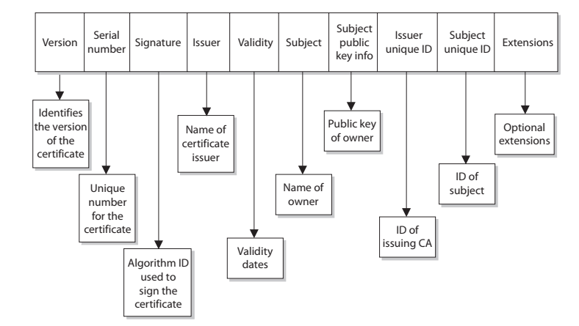
Cryptography
The standard for how the CA creates the certificate is X.509, which dictates the different fields used in the certificate and the valid values that can populate those fields.

Slide 107
Cryptography
The Registration Authority
The registration authority (RA) performs the certification registration duties.
The RA establishes and confirms the identity of an individual, initiates the certification process with a CA on behalf of an end user, and performs certificate life-cycle management functions.
The RA cannot issue certificates, but can act as a broker between the user and the CA.
When users need new certificates, they make requests to the RA, and the RA verifies all necessary identification information before allowing a request to go to the CA.

Slide 108
Cryptography
A PKI may be made up of the following entities and functions:
  Certification authority
  Registration authority
  Certificate repository
  Certificate revocation system
  Key backup and recovery system
  Automatic key update
  Management of key histories
  Timestamping
  Client-side software
Another important component that must be integrated into a PKI is a reliable time source that provides a way for secure timestamping.

Slide 109
Cryptography
Trusted Platform Module
The Trusted Platform Module (TPM) is a microchip installed on the motherboard of modern computers and is dedicated to carrying out security functions that involve the storage and processing of symmetric and asymmetric keys, hashes, and digital certificates.
The TPM was devised by the Trusted Computing Group (TCG), an organization that promotes open standards to help strengthen computing platforms against security weaknesses and attacks.
The essence of the TPM lies in a protected and encapsulated microcontroller security chip that provides a safe haven for storing and processing security-intensive data such as keys, passwords, and digital certificates.

Slide 110
Cryptography
The most common usage scenario of the TPM is to bind a hard disk drive, where the content of a given hard disk drive is affixed with a particular computing system.
The content of the hard disk drive is encrypted, and the decryption key is stored away in the TPM chip.
To ensure safe storage of the decryption key, it is further “wrapped” with another encryption key.
Another application of the TPM is sealing a system’s state to a particular hardware and software configuration. Sealing a computing system through TPM is used to deter any attempts to tamper with a system’s configurations.

Slide 111
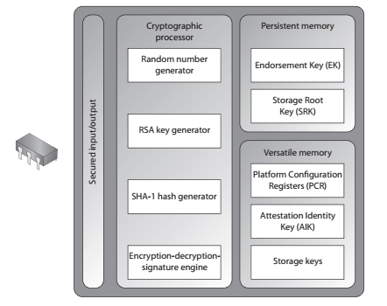
Cryptography
A sealed system will only be activated once the TPM verifies the integrity of the system’s configuration by comparing it with the original “sealing” value.

Slide 112
Cryptography
TPM’s internal memory is divided into two different segments: persistent (static) and versatile (dynamic) memory modules.
Persistent Memory
Two kinds of keys are present in the static memory:
Endorsement Key (EK) - A public/private key pair that is installed in the TPM at the time of manufacture and cannot be modified. The private key is always present inside the TPM, while the public key is used to verify the authenticity of the TPM itself. The EK, installed in the TPM, is unique to that TPM and its platform.
Storage Root Key (SRK) -The master wrapping key used to secure the keys stored in the TPM.

Slide 113
Cryptography
Versatile Memory
Three kinds of keys (or values) are present in the versatile memory:
Attestation Identity Key (AIK) - Used for the attestation of the TPM chip itself to service providers. The AIK is linked to the TPM’s identity at the time of development, which in turn is linked to the TPM’s Endorsement Key. Therefore, the AIK ensures the integrity of the EK.
Platform Configuration Registers (PCR) - Used to store cryptographic hashes of data used for TPM’s “sealing” functionality.
Storage keys - Used to encrypt the storage media of the computer system.

Slide 114
Cryptography
Attacks on Cryptography
Eavesdropping and sniffing data as it passes over a network are considered passive attacks because the attacker is not affecting the protocol, algorithm, key, message, or any parts of the encryption system.
Altering messages, modifying system files, and masquerading as another individual are acts that are considered active attacks because the attacker is actually doing something instead of sitting back and gathering data.
The common attack vectors in cryptography are key, algorithm, implementation, data, and people.

Slide 115
Cryptography
Ciphertext-Only Attacks
In this type of attack, the attacker has the ciphertext of several messages.
Each of the messages has been encrypted using the same encryption algorithm.
The attacker’s goal is to discover the key used in the encryption process.
A ciphertext-only attack is the most common type of active attack because it is very easy to get ciphertext by sniffing someone’s traffic, but it is the hardest attack to actually be successful at because the attacker has so little information about the encryption process.

Slide 116
Cryptography
Known-Plaintext Attacks
In known-plaintext attacks, the attacker has the plaintext and corresponding ciphertext of one or more messages.
Again, the goal is to discover the key used to encrypt the messages so other messages can be deciphered and read.
Messages usually start with the same type of beginning and close with the same type of ending.
Known-plaintext attacks were used by the United States against the Germans and the Japanese during World War II.

Slide 117
Cryptography
Chosen-Plaintext Attacks
In chosen-plaintext attacks, the attacker has the plaintext and ciphertext, but can choose the plaintext that gets encrypted to see the corresponding ciphertext.
This gives the attacker more power and possibly a deeper understanding of the way the encryption process works so she can gather more information about the key being used.
Once the key is discovered, other messages encrypted with that key can be decrypted.

Slide 118
Cryptography
Chosen-Ciphertext Attacks
In chosen-ciphertext attacks, the attacker can choose the ciphertext to be decrypted and has access to the resulting decrypted plaintext.
Again, the goal is to figure out the key.
This is a harder attack to carry out compared to the previously mentioned attacks, and the attacker may need to have control of the system that contains the cryptosystem.

Slide 119
Cryptography
All of these attacks have a derivative form, the names of which are the same except for putting the word “adaptive” in front of them, such as adaptive chosen-plaintext and adaptive chosen-ciphertext.
What this means is that the attacker can carry out one of these attacks and, depending upon what she gleaned from that first attack, modify her next attack.
Differential Cryptanalysis
This type of attack also has the goal of uncovering the key that was used for encryption purposes.
This attack looks at ciphertext pairs generated by encryption of plaintext pairs with specific differences and analyzes the effect and result of those differences.

Slide 120
Cryptography
The attacker takes two messages of plaintext and follows the changes that take place to the blocks as they go through the different S-boxes.
The differences identified in the resulting ciphertext values are used to map probability values to different possible key values.
The attacker continues this process with several more sets of messages and reviews the common key probability values.

Slide 121
Cryptography
Linear Cryptanalysis
Linear cryptanalysis is another type of attack that carries out functions to identify the highest probability of a specific key employed during the encryption process using a block algorithm.
The attacker carries out a known-plaintext attack on several different messages encrypted with the same key.
The more messages the attacker can use and put through this type of attack, the higher the confidence level in the probability of a specific key value.

Slide 122
Cryptography
Side-Channel Attacks
All of the attacks we have covered thus far have been based mainly on the mathematics of cryptography.
Attacker could detect how much power consumption is used for encryption and decryption (the fluctuation of electronic voltage).
Attacker could also intercept the radiation emissions released and then calculate how long the processes took.
Looking around the cryptosystem, or its attributes and characteristics, is different from looking into the cryptosystem and trying to defeat it through mathematical computations.

Slide 123
Cryptography
An attacker could measure power consumption, radiation emissions, and the time it takes for certain types of data processing.
With this information, he can work backward by reverse-engineering the process to uncover an encryption key or sensitive data.
A power attack reviews the amount of heat released.
This type of attack has been successful in uncovering confidential information from smart cards. In 1995, RSA private keys
were uncovered by measuring the relative time cryptographic operations took.

Slide 124
Cryptography
The idea is that instead of attacking a device head on, just watch how it performs to figure out how it works.
Replay Attacks
A big concern in distributed environments is the replay attack, in which an attacker captures some type of data and resubmits it with the hopes of fooling the receiving device into thinking it is legitimate information.
Many times, the data captured and resubmitted is authentication information, and the attacker is trying to authenticate herself as someone else to gain unauthorized access.
Timestamps and sequence numbers are two countermeasures to replay attacks.

Slide 125
Cryptography
Meet-in-the-Middle Attack
This attack targets block ciphers.
The attacker has a plaintext and ciphertext of a block cipher.
He then attempts to encrypt the plain text using different keys.
Simultaneously he attempts to decrypt the ciphertext using different keys.
Somewhere he gets the same block of bits in both the processes.
In this case it is a high possibility that the key used to encrypt the plaintext and the key used to decrypt the ciphertext are the two keys used by the block cipher.

