Slide 1

Exploring the Viability of LLMs: Generating Python Bindings with Open Source and API-Based Models
Presented by
Sandeep Yedla
Mentors
Samee Sameeul
Jesse McKinzie

Slide 2
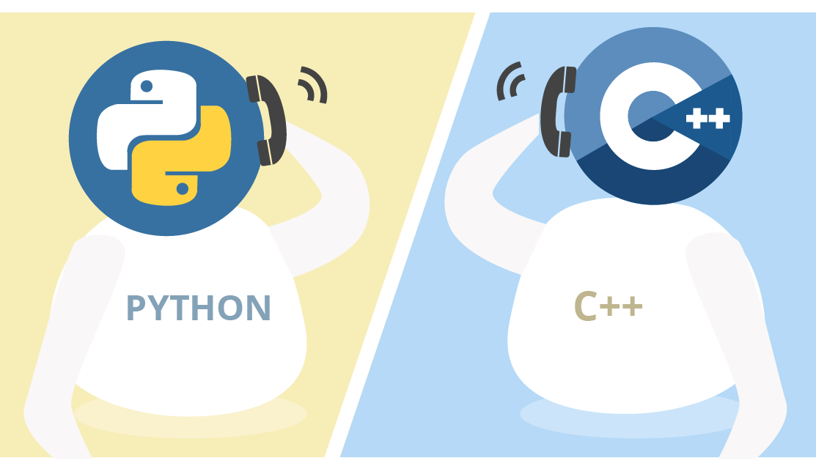
Problem Statement
Problem: Creating Python wrappers for C++ API to integrate with Python and extending compatibility to other programming languages (e.g., pybind11 and libpy)
Solution: A Large Language models (Code-LLM) powered solution to automate the generation of bindings code, reducing the manual effort required and minimizing the chances of errors
Substantial amount of boilerplate code
Increased development time

Slide 3

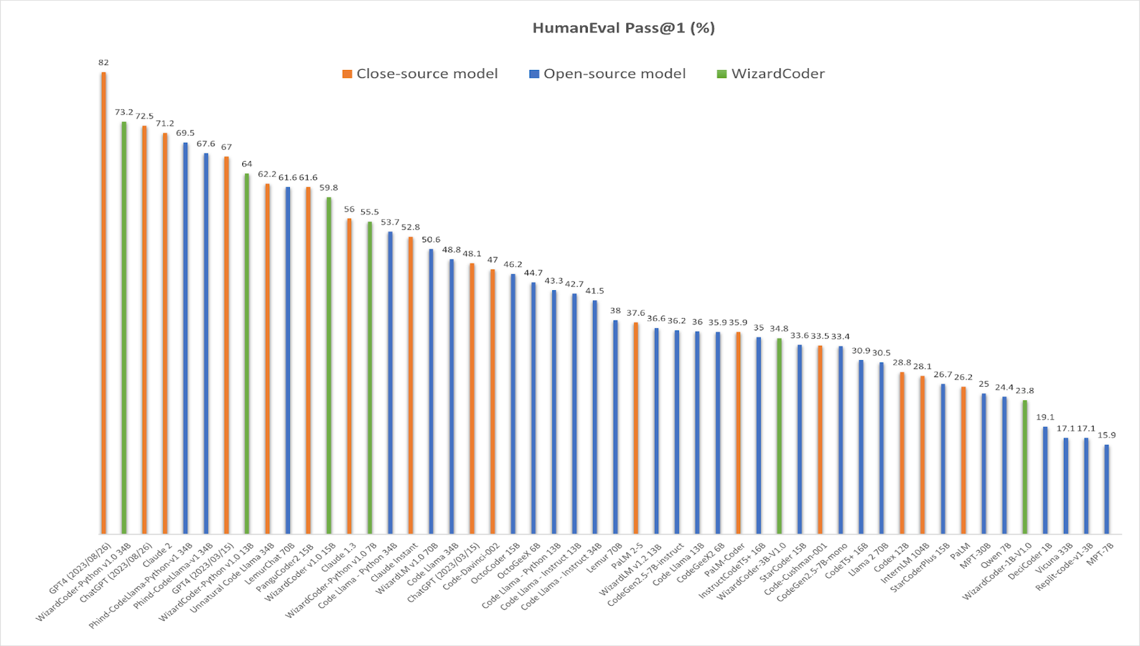



ChatGPT Vs Open – Source LLMs

Slide 4
Project Pipeline
Project directory path
Phind-CodeLlaMa-34B-v2
CodeLLaMa-34B
Wizard-Coder-34B-V1
NCAT server deployed Code-LLMs
Project Parser with Clang
Class Extraction
Input Prompt Generation
Model Selection
Output code generation
Abstract sparse tree (AST) generation
Conditional filtering of classes
{‘class name’ : ‘file path’, ‘class start line number’, ‘end line number’}
Read the parser script generated file
Extract desired Class definition
Instruction + extracted ‘class definition’
Together.ai API
89 open-source LLM models
Around 13 Code LLMs
Subscription based

Slide 5
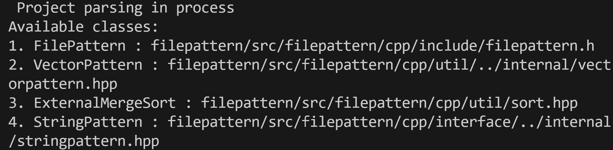
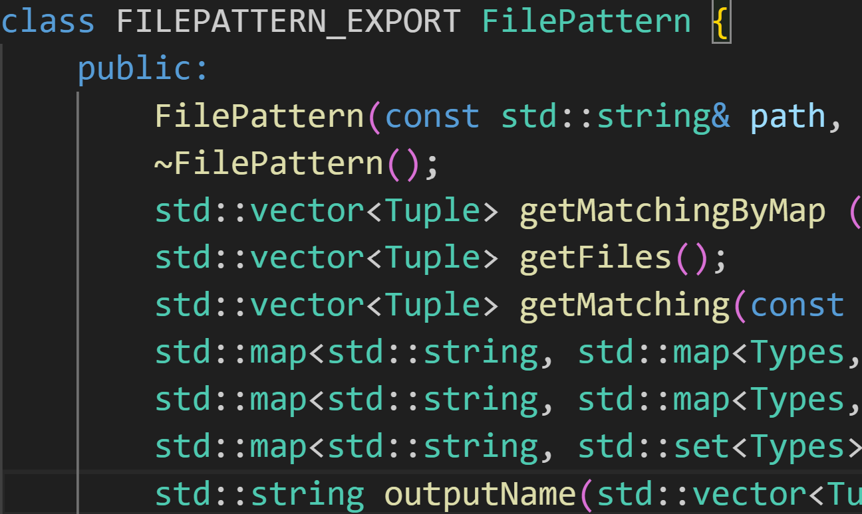
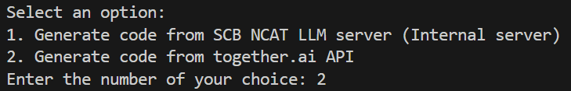
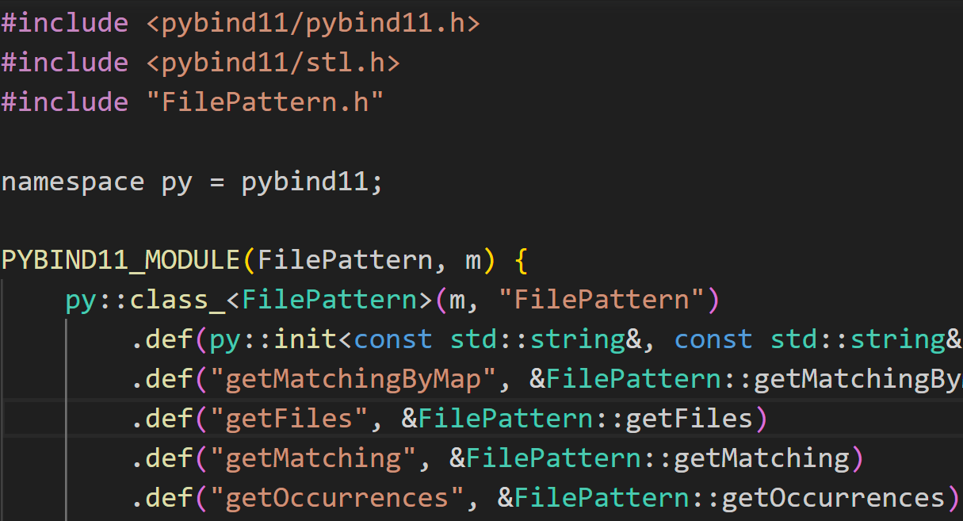
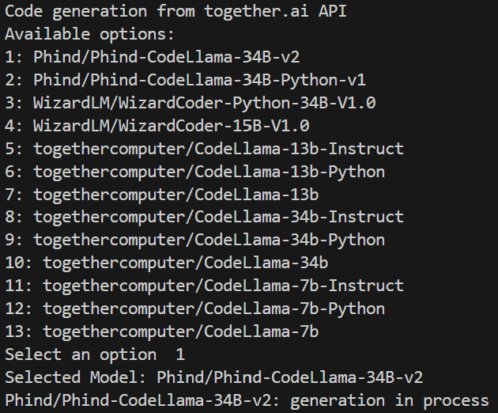
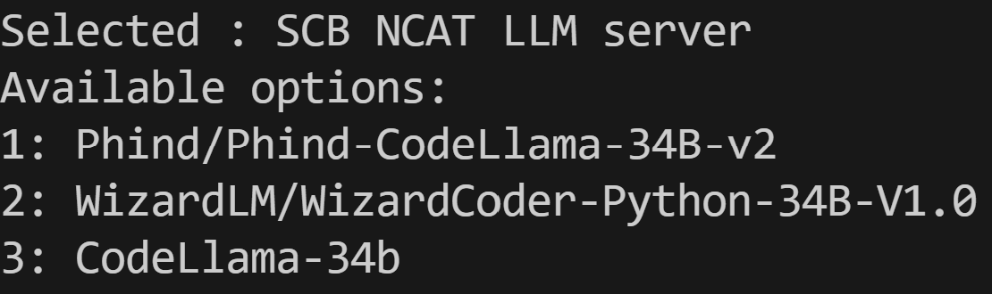
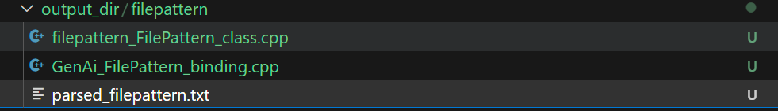
Output Screenshots
git - clone filepattern project
Extracted
Class def
Class Selection : Parsed_filepattern.txt
Input
Model Selection
or
NCAT server deployed models
Storage format
LLM Generated output bindings
together.ai
NCAT LLM server without GPU
18.6 mins
13 Together.ai models

Slide 6
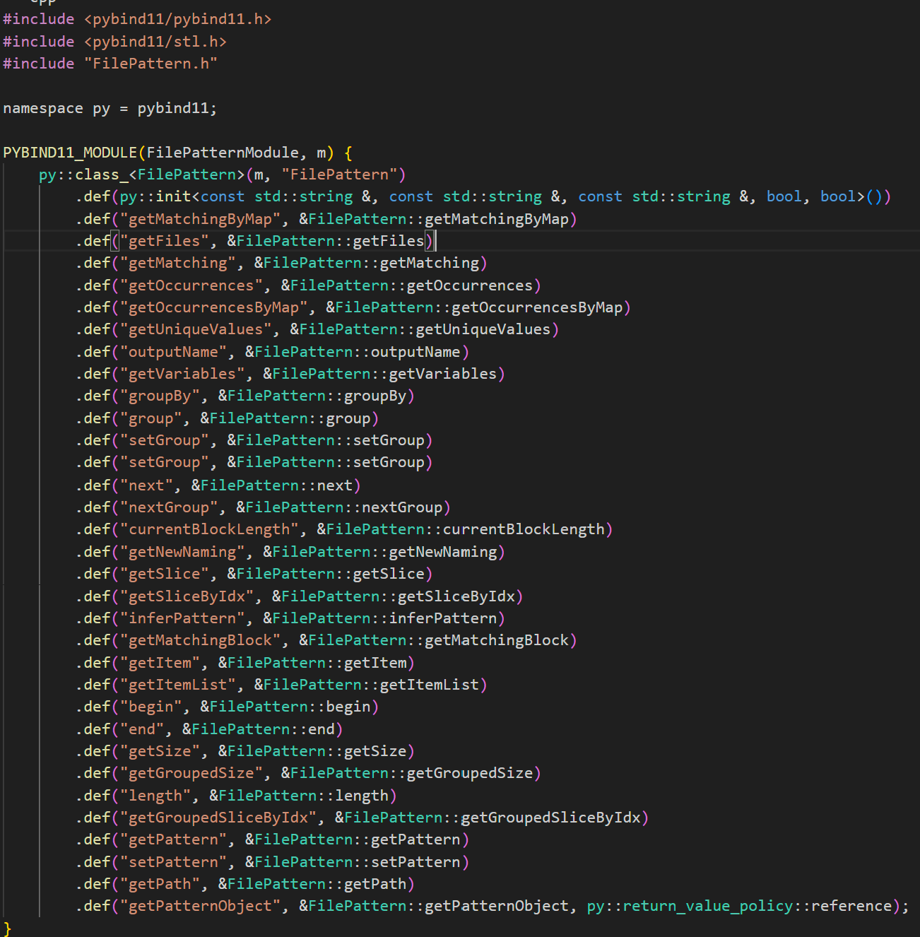
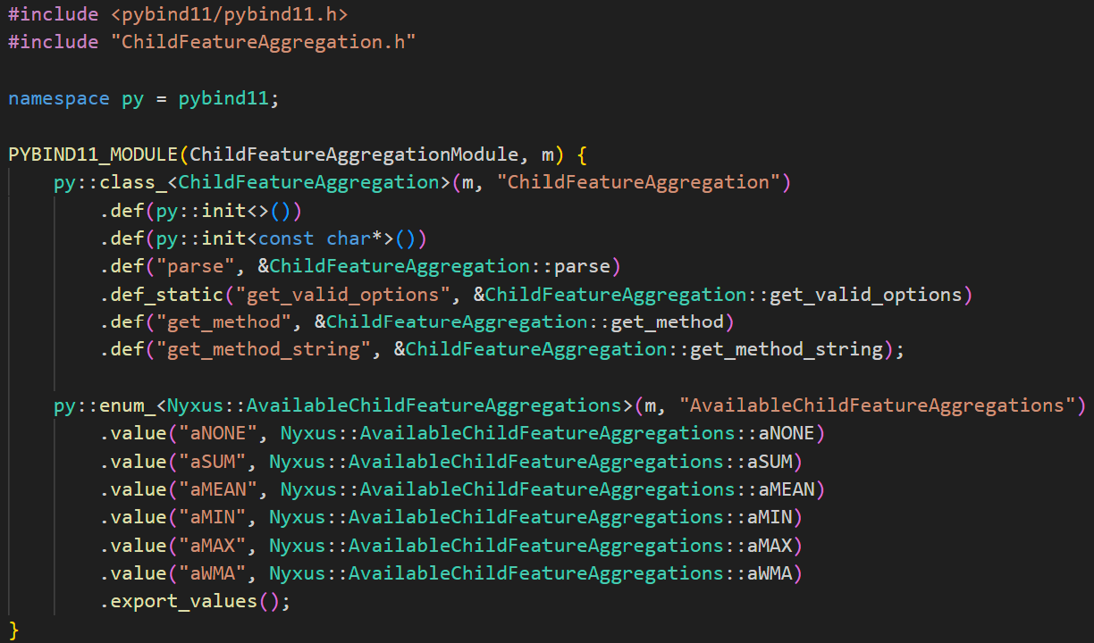
Sample outputs
Filepattern_bindings.cpp
nyxus_bindings.cpp

Slide 7
Test Result – Successful Project builds
filepattern
nyxus
Parsed class with 93 lines of code
Non-PolusAI Project - Simdjson
Parsed class with 50 lines of code
Adding missing Namespace to generated script
Successful build : Changes in 3 lines
Successful build : Zero changes
Generated 43 lines of code
Successful build : Commented three lines
Captured static methods and enums
Parsed class with 73 lines of code and 28 methods

Slide 8
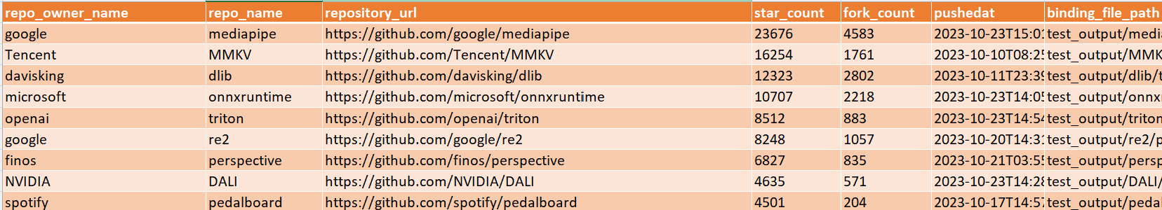
Data Preparation
Developed a GitHub crawler script
GraphQL query, GitHub repo ( 150 pybind11 utilized repositories )
Metadata.csv with repo link, star count, fork count, and the last push date
Visited_Repositories.txt file – Track visited repositories
Aggregated data

Slide 9

Challenges
Class definition selection
Internal server deployed model
Execution time on 96 CPU, 768 Gb RAM – 15 – 40 mins
Model checkpoint size – 80Gb
Model output variability
Handling static methods
Capturing enums
Namespaces
Trial limitation of together.ai API requests

Slide 10
Future Scope
Testing on complex projects
Implementing robust testing framework
Handling different codebase
Testing Automation Plan
Fine tuning the Open source LLMs - With Aggregated Data
Defining class definition identification rules
Automating building process
Testing modules

Slide 11


Thank you Axle!
Any questions?

