Slide 1
Word counter, serial vs parallel
ITF23019, Spring 2021
Sander Riis
Notes:
This slide is up to your design. However, we have to know your project title and your name
You can add date or other information if you want
One example: https://cse.buffalo.edu/faculty/miller/Courses/CSE633/Ye-Fall-2012-CSE633.pdf

Slide 2
Outline
Problem statement
Sequential Programming
Parallel Programming
Performance Evaluations
Notes:
This slide is optional
Problem statement: Shortly summary your project problem
Sequential Programming: How you solve problem by serial programming
Parallel Programming: will explain how you design your own parallel algorithm to solve problem
Performance evaluation: basically for question 3 and 4
Your program will be evaluated in terms speed up and efficiency

Slide 3
Problem Statement
Create a program that count how many times a given word occurs in parallel
Solve the problem using sequential programming (20 pts).
Solve the problem using parallel programming (40 pts).
Calculate speedup and efficiency of your parallel algorithm with the number of processors being p = 2,4,6, 8, …(20 pts).
How the performance of the algorithm changes with p and N (20 pts)?

Slide 4
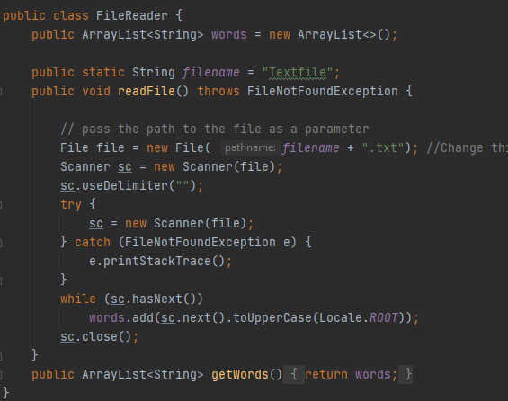
Sequential Programming
Explain how you solve the problem by conventional sequential programming

Slide 5
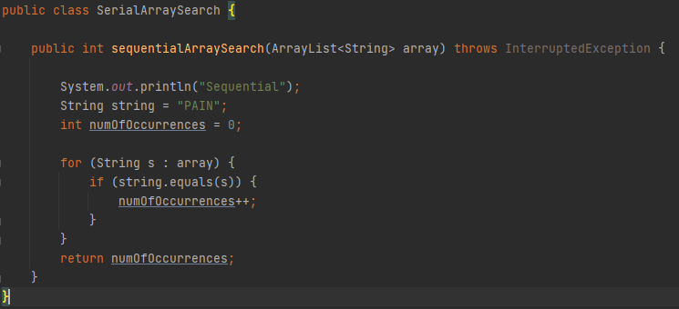
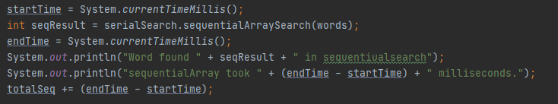
Sequential Programming

Slide 6
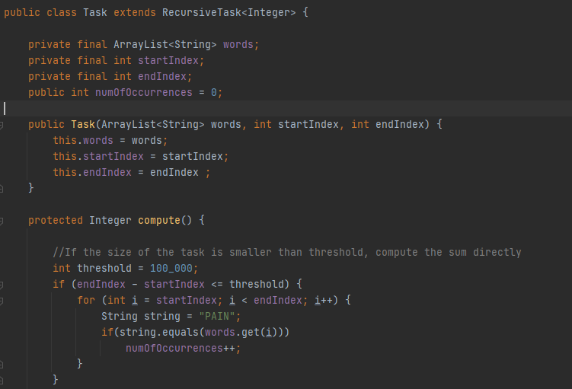
Parallel Programming

Slide 7
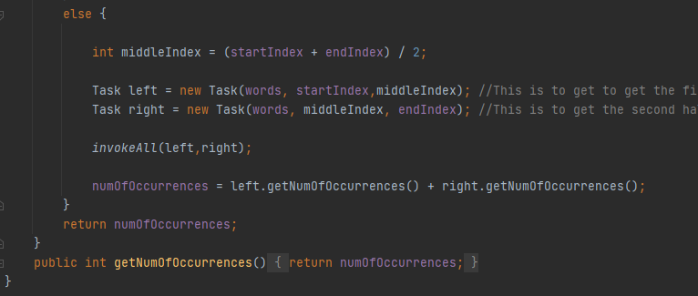
Parallel Programming

Slide 8
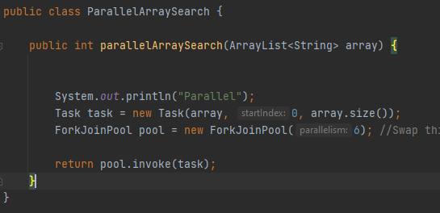
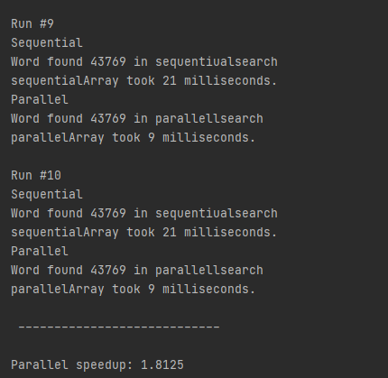
Parallel Programming

Slide 9


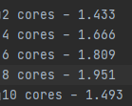
Performance Evaluation - Speedup
How can you get speedup?
Calculate from formulas ?
Latency (uses cycles per instruction)
Throughput (uses instructions per cycle)
Running your code?
Notes:
Mainly for question 3

Slide 10
Performance Evaluation - Efficiency
How can you calculate efficiency?
Calculate from formulas ?
Running your code?
Add some output here
Notes:
Mainly for question 3

Slide 11
Performance Evaluation: Speedup vs. p
Fix N, change p: 2,4,6,….
Explain how speedup varies with p
Notes:
Mainly for question 3

Slide 12
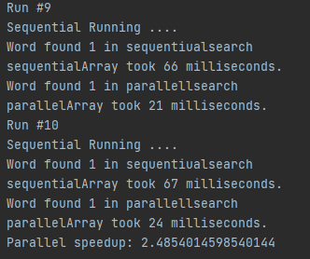
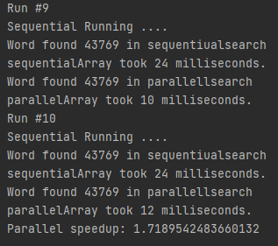
Performance Evaluation: Speedup vs. N
Fix p, change N
Explain how speedup varies with N
100MB 50MB
Notes:
Mainly for question 3

Slide 13
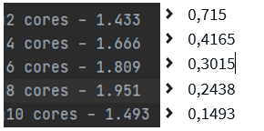
Performance Evaluation: Efficiency vs. p
Fix N, change p: 2,4,6,….
Explain how Efficiency varies with p
Notes:
Mainly for question 3

Slide 14
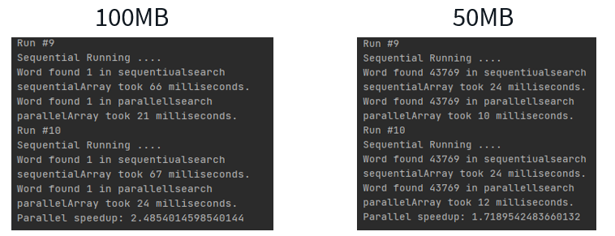
Performance Evaluation: Efficiency vs. N
Fix p, change N
Explain how Efficiency varies with N
2.5 / 8 = 0,3125
1.7 / 8 = 0,2125
Notes:
Mainly for question 3

Slide 15
Demonstration
After your presentation, you have run your code with
Sequential programming
Parallel Programming with different testcases
Testcases can be from TA or your own test files

Slide 16

Goodluck with your presentation!!!

